Slide 1
07-Machine-Data
瞿睿
2023/10/11

Slide 2
1 Arrays
2 Structures
3 Floating Points

Slide 3
Arrays
Allocation
T a[L] : Contiguously allocated region of L * sizeof(T) bytes in memory
Multidimensional : Nested(“Row-Major” ordering)
Access
Identifier A can be used as a pointer to array element 0: Type T*
Mutidimensional
implicit indexing

Slide 4
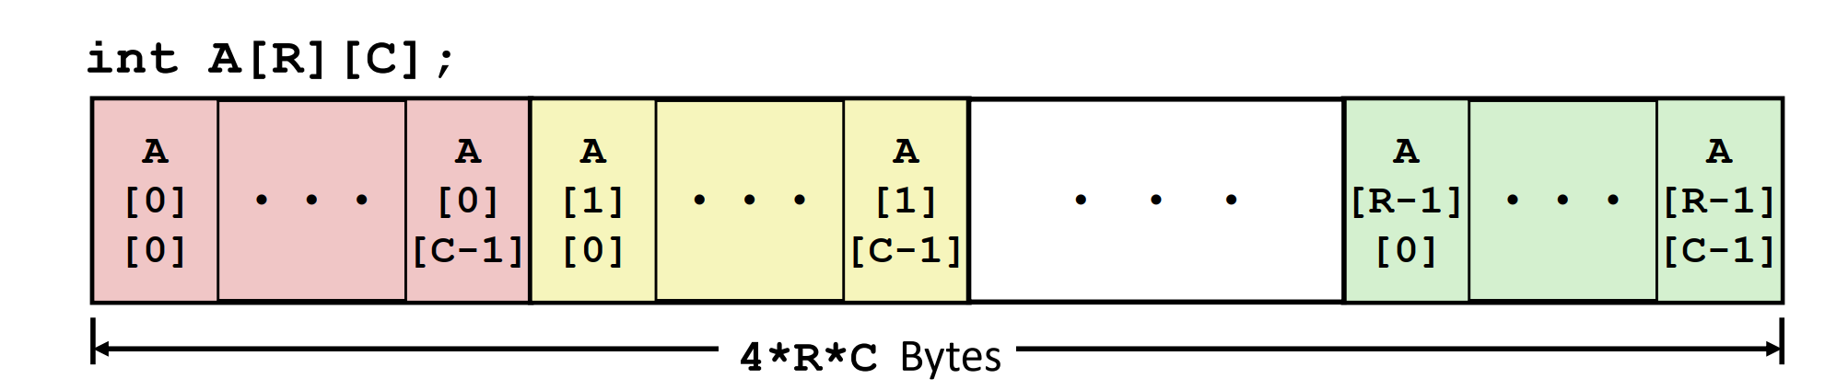
Array allocation
Basic Principle : T a[L] Contiguously allocated region of L * sizeof(T) bytes in memory
Multidimensional : Nested

Slide 5
Arrays
Allocation
T a[L] : Contiguously allocated region of L * sizeof(T) bytes in memory
Multidimensional : Nested(“Row-Major” ordering)
Access
Identifier A can be used as a pointer to array element 0: Type T*
Mutidimensional
implicit indexing

Slide 6
Array access
Identifier A can be used as a pointer to array element 0: Type T*
但是数组和指针并不是一个东西，尽管他们大多数时候是相同的
数组像一座房子，而指针像门牌号，数组是一个常量而指针不是，数组比指针包含了更多的信息
例子：sizeof(数组)和sizeof(指针)
把数组作为参数传递时，它会退化为指针
Nested:Row Vectors
▪ A[i] is array of C elements
▪ Each element of type T requires K bytes
▪ Starting address A + i * (C * K)
Multi-level

Slide 7
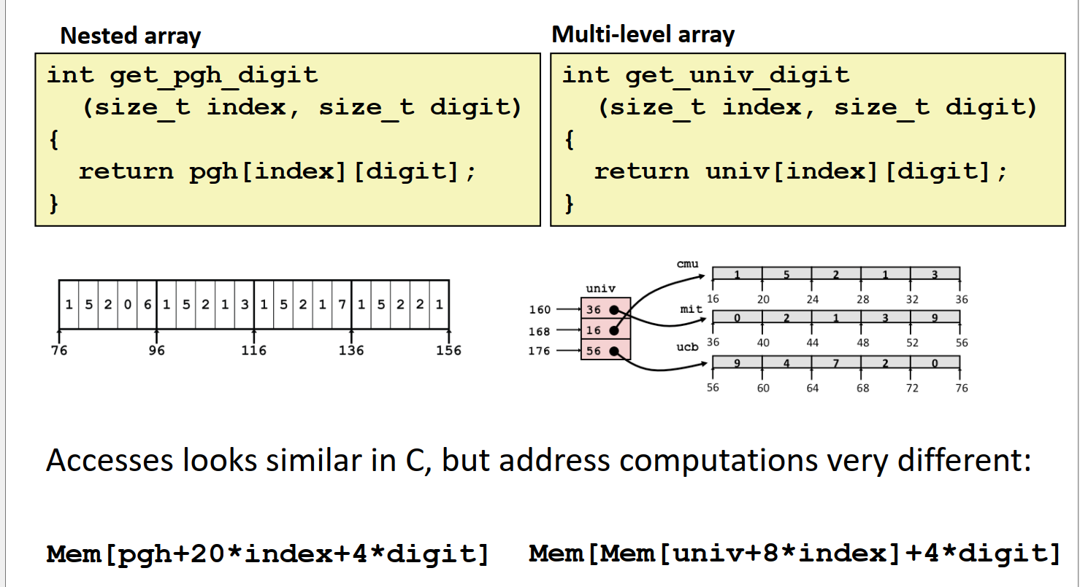
Array Element Accesses:Compare
we use nested array to reduce memory access times

Slide 8
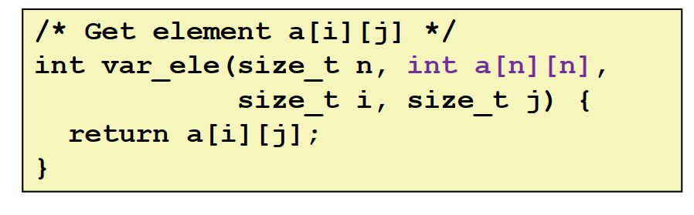
Variable dimensions, implicit indexing
Now supported by gcc

Slide 9
1 Arrays
2 Structures
3 Floating Points

Slide 10
Structures
Allocation
Fields ordered according to declaration
Alignment

Slide 11
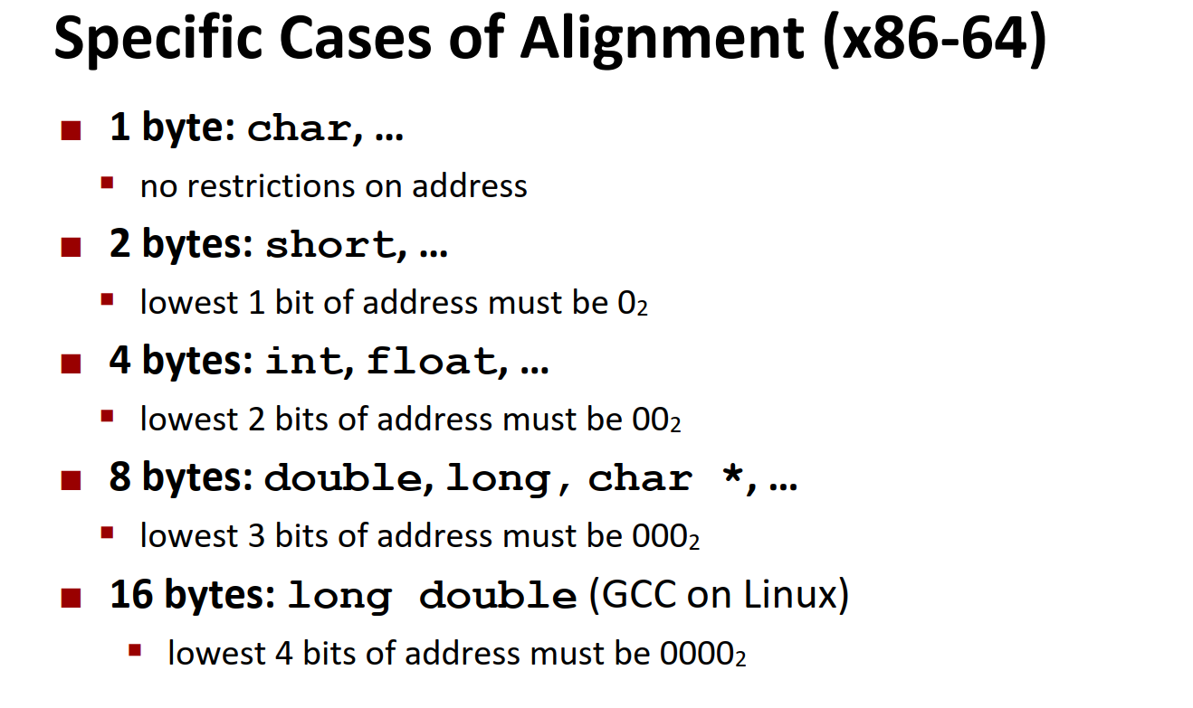
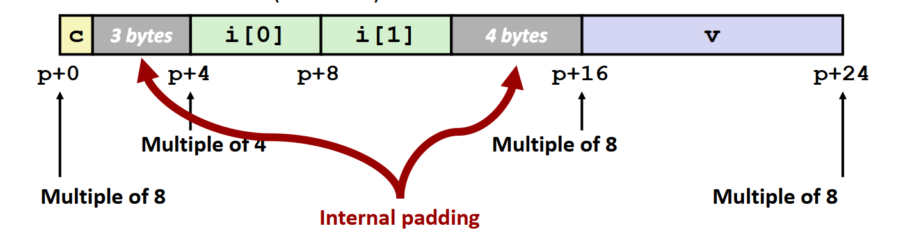
Structures Alignment
Rules
Primitive data type requires K bytes
Initial address & structure length must be multiples of K
Reasons : efficiency
To Saving Space : Put large data types first

Slide 12
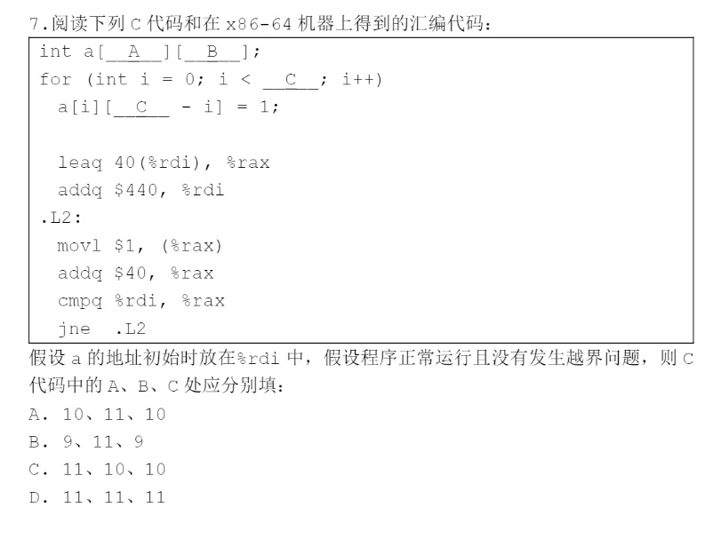
往年题
Notes:
A

Slide 13
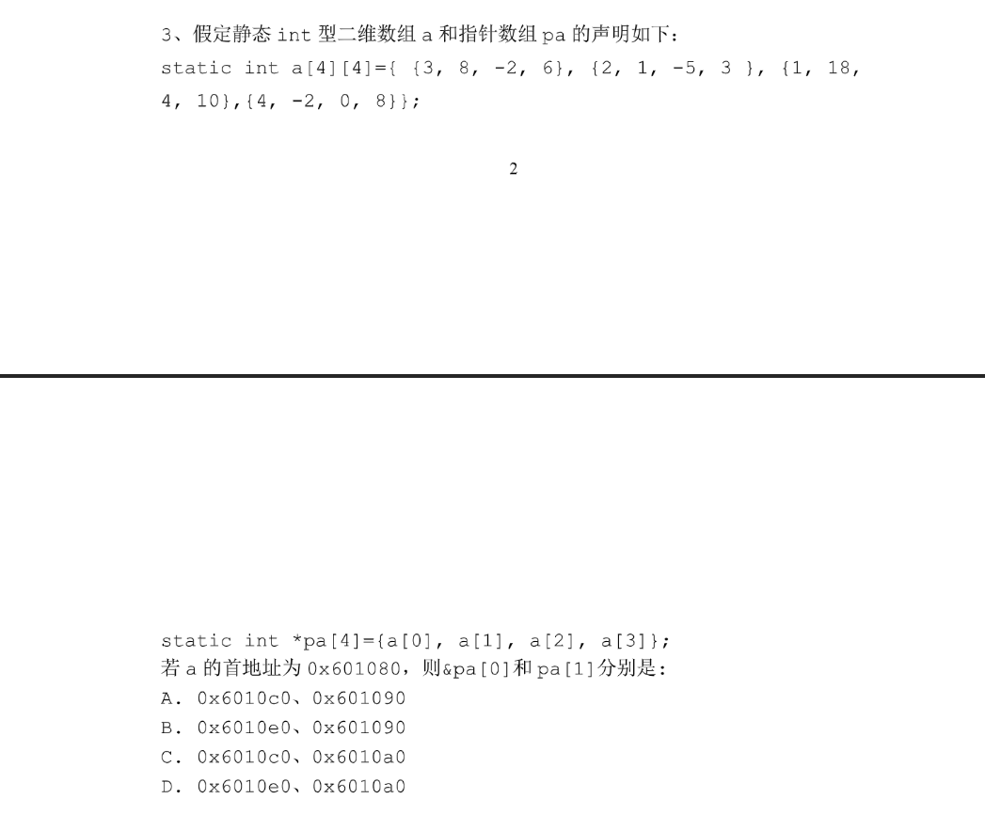
往年题
Notes:
A

Slide 14
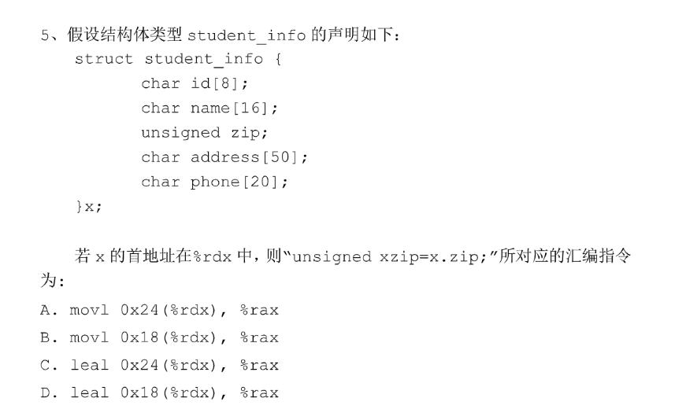
往年题
Notes:
B

Slide 15
Floating Points
Registers
Instructions
Comparisons
Using constant values

Slide 16
Registers
Arguments passed in %xmm0, %xmm1, ...
Result returned in %xmm0
%ymm : 32bytes %xmm : low 16 bytes of %ymm
Integer (and pointer) arguments passed in regular registers

Slide 17
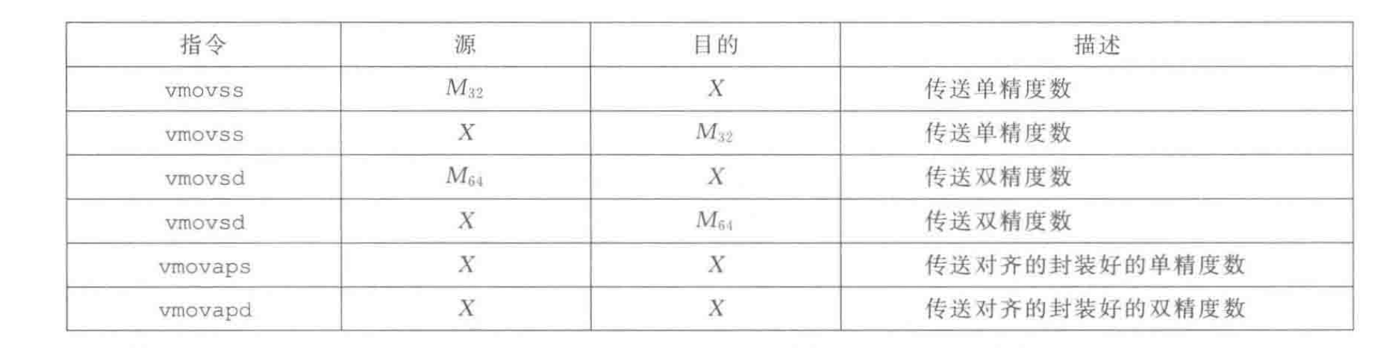
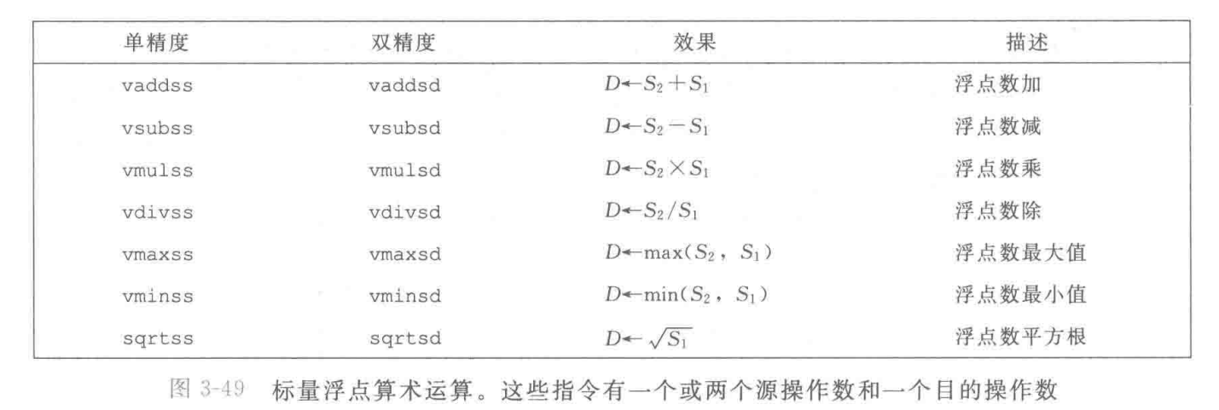
Instructions

Slide 18
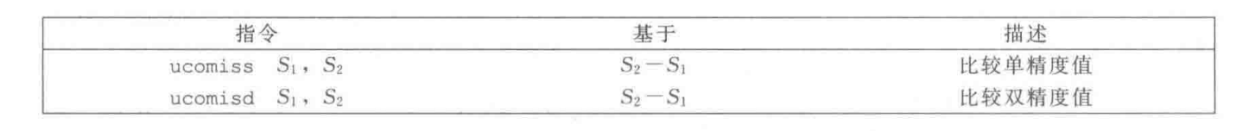
Comparisons
Instructions
Flags: ZF(zero), CF(carry), PF(parity)

Slide 19
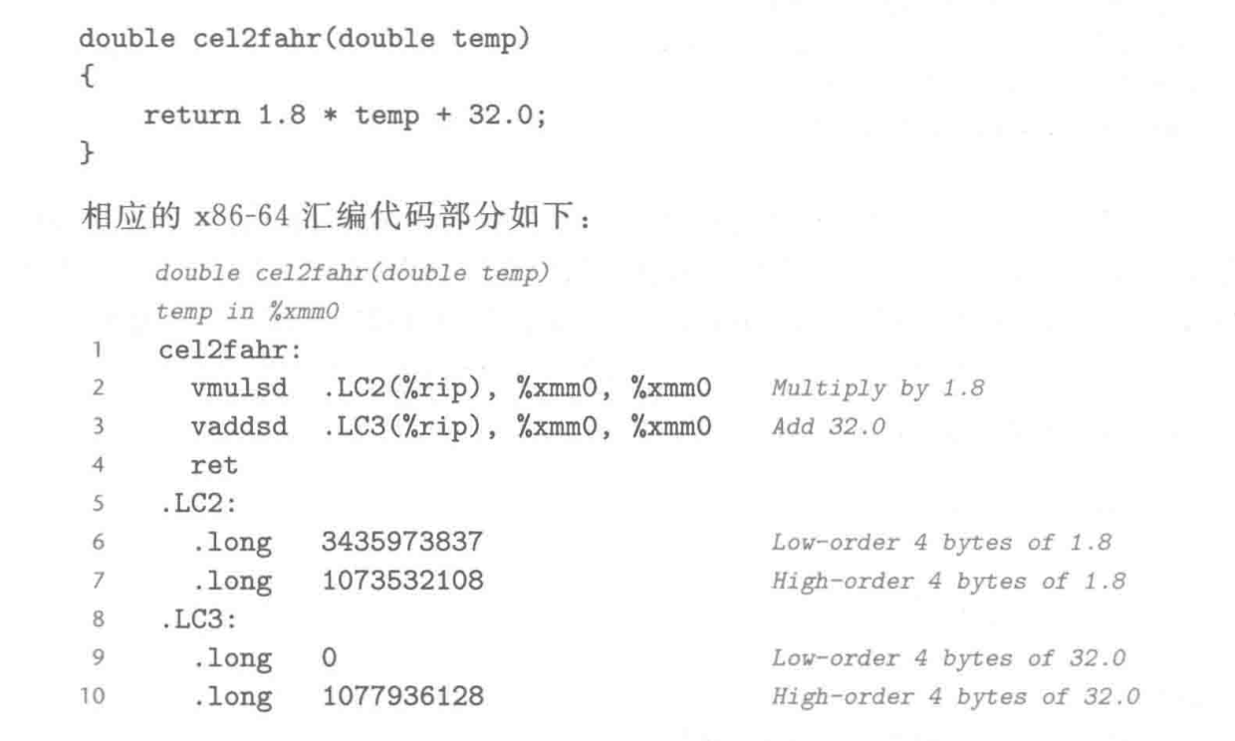
Using constant values
Loaded from memory

Slide 20
谢谢大家

