Slide 1
Recitation5
李磊
2023/10/11

Slide 2
Announcements
bomblab将于今天due, 后天ddl
Attacklab预计今晚24:00发布, 10/24 due, 10/26 ddl, 请大家合理安排时间
第三章汇编快要学完了, 这一章占用了五节大课, 时间拖得较长, 希望大家能对x86汇编有充分的了解
第四章将会是上半学期的重点与难点, 也是整本书比较有难度的一章, 建议大家尽早开始预习
根据同学的建议, 为了防止听回课的同学一头雾水, 辛苦之后回课的同学将自己回课的课件提前发到群里

Slide 3
Schedule
柯宇斌, 瞿睿两位同学回课
助教回顾procedure & data
讲一点不太好看懂的c pointer

Slide 4
Calling convention
How to transfer control?
When a function(caller) calls another function(callee), how to tranfer control?
When the callee has done its job, how can it return to the caller?
How to transfer data?
How to transfer function arguments?
How to transfer return values?

Slide 5
CALL & RET
CALL
Pushes the return address onto the stack.
Sets the PC to the address of the called function.
Essentially, call saves the current execution context by pushing the return address onto the stack and then jumps to the specified function.
RET
Pops the return address from the stack.
Sets the PC to the popped return address.
This allows the program to resume execution from the point immediately following the original call instruction.

Slide 6
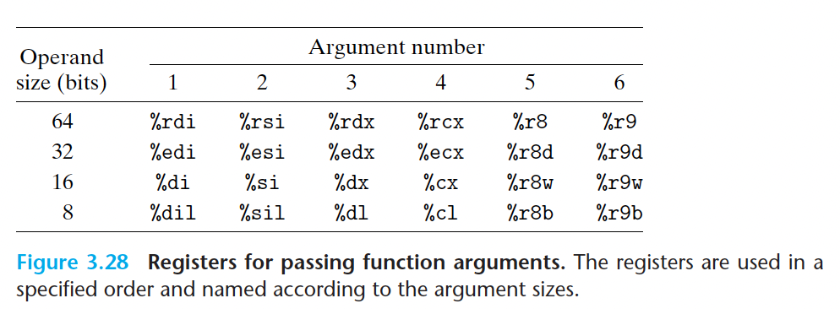
Argument passing & return value
up to six arguments can be passed via registers.
specified order and name
rounded up to be multiples of eight
more arguments?
Stack!(later on)

Slide 7
Caller & callee saved registers
Why this restriction?
To manage the state of registers across function calls and ensure that data is not unintentionally clobbered
In general we want to avoid the model where we have to save every register we use.
Callee saved registers(e.g. %rbx, %rbp, and %r12–%r15)
Callee should preserve the values of these registers
Caller saved registers(other registers other than %rsp)
Caller should preserve the values of these registers if it makes a function call

Slide 8
How to implement caller & callee saved regs?
Prologue & Epilogue
def prologue ():
Decrement rsp by num s registers + local var space Store any saved registers used
Store caller-saved regs if a function call is made and if these regs are used later.
def epilogue ():
Reload any saved registers used
Set rsp back to previous value

Slide 9
So, why stack?
convenient and flexible way to pass function arguments
variable number of arguments(like printf)
Nesting of function calls
caller’ s states(saved registers and return address) are all on the stack
Register preservation
Save the values of caller save or callee save registers
Easy way to implement recursion
Recursion is naturally stack-alike

Slide 10
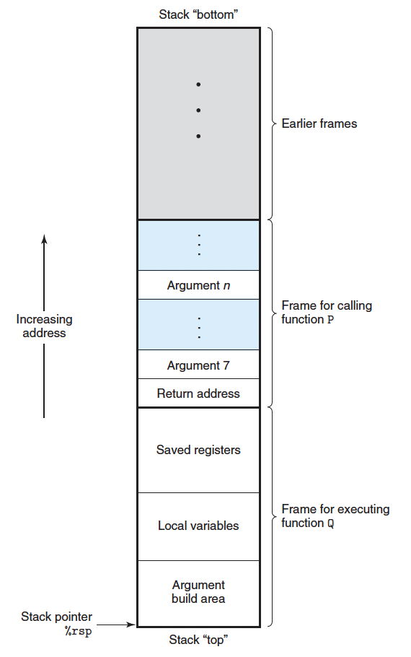
To sum it up……
You can see argument 7 through argument n and the return address.
Stack frame is not necessary for all procedures.
In saved registers, are these registers caller saved or callee saved?
Both!

Slide 11
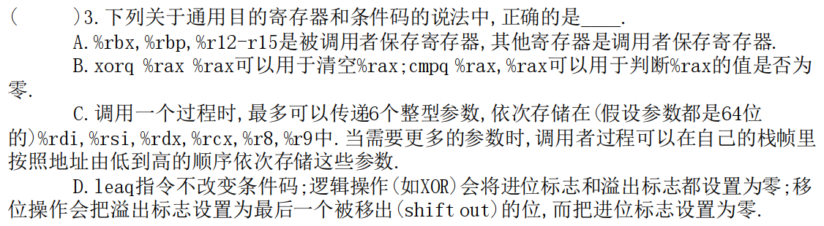
Example
C

Slide 12
Example
8. 大多数过程的栈帧是____的，其长度在____时确定。（注：此处的编译指从高级语言转化为汇编语言的过程） ?
A. 定长，编译
B. 定长，汇编
C. 可变长，汇编
D. 可变长，运行
A

Slide 13
Array & Multidimensional Array
T a[N]
A declaration of the form T a[N]; declares a as an array object that consists of N contiguously allocated objects of type T.
T a[x][y]
A two – dimensional array can be seen as a table with ‘x’ rows and ‘y’ columns where the row number ranges from 0 to (x-1) and the column number ranges from 0 to (y-1). Data are also stored contiguously in memory.

Slide 14
Struct
Struct creates a data type that groups objects of possibly different types into a single object.
Different components of a structure are stored in a contiguous memory.
A pointer to a structure is the address of its first byte.

Slide 15
Union
Unions allow a single object to be referenced according to multiple types.
Unlike structs, different fields reference the same block in memory.
The size of a union is the maximum size of any of its fields.
Can only use one field at a time.

Slide 16
Two simple examples
struct S {char c;int i[3];char v;};
union S {char c;int i;double v;};
c |  | i[0] | i[1] | i[2] | v
0
1
4
8
12
16
17
20
Low address
High address
c
i
v
Low address
High address

Slide 17
Alignment
Why?
The CPU in modern computer hardware performs reads and writes to memory most efficiently when the data is naturally aligned, which generally means that the data's memory address is a multiple of the data size.
How? (On a x86-64 machine)
any primitive object of K bytes must have an address that is a multiple of K

Slide 18
Pointer & arrays
Pointers are a central feature of the C programming language. They serve as a uniform way to generate references to elements within different data structures.
Pointers are created with the ‘&’ operator and are dereferenced with the ‘*’ operator.
Pointers can also point to functions.

Slide 19
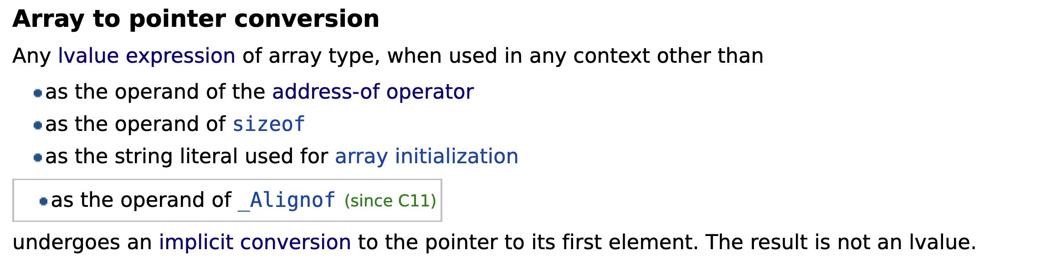
Pointer & arrays
In most cases, arrays can be converted into pointers
Typical examples : *A can be interpreted as A[0] if A is an array
If an array is a parameter of a function, it is implicitly converted to a pointer of the same type.

Slide 20
Pointers arithmetic
Pointer addition (p + i)
Remember that when you add a number i to a pointer,the memory location is actually increased by i * L, where L is the size of the data type associated with p.
Pointer subtraction (p1 – p2)
You can only subtract two pointers of the same type, it returns (p1 – p2) / sizeof(*p1)

Slide 21
Example
1.某C语言程序中对数组变量a的声明为"long a[10][10];",有如下一段代码：
for (i=0; i<10; i++)
for (j=0; j<10; j++)
sum+= a[i][j];
假设执行到“sum+= a[i][j];”时,sum的值在%rax中,a[i][0]所在的地址在%rdx中,j在%rsi中,则“sum+= a[i][j];”所对应的指令是( ).
A. addl 0(%rdx, %rsi, 8), %eax
B. addl 0(%rsi, %rdx, 8) , %eax
C. addl 0(%rdx, %rsi, 4) , %eax
D. addl 0(%rsi, %rdx, 4) , %eax
A

Slide 22
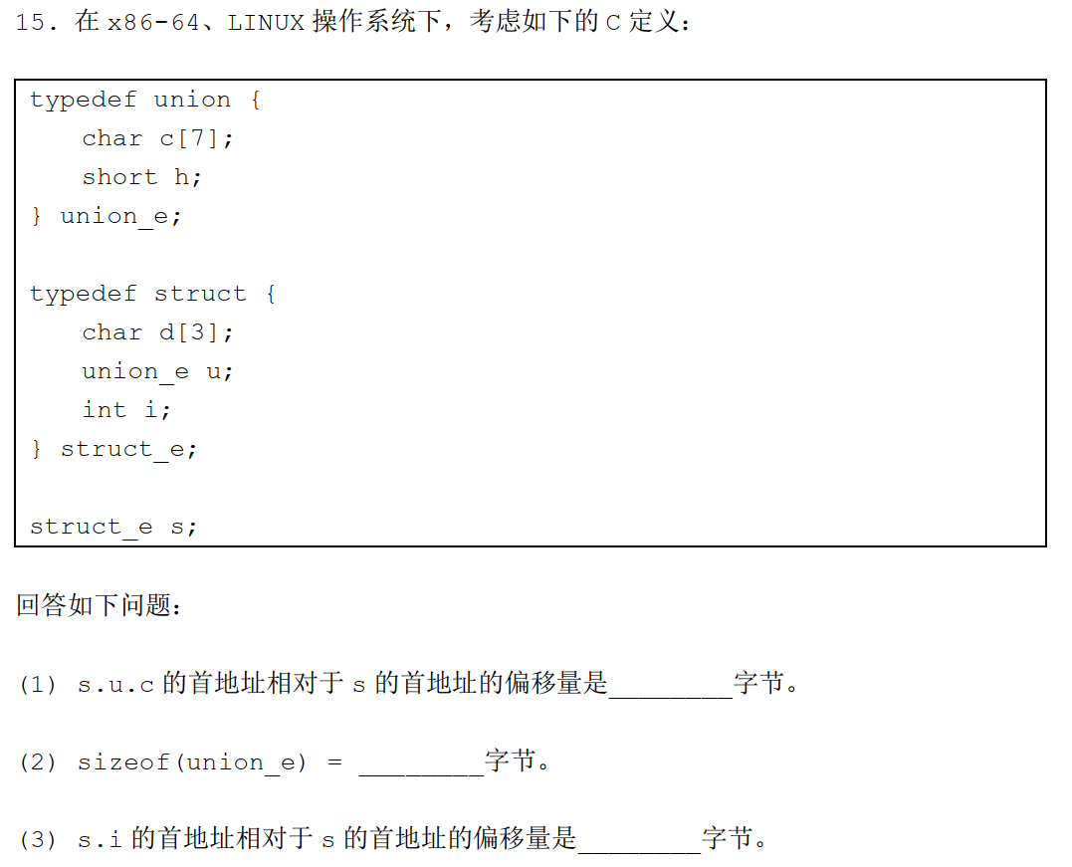
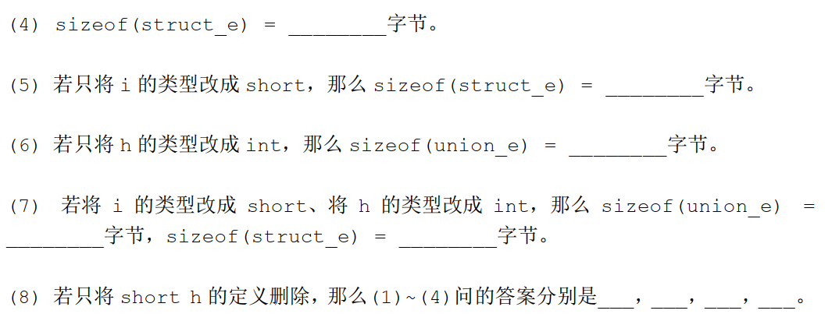
16
4
14
8
8
12
8
16
3
7
12
16

Slide 23
Example
在Linux 下使用GCC 编译器,仅采用-O2 选项,上述代码对应的汇编语言是：(将选项内的数依次填入横线上)
movslq %edx, %rdx
movl ____(%rdi,%rdx,____), %eax
movl %eax, ____(%rsi)
(16, 4, 52) B. (24, 4, 52)
C.(16, 4, 49) D. (24, 4, 49)
struct A{
char c;
int i;
double d;
int array[10];
};
struct B{
int array[10];
double d;
char c;
int i;
};
void foo(struct A *pa, struct B *pb, int index){
pb->i= pa->array[index];
}
A

Slide 24
Questions?

Slide 25
Pointer & arrays
Decl | An |  |  | *An |  |  | **An
 | Cmp | Bad | Size | Cmp | Bad | Size | Cmp | Bad | Size
int A1[3]
int *A2[3]
int (*A3)[3]
int (*A4[3])
Cmp: Compiles (Y/N)
Bad: Possible bad pointer reference (Y/N)
Size: Value returned by sizeof

Slide 26
Pointer & arrays
Decl | An |  |  | *An |  |  | **An
 | Cmp | Bad | Size | Cmp | Bad | Size | Cmp | Bad | Size
int A1[3] | Y | N | 12 | Y | N | 4 | N | - | -
int *A2[3]
int (*A3)[3]
int (*A4[3])
Cmp: Compiles (Y/N)
Bad: Possible bad pointer reference (Y/N)
Size: Value returned by sizeof

Slide 27
Pointer & arrays
Decl | An |  |  | *An |  |  | **An
 | Cmp | Bad | Size | Cmp | Bad | Size | Cmp | Bad | Size
int A1[3] | Y | N | 12 | Y | N | 4 | N | - | -
int *A2[3] | Y | N | 24 | Y | N | 8 | Y | Y | 4
int (*A3)[3]
int (*A4[3])
Cmp: Compiles (Y/N)
Bad: Possible bad pointer reference (Y/N)
Size: Value returned by sizeof

Slide 28
Pointer & arrays
Decl | An |  |  | *An |  |  | **An
 | Cmp | Bad | Size | Cmp | Bad | Size | Cmp | Bad | Size
int A1[3] | Y | N | 12 | Y | N | 4 | N | - | -
int *A2[3] | Y | N | 24 | Y | N | 8 | Y | Y | 4
int (*A3)[3] | Y | N | 8 | Y | Y | 12 | Y | Y | 4
int (*A4[3])
Cmp: Compiles (Y/N)
Bad: Possible bad pointer reference (Y/N)
Size: Value returned by sizeof

Slide 29
Pointer & arrays
Decl | An |  |  | *An |  |  | **An
 | Cmp | Bad | Size | Cmp | Bad | Size | Cmp | Bad | Size
int A1[3] | Y | N | 12 | Y | N | 4 | N | - | -
int *A2[3] | Y | N | 24 | Y | N | 8 | Y | Y | 4
int (*A3)[3] | Y | N | 8 | Y | Y | 12 | Y | Y | 4
int (*A4[3]) | Y | N | 24 | Y | N | 8 | Y | Y | 4
Cmp: Compiles (Y/N)
Bad: Possible bad pointer reference (Y/N)
Size: Value returned by sizeof

Slide 30
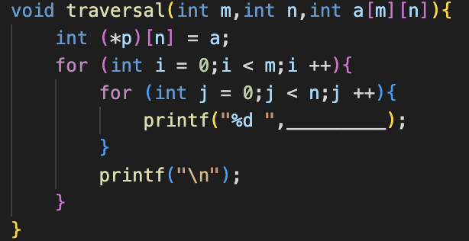
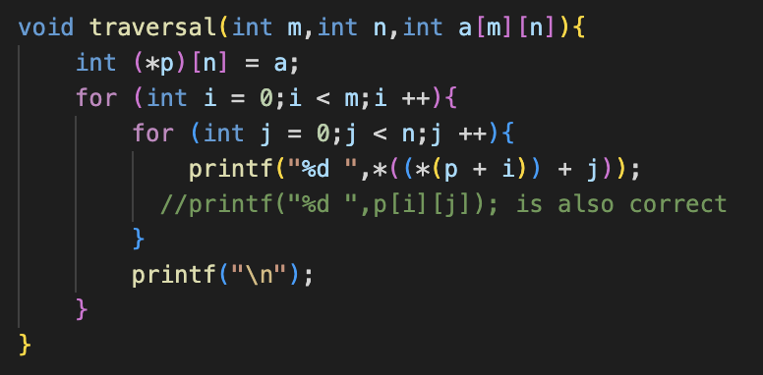
One example
Note: *(p + i) is equal to p[i]

Slide 31
Pointer & arrays
Decl | An |  |  | *An |  |  | **An |  |  | ***An
 | C | B | Size | C | B | Size | C | B | Size | C | B | Size
int A1[3][5]
int *A2[3][5]
int (*A3)[3][5]
int *(A4[3][5])
int (*A5[3])[5]
C: Compiles (Y/N)
B: Possible bad pointer reference (Y/N)
Size: Value returned by sizeof
Do it by yourself!

Slide 32
Pointer & arrays
Decl | An |  |  | *An |  |  | **An |  |  | ***An
 | C | B | Size | C | B | Size | C | B | Size | C | B | Size
int A1[3][5] | Y | N | 60 | Y | N | 20 | Y | N | 4 | N | - | -
int *A2[3][5] | Y | N | 120 | Y | N | 40 | Y | N | 8 | Y | Y | 4
int (*A3)[3][5] | Y | N | 8 | Y | Y | 60 | Y | Y | 20 | Y | Y | 4
int *(A4[3][5]) | Y | N | 120 | Y | N | 40 | Y | N | 8 | Y | Y | 4
int (*A5[3])[5] | Y | N | 24 | Y | N | 8 | Y | Y | 20 | Y | Y | 4
C: Compiles (Y/N)
B: Possible bad pointer reference (Y/N)
Size: Value returned by sizeof

Slide 33
Function pointers
return_type (*pointer_name) (parameter_type1, parameter_type2, ...);
Notice the difference
int (*f)(int*);
int *f(int*);
int square(int x) {
return x * x;
}
int (*funcPtr)(int) = square;
// Initialize the function pointer
int result = funcPtr(5);
// Call the function through the pointer

Slide 34
Complicated examples
char (*(*x( ))[ ]) ( );
x is a function returning pointer to array[ ] of pointer to function returning char
char (*(*x[3])( ))[5];
x is an array[3] of pointer to function returning pointer to array[5] of char
Do not write code like this!
More references on 《The C Programming Language》(Brian Kernighan &. Dennis M Ritchie) [Sec 5.12]

Slide 35
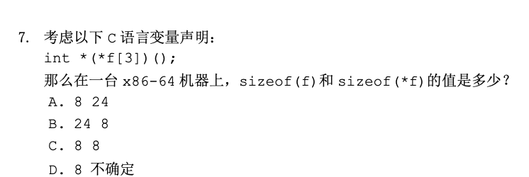
Examples
B

