Slide 1
My Cool Capston Project:
Road collisions in Montreal - Canada
Data description
The data-set has 190552 entries, each with 68 attributes
One of the attributes is the severity of the collision, it has the following values,
Value ID | Label | Entries
1 | Minor material damages | 78300
2 | Major material damages | 71670
3 | Minor injured persons | 38831
4 | Major injured persons | 1543
5 | At least one fatality within the next 30 days | 208
The number of entries seems to be enough to use the severity attribute to train and test the machine learning model, for further prediction

Slide 2
As suggested, the road condition attribute is analyzed firs
The road condition attribute has the following entries
Data assessment:
Condition ID | Description
11 | Dry
12 | Humid
13 | Water accumulation
14 | Sand over the road
15 | Melt snow
16 | Snow
17 | Hard snow
18 | Icy
19 | Muddy
20 | Oily
99 | Other
The correlation indexes to severity are:
Severity | Correlation
1 | -0,46
2 | -0,45
3 | -0,46
4 | -0,51
5 | -0,74
Meaning that the linear relationship between severity and the road condition is fair.

Slide 3
Then, the weather condition attribute
The weather condition attribute has the following entries
Data assessment:
Condition ID | Description
11 | Clear
12 | Partially cloudy
13 | mist
14 | Light Rain
15 | Heavy rain
16 | Heavy wind
The correlation indexes to severity are:
Severity | Correlation
1 | -0,46
2 | -0,45
3 | -0,46
4 | -0,51
5 | -0,74
Meaning that the linear relationship between severity and the weather condition is fair.

Slide 4
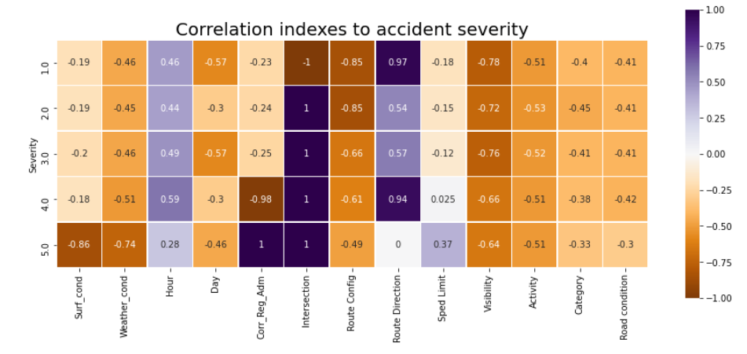
Finding attributes with better correlation indexes to accident severity
The correlation heat map shows that there are attributes with better linear relationship, these are shown at the center with darker color.
It is worth to make a richer predictive model.

