Slide 1

Correlation between Physical Height and Contributing Factors
Coursera Capstone – Applied Data Science Capstone

Slide 2
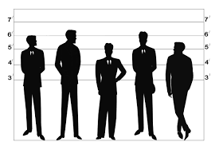
Introduction
Have you ever wondered why people from certain countries seem so much taller than others? Why is that?
This Data Science study seeks to analyze the correlation between a country’s average height with factors such as:
Meat consumption per capita (kg/person)
Milk consumption per capita (kg/person)
Wealth (GDP per capita in $USD)

Slide 3

Setup
Study performed in Python using the pandas, matplotlib, and other libraries
Data scraped from internet sources such as:
Height (Average Height, NCD Risk Factor Collaboration, and World Data Info)
Meat consumption (Wikipedia)
Milk consumption (Statista)
Wealth (GDP per capita) (World Bank)

Slide 4
Top 10 Tallest Countries
Country | Average Height(in)
Bosnia & Herzegovina | 72.4
Netherlands | 72.19
Denmark | 71.73
Montenegro | 71.48
Serbia | 71.46
Norway | 71.46
Iceland | 71.19
Germany | 71.11
Croatia | 71.1
Czech Republic | 70.96

Slide 5
Top 10 Shortest Countries
Country | Average Height(in)
Indonesia | 62.93
Vietnam | 63.82
Bolivia | 63.89
Philippines | 63.91
Nepal | 64.08
Cambodia | 64.09
Sri Lanka | 64.68
Peru | 64.73
Nigeria | 64.77
Ecuador | 64.84

Slide 6
Meat consumption per capita of Top 10 Tallest Countries
Country | Meat per capita (kg/person)
Croatia | 66.3
Czech Republic | 83.4
Denmark | 95.2
Germany | 88.1
Iceland | 86.2
Montenegro | 57.7
Netherlands | 85.5
Norway | 66
Serbia | 45.2
Bosnia & Herzegovina | 27.9

Slide 7
Meat consumption per capita of Top 10 Shortest Countries
Country | Meat per capita (kg/person)
Bolivia | 59.1
Cambodia | 16.6
Ecuador | 56.4
Indonesia | 11.6
Nepal | 9.9
Nigeria | 8.8
Peru | 20.8
Philippines | 33.6
Sri Lanka | 6.3
Vietnam | 49.9

Slide 8
Milk consumption per capita of Top 10 Tallest Countries
Country | Milk Consumption (kg/person)
Bosnia & Herzegovina | 197.24
Croatia | 242.15
Czech Republic | 190.93
Denmark | 307.03
Germany | 267.52
Iceland | 255.76
Montenegro | 389.91
Netherlands | 340.35
Norway | 252.82
Serbia | 173.12

Slide 9
Milk consumption per capita of Top 10 Shortest Countries
Country | Milk Consumption (kg/person)
Bolivia | 47.75
Cambodia | 3.31
Ecuador | 107.93
Indonesia | 6.74
Nepal | 54.12
Nigeria | 2.18
Peru | 56.68
Philippines | 1.2
Sri Lanka | 11.19
Vietnam | 8.66

Slide 10
Wealth of Top 10 Tallest Countries
Country | GDP/capita
Bosnia & Herzegovina | $ 5,633.68
Croatia | $ 13,886.56
Czech Republic | $ 21,248.00
Denmark | $ 58,254.46
Germany | $ 45,086.60
Iceland | $ 68,172.82
Montenegro | $ 8,129.79
Netherlands | $ 50,044.75
Norway | $ 75,777.51
Serbia | $ 6,672.28

Slide 11
Wealth of Top 10 Shortest Countries
Country | GDP/capita
Bolivia | $ 3,382.11
Cambodia | $ 1,452.52
Ecuador | $ 6,188.34
Indonesia | $ 3,857.48
Nepal | $ 949.57
Nigeria | $ 2,101.79
Peru | $ 6,708.61
Philippines | $ 3,233.52
Sri Lanka | $ 3,974.25
Vietnam | $ 2,459.93

Slide 12
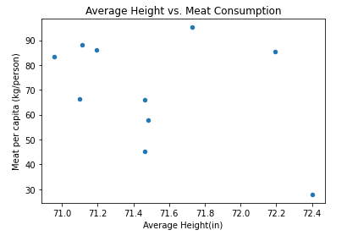
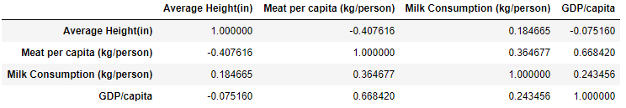
Initial Comparisons
Initially, we studied the data within each data frame:
Height versus Meat consumption per capita (Top 10 tallest countries only)
Height versus Meat consumption per capita (Top 10 shortest countries only)
Height versus Milk consumption per capita (Top 10 tallest countries only)
Height versus Milk consumption per capita (Top 10 shortest countries only)
Height versus GDP per capita (Top 10 tallest countries only)
Height versus GDP per capita (Top 10 shortest countries only)
RESULTS DID NOT SHOW MUCH CORRELATION

Slide 13
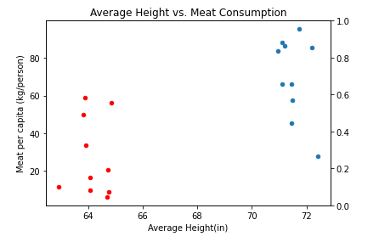
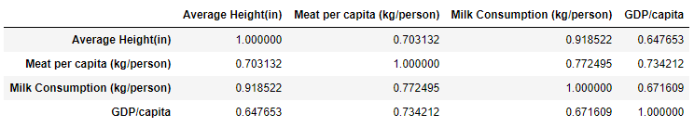
Comparison 2
Then we stacked both data frames and ran the same studies
The results showed more correlation between average height and the potentially contributing factors

Slide 14
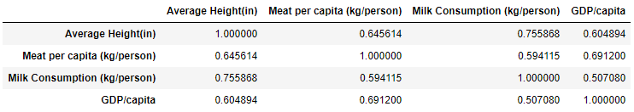
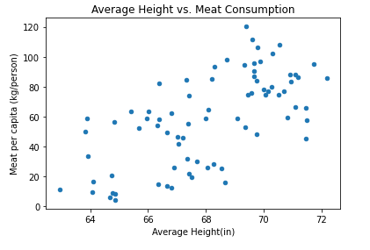
Final Comparison
Ran studies on correlation for all countries (78 countries with complete data)

Slide 15

Results
When comparing 78 countries:
There is a very strong positive correlation between height and milk consumption (>0.7)
A moderate positive correlation between height and meat consumption, wealth (<0.7 and >0.3)

Slide 16

Conclusion
These results lead us to believe that milk consumption is a strong contributing factor to the height of a country
Meat consumption and wealth are also positively correlated but not as strong

