Slide 1
Green and Healthy Schools (Iteration 2)
Team Plan
team roles
technologies
Flow Chart of Project
Collections
Github repo
By: Janett Morales, Shantel Parrish, & Nhat Minh Vu

Slide 2








Team Roles
Nhat Minh Vu
Shantel Parrish
Janett Morales
Data analyzer
Project Documentation
Data Modeler
Client Liaison
Visualization
Team Manager
Notes:
Janett

Slide 3
Team Plan
Finalize Form
Edit the Code
Received feedback, and made edits to the format of the database form
Make sure the code is working
Meet with sd team
Merge our code
Download the apps needed to work together
Attach our HTML code into our projects branch
Work on web design
Create analyzing tools
Design the lay out for the database form
Implement tools that can be used to help with the visualizations of the data
Notes:
Janett

Slide 4





Node
Replit
Angular
Jira
Handles multiple client requests concurrently and efficiently
Firebase
Create HTML interface in a collaborative environment
Framework for building single-page client applications using HTML and TypeScript
Used for project planning and management
Used to link the HTML form into a realtime database
Technologies

Slide 5




One Drive
Google Colab
Visual Studio Code
Github
Documental storage
Used to help clean and analyze the data
Document notebook
Fast code editor
Technologies (continued)

Slide 6
Project Flow Chart
Met with client
Received client feedback
Debugging
Learning the software
Edited HTML Form with feedback
Met with software team
Project touch ups
Project Planning

Slide 7
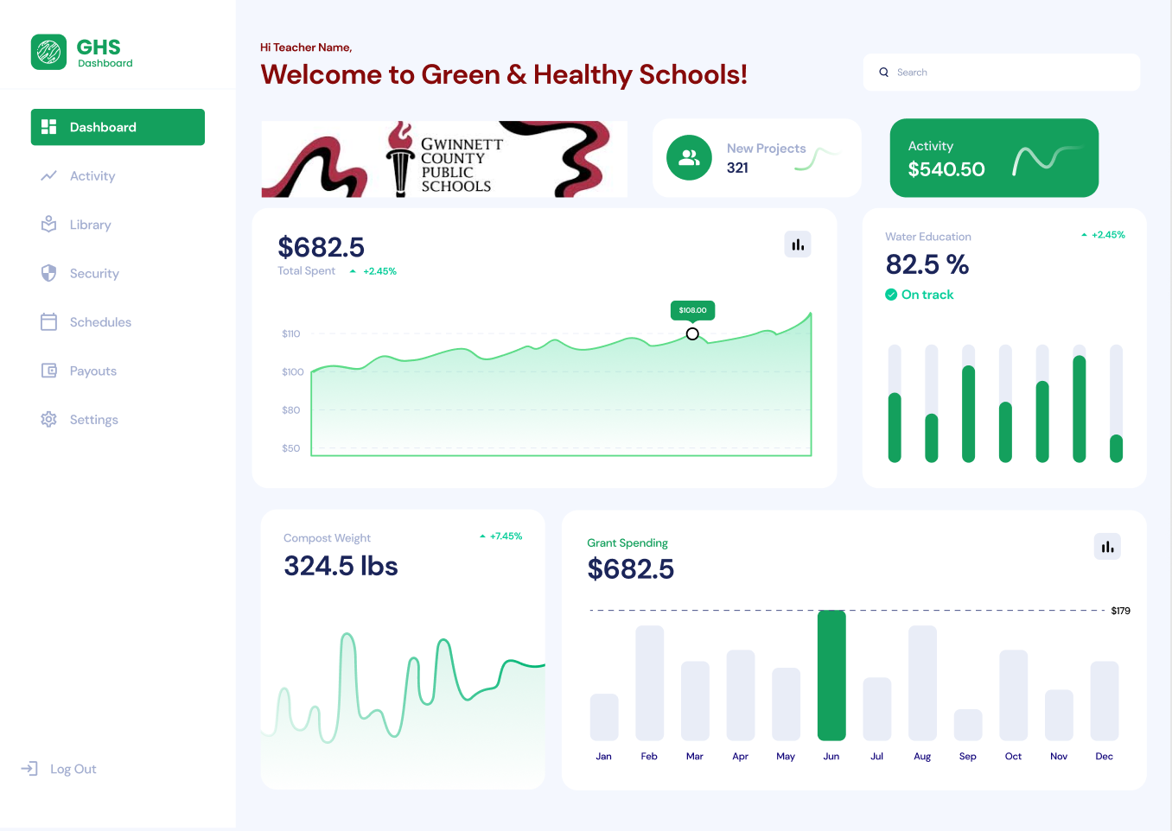
Mock-Up Dashboard

Slide 8
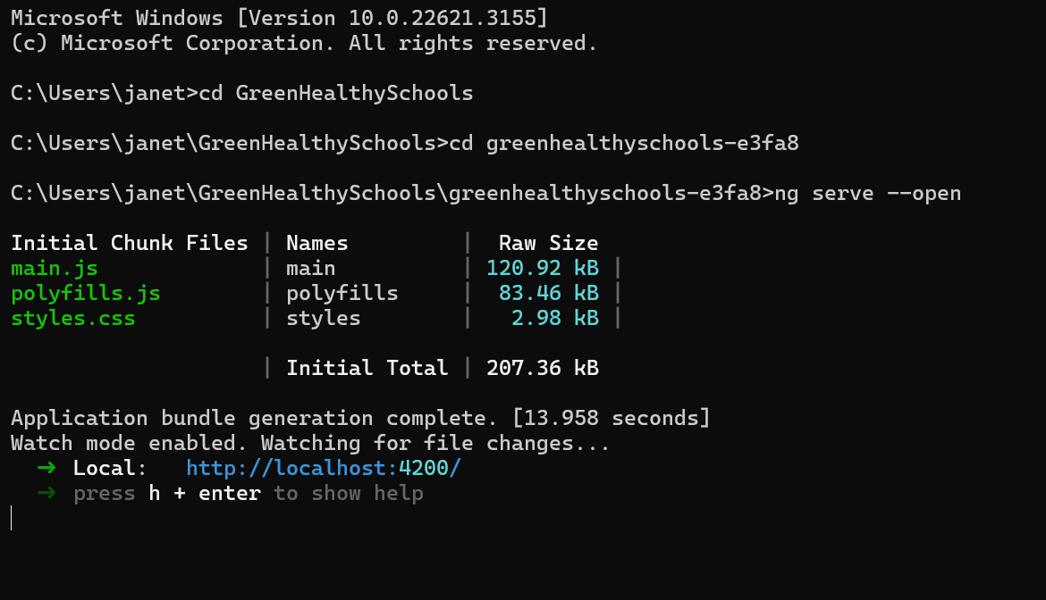
Allows you to run and open Angular
Last line of code will open the web browser with the working web site

Slide 9
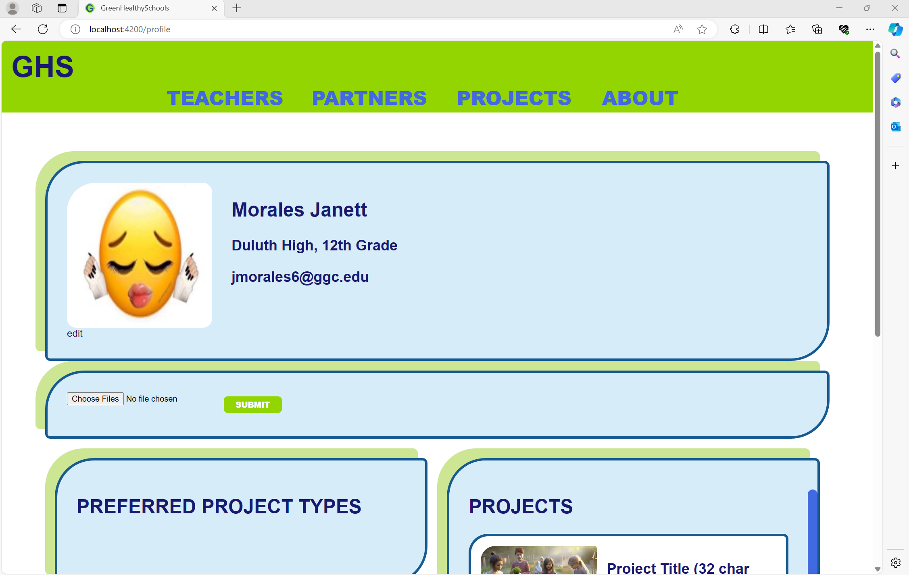
Teacher Log-in

Slide 10
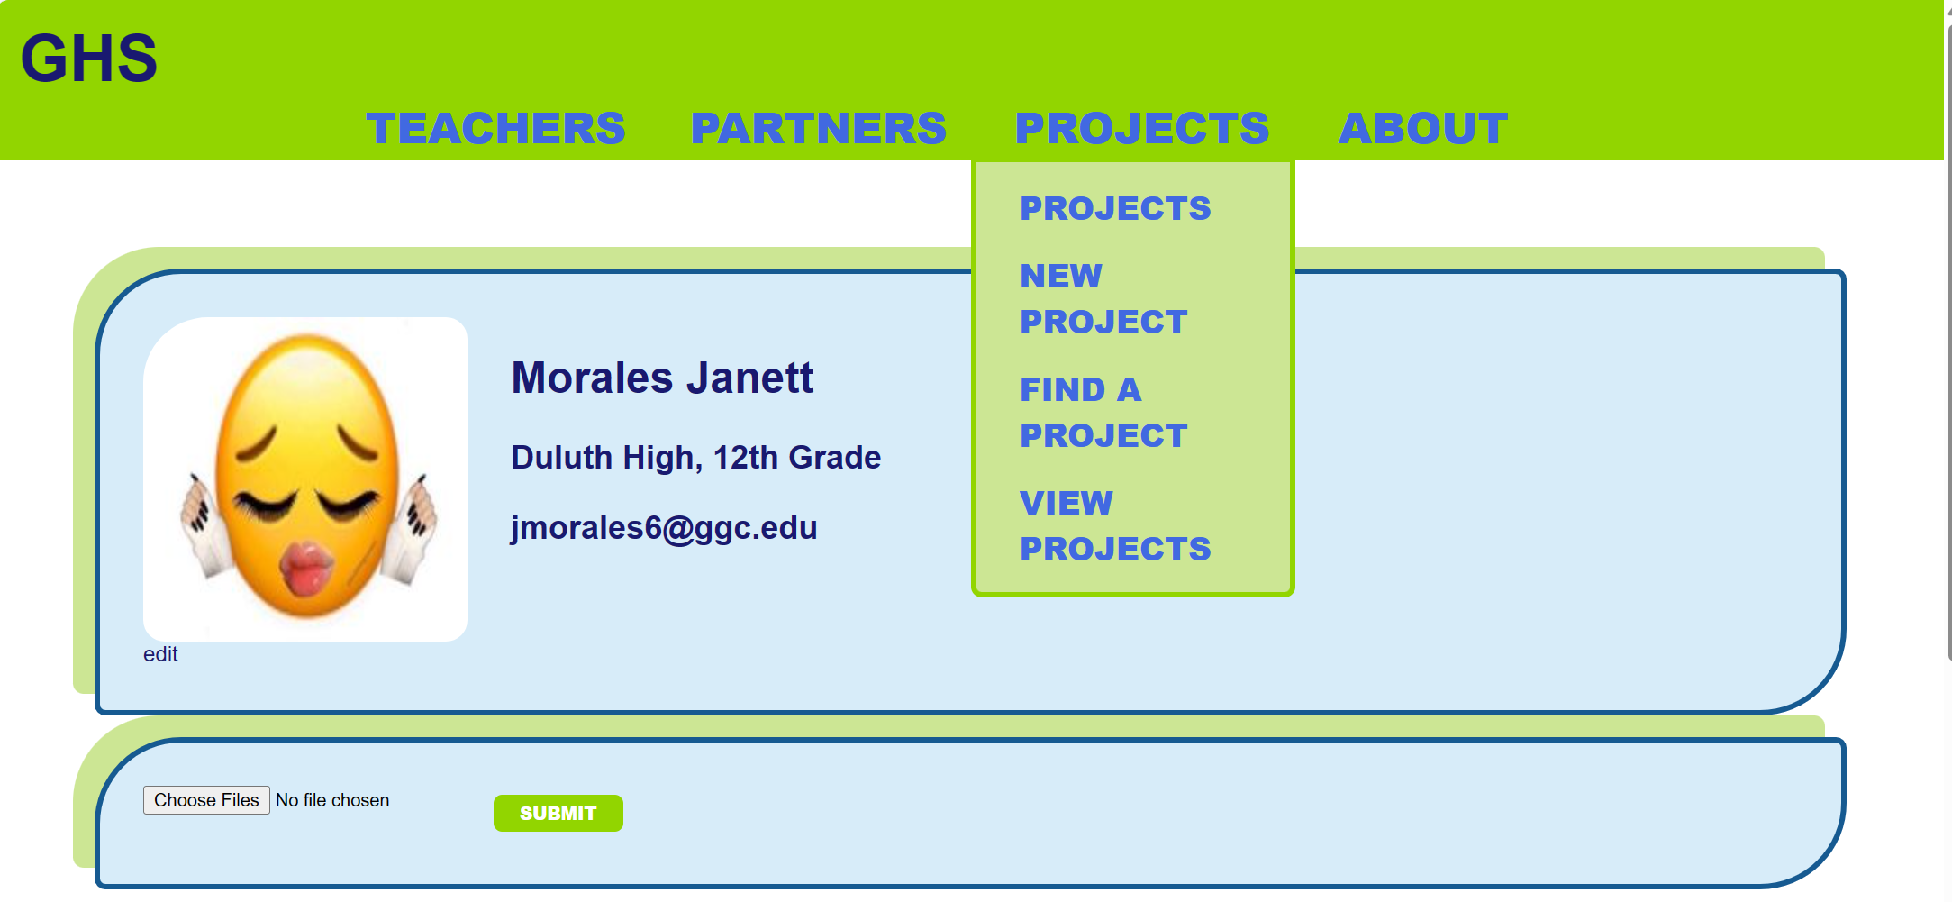
Projects tab – will have the dashboard
New Project tab – will have the database attached

Slide 11
Link for Our GitHub and Form Mockup
Github
Form Mockup
Project HTML Page
Firebase Database
Google Colab Notebook

Slide 12
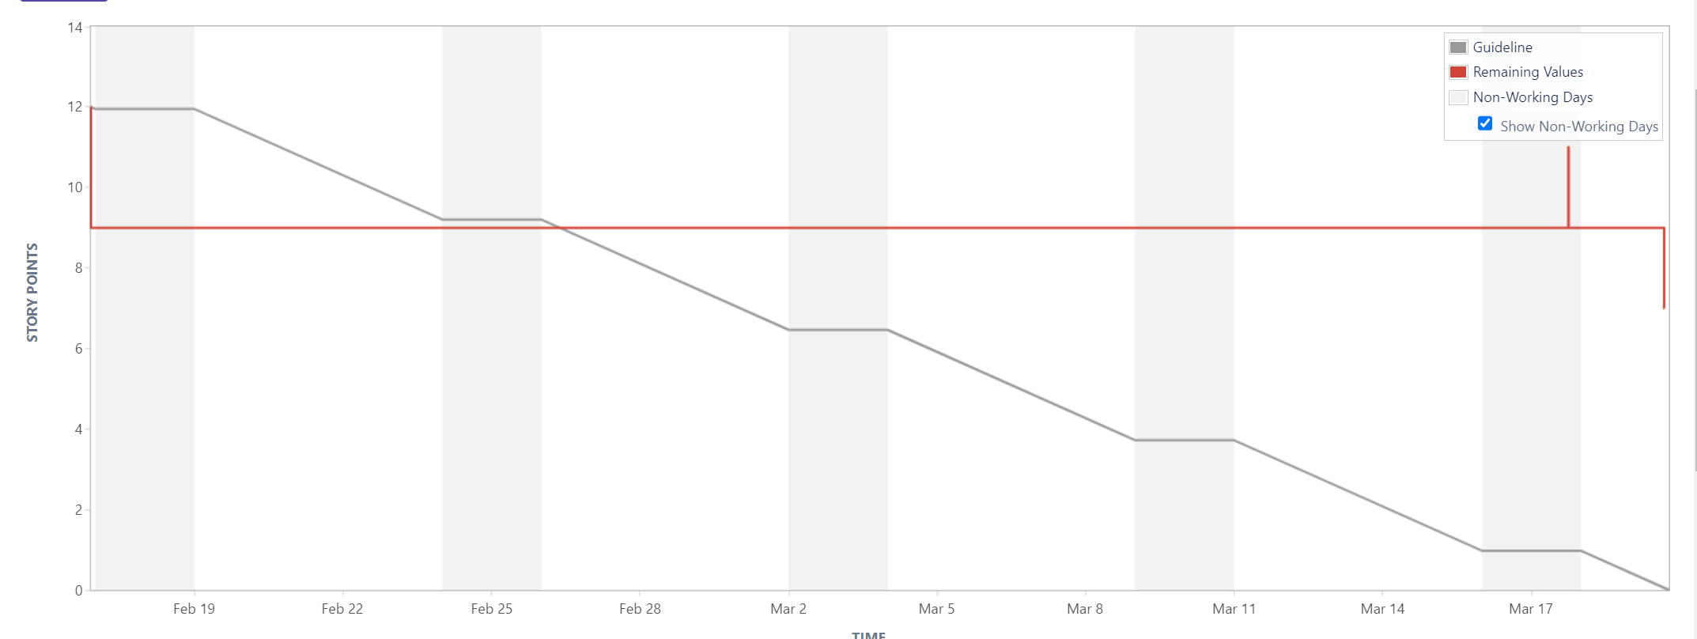
Burndown Chart

Slide 13
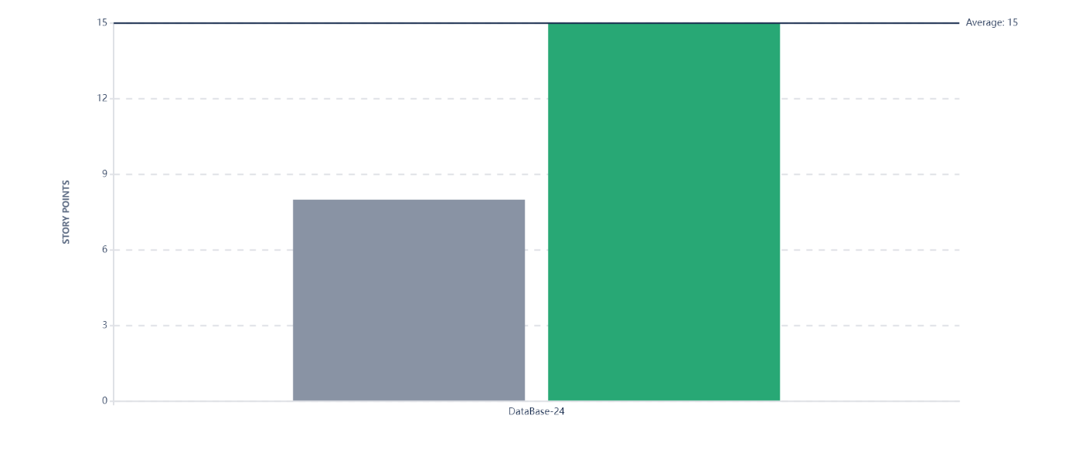
Velocity Charts

Slide 14
Questions

