Slide 1
Green and Healthy Schools
project description
team roles
technologies
team plan
Flow chart of the project
collections

Slide 2

Project & Goals
Description
Reporting and Analytics
The project seeks to support educators and stakeholders in Gwinnett County Public Schools by facilitating data collection on various environmental aspects, such as recycling practices, water education programs, and food wastage. The client aims to enhance the form's usability to ensure efficient data collection while offering real-time insights through visual representations and charts. Additionally, they aim to incorporate functionality for uploading pictures and videos.
Searchable Database
Category Based Form
Dashboard Interface
Notes:
Janett

Slide 3








Team Roles
Nhat Minh Vu
Shantel Parrish
Janett Morales
Data analyzer
Project Documentation
Data Modeler
Client Liaison
Visualization
Team Manager
Notes:
Janett

Slide 4





Technologies
Firebase
Google Colab
Jira
Replit
One Drive
Create HTML form linked to database
Clean and analyze data
Project Planning and Managment
Create HTML interface
Dashboard visualization with D3.js
Documental storage
Notes:
Shantel & Nhat

Slide 5



Team Plan
Web form
database
Dashboard
User-friendly forms for busy teachers and principals
Collapsible/optional sections
To be completed by staff every quarter minimum
Form inputs to be stored in a database
Form will have numerical and textual inputs
Readable database for admin to refer back
Real-time dashboards that can be accessed when needed
Be able to filter by school and individual teacher for recognition
Easy to read and fun visualizations
Notes:
Shantel

Slide 6
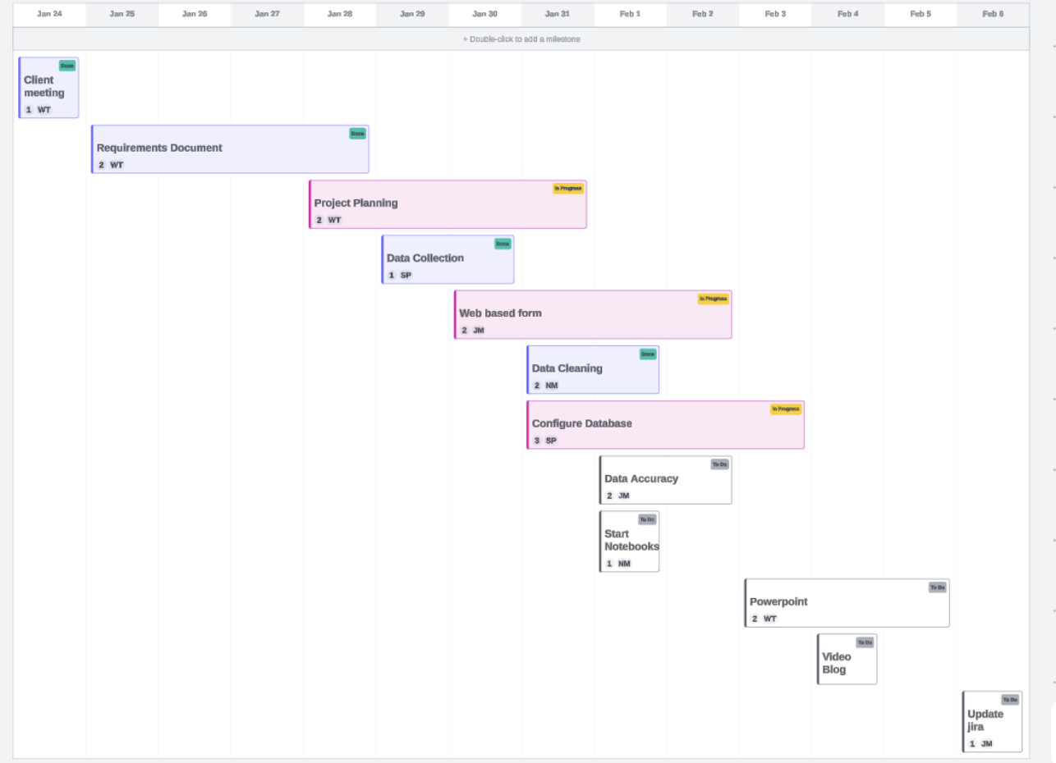
Project Flow Chart
(Whole team)
(Whole team)
(Whole team)
(Shantel)
(Janett)
(Nhat)
(Shantel)
(Janett)
(Nhat)
(Whole team)
(Shantel)
(Janett)
Notes:
Janett

Slide 7
Data Collection for Green & Healthy Schools (GHS)
Project Charter
Project Charter link
Project Overview:
Objective: Enhance environmental education in Gwinnett County Public Schools (GCPS) through integrated programs.
Scope: Develop an Online Data Collection Form and a Visualization Dashboard for environmental impact data.
Deliverables:
Online Form for Data Collection
Dashboard for Visualizing Environmental Impact Data
Creative Requirements:
Online Form:
Captures detailed environmental information.
User-friendly for teachers and principals.
Includes fields for multimedia and project details.
Dashboard:
Visualizes impact data at different levels.
Provides filters and sorting options.
Generates analytics reports with visualizations.
Notes:
Nhat

Slide 8
Data Collection for Green & Healthy Schools (GHS)
Project Charter (continue)
Resources:
Team: Green Team (3 developers) and project managers.
Time: 5 hours/week for 4 months.
Budget: (TBA)
Stakeholders:
Sponsor: Jenna Mobley, Brenda O McDaniel.
Approver: Dr. Anca Doloc Mihu.
Constraints:
Reliable internet access and basic computer literacy assumed.
Accuracy of entered data assumed.
Assumptions:
Compatibility with popular web browsers.
System handles concurrent users efficiently.
Non-functional Requirements:
Data security measures for confidentiality.
Compliance with data protection regulations.
Scalability for increasing submissions and users.
Notes:
Nhat

Slide 9
Link for Our GitHub and Form Mockup
Github
Form Mockup

Slide 10
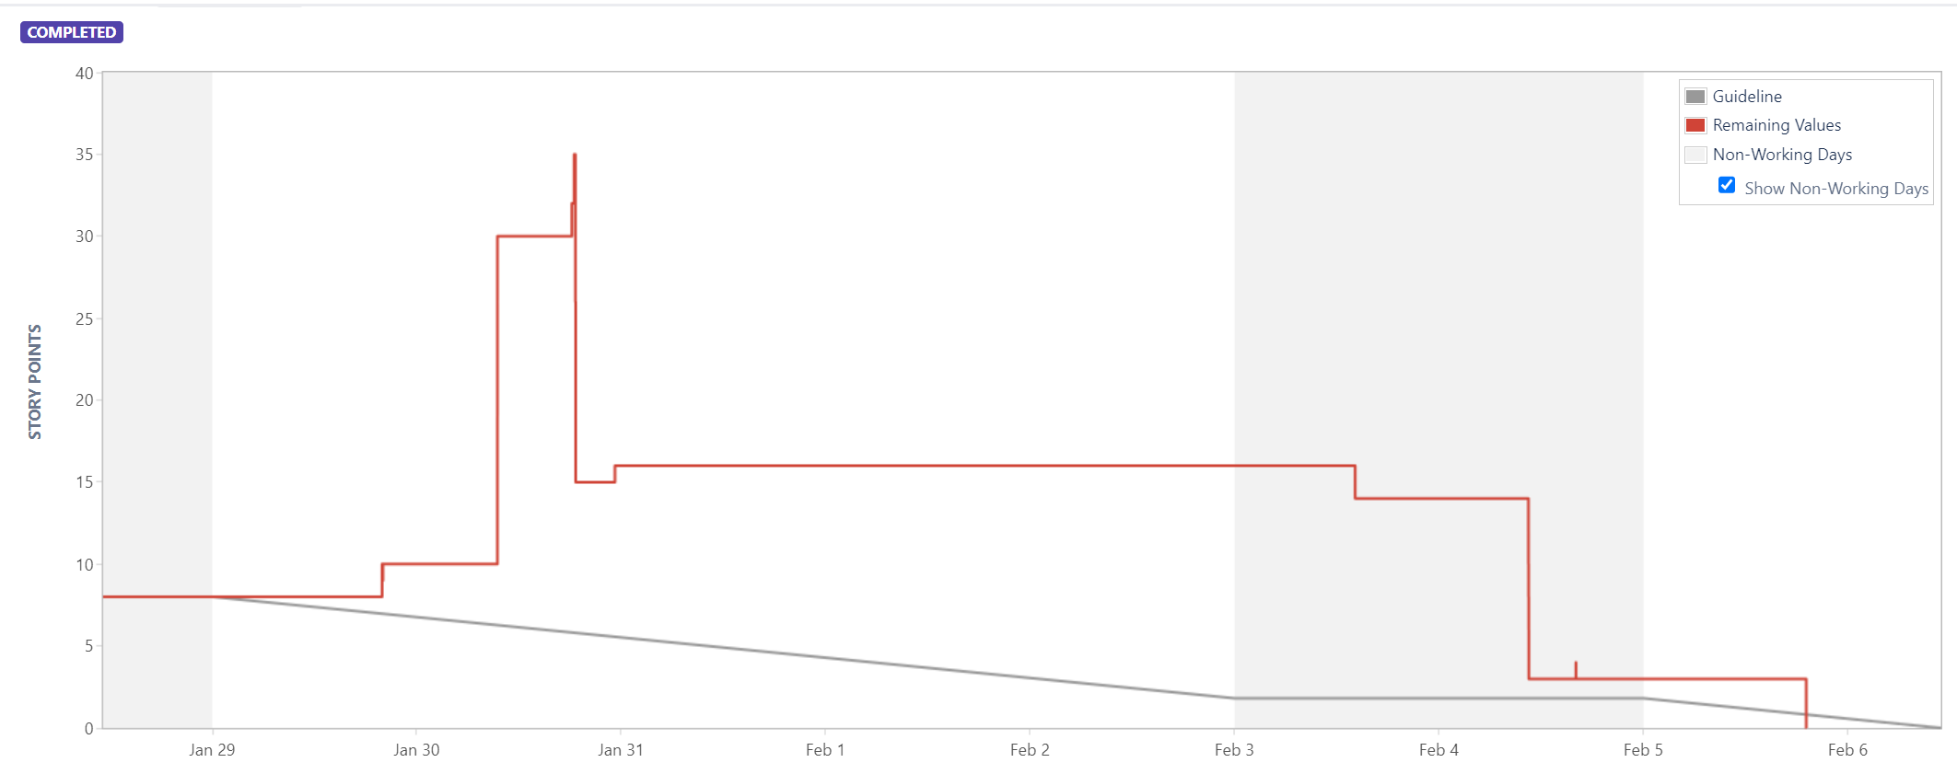
Burndown Chart

Slide 11
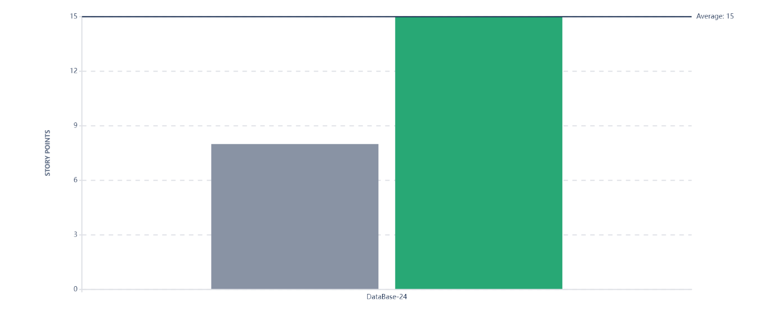
Velocity Charts

Slide 12


