Slide 1

REAL ESTATE ANALYSIS FOR PROPERTY PURCHASE IN GEORGIA​
By: Niko Melas, Nazmun Nahar, Tran Truong
Team: Squad

Slide 2

Project Description
Our project uses a detailed real estate dataset, along with other useful data, to help a client make a smart decision when buying property in Georgia. By analyzing key market factors, we provide valuable insights to ensure they make the best investment choice.

Slide 3




Technology

Slide 4

Team Plan
SPRINT
SPRINT 1 Due: February 5th
GATHER DATA
SPRINT
SPRINT 2 Due: March 24th
ANALYZE DATA
SPRINT
SPRINT 3 Due: April 24th
VISUALIZE DATA

Slide 5


Role
Nazmun Nahar
Visualization
Project Manager
Niko Melas
Data Modeler
Project Documenter
Tran Truong
Client Liaison
Data Analyzer

Slide 6
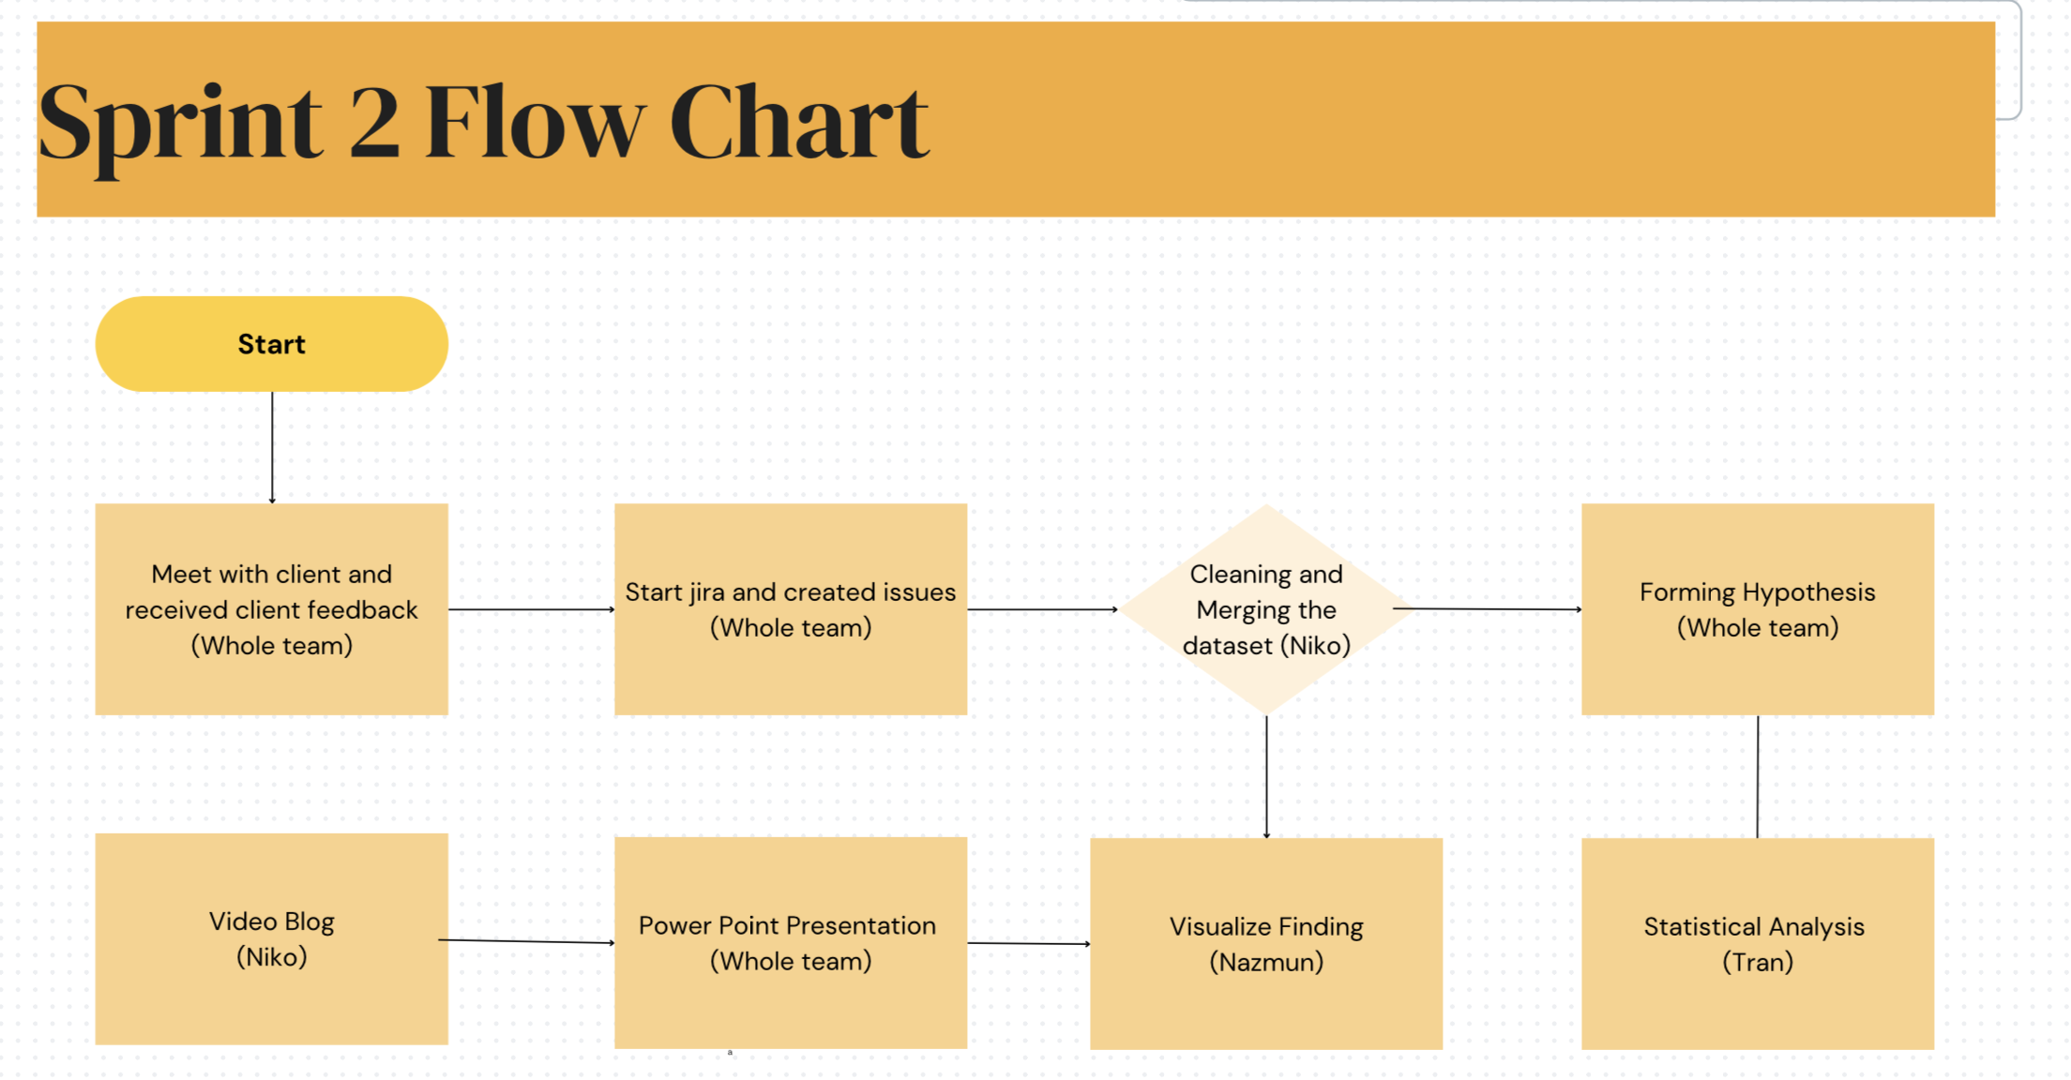
Project Flow Chart

Slide 7
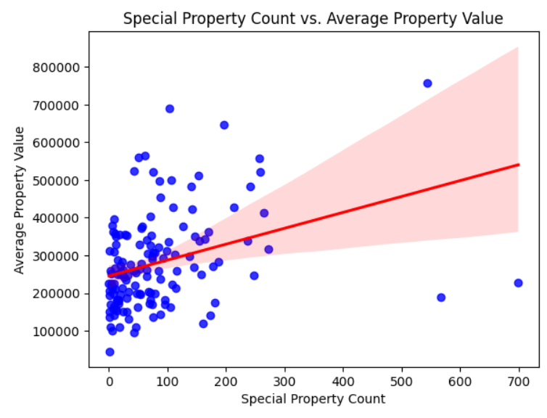
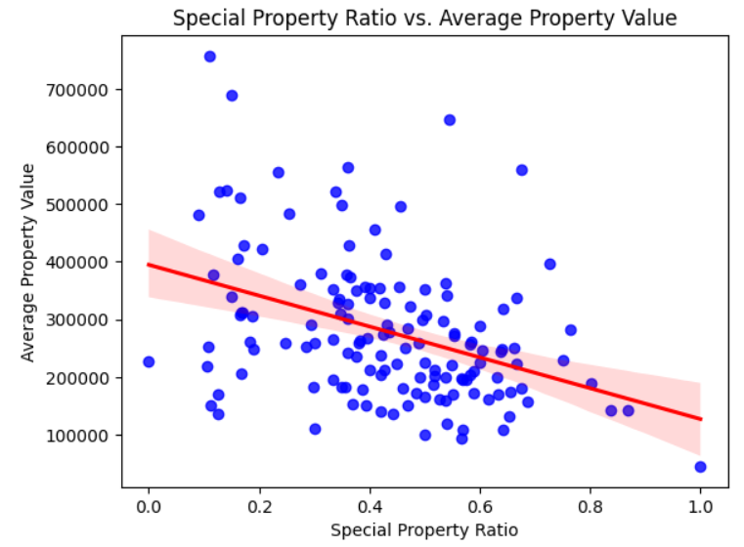
More "Special Properties" lowers real estate prices

Slide 8
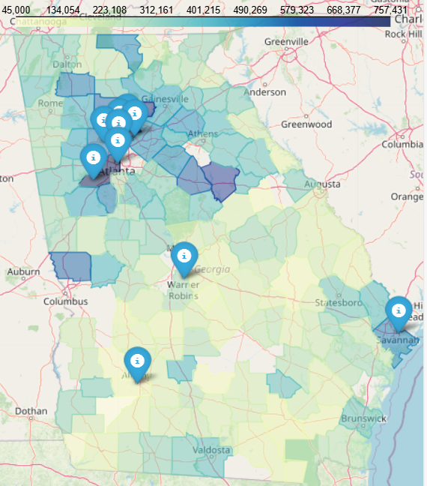
Real estate located near major cities will, on average, have a higher price

Slide 9
Hypothesis 1
Counties with lower unemployment rates have higher property values.

Slide 10
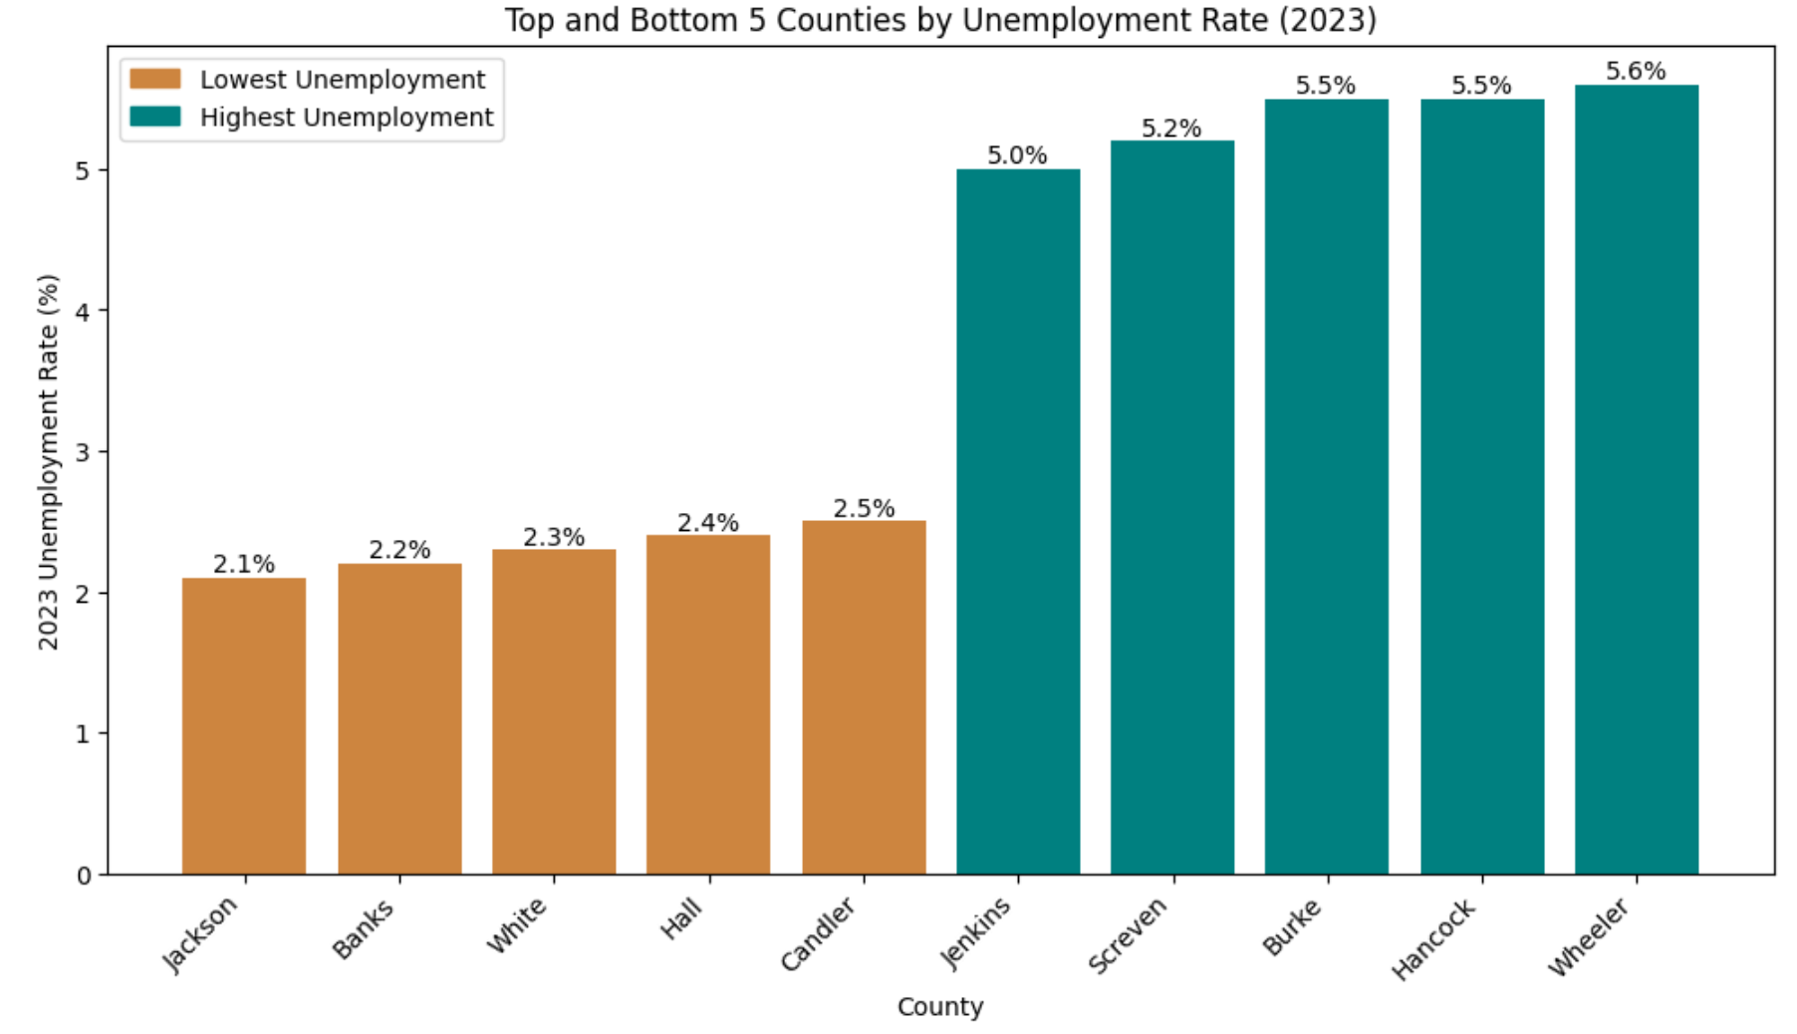

Slide 11
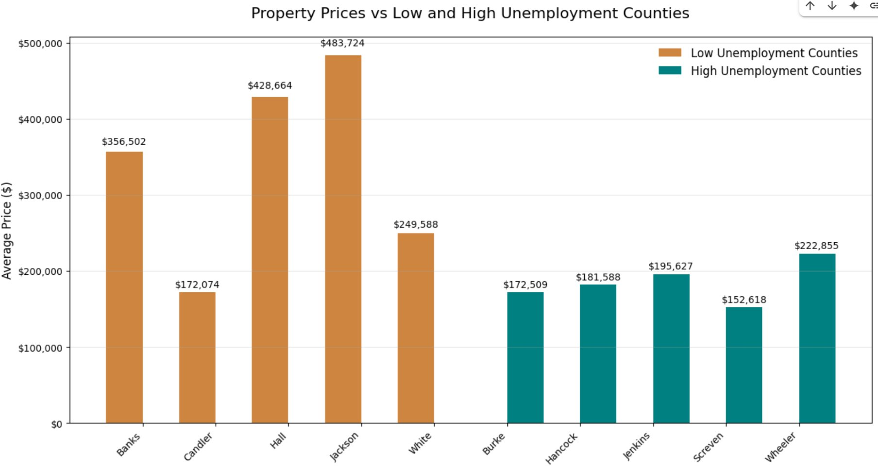

Slide 12
Hypothesis 2
Counties with a higher number of establishments in high-skill industries (such as Professional and Technical Services, Healthcare and Government) will have higher average property values.

Slide 13
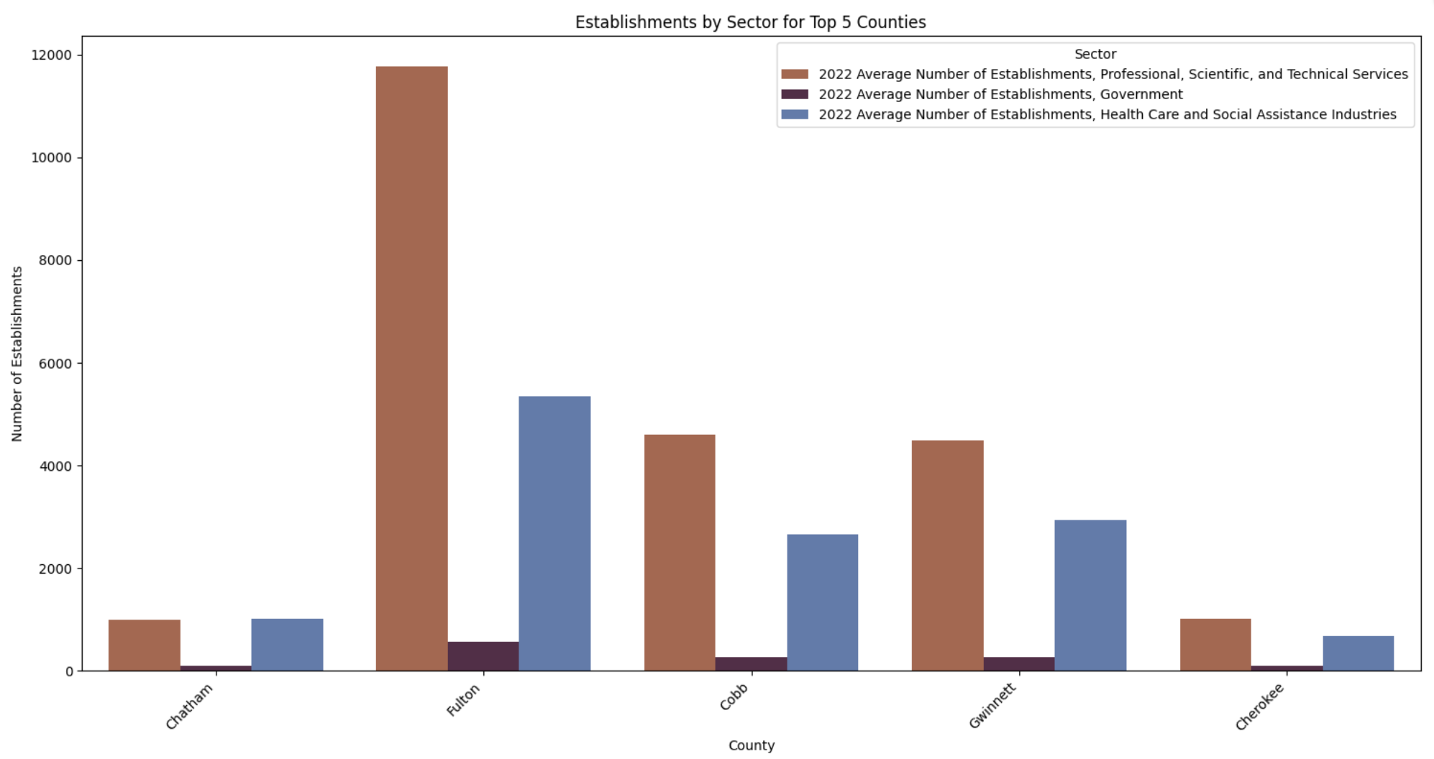

Slide 14
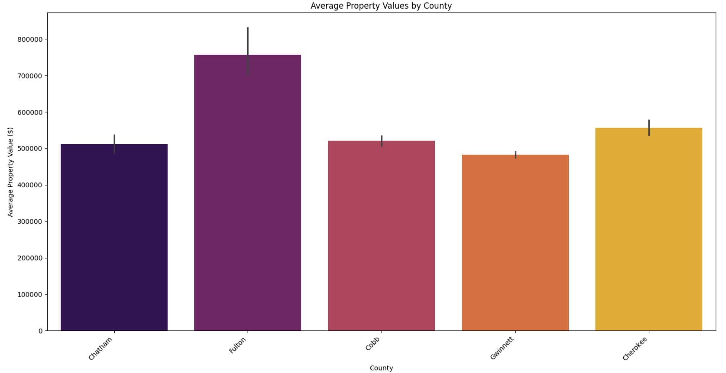

Slide 15
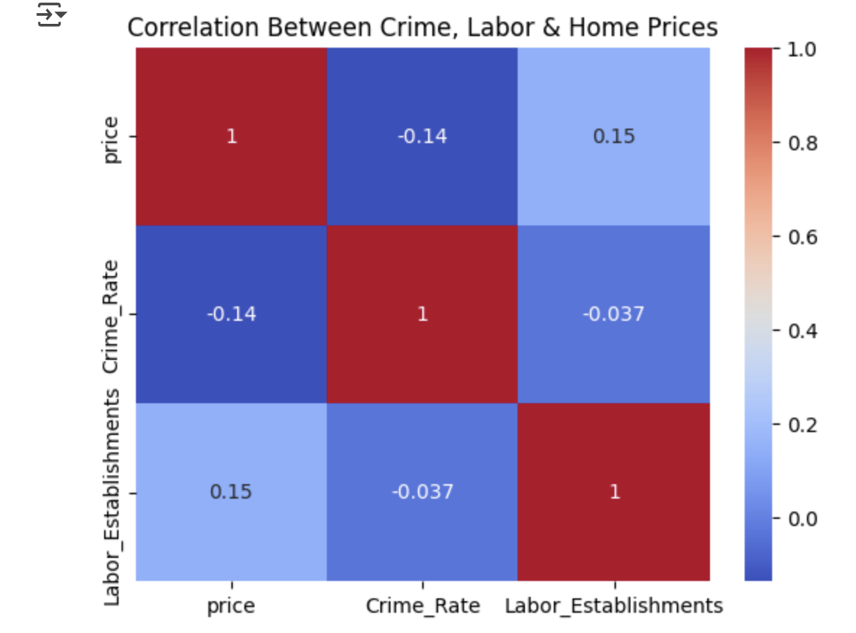
Hypothesis 1: Lower Crime & More Labor → Higher Home Prices

Slide 16
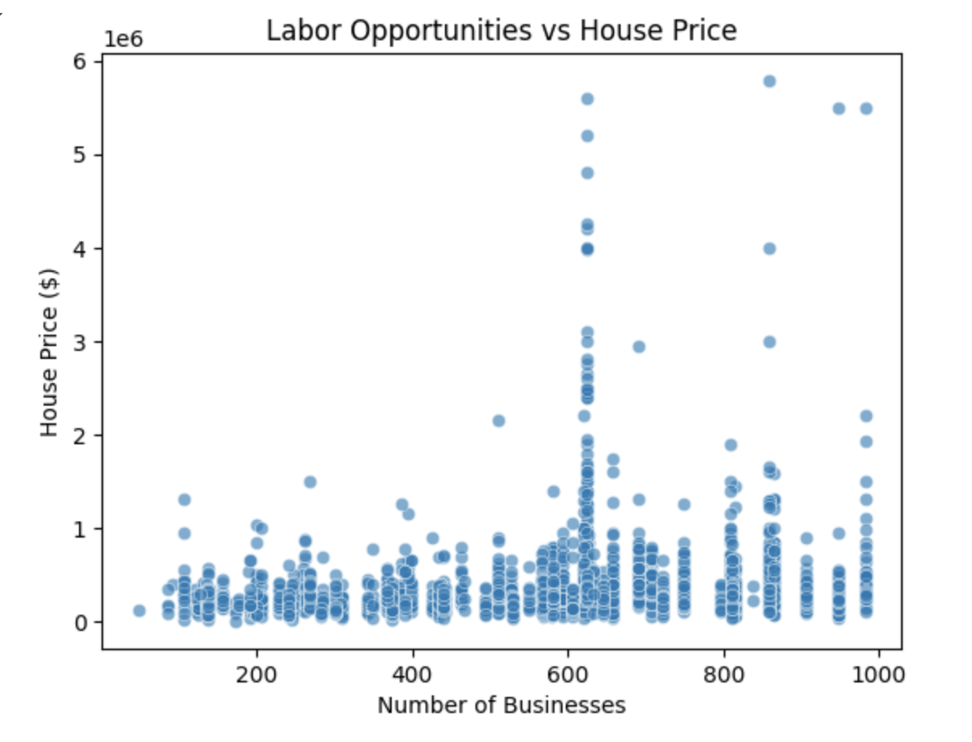
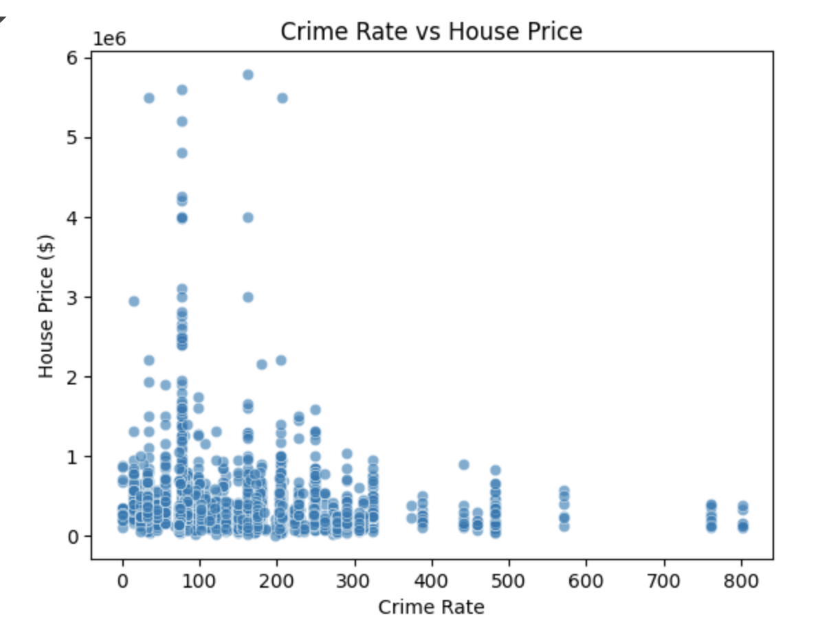
Hypothesis 1: Lower Crime & More Labor → Higher Home Prices

Slide 17
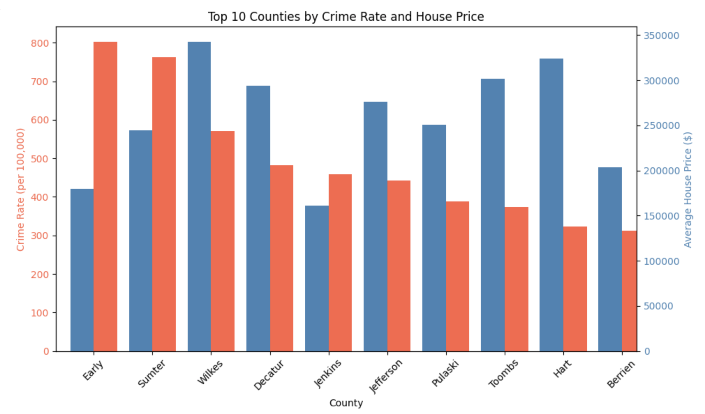
Top 10 Counties by Crime and House Price

Slide 18
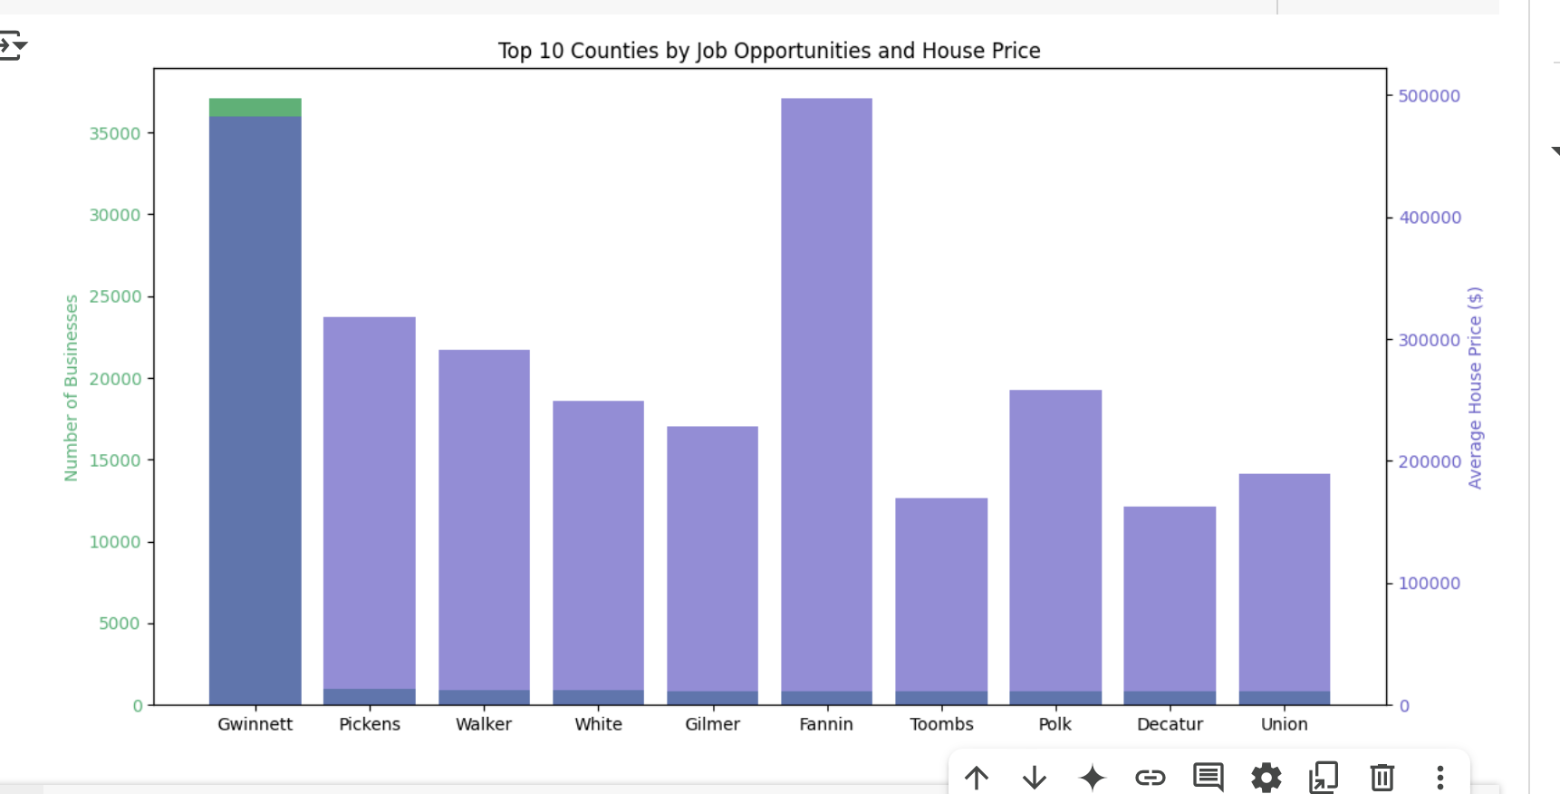
Top 10 Counties by Job and House Price

Slide 19
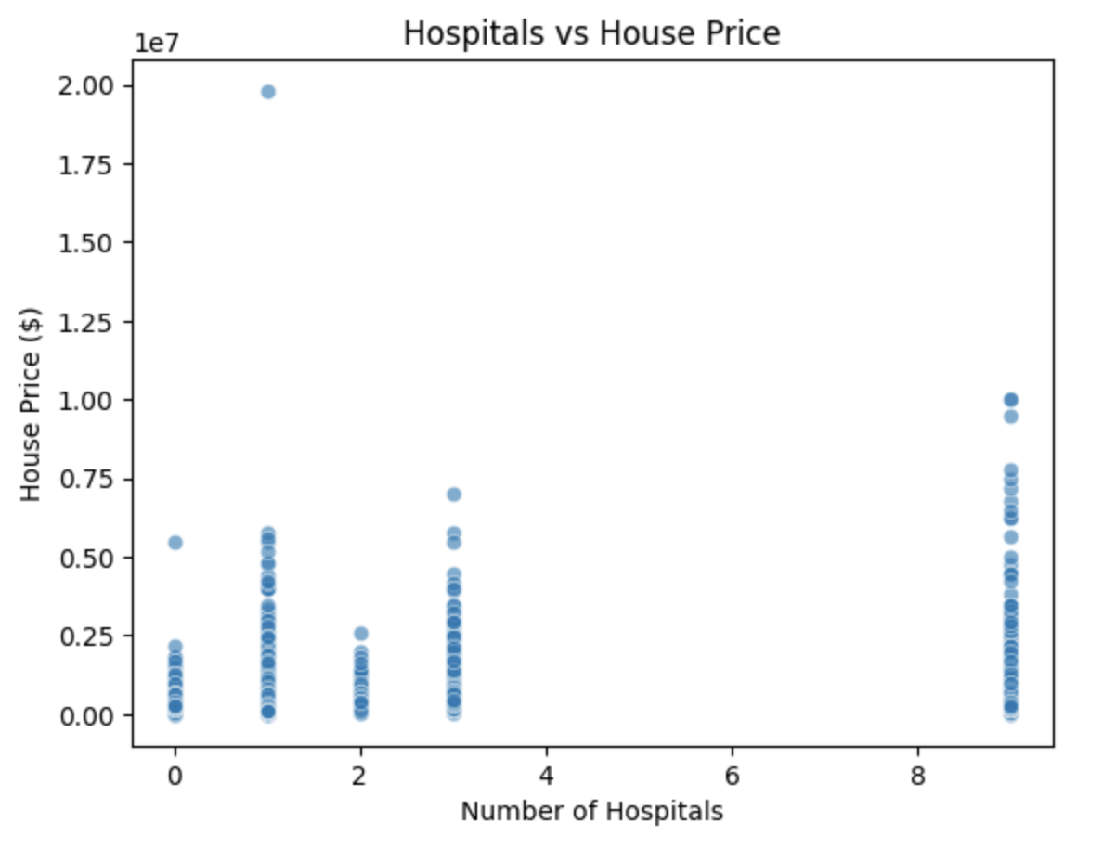
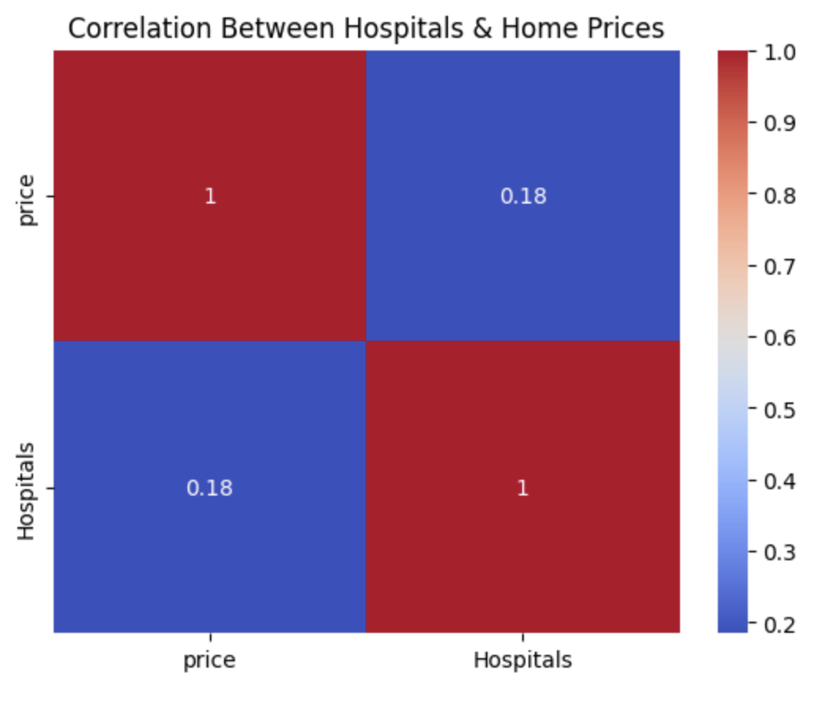
Hypothesis 2: More hospital -> Higher real estate demand

Slide 20
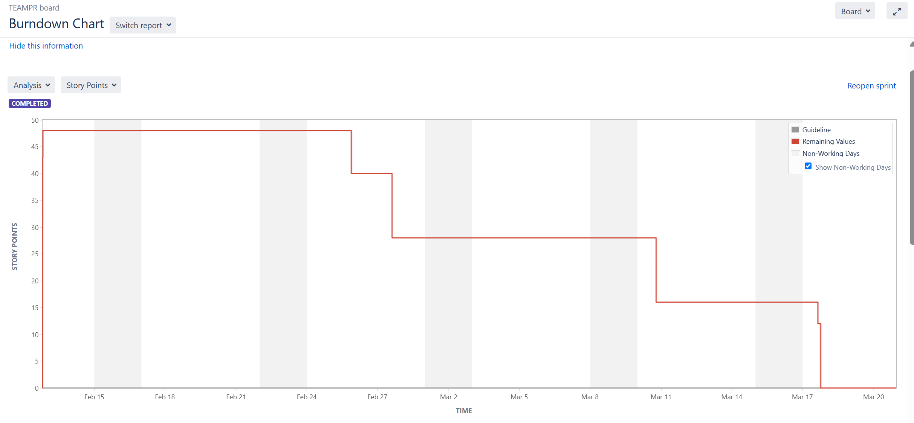
Burndown Chart

Slide 21
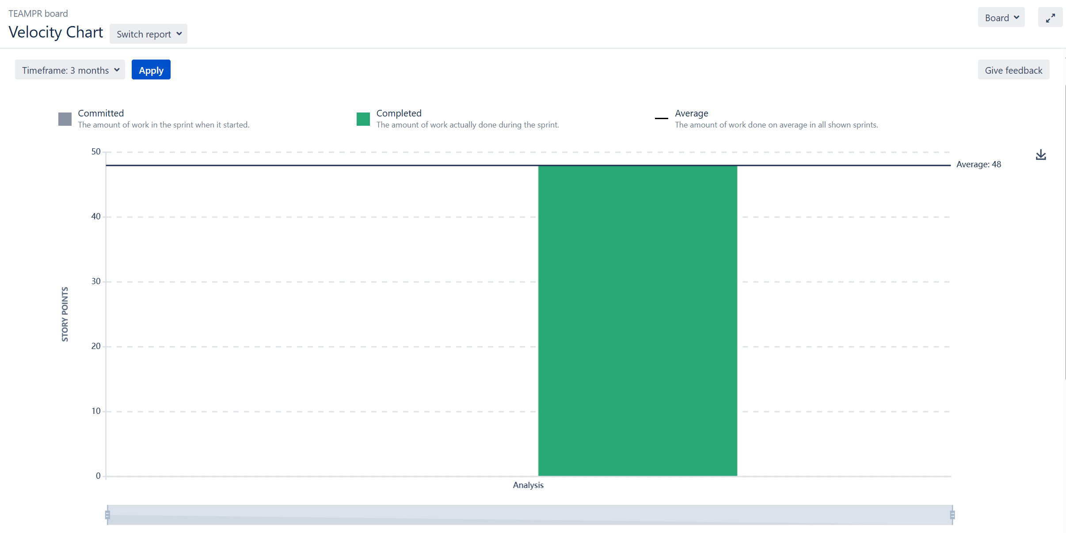
Velocity Chart

Slide 22


Link for Our GitHub and Notebook
GitHub
Final Google Colab Notebook

Slide 23


