Slide 1

REAL ESTATE ANALYSIS FOR PROPERTY PURCHASE IN GEORGIA​
By: Niko Melas, Nazmun Nahar, Tran Truong
Client: Dr. Anca Doloc Mihu
Team: Squad

Slide 2

Project Description
Our project uses a detailed real estate dataset, along with other useful data, to help a client make a smart decision when buying property in Georgia. By analyzing key market factors, we provide valuable insights to ensure they make the best investment choice.

Slide 3



Role
Nazmun Nahar
Visualization
Project Manager
Niko Melas
Data Modeler
Project Documenter
Tran Truong
Client Liaison
Data Analyzer

Slide 4
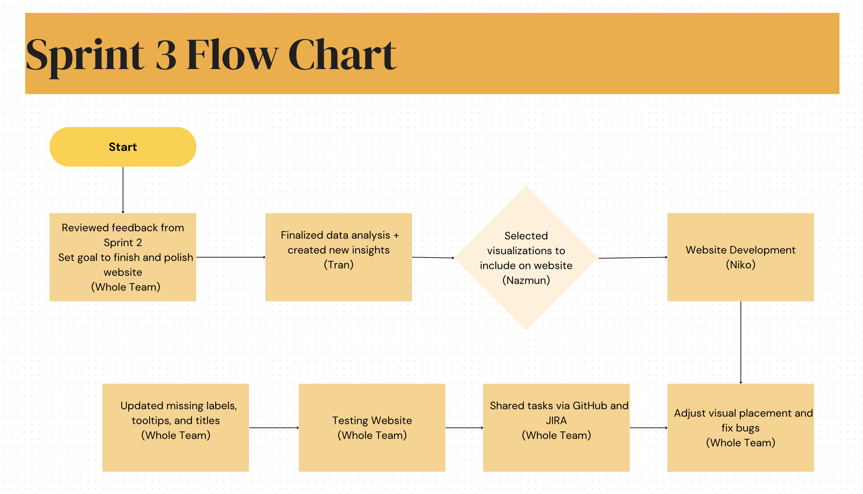
Flow Chart

Slide 5
Future Feature
Expand the Dataset to include more States and newer housing market trends.
Real-Time Data Integration for updating crime, health, and job metrics.
Implement Advanced Filtering Options on the website (e.g., filter by county, crime level, job market)

Slide 6
Goal for Sprint 1
Collect (real estate, health, labor, and crime datasets from public sources (Kaggle, Data.gov))
1
Define project objectives and key research questions
2
Clean and preprocess datasets (remove duplicates, convert data types, standardize county names)
3
Plan initial hypotheses related to property value, crime rate, labor force, and hospital access
4
Set up project tools: GitHub repo, Google Colab for analysis, and JIRA for task tracking
5

Slide 7
Goal for sprint 2
Finalize cleaned datasets for (real estate, crime, labor, and hospitals)
Perform data merging and transformation by county
Meet as a team to review hypothesis direction and assign tasks
Run exploratory analysis and generate preliminary charts (e.g., bar charts, scatter plots, maps)
Start building the website layout and decide on design elements
Integrate early analysis tools (e.g., correlation plots, trendlines) into the colab notebook.

Slide 8
Goal for sprint 3
Finalize and embed key visualizations (crime, hospital access, labor, unemployment) onto the website
1
Improve website layout and styling for a better user experience
2
Add written insights for each hypothesis directly on the site
3
Prepare the website for public presentation at CREATE
4

Slide 9


