Slide 1
Iteration 3
Capstone Project
4/26/2022
Samuel Dean & Matthew Bauer
CLient: Tom Coffin

Slide 2
Team members
Roles
Samuel Dean
Project Documenter
Visualization
Data Analyzer
Matthew Bauer
Project Manager
Data Modeler
Data Analyzer
Tom Coffin
Project Client

Slide 3

Our project
Tornados in the Last Century
We worked with our client Tom Coffin to analyze a dataset featuring tornados recorded in the United States from 1950 to 2015
Our main goal is to determine if tornados are becoming more frequent, causing more deaths and injuries, and are becoming larger and stronger

Slide 4

Technologies
Jupyter Notebooks
DeepNote
Github
Jira
HTML through w3schools
Python libraries

Slide 5
Hypotheses

Slide 6
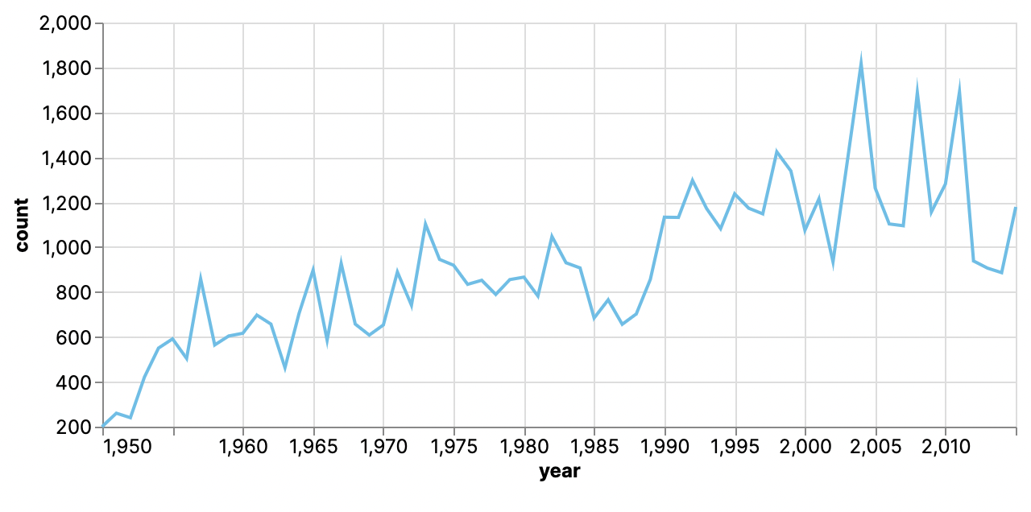
Tornados are becoming more frequent
The total count of tornados per year was calculated and graphed on a simple line plot
Linear Regression was used to determine how strong the trend line is
There is certainly a noticeable upward trend to show that more tornados are happening in the last 20 years

Slide 7
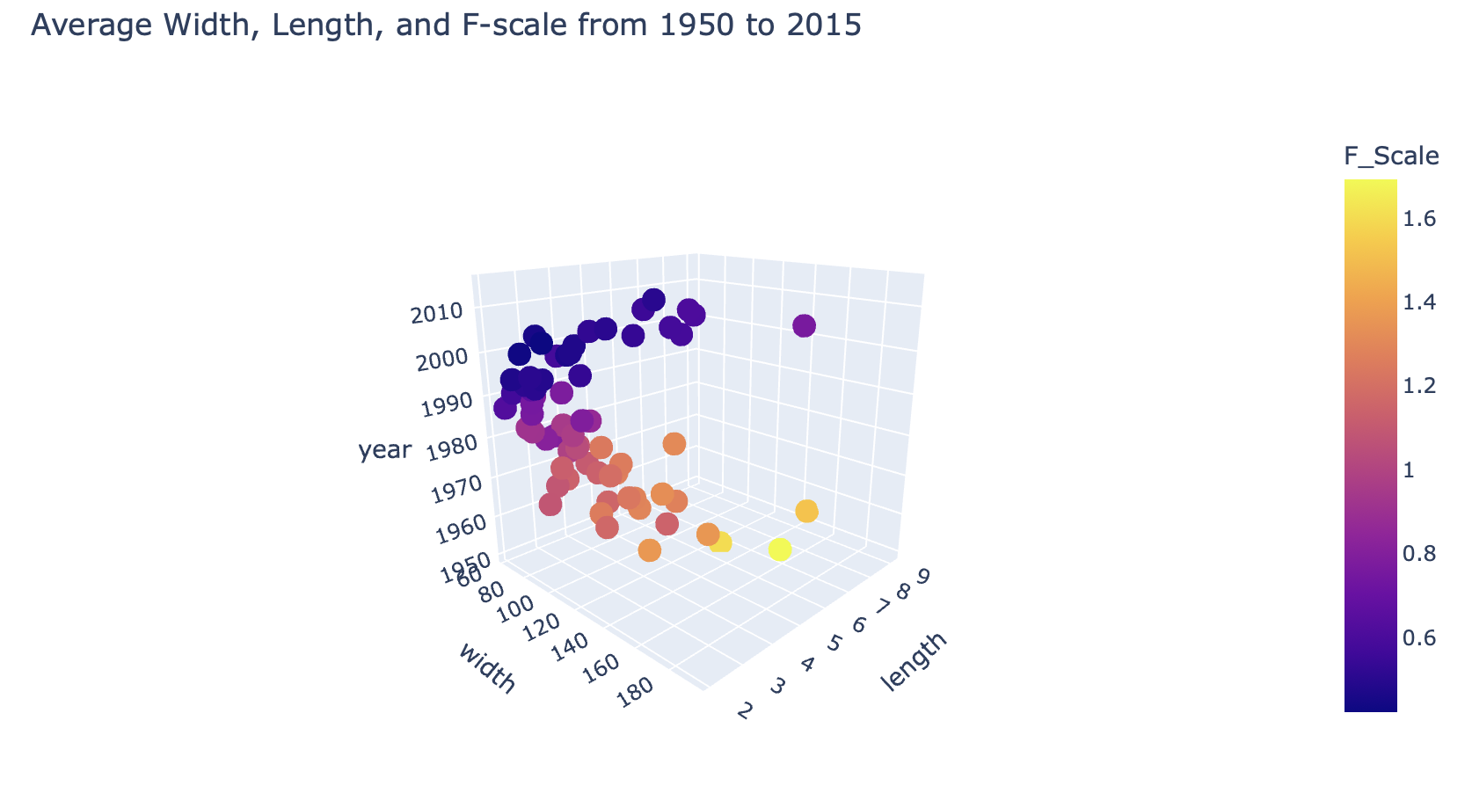
Tornados are getting longer and wider
For this hypothesis, the average length and average width of tornados each year were calculated
A 3D plot shows how both width and length trend downwards from 1950 to 1985 and then upwards till around 2012
Both average width length doubled from 1995 to 2010

Slide 8
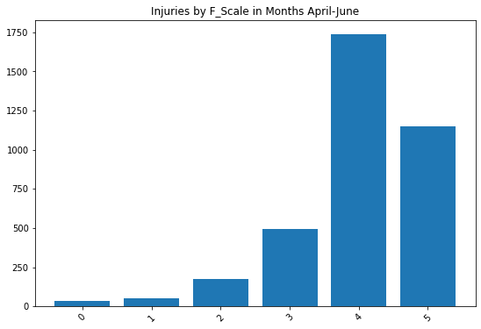
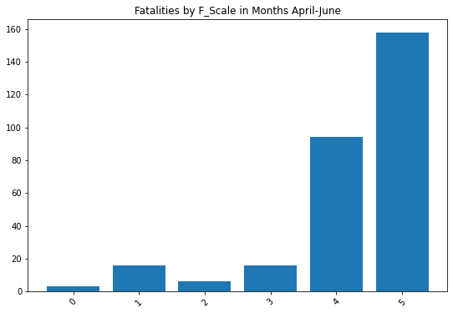
f-Scale 5 Tornados are the most deadly
For this hypothesis, I have found out that based on the average for each F_Scale, that an F_Scale 5 has far more injuries, fatalities, and property loss.
However total count of injuries and fatalities are more for tornadoes with an f_scale of 4

Slide 9
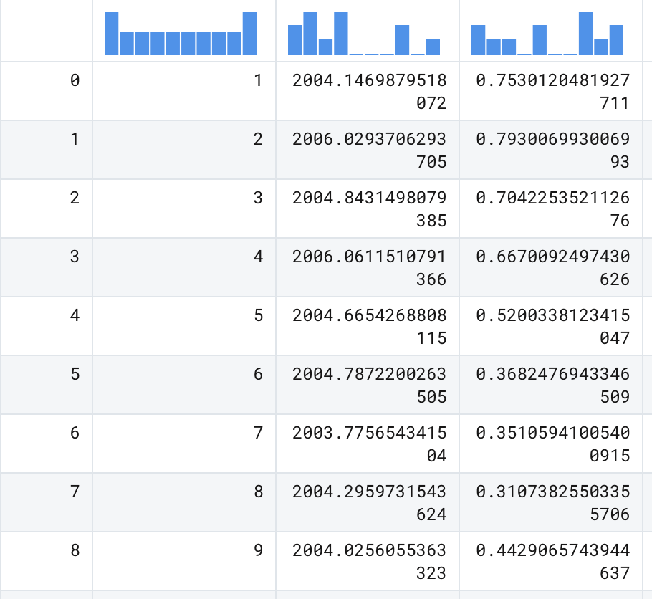
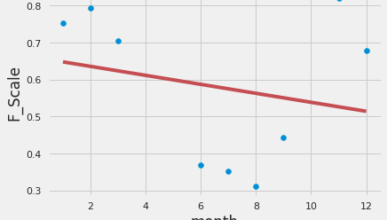
Warmer months is the highest chance for Higher F_Scale tornados to occur in last 20 years
Based on this hypothesis, we have found that the first three months of the year are when the average F_Scale is at its highest.
The middle of the year is when its at its lowest
Shows that F_Scale goes down the deeper in the year you go
Caption
Caption

Slide 10
Future TO-DO List
Further Data to Explore
Analyzing more of the location data provided which includes latitude and longitude
Implement more complex machine learning algorithms
Introduce new datasets that record more recent data (2016-2022)

Slide 11
Website Demo
Github
Notebook

