Slide 1
SIOS Sustainability Pledge
UI Mockup
Team Green Machine – Fall 2020
Trevor Lee, Cesar Lopez, Jonathan Roof, Angel Mercado
Notes:
17

Slide 2
Team Management
Trevor Lee

Slide 3
Client’s Vision
Client: Student Innovators Organization for Sustainability
Main Purpose: To record the GGC’s community’s pledges to sustainability practices
Give users info about the organization’s projects
Allow users to get involved in the organization
Provide relevant current events and news concerning the organization

Slide 4
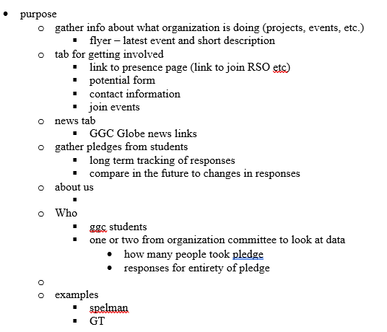
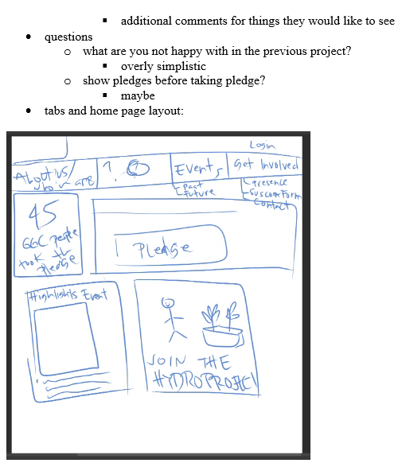
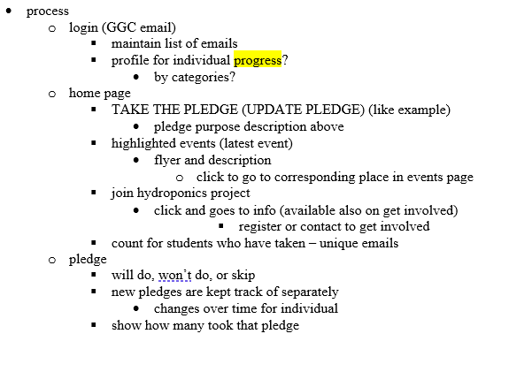
Client’s Vision

Slide 5
Agile and Team Composition
Team skills
Team members’ completed classes
Team members’ personal goals

Slide 6
Agile
Adapting to change
Communication
Involving the customer
Organization
Iteration
I.N.V.E.S.T.
Scrums

Slide 7
Requirements
Login System
  As a GGC user, I want to enter login information by clicking a link in the top right corner of the page, so I can have access to taking the sustainability pledge.
Home page
  As a user, I want to access all navigation tabs and pages from the home screen, so I can access the other sections of the site.
Sustainability Pledge Survey
  As a verified GGC user, I want to select different sustainability pledges, so I can record my responses to committing to certain sustainability practices

Slide 8
User Stories
Profile Page
Login
About Us
Get Involved
Events
News

Slide 9
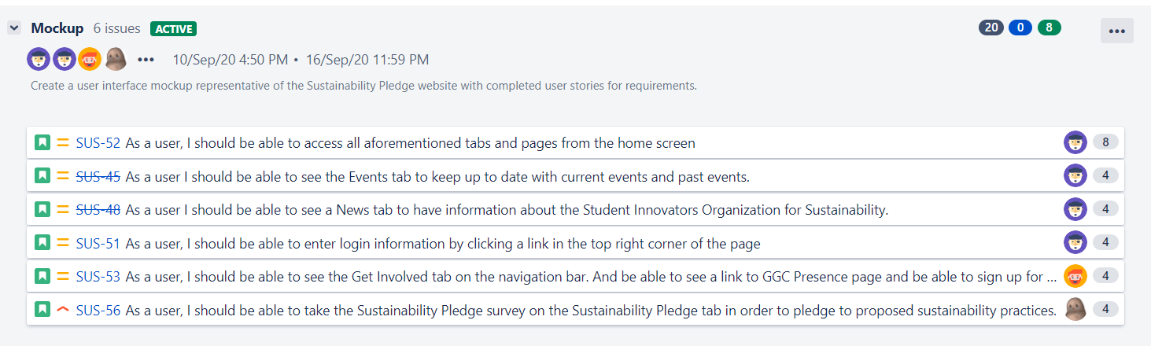
First Iteration
UI Mockup/Demo
  Working HTML and CSS of main site pages and features
  Working navigation between each page

Slide 10
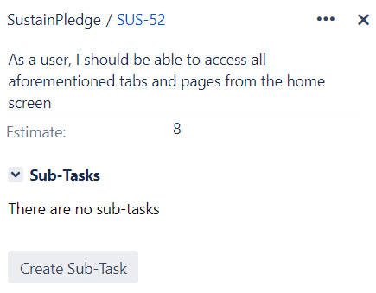
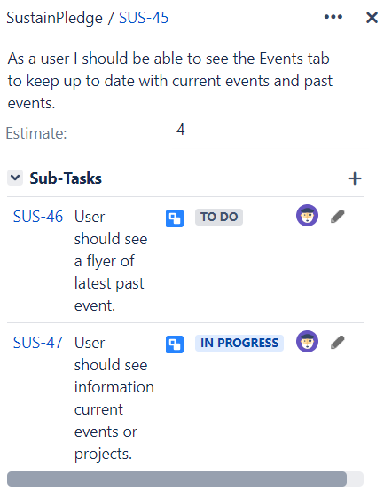
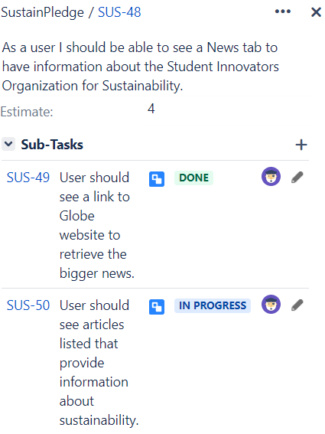
First Iteration

Slide 11
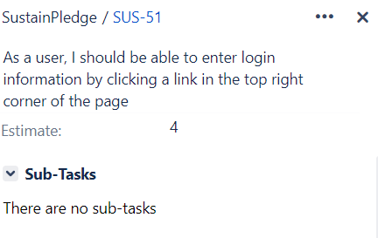
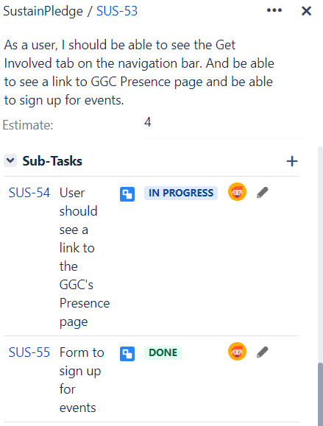
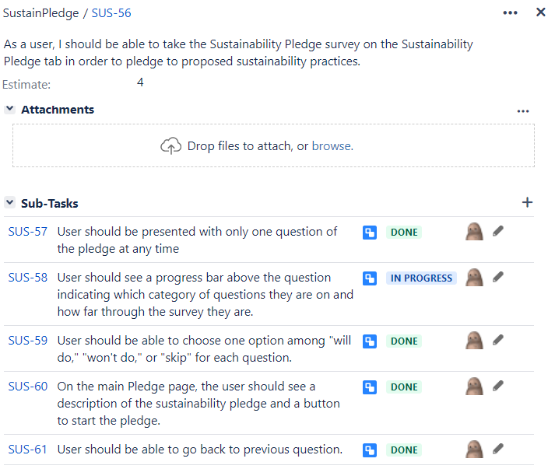
First Iteration

Slide 12
Upcoming Semester Plans
UI Mockup: 9/17
Functional Software: 10/8
Create Symposium: 11/12

Slide 13
Code Architecture
By: Cesar Lopez – The Green Machine

Slide 14
Framework/Languages/Technologies/IDE
HTML5, CSS, JavaScript, TypeScript
Angular10
Github, Node, Firebase
Visual Studio Code

Slide 15
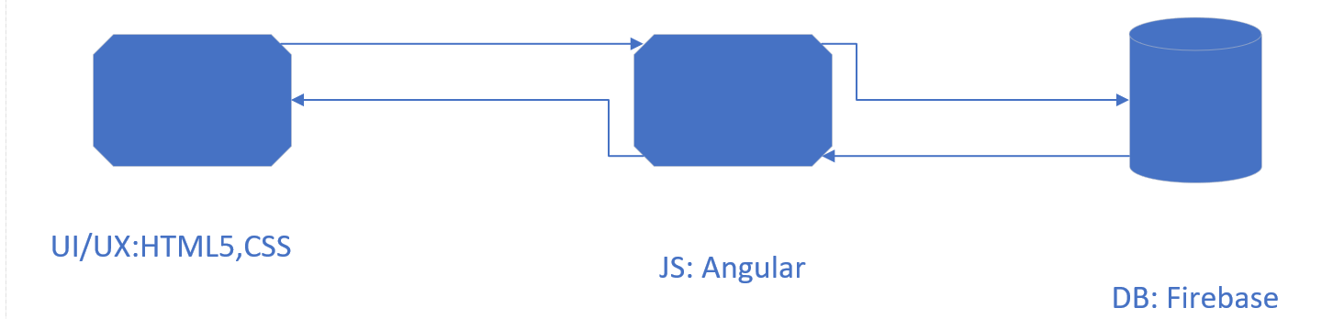
Diagram

Slide 16
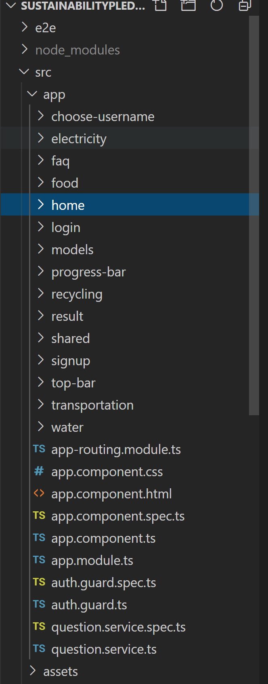
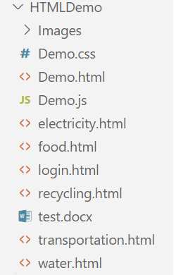
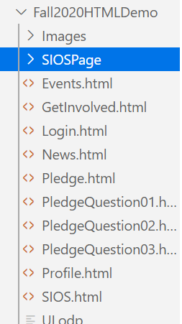
Folder Structure

Slide 17
What’s next?
Start getting the interactions to work
Connecting the database

Slide 18
SIOS Sustainability Pledge
UI Mockup
Jonathan Roof – Team Green Machine – Fall 2020

Slide 19
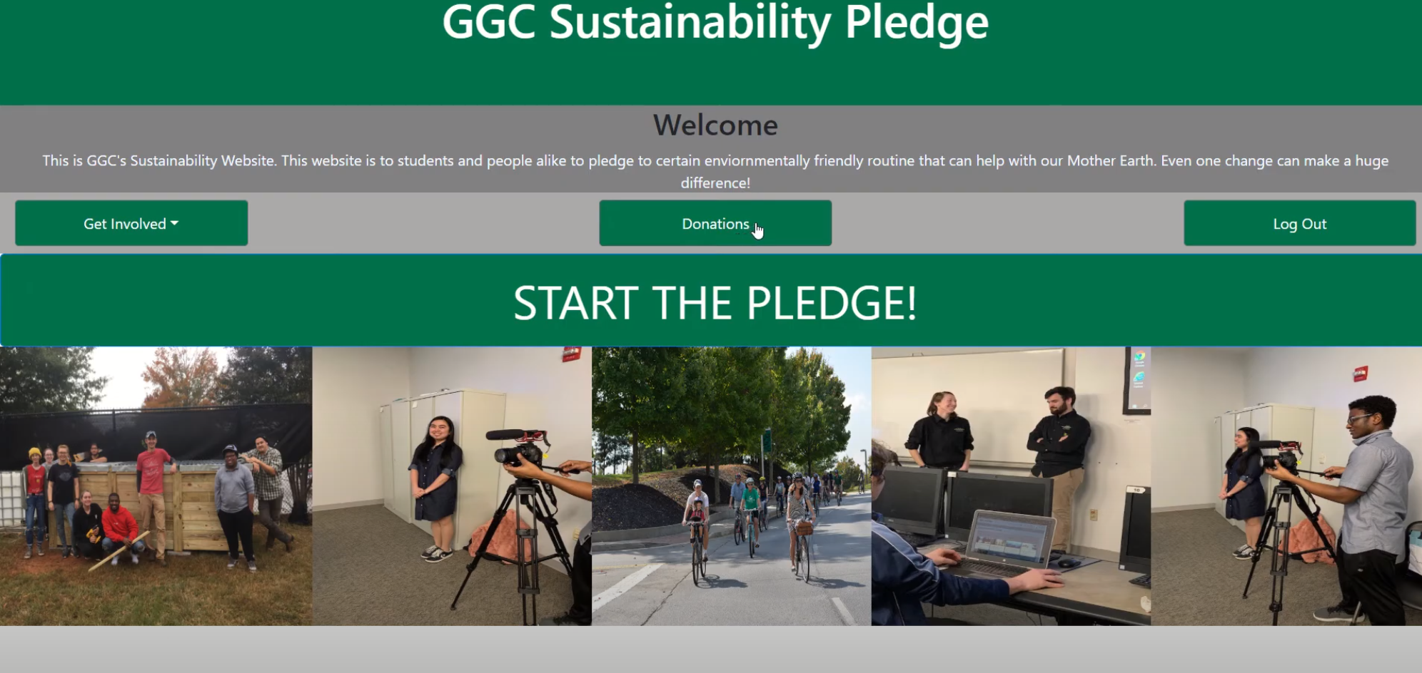
Before: Landing Page

Slide 20
Before: Landing Page - Issues
1. Logo is not present on the header.
2. Welcome text separates navigation buttons from header.
3. Buttons are chunky and have too much space between them.
4. Images are stretched and squashed instead of cropped, and have less space due to the aforementioned issues
5. News and Profile pages missing.

Slide 21
Mockup Activity Diagram
SIOS.html
Homepage
“Pledge” Button
-
Login.html
“News” Button
-
News.html
“Profile” Button
-
Profile.html
“Get Involved” Button
-
GetInvolved.html
“Login” Button
-
Pledge.html

Slide 22
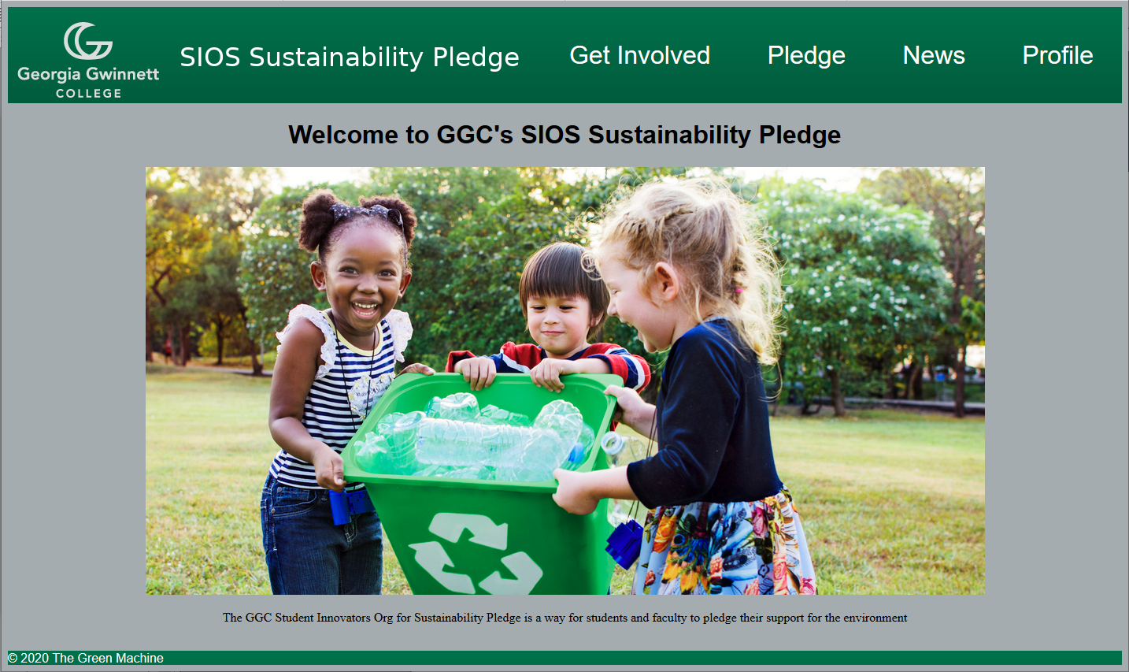
Mockup Screenshots

Slide 23
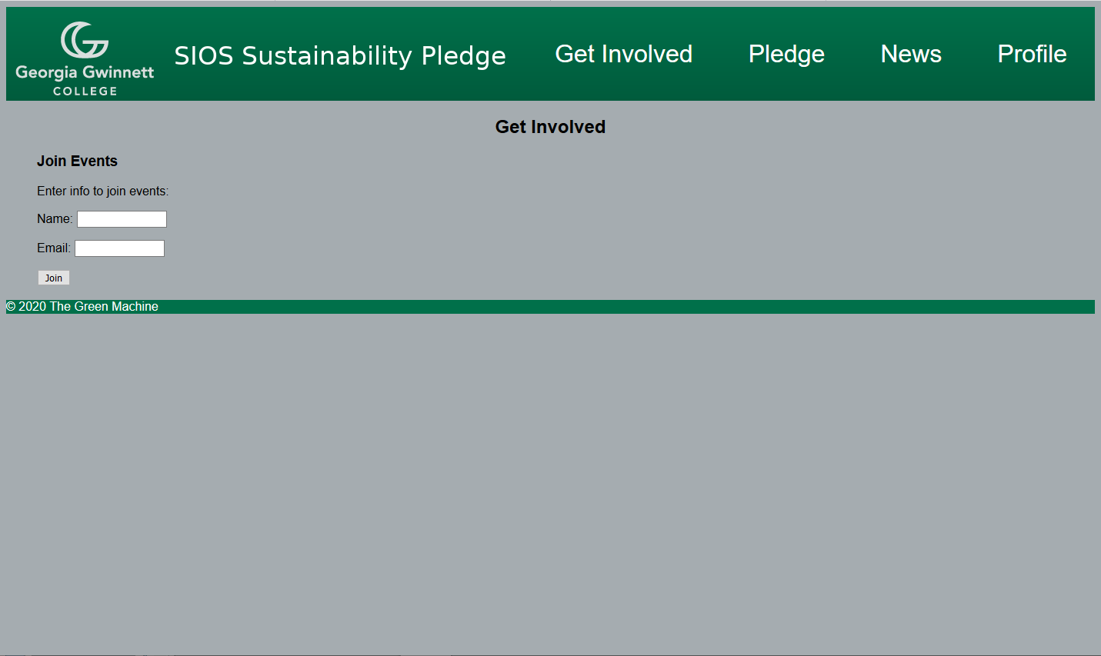
Mockup Screenshots

Slide 24
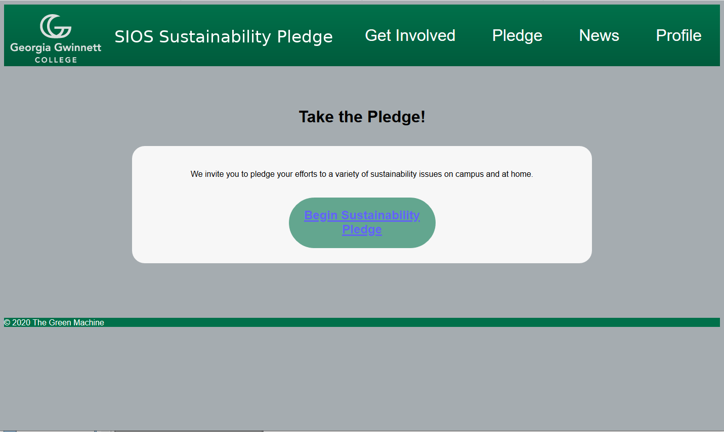
Mockup Screenshots

Slide 25
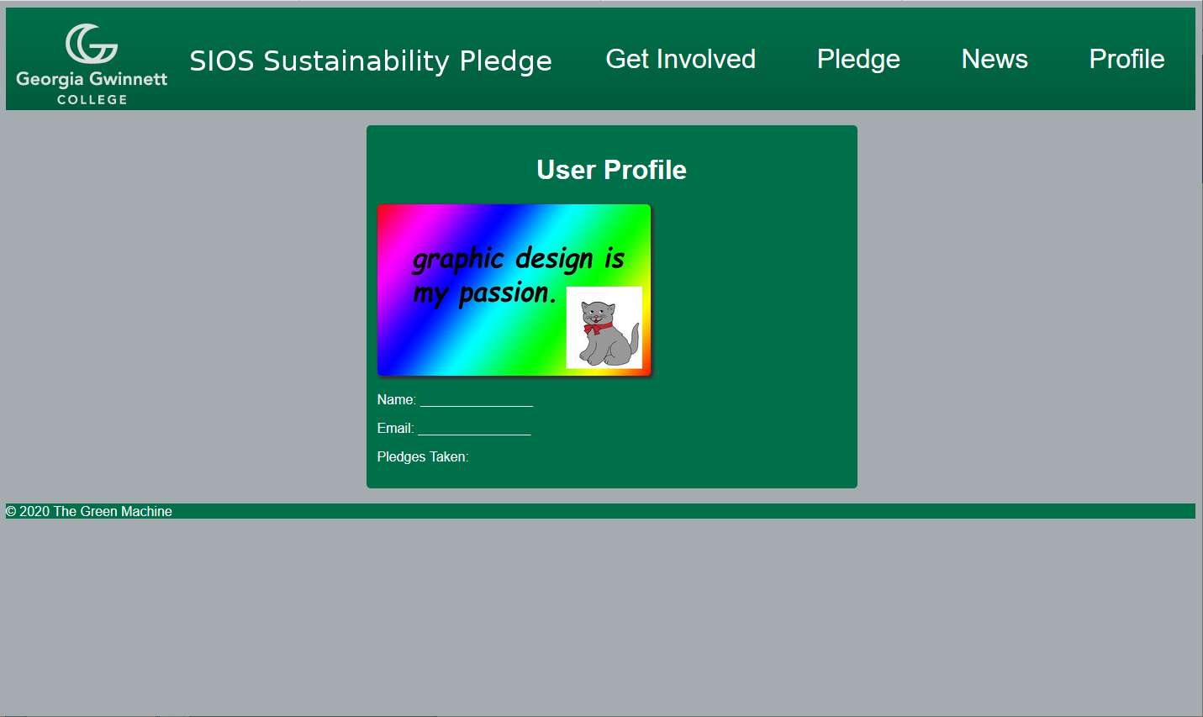
Mockup Screenshots

Slide 26
Future Changes
1. Login will be checked and “Profile” or “Login” buttons will appear depending on login status.
2. Pledge button will only lead to login page if user is not logged in.
3. Add counter for number of pledges signed to home page
4. Enabling editing of the profile, determine if profile pic is needed in client meeting.
5. Ensure page scaling doesn’t cause nav bar overlap with the logo.

