Slide 1

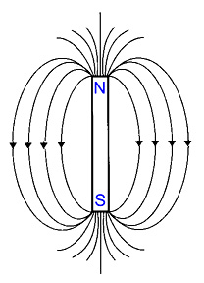
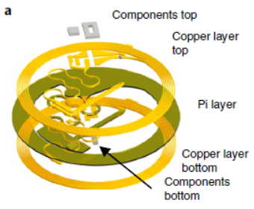
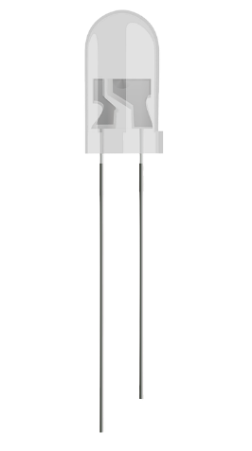
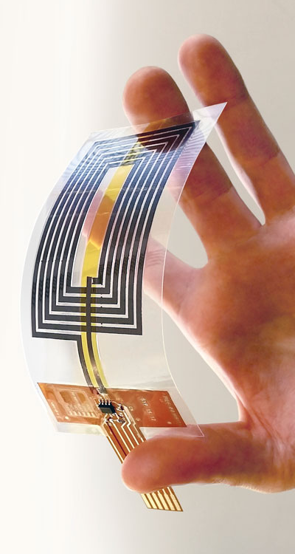
1. Purpose of the device
Given a magnetic field that provides power to the device by the antena, the device should turn on an LED in a specific área of the brain

Slide 2
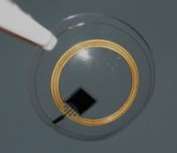
2. Modules of the device
Antenna
Circuit
Circuit
shank
Neural Interface
Encapsulation

Slide 3
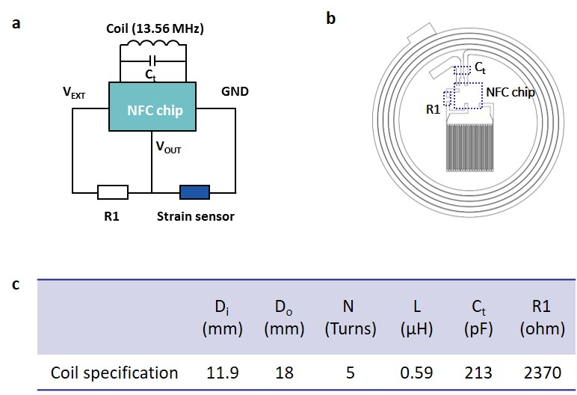
3. Antenna

Slide 4
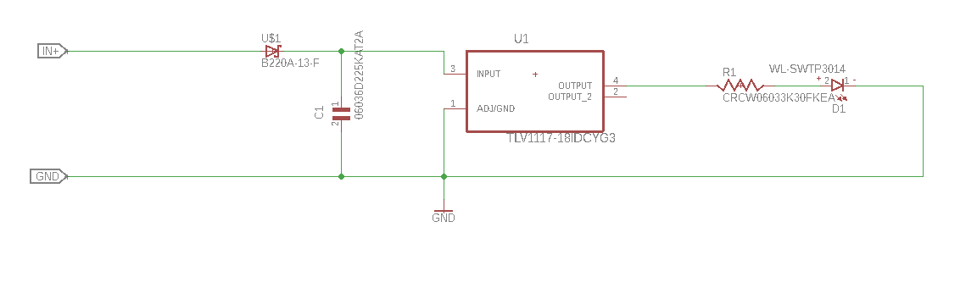
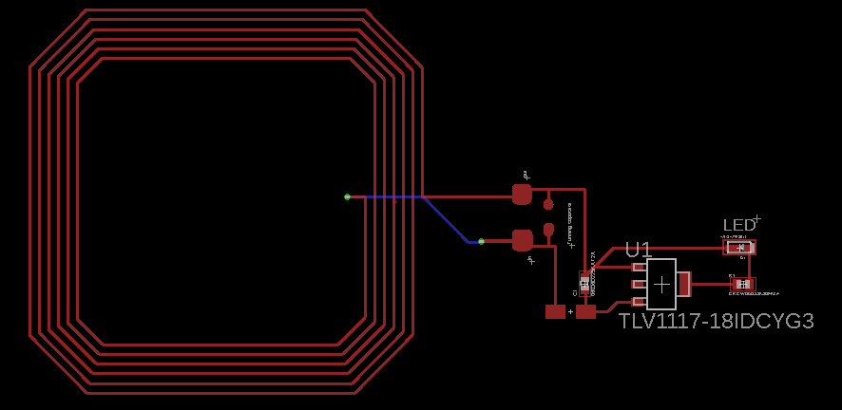
4. Circuit

Slide 5
5. Why this design?
Pros and cons of this design:
+ Easy to reduce size of antena → Antenna and circuit are separate.
+ Easy to model the shank as separated from the rest of the device.
+ more length to the shank → Can reach more deep in tissue.
+ better encapsulation.
- Lenght of the shank can cause a voltage drop.

Slide 6
6. Next steps
Design antena for our device dimensión 2x2cm
Design shank of LED
Develope coating model of the device
Think about the final prototype of the device
Research about LED soldering
Test mechanical propoerties of final device
Find onchip rectifier
Improve efficiency of circuit

