Slide 1

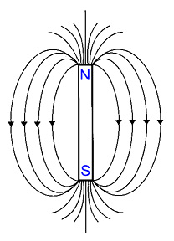
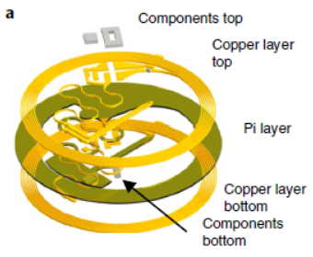
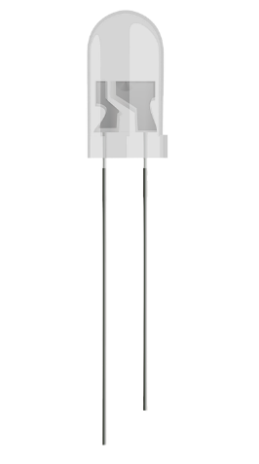
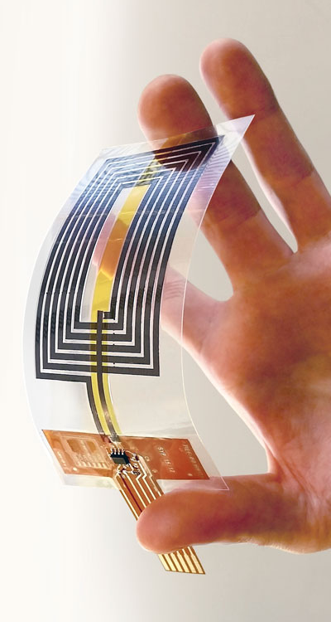
1. Purpose of the device
Given a magnetic field that provides power to the device by the antena, the device should turn on an LED in a specific área of the brain

Slide 2
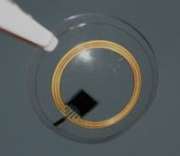
2. Modules of the device
Antenna
Circuit
Circuit
shank
Neural Interface
Encapsulation

Slide 3
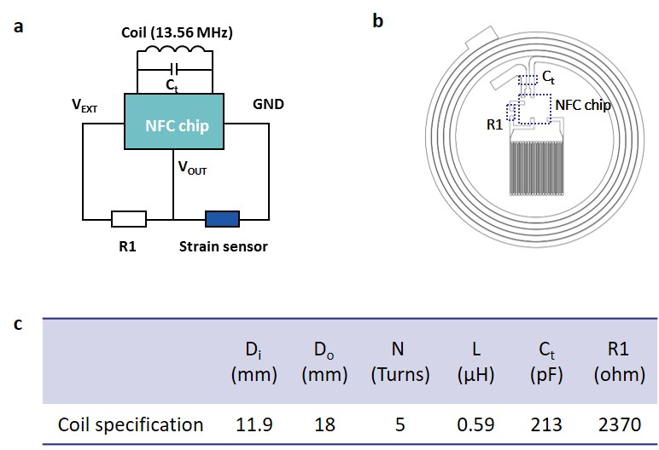
3. Antenna

Slide 4
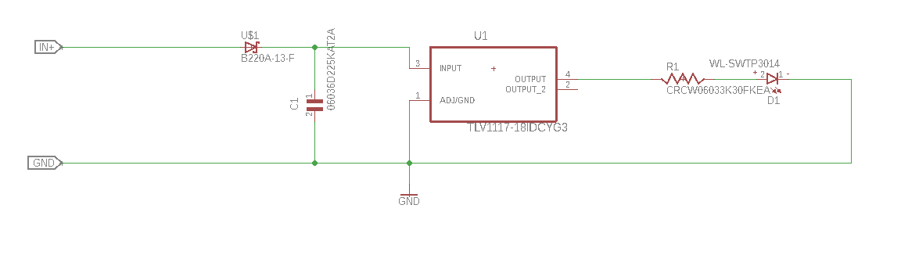
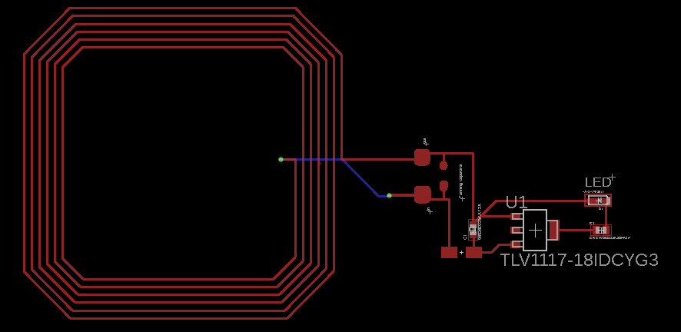
4. circuit

Slide 5
4. circuit
Pros and cons of this design:
+ Easy to reduce size of antena
+ Easy to model the shank as separated from the rest of the device
+ more length to the shank
+ better encapsulation
-

