Slide 1
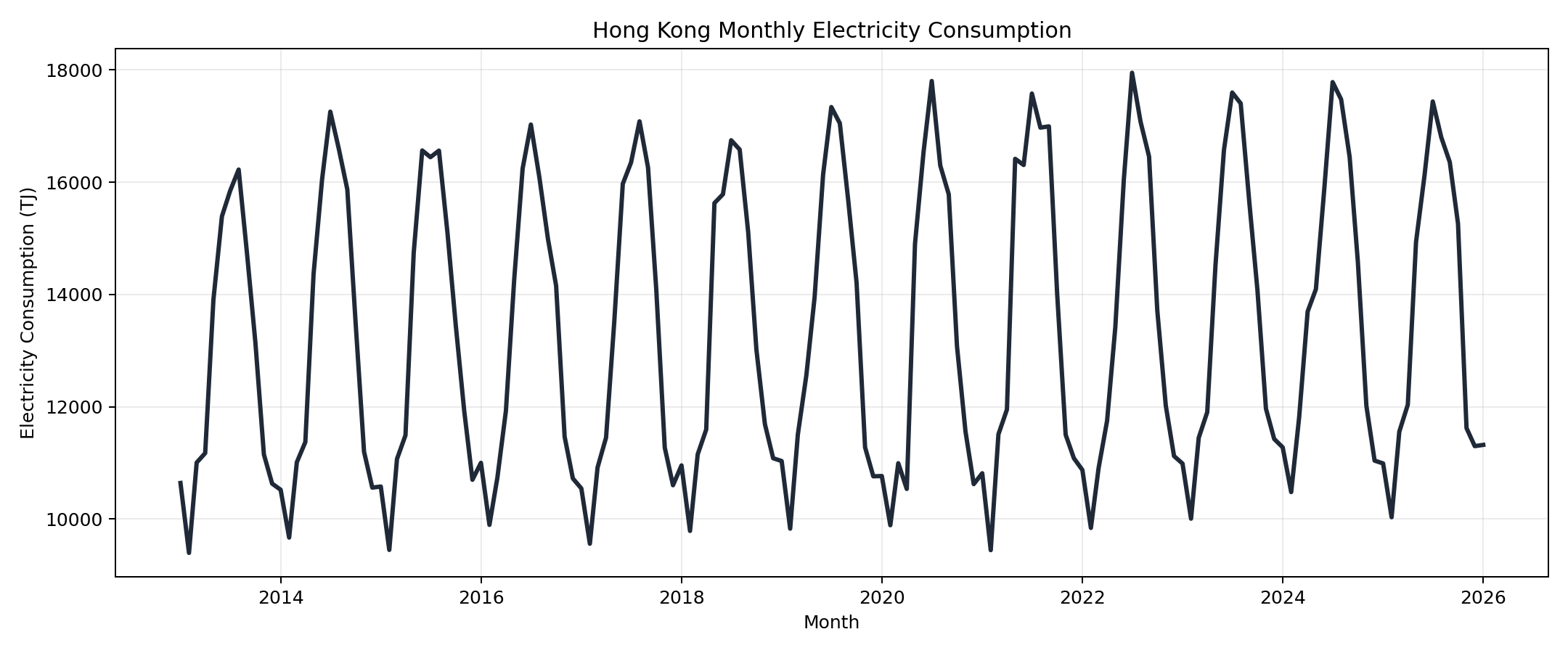
???????
????????????????????????????????
???? raw?silver?model?result ??
?????? city_monthly_train_ready.csv
????? 157 ??96 ??????? 2013-01 ? 2026-01
??????????? footprint?????????????
???? target_electricity_total_t_plus_1m
Hong Kong Monthly Electricity Forecasting

Slide 2
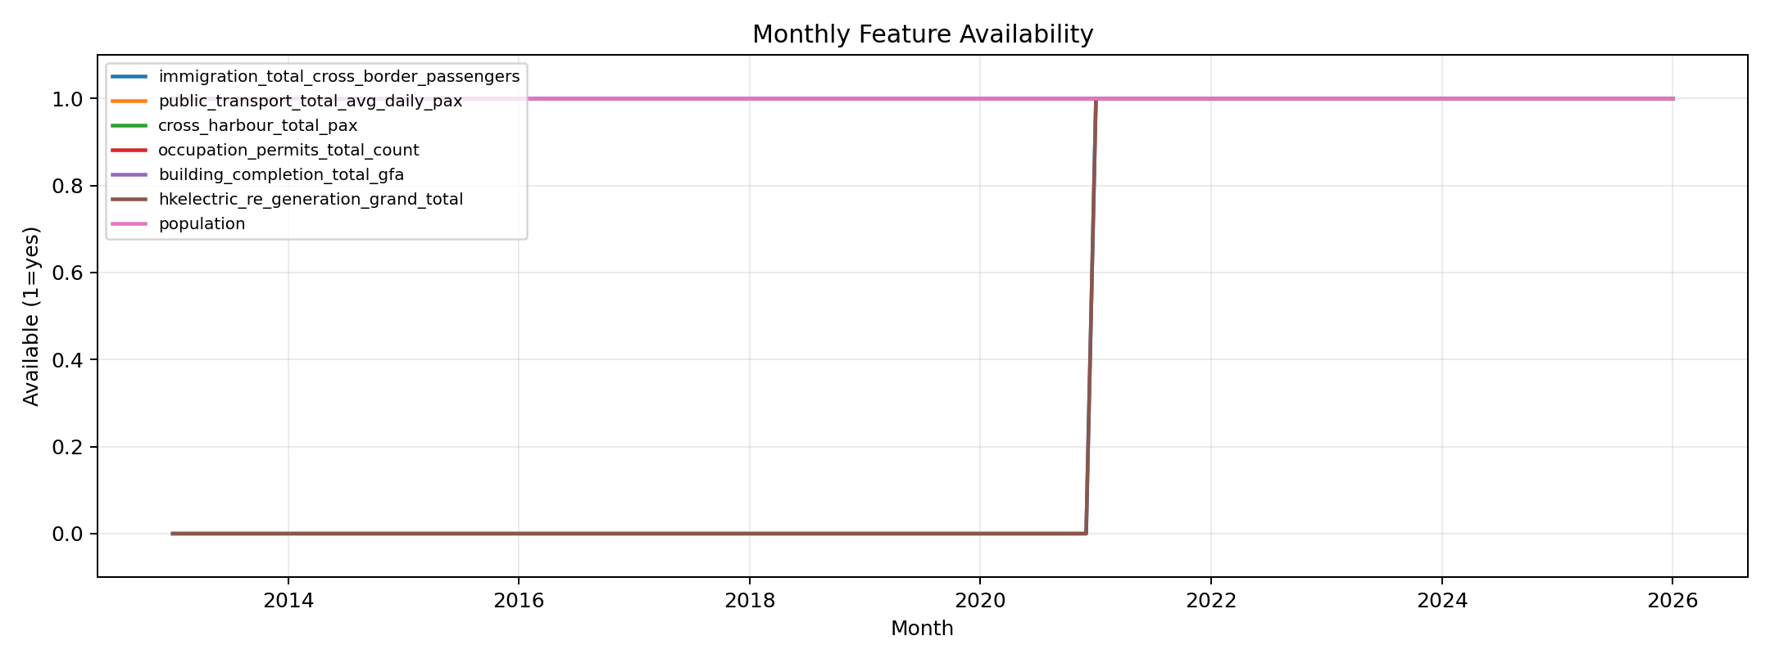
??????
?????? C&SD ??????
???????????????????????????? Buildings Department ???????
?????????????????????
????????? silver ???????????
????????????????occupation permits??????????????
???????????? train-ready ???
Hong Kong Monthly Electricity Forecasting

Slide 3
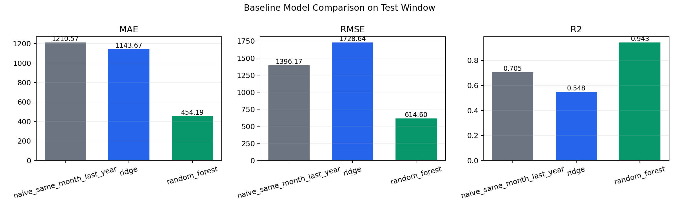
?????
??? baseline ?? seasonal naive?ridge regression ? random forest
Random Forest ???MAE 454.19?RMSE 614.60?R2 0.9429
Simple regression ??? electricity_lag_12m
Multiple regression ???????????????????????????
Simple regression?MAE 1155.41?RMSE 1346.22?R2 0.7261
Multiple regression?MAE 684.98?RMSE 857.50?R2 0.8889
?????????????????????????????
Hong Kong Monthly Electricity Forecasting

