Slide 1
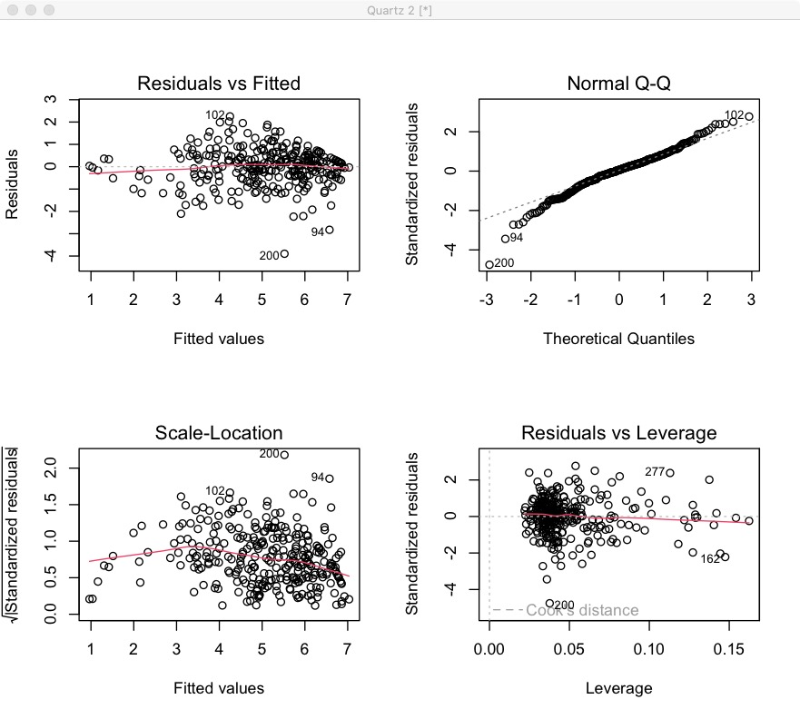
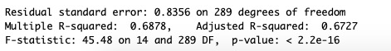
Problem
Finding the best predictive model to identify the level of customer loyalty
Model
OLS regression model predict the customer loyalty by adding interaction, quadratic terms and log transformation term on independent variables.
Model estimation is based on the value of Adjusted R-squared and chose the best features to make the model, achieving the largest Adjusted R-squared.
Process
Data Cleaning
Check and remove irrelevant variables
Check for Diagnostics
Remove outliers according to Cook’s Distance Discipline
Add Interaction and Quadratic terms
Add Log Transformations of predictors
Find the adjusted largest Model of R-Squared and check VIF value
Explanation
Observing the picture of Residuals vs Leverage, we found that there is no influential case, because all cases are well inside of the Cook’s distance lines, and it satisfies the test linearity.

Slide 2
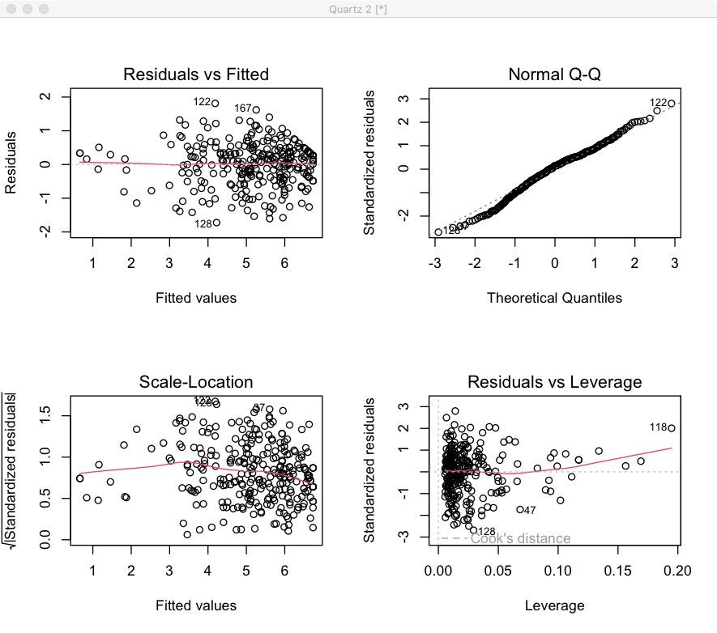

Results
The interaction means that the effect of use value on Loyalty for customers is different for different values of company reputation.
According to quadratic terms, Loyalty for Customer is significantly increasing as Trust Grade increases.
Log transformation on Agent Trust can reduce the skew in this variable and format the presentation of variable into an understandable pattern.
In our model, the most important factors are Use Value and Satisfaction of customers.
We optimized the OLS model and chose the factors above to predict Customer Loyalty, improving R-Squared from 0.6727 to 0.7779.
Limitation
Finding the best predictive model to identify the level of customer loyalty.
As observed in our model, non-constant variances in the residual errors are suggested by the fact that the variability (variances) of the residual points decrease with the value of the fitted outcome variable (or heteroscedasticity).

