Slide 1
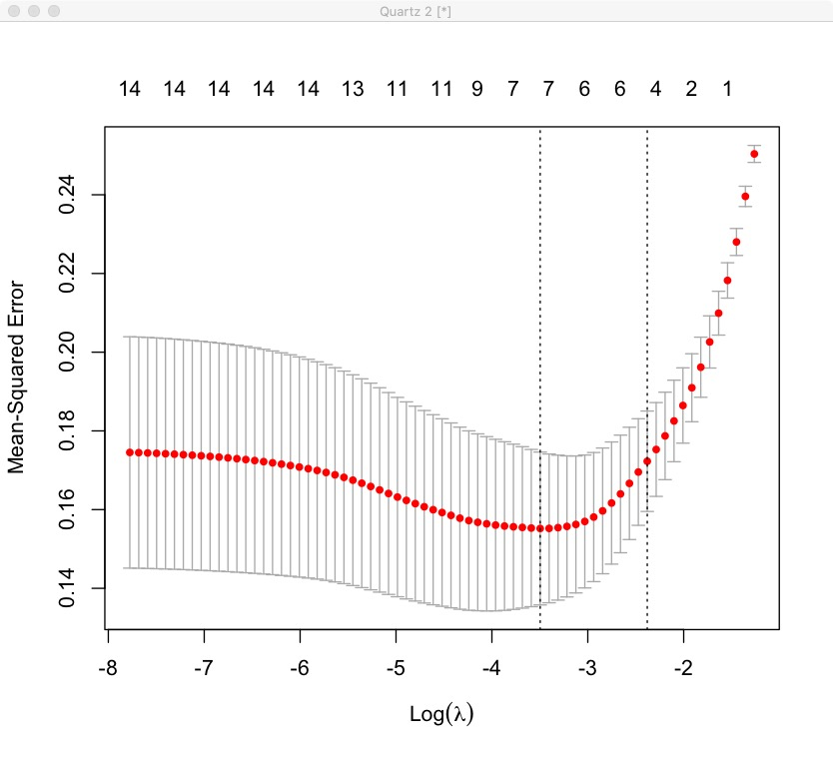
Problem
Finding the best lambda, and using cross-validation to do feature selection
Check the ANOVA test to select the important predictor variables and interaction terms. Build LDA model with normalized predictor variables
Compare the accuracy obtained with Lasso Regression against the one obtained using the full logistic regression model (including all predictors) and LDA model
Analyze important performance metric (confusion metrics ROC and AUC), classification-model-evaluation
Finding the best predictive model to identify the level of customer loyalty
Model
Logistic regression model predict the customer loyalty by optimizing this model with the smallest number of predictors that also gives a good accuracy
For Model estimation, we compare LDA model with Logistic regression model, according to Accuracy, Recall, Precision and F1-score
Process
Data preprocessing and check the correlation of predictors
Randomly split the data into training set (60% for building a predictive model) and test set (40% for evaluating the model)
Using Lasso Regression, compute penalized logistic regression, for automatically selecting an optimal model containing the most contributive predictor variable

Slide 2
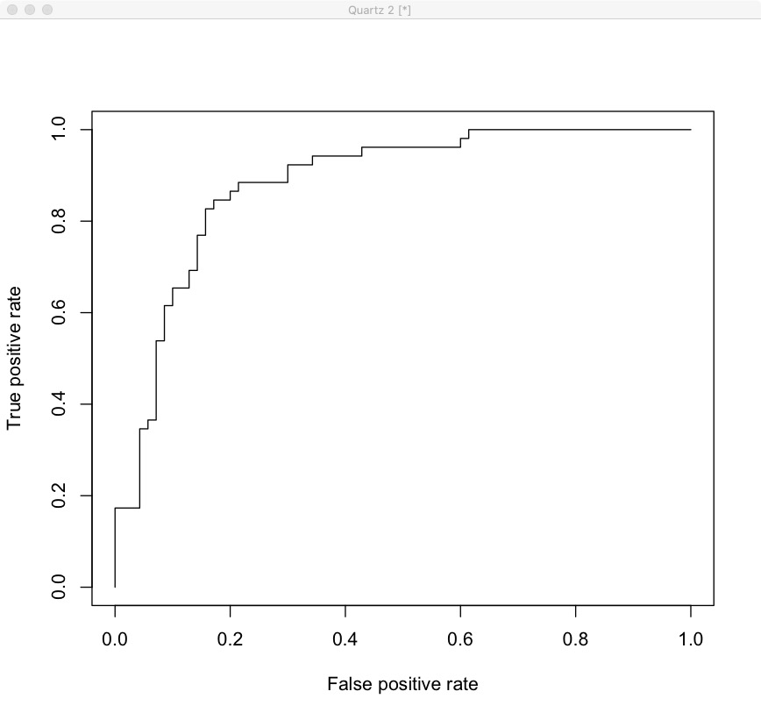
Variables | Coefficient | Value
(Intercept) | β0 | 0.2948
Satis | β1 | 0.8772
VALUE | β2 | 1.0504
Reputa | β3 | 1.6845
sex_male | β4 | -1.2017
CTRUST | β5 | 0.4751
Reputa:sex_male | β6 | -0.9256
VALUE:Reputa | β7 | -0.8668
Confusion matrix
 | True
Pred | 0 | 1
0 | 58 | 9
1 | 12 | 43
Difference
Results
LDA works when all the independent variables are continuous (not categorical) and follow a Normal distribution. Whereas in Logistic Regression this is not the case and categorical variables can be used as independent variables while making predictions
Linear discriminant analysis is more suitable for predicting the category of an observation in the situation where the outcome variable contains more than two classes
The regression coefficient for use value is 1.0504. This indicate that one unit increase in use value will increase the Loyalty of consumer by exp(1.0504) 2.86 times
Reputa:sex_male occurs if the relation between one predictor, Reputa, and the outcome (response) variable, Consumer Loyalty, depends on the value of another independent variable, sex_male
From the logistic regression results, it can be noticed that some variables like ATRUST, age_1, age_2, etc. are not statistically significant. Keeping them in the model may contribute to overfitting. Therefore, they should be eliminated

