Slide 1
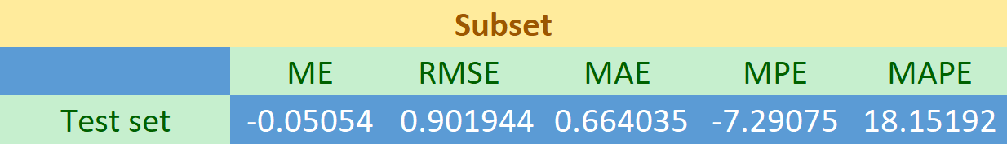
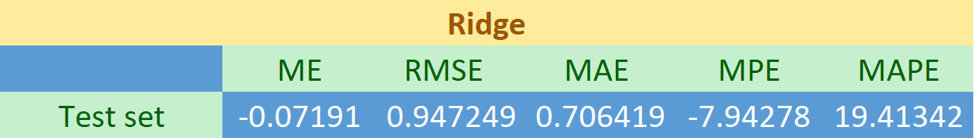
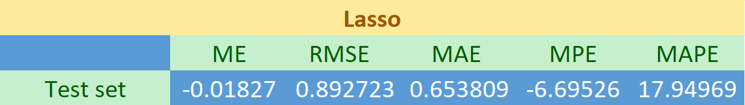
Problem
Process
Finding the best predictive model to identify the level of customer loyalty
Data preprocessing and check the correlation of predictors
Randomly split the data into training set (50% for building a predictive model) and test set (50% for evaluating the model)
Using Lasso Regression, compute penalized logistic regression, for automatically selecting an optimal model containing the most contributive predictor variable
The plot shows the change of each characteristic coefficient according to the change of lambda
Model
Best Subsets Regression
Best subsets regression is an exploratory model building regression analysis. It compares all possible models that can be created based upon an identified set of predictors
Ridge Regression
Ridge regression is a method of estimating the coefficients of multiple-regression models in scenarios where the independent variables are highly correlated.it is a method of regularization of ill-posed problems
Lasso Regression
LASSO is a regression analysis method that performs both variable selection and regularization in order to enhance the prediction accuracy and interpretability of the resulting statistical model
Accuracy

Slide 2
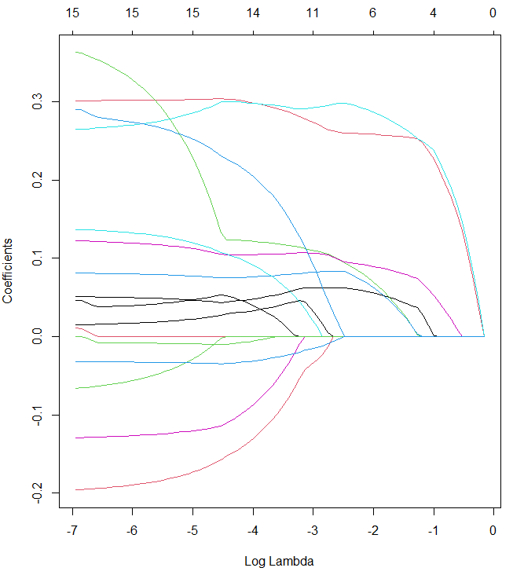
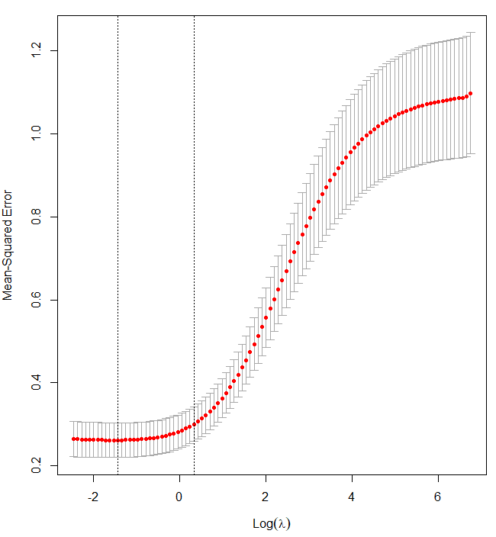
Variables | Coefficient | Value
(Intercept) | β0 | 0.2998
Satis | β1 | 0.1210
VALUE | β2 | 0.2875
CTRUST | β3 | 0.1293
Reputa | β4 | 0.1672
Difference
Results
Lasso is similar to the optimal subset method and completes variable selection. The model built by Lasso is easier to interpret than Ridge regression
Ridge has some disadvantage that the optimal subset, the stepwise method will select a subset of variables for modeling, and the final model of Ridge regression contains all p variables
Lasso is better at feature selection, but ridge generally results in a better overall fit
The Lasso regression coefficient for use value is 0.2875. This indicate that one unit increase in use value will increase the Loyalty of consumer by exp(0.2875) 1.33 times
Regularization term penalizes absolute value of the coefficients (lasso adds a penalty equal to the absolute value of the magnitude of the coefficients multiplied by lambda)
From the Lasso regression results, it can be noticed that some variables like Satis, Value, CTRUST, Reputa, etc. are statistically significant.

