Slide 1
Identifying Interludes in VOCALOID-Related Music
孟令浩，郭冠男
2023-04-19

Slide 2
Content
Background
Pipeline
Project Structure
About MFCC
Feature Abstract
Feature Selection
Related Work
Future Research

Slide 3

Background
周刊VOCLOID中文排行榜
The QR code in the top right corner is for the latest issue of the weekly magazine (2023-04-16 #558).
Music Segment Recognition => Interlude Identification

Slide 4
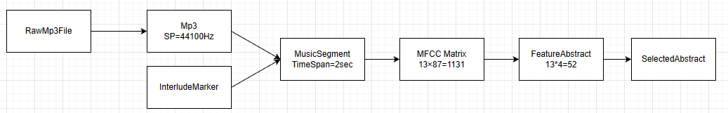
Pipeline
Automated Boundaries
Complete mp3 music file, interlude marker file

Slide 5
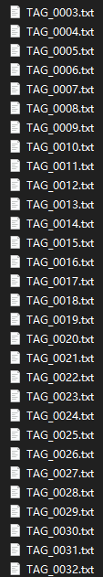
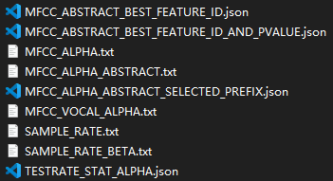
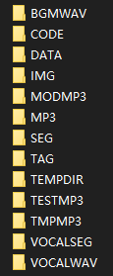
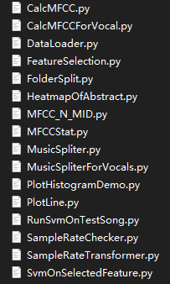
Project Structure
details omitted

Slide 6
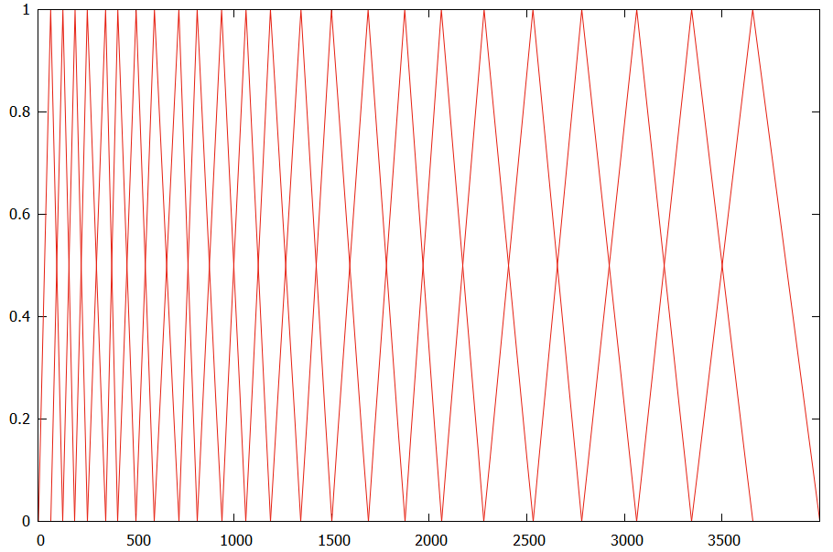

About MFCC
$M\left(f\right)=1125⋅\ln\left(1+\frac{f}{700}\right)=2595⋅\lg\left(1+\frac{f}{700}\right)$
https://zhuanlan.zhihu.com/p/365714663

Slide 7
Feature Abstract
List of log(E) => Min, Max, Avg, Std
(There is a lot of professional knowledge related to music data characteristics here, and it cannot be explained fully in a short period of time.)

Slide 8
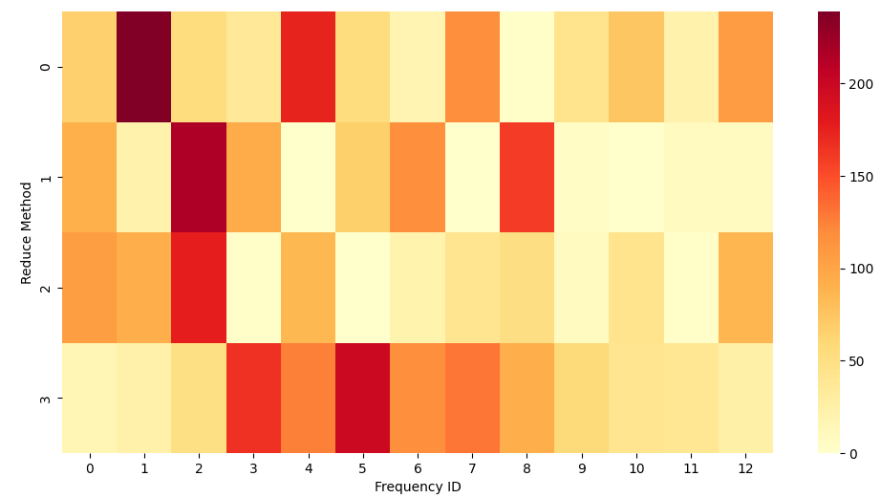
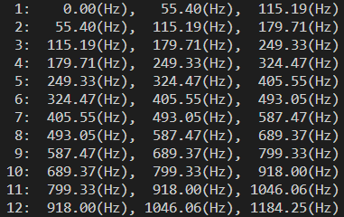

Feature Selection
Ttest: 0-Min, 1-Max, 2-Avg, 3-Std
based on: $−\ln\left(\text{pvalue}\right)$

Slide 9
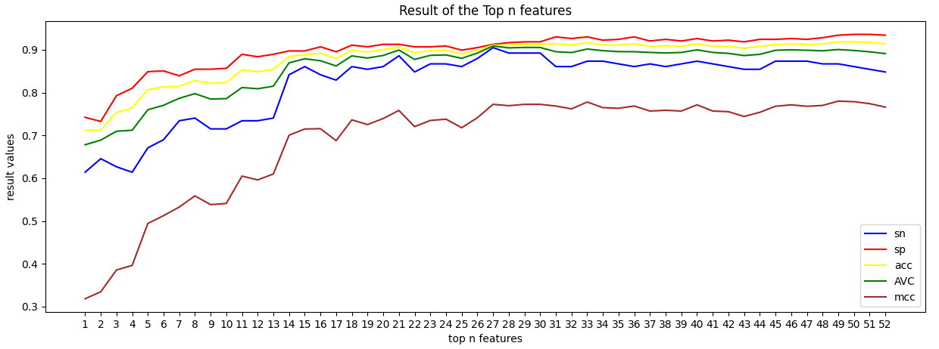

Feature Selection (cont.)
Top 27 Features, SVM(rbf), $sn=90.5\%, sp = 91.3\%$

Slide 10
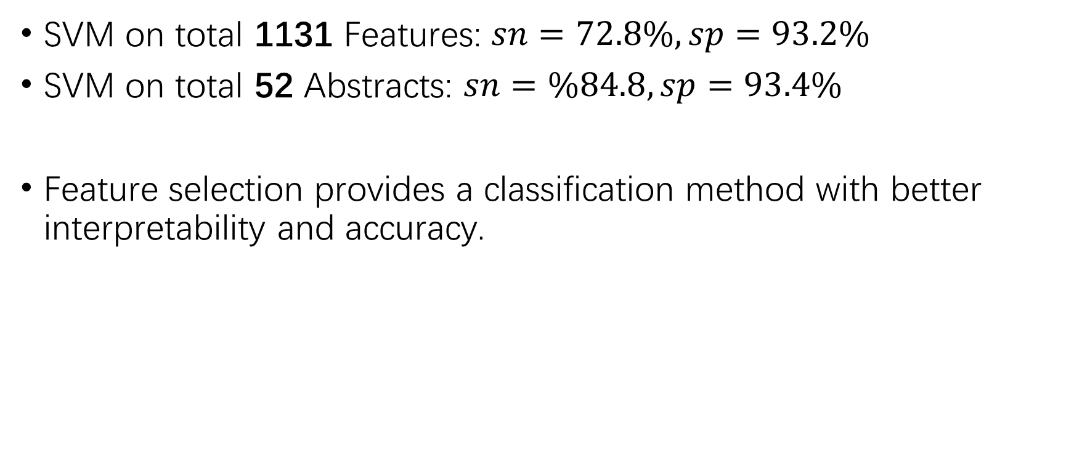
Feature Selection (cont.): Baseline
SVM on total 1131 Features: $sn=72.8\%, sp=93.2\%$
SVM on total 52 Abstracts: $sn=\%84.8, sp=93.4\%$
Feature selection provides a classification method with better interpretability and accuracy.

Slide 11
Related Work
In addition to the aforementioned feature selection, we also attempted to use deep learning models (CNN) for voice extraction, but the optimal classification performance, as measured by SN, was around 84.
After voice extraction, a significant amount of information is lost, which is not sufficient for accurate detection of interludes.

Slide 12
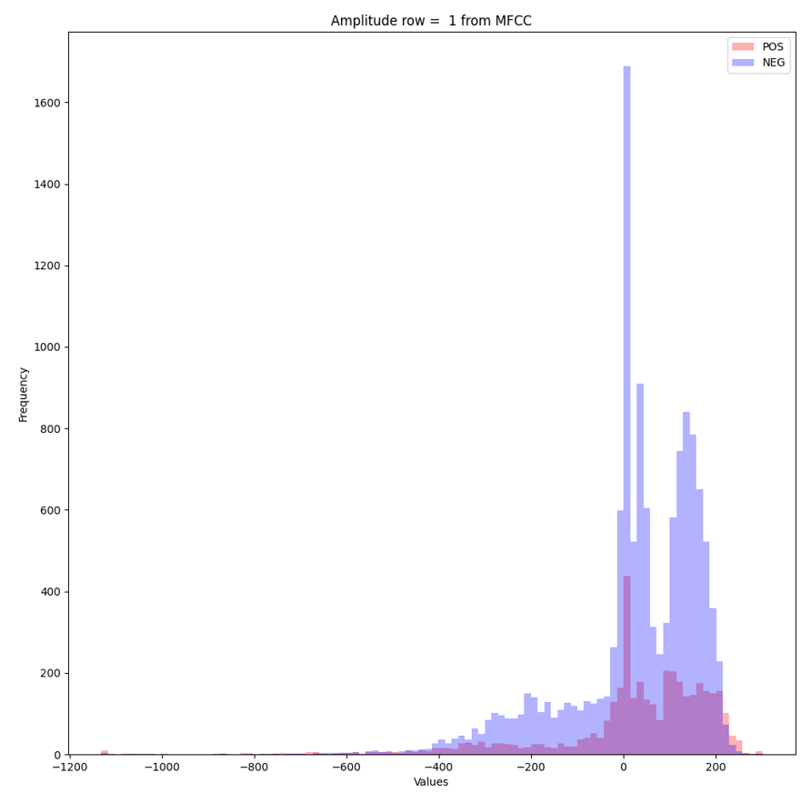
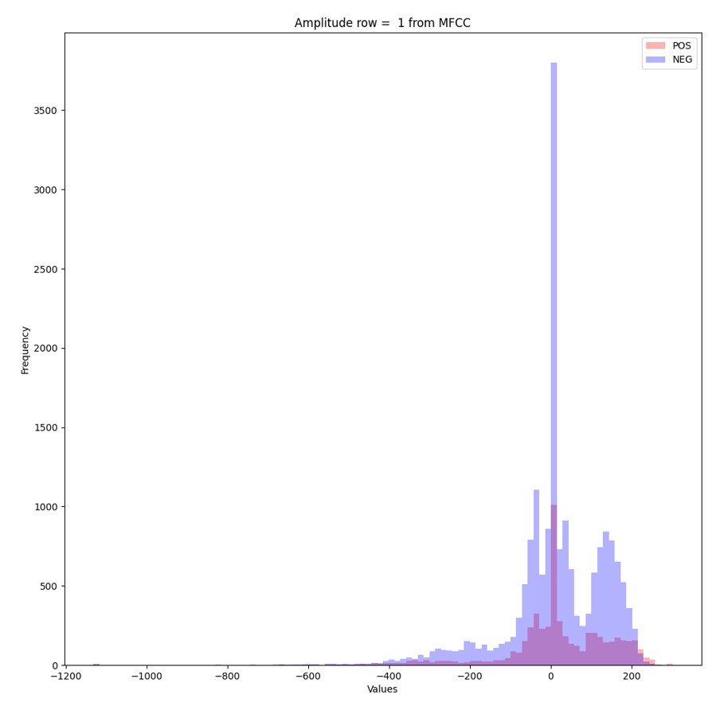
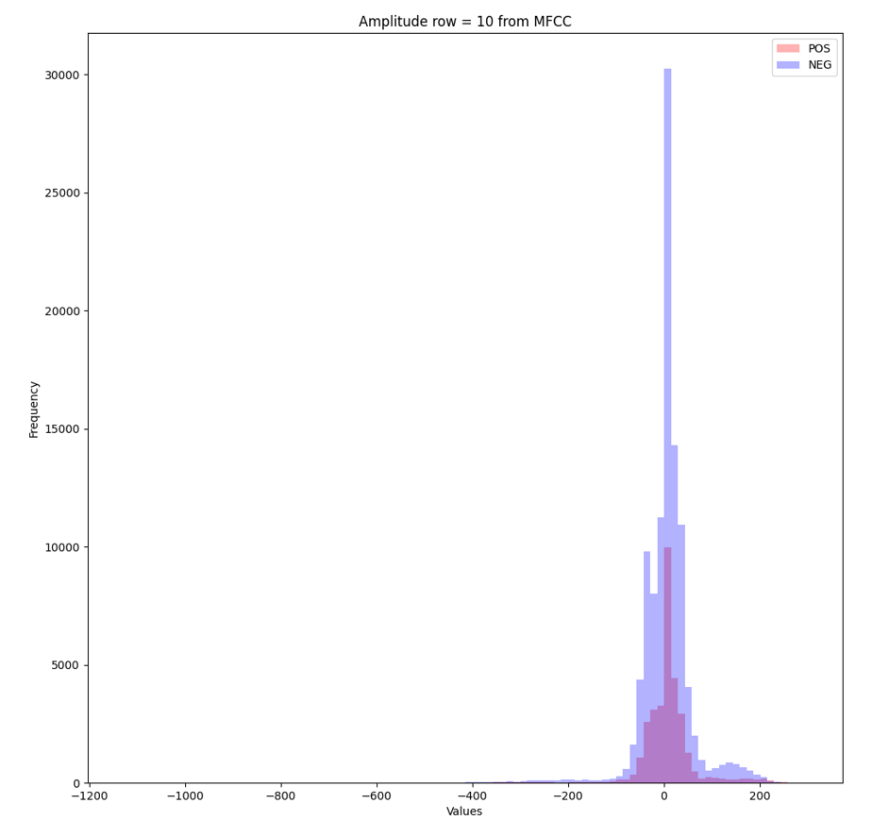
Related Work (cont.)
Regarding the distribution of data, on the Abstract dataset, the logarithmic energy in most frequency intervals follows a normal distribution, and the distributions of POS and NEG are the same.
In the low-frequency range (Index=1), the (logarithm) energy seldom follows a normal distribution.

Slide 13
Future Research
Due to time constraints, here are some further research works that can be explored.
Combining clustering and binary classification methods.
Analyze the correlation between spectral summary items.
Enumerate and select better feature combinations.

Slide 14
That’s All
Thank you for your listening.
2023-04-19
Version=01

