Slide 1



Virtual Reassembly of Fractured Bones for Orthopedic Surgery
Wang, Lei
Beihang University
Pan, Junjun
Beihang University
Yao, Qingqiang
Nanjing First Hospital,
Nanjing Medical University

Slide 2
Content
Motivation and Problem
Methods
Reconstruction of Bone Model
Calculating Keypoints and Descriptor
Aligning Pieces with Template
Experimental Results
Conclusion

Slide 3
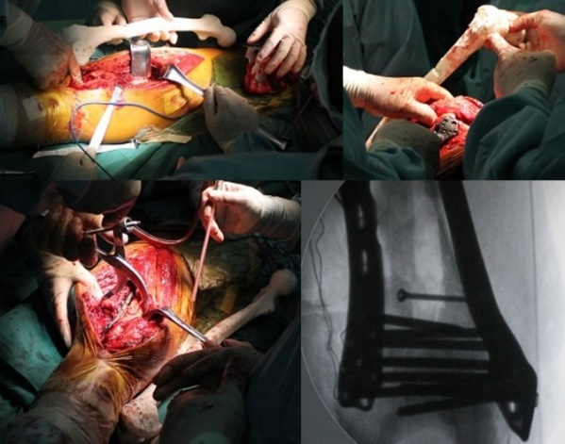
Motivation and Problem
Traditional repairing surgery:
More exposure to radiation
Longer recovery time
Joint dysfunction and infection
Compared with some semi-automatic reassembly methods for archaeo-logical artifacts and forensic evidences, ours is fully automatic without human interactions and specialized to medical purposes. It can help orthopedic surgeons to make correct decisions in fractured bones rea-ssembly.

Slide 4
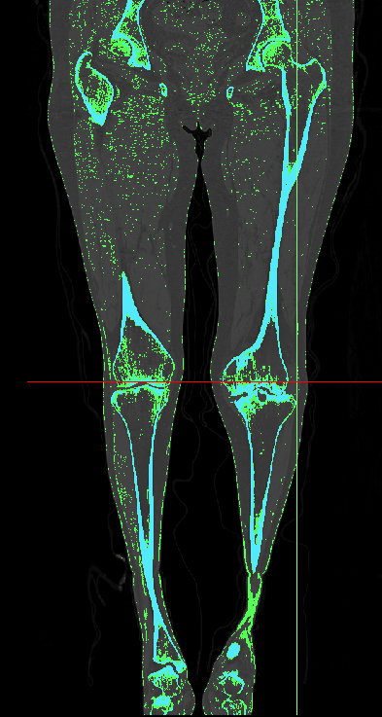
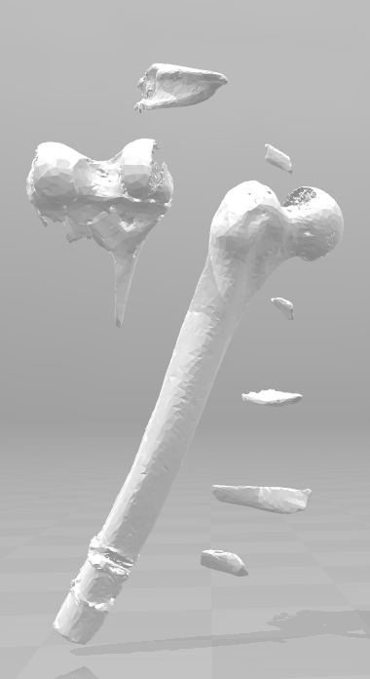
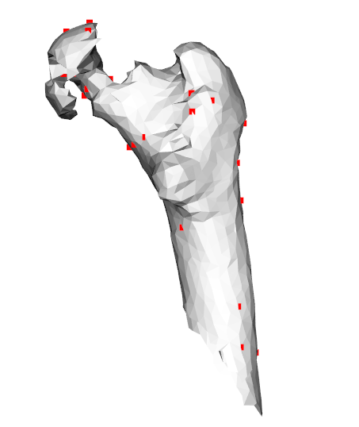
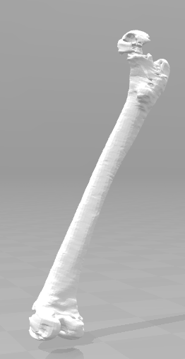
Methods Overview
1
2
3
CT Data
3D Model
Keypoints
Complete
Separating, Segmenting, Reconstructing the CT image
Extracting Keypoints, Computing Descriptor
Aligning Fragments to Template

Slide 5
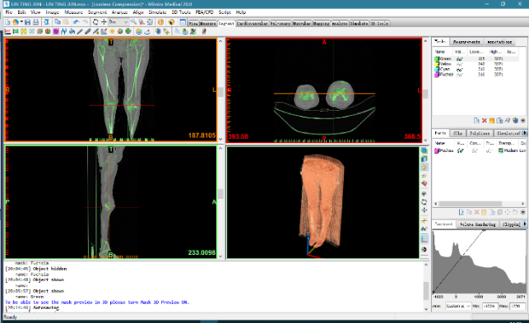
I. Reconstruction of Bone Model
Mimics Medical 20.0
Notes:
Mimics is a medical image control system invented by Materialise. It is a modular structured software and can be configured according to different needs of users. It reads various scan data (CT, MRI), builds 3D models for editing, and then outputs widely used format.

Slide 6
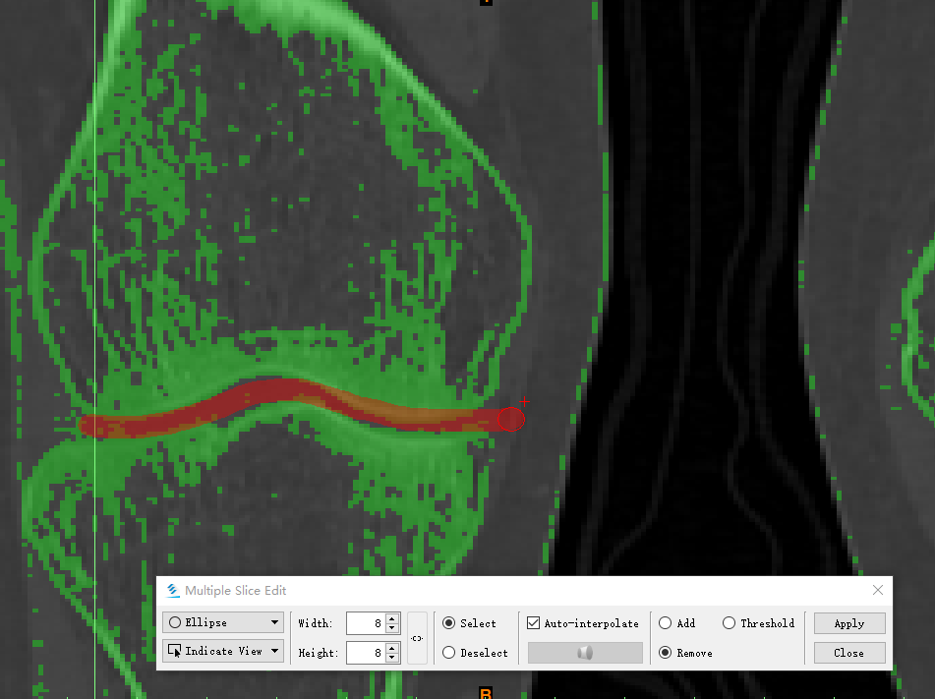
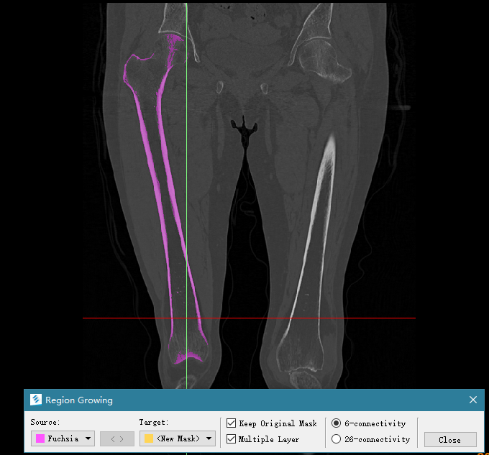
I. Reconstruction of Bone Model
Mark the invalid connection
Extracted bone (red region)
Defining a density threshold to distinguish soft tissue and bones
Cutting off invalid connection and making the contour clear
Performing region growing algorithm to sperate the piece
Notes:
Because of soft tissue and precision limit of the scanning device, pieces are broken but still connected to each other. The connection can make negative effect to the final result, because the connected pieces would be treated as one object. Therefore, we need to separate them before successive operation.

Slide 7
II. Calculating Keypoints and Descriptor
Requirements desirable feature needs to meet:
1) Reflecting real distinctive point in the model
2) Accurate positioning performance
3) High repetition rate of detection
4) Robustness of noise
5) High computational efficiency
Keypoints of a fractured bone model

Slide 8
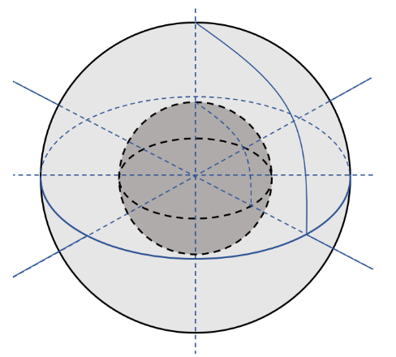
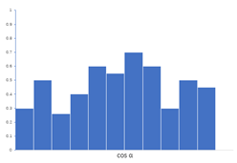
II. Calculating Keypoints and Descriptor
SHOT (the Signature of Histograms of OrienTations) .
Divide the sphere into 32 small areas.
Calculate distribution of the cosine of the angle between the normal vector of keypoints and points in each small area.
The cosine value is divided into 11 bins, so the length of SHOT descriptor is 32*11=352.
LRF (local reference frame)
Distribution histogram

Slide 9
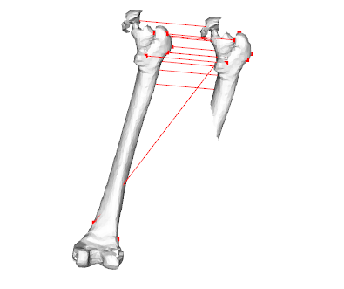
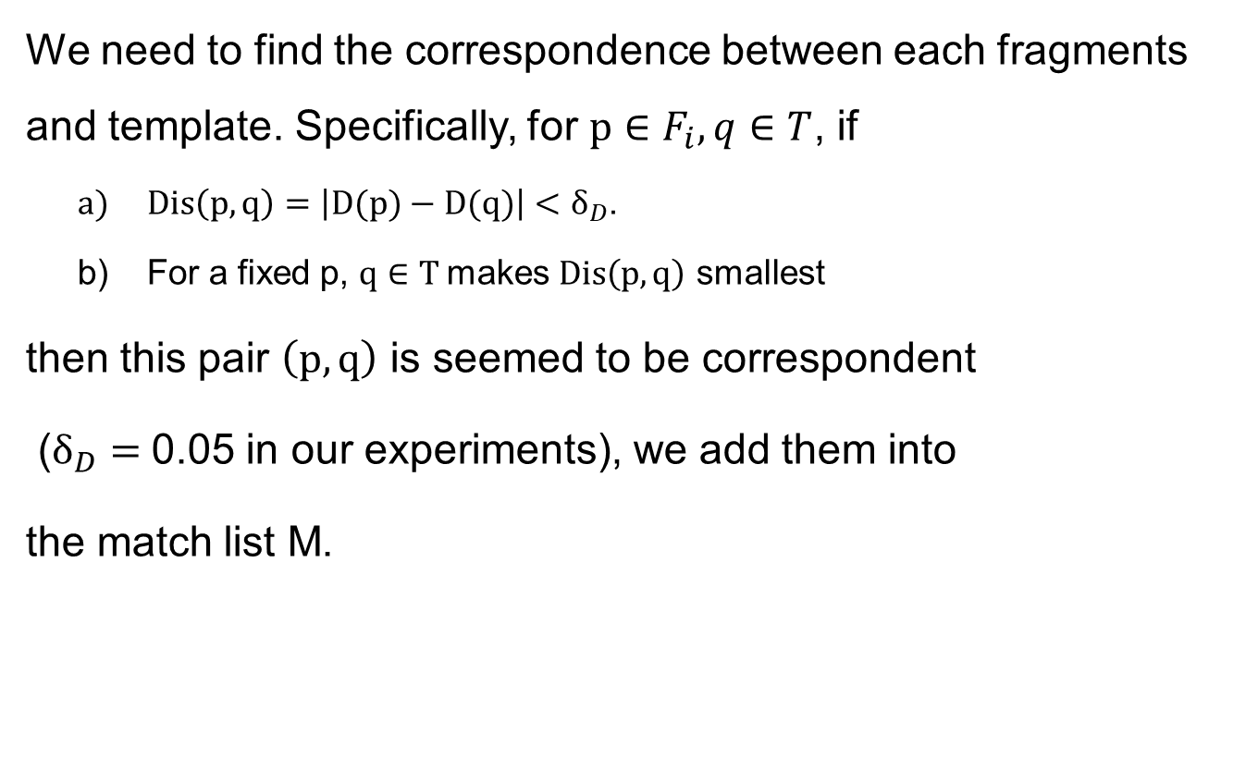
III. Aligning Pieces with Template
We need to find the correspondence between each fragments and template. Specifically, for $p∈F_{i},q∈T$, if
$Dis\left(p,q\right)=\left|D(p)−D(q)\right|<δ_{D}$.
For a fixed p, $q∈T$makes $Dis\left(p,q\right)$ smallest
then this pair $\left(p,q\right)$ is seemed to be correspondent
($δ_{D}=$0.05 in our experiments), we add them into
the match list M.
Mismatch of the keypoints

Slide 10
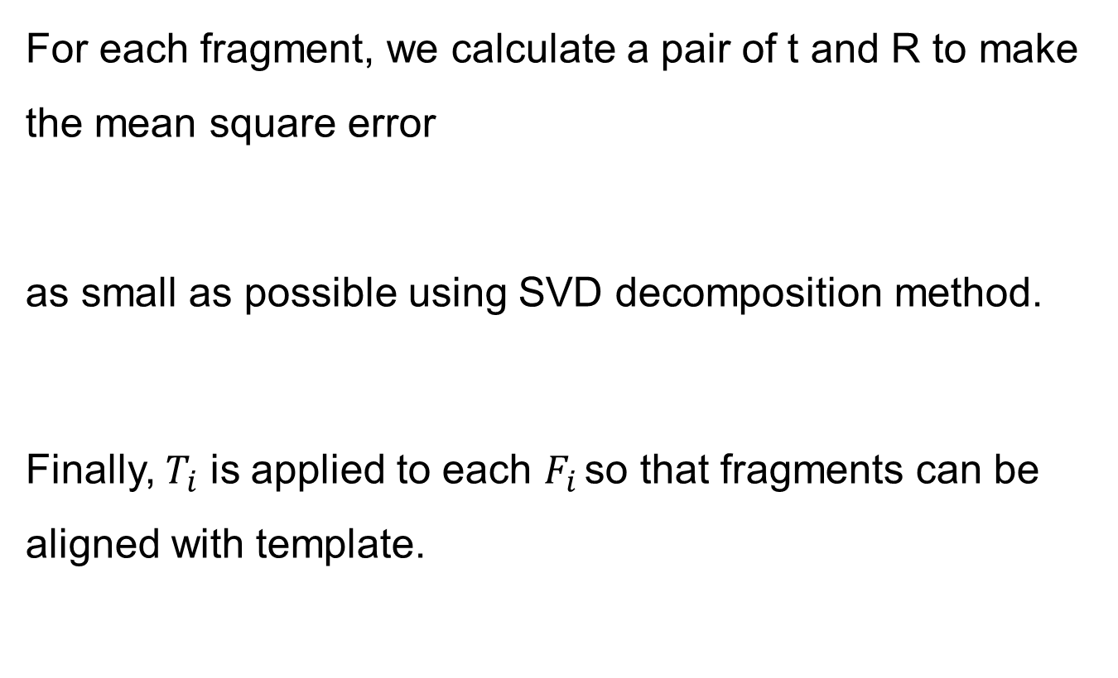
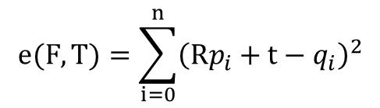
III. Aligning Pieces with Template
For each fragment, we calculate a pair of t and R to make the mean square error
as small as possible using SVD decomposition method.
Finally, $T_{i}$ is applied to each $F_{i }$so that fragments can be aligned with template.
$$e(F,T)=\sum_{i=0}^{n}{{\left(Rp_{i}+t−q_{i}\right)}^{2}}$$

Slide 11
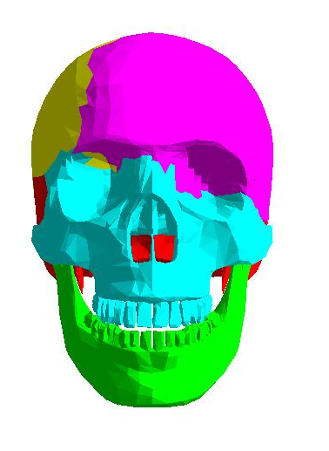
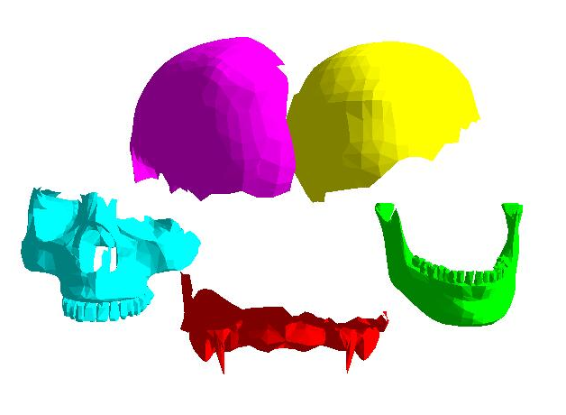
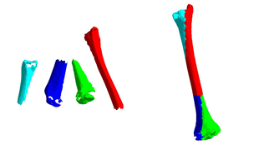
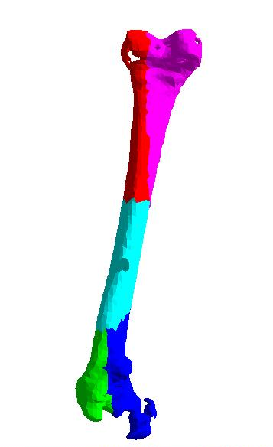
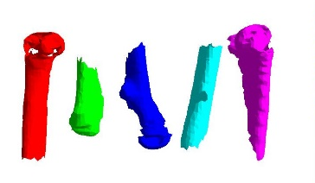

Experimental Results
Cranial bone
$$ε=\frac{1}{n}\sum_{i=0}^{n}{∥T(p_{i})q_{i}∥}$$
Thigh bone
Shin bone
Bones | Nf | Np | Riss | Rshot | Tiss | Tmatch | E
shin | 4 | 18642 | 1.5 | 5 | 12888 | 145362 | 6.21
thigh | 6 | 24282 | 1.5 | 6 | 11518 | 376850 | 6.89
cranial | 5 | 18216 | 1.8 | 1328 | 18208 | 99931 | 2.41
Nf - number of fragments,
Np - number of points
Riss - radius of ISS (millimeter)
Rshot - radius of SHOT (millimeter)
Tiss - time of extracting keypoints (millisecond)
Tmatch - time of matching pieces (millisecond)
E - matching error (millimeter)

Slide 12
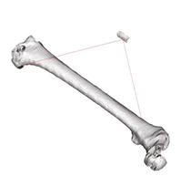
Conclusion
We present a complete pipeline of automatically reassembling fractured bones, which can provide some references to surgeon in orthopedic surgery, then introduce the way to create 3D model from CT image, extract the prominent points, analyze the structure and find correspondence among them.
Limitations. When the fragments become pretty small, the alignment results are not very satisfactory.
A small piece containing 193 vertexes, 483 edges, 308 faces

Slide 13
Thank you !

