Slide 1
Free editing of Shape and Texture with Deformable Net for 3D Caricature Generation
Yuanyuan lin1 · Ju Dai2 · Junjun Pan1 · Feng Zhou3 · Junxuan Bai4,5
1 Beihang University, Beijing, China
2 Peng Cheng Laboratory, Shenzhen, China
3 North China University of Technology, Beijing, China
4 Institute of Artificial Intelligence in Sports, Capital University
of Physical Education and Sports, Beijing, China
5 Emerging Interdisciplinary Platform for Medicine and
Engineering in Sports (EIPMES), Beijing, China
Yuanyuan lin
Notes:
experts, the paper title of this report is xxx;
The author is:
Respectively from

Slide 2
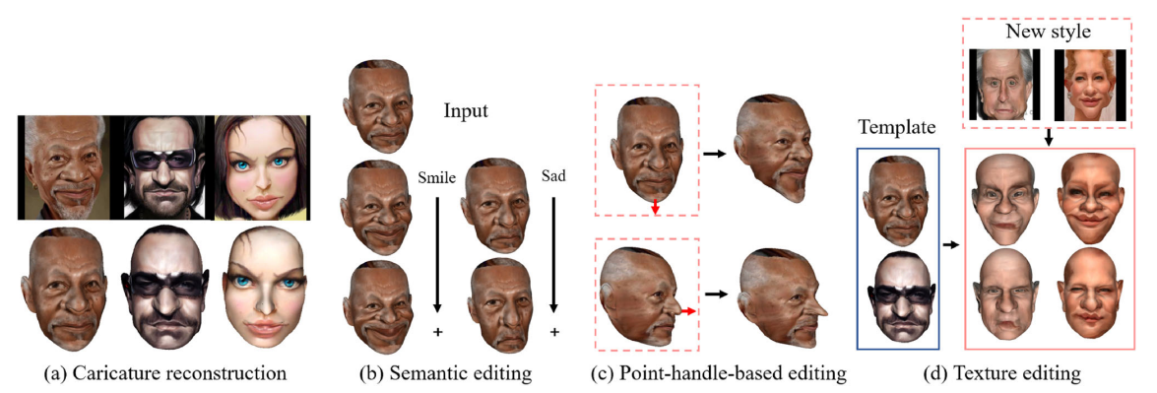
the contributions of our method
1. We propose a novel end-to-end network to generate high quality 3D caricatures from 2D images with flexible, editable, and controllable capacities.
2. Our method allows for diversified editing, consisting of semantic editing, point-handle-based editing, and textural style editing across different characters.
3. We contribute a new high-quality dataset of 3D caricature faces with corresponding camera parameters to validate
the superiority of the proposed method against cutting edge methods.
Notes:
2D caricature editing has shown superior performance. However, 3D exaggerated caricature face (ECF) modeling with flexible
shape and texture editing capabilities is far from achieving satisfactory high-quality results. This paper aims to model shape
and texture variations of 3D caricatures in a learnable parameter space. To achieve this goal, we propose a novel framework
for highly controllable editing of 3D caricatures.1.，2.，3.

Slide 3
Related Work
2D Caricature Editing
Nevertheless, those methods focus on 2D ECF generation from standard face images and cannot perform its 3D counterpart generation. Our work aims to produce 3D caricature faces with geometric shapes and texture styles that can be flexibly edited.
2D Caricature Editing
However, those methods can not simultaneously perform texture rendering and character style editing for 3D ECF generation. In contrast, our work can generate more natural and exaggerated 3D face shapes with diversified texture styles.
2D Caricature Editing
All of these efforts require the preparation of datasets of different caricature styles before realizing the caricature face style transformation. In contrast, our method can achieve shape and cross-character style editing with high quality flexibility by disentangling the shape and texture.
Notes:
Thanks to the advancement of the generative adversarial network (GAN), conspicuous works of 2D ECF modeling have been achieved, which can execute exaggerated shape and textural styles reconstruction. such as MW-GAN\StyleCariGAN\CariGANs,_x0002_ Nevertheless, those methods focus on 2D ECF generation from standard face images and cannot perform its 3D counterpart generation. Our work aims to produce 3D caricature faces with geometric shapes and texture styles that can be flexibly edited.
3D face deformable model is divided into 3D standard face deformable model and 3D exaggerated face deformable model. about 3D standard face deformable model ,due to the mesh’s severe stretching,the effectiveness of an expression is inadequate. about 3D exaggerated face deformable model, those methods can not simultaneously perform texture rendering and character style editing for 3D ECF generation.
3D_x0002_CariGAN, 3DCarishop, 3D-CariNet, 3DMagicMirror . All of these efforts require the preparation of datasets of different caricature styles before realizing the caricature face style transformation.

Slide 4
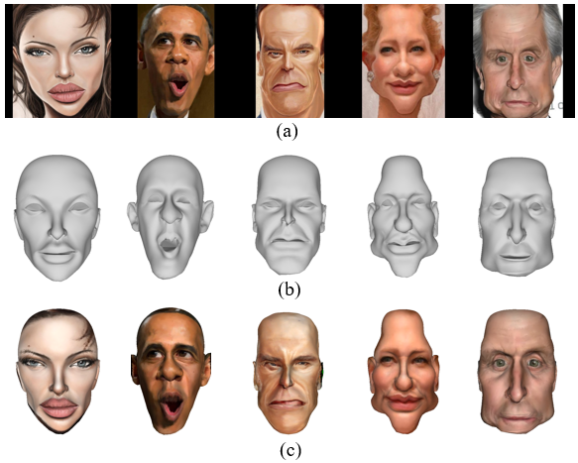
Some samples of 3DCaricshop dataset and its variants.
(a)is the 2D images corresponding to the 3DCaricshop dataset, (b) is the 3DCaricshop dataset, and (c) is our dataset
Notes:
We fully utilize 3DCaricShop dataset’s characteristics and select 531 caricature face meshes that are frontal rather than side. Mean_x0002_while, the original meshes of eyes and mouth are deleted and re-divided. Then, the center of gravity of the full-face mesh is obtained, the center of gravity encrypts the mesh, and finally,
the face images are inverted and mapped to the 3D model by the camera parameters, and the points on the 2D images are obtained to be the texture of the nearest points on the corresponding 3D model pixel values. In this way, a textured 3D exaggerated caricature face model is constructed

Slide 5
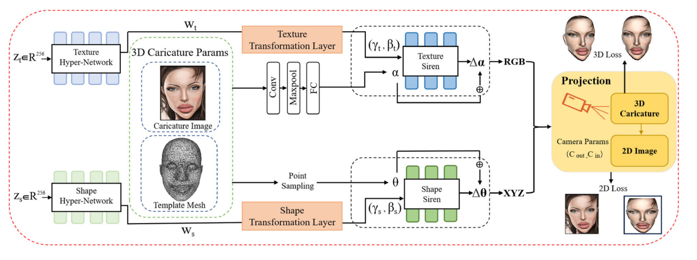
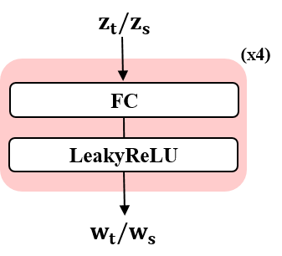
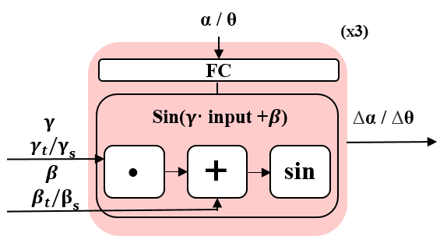
Notes:
Our work aims to generate 3D exaggerated caricatures automatically with high-fidelity performance and online editing capabilities. To achieve this goal, we propose a novel net_x0002_work that combines the advantages of 3D caricature mesh representation power (flexibility and the ability to edit easily) with the high-fidelity texture of 2D images. An overview of the proposed framework is illustrated in Fig. 2. Our model mainly consists of five components: texture hyper-network, shape hyper-network, texture Siren, shape Siren, and projection block. The two hyper-networks receive the latent codes of texture and shape as inputs and produce intermediate latent representations, which will be transformed into the parame_x0002_ters for texture Siren and shape Siren. The two Siren modules
concentrate on modeling each shape and texture as a defor_x0002_mation of a fixed template surface. The projection block projects the generated 3D caricature faces into corresponding 2D counterparts to leverage the 2D ground truth caricature faces to supervise the network training and enhance the 3D caricature face generation quality.
Our texture hyper-network is made up of four hyper_x0002_network blocks, and we illustrate one hyper-network block in Fig. 3, which consists of a fully connected (FC) layer and a LeakyReLu activation layer. Precisely, the texture hyper-network receives the texture latent code zt as input to learning the intermediate representation wt , which will be transformed into frequency γt and phase shift βt through texture transformation layer [21]. γt and βt are leveraged to condition each layer of the subsequent texture Siren.
Our texture Siren is inspired by the FiLM layer [43], which enables conditional adjustment of texture features. The FiLM layer works by first giving a texture input feature and then scaling and offsetting the input texture feature through the sinusoidal function. As shown in Fig. 4, Texture Siren con_x0002_tains a linear FC layer and an affine transformation layer with its frequency γt and phase shift βt coming from the texture hyper-network. The FC layer applies a linear transform defined by a weight matrix Wα and the biases bα to the texture input α. The Texture Siren constructs a learnable Sine function, making the texture of the generated 3D ECF more explicit and enables modeling continuous exaggerated texture variations _x0007_α ∈ R3.

Slide 6







the 3D modeling loss
the texture modeling loss
the shape modeling loss
the 2D projection loss
Notes:
Our model aims to generate 3D caricature faces with exag_x0002_gerated geometry shapes and diversified texture styles given the editable latent codes of shape and texture. To achieve the goal, we leverage the 3D modeling loss Lmod of the cor_x0002_responding 3D caricatures and 2D projection loss Lpro to optimize the whole network:
3D modeling loss. 3D ECF modeling of our work involves shape and texture learning. Regarding shape modeling, we compute the vertex coordinate distances between the ground truth ˆpθ and the generated result pθ . The same computation process is adopted for texture modeling. We calculate the tex_x0002_ture distance between the ground truth ˆpα and the deformed value pα. Thus, the 3D modeling loss consists of the texture term Lt and shape term Ls,
Generating high-quality textured 3D caricatures requires 2D images with caricature styles. Thus, we can project the 3D caricatures into their 2D counterparts.
We obtain corresponding coordinate points of 3D ECF mesh on a 2D image by the projection module. We supervise the learning process by calculating the distance between mesh point texture values and the corresponding projected results texture values.

Slide 7
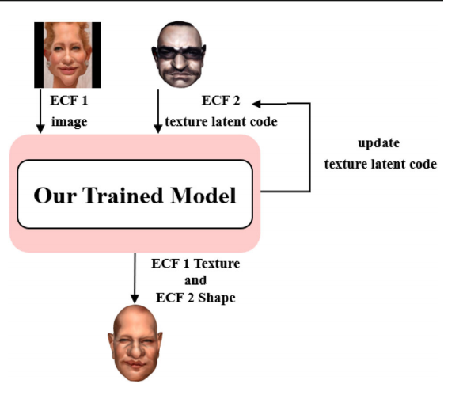
Notes:
Since the learned shape and texture fea_x0002_ture spaces are separate, we can update the texture features while keeping the shaped features unchanged. After finish_x0002_ing optimizing the proposed network, each sampled texture latent code in the texture latent space represents a 3D ECF texture feature. Thus, we can transfer texture features from one caricature to another with the learned texture latent space.We transfer the reference 2D image texture to a 3D ECF by
optimizing the new texture latent space zt,new.

Slide 8
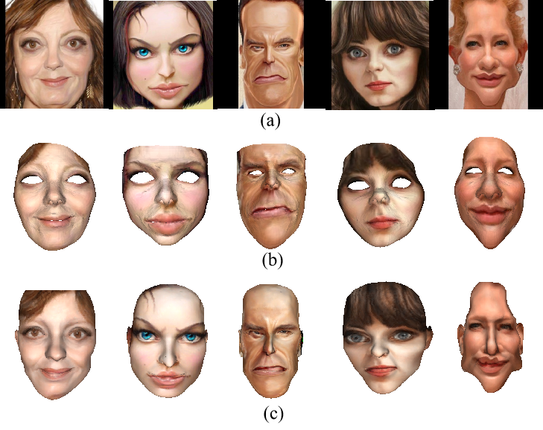
Notes:
Our network enables high-quality texture reconstruction in generating 3D caricatures. To demonstrate its superiority, we compare it with 3D-CariNet [34] and
illustrate the results in Fig. 7. 3D-CariNet [34] is a cutting_x0002_edge work for generating 3D caricature faces with textures, and its training data is also 3D caricature mesh data. From Fig. 7, it can be observed that the face images generated by 3D-CariNet present artifacts, blurring, and lack of eyes and mouthparts. In contrast, our method can reconstruct the whole 3D face with high-quality texture details. We attribute the promising results of our method to the fact that our texture
modeling can learn better texture representation and improve the matching correspondence between the 3D caricature and 2D face image through back projection.

Slide 9
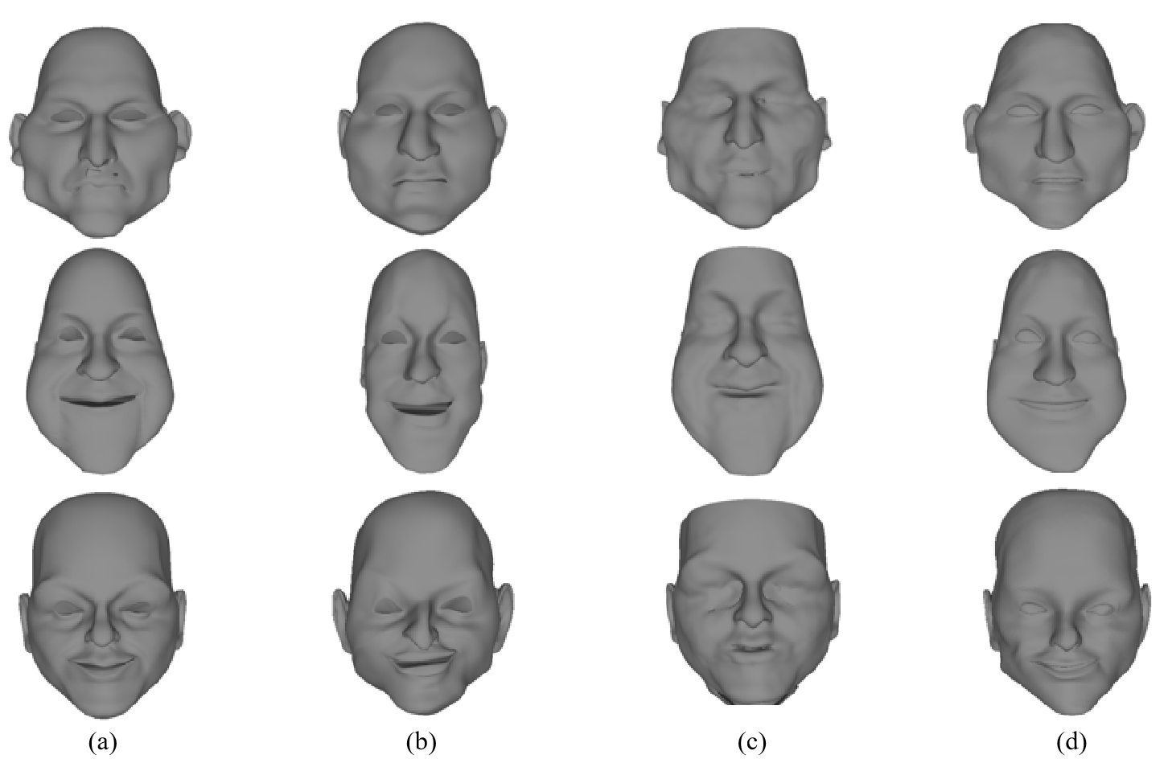
Notes:
3D caricature faces are characterized by exaggerated facial shapes. To identify the geometric shape modeling abilities, we visualize the comparisons with deep
deformable [19], DIF-NET [7] in Fig. 8. Compared with deep deformable [19], our method can express more high-fidelity and natural 3D ECF shapes. In addition, we implement quan_x0002_titative evaluation and compare with the deep deformable. Experimental results of the mean position loss for the 3D ECF testing set are reported in Table 2. It can be seen that our method has the smallest reconstruction error. Compared to DIF-NET, although DIF-NET could reconstruct the overall shape, it ignores important facial details. For example, the part of the eye, we can not even see the shape of the eye. Since the DIF-NET is used to express the face shape in the form of the point cloud, the specific coordinate points corresponding to the coordinate points of the ground truth cannot be found.
So, we do not make quantitative comparisons.

Slide 10
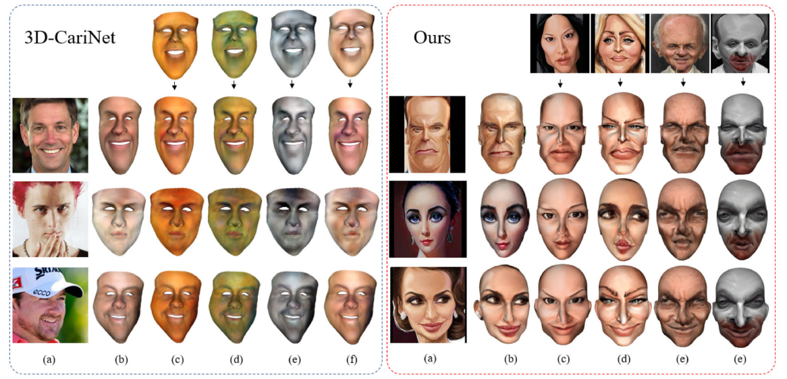
Notes:
Since we represent the textured feature of 3D caricature faces in texture latent spaces, we can easily transfer the textures of reference 2D images to target 3D ECF by editing the texture latent space. We summarize the generation effects of texture style editing in Fig. 9 and compare our method with 3D-CariNet [34]. 3D_x0002_CariNet requires preparing the data of four style textures in advance and training the texture encoder offline when per_x0002_forming style transformation. 3D-CariNet can only generate textured 3D caricatures within four predefined texture styles.While our work can perform texture editing across character styles online. Most importantly, our work can generate a wide variety of texture styles based on diversified input images, not limited to four styles. From Fig. 9, we can observe that our work can handle texture editing for different characters, flexibly generating a variety of texture styles and preserving shape details under different 3D caricature faces with high quality and naturalness.

Slide 11
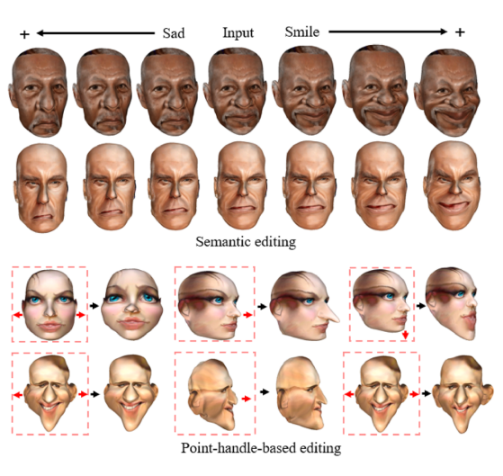
Notes:
For semantic editing, our method can realize editing of 3D ECF with varying degrees through a data-driven editing space for 3D ECF shapes. Our
model can make the input images more smiling or more sad. We can also edit 3D ECF using the learned latent space for point-handle-based editing. For the cheek, stretch the two points sideways after picking a point at each side of the cheek. For the nose, move the point to the front after selecting a point
on the nose tip. For ears, stretch the two points after picking a point at each side of the ears.

Slide 12
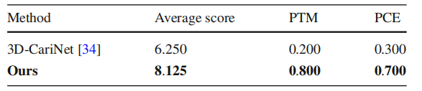
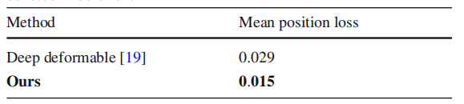
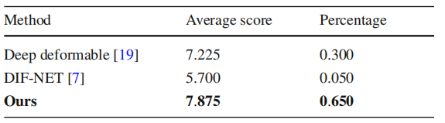
Notes:
We engage 20 professionals in animation to score the gen_x0002_eration of quality in Fig. 7, and ask them to choose the best
method regarding texture modeling and caricature exagger_x0002_ation. The highest and lowest scores are set to 10 and 0,respectively. The statistical results are reported in Table 1. It
can be observed that our method has been widely recognized
by experts regarding the three evaluation terms.Statistical comparison regarding texture modeling. PTM denotes percentage about texture modeling and PCE means percent_x0002_age about caricature exaggeration. The best results are denoted in bold font.
we implement quan_x0002_titative evaluation and compare with the deep deformable.
Experimental results of the mean position loss for the 3D
ECF testing set are reported in Table 2. It can be seen that
our method has the smallest reconstruction error. Comparisons with deep deformable [19]. The best results are denoted in bold font.
Similar to the texture modeling, the 20 professionals also
are requested to evaluate deep deformable [19], DIF-NET
[7], and our method in Fig. 8 in view of shape modeling. The
best shape modeling is asked to be selected. We record the results in Table 3. From Table 3, we can see that our method
is considered to be the best method for shape modeling.Statistical comparison regarding shape modeling. The results are denoted in bold font.

Slide 13
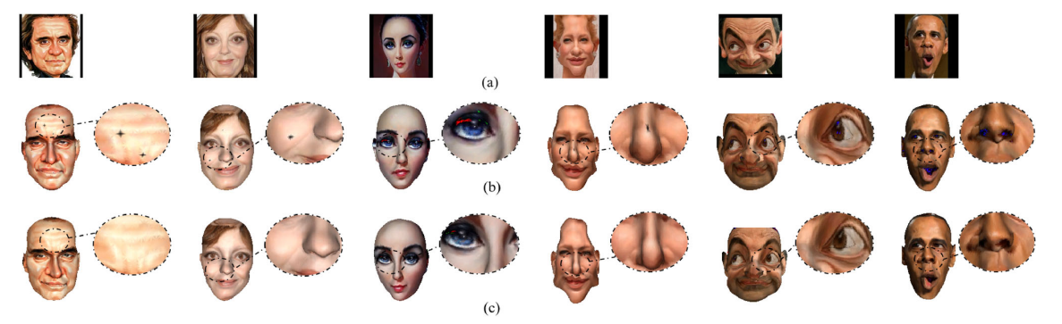
Notes:
To verify the superiority of separate latent codes, we conduct experiments using merged latent codes to represent caricature texture and
shape. The contrast results of utilizing separated and merged shape and texture latent codes are exhibited in Fig. 11. We can observe that merged latent codes result in a lot of texture errors, such as red and black spots. In contrast, separating latent codes achieves high-quality modeling performance for both shape and texture. The possible reason may be that due to the inconsistency between the spatial distribution of shape features and texture features, combining the latent codes will lead to adverse mutual influences for feature learning, result_x0002_ing in the deviation of both shape and texture from the original feature distributions.

Slide 14
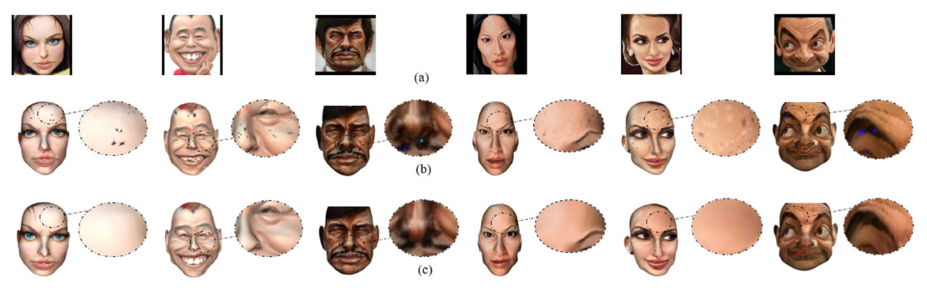
Notes:
We implement comparison experiments of merging or separating shape and texture siren networks to verify the importance of decoupling deformation spaces. The generated 3D caricature faces are illustrated in Fig. 12. It can be summarized from Fig. 12 that merging texture and shape deformation space yields considerable texture errors, such as the blue, green, and black patches. We justify that when integrating the shape and texture of the Siren network, the 3D caricature shape and texture are entangled, leading to the learning of a flawed, not good enough deformation space. On the contrary, decoupling
shape and texture can effectively perform feature extraction and editing of shape and texture. In the meantime, we can also keep the consistency of shape and texture through the structural topology of 3D caricature faces.

Slide 15
Thank you for your attention

