Slide 1




A Lightweight Pose Estimation Network with Multi-Scale Receptive Field
Shuo Li^{1,2}, Ju Dai² , Zhangmeng Chen^{1,2}, Junjun Pan^{1,2}
1 Beihang University 2 Peng Cheng Laboratory

Slide 2
Contents
Introduction
Method details
Experimental results
Limitations and conclusion
A Lightweight Pose Estimation Network with Multi-Scale Receptive Field – Shuo Li

Slide 3
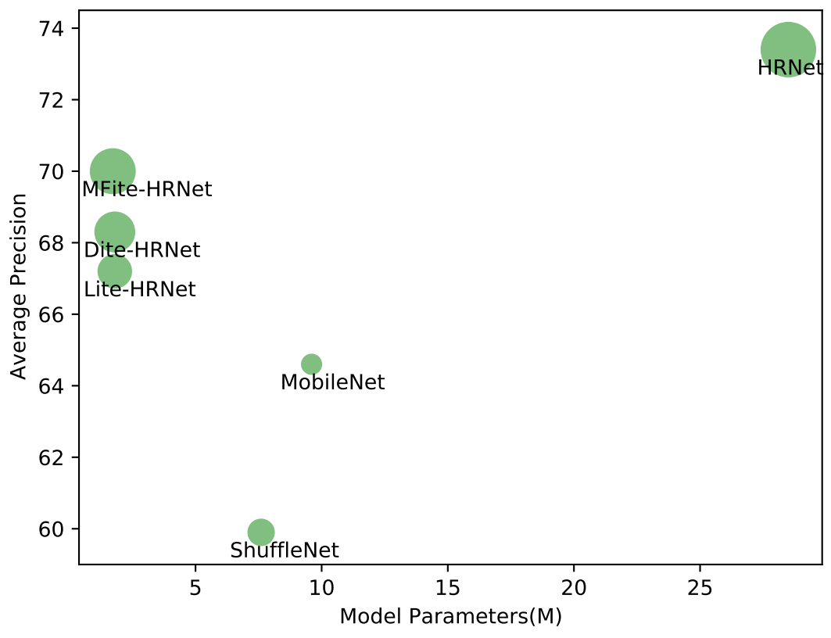
Motivation
High model complexity makes human pose estimation computationally prohibitive.
Using large kernels or attention for long-range receptive field learning.
Expanding and customizing receptive fields balances model capabilities and complexity.
A Lightweight Pose Estimation Network with Multi-Scale Receptive Field – Shuo Li

Slide 4
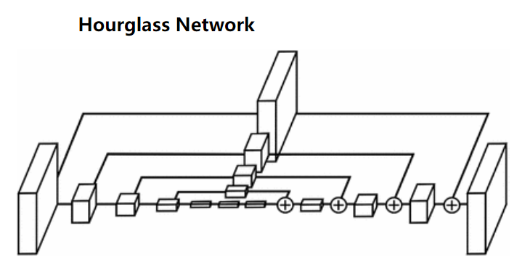
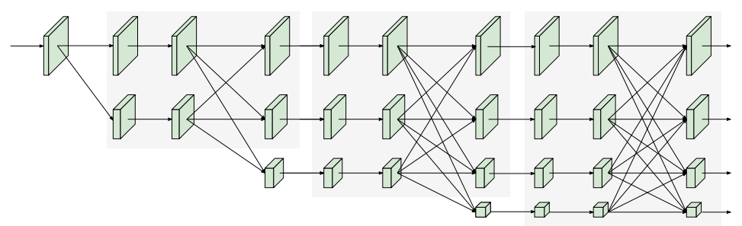
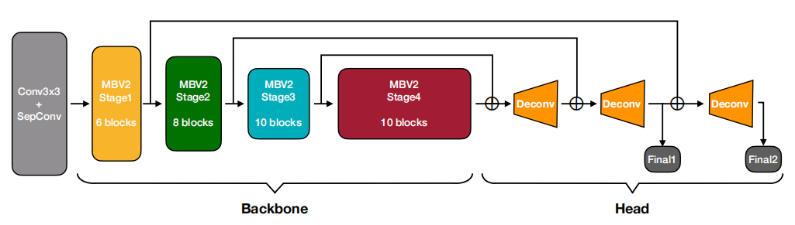
Related work
Human pose estimation
The hourglass network [ECCV16]
High-resolution network [CVPR19]
Lightweight single-person pose estimation
Lite-Hrnet [CVPR21]
Dite-HRNet [IJCAI22]
Lightweight multi-person pose estimation
HigherHRNet-W24 [CVPR20]
Lite pose [CVPR22]
[ECCV16]
[CVPR21]
[CVPR22]
A Lightweight Pose Estimation Network with Multi-Scale Receptive Field – Shuo Li

Slide 5
Challenges
Balance between number of model parameters and performance.
Keeping the number of parameters small and improving the model's multiscale representation and receptive fields.
We propose a novel Multi-scale Field Lightweight High-resolution Network (MFite-HRNet) for human pose estimation. The model maintains a small number of parameters and higher performance.
A Lightweight Pose Estimation Network with Multi-Scale Receptive Field – Shuo Li

Slide 6
Contributions
MFite-HRNet, a lightweight human pose model based on HRNet with MRB and LRB blocks for expanded fields and fewer parameters.
MRB learns multi-scale context features with different dilation rates. LRB captures long-range spatial features.
Experiments on COCO, MPII, and CrowdPose show MFite-HRNet outperforms lightweight pose models.
A Lightweight Pose Estimation Network with Multi-Scale Receptive Field – Shuo Li

Slide 7
Contents
Introduction
Method details
Experimental results
Limitations and conclusion
A Lightweight Pose Estimation Network with Multi-Scale Receptive Field – Shuo Li

Slide 8
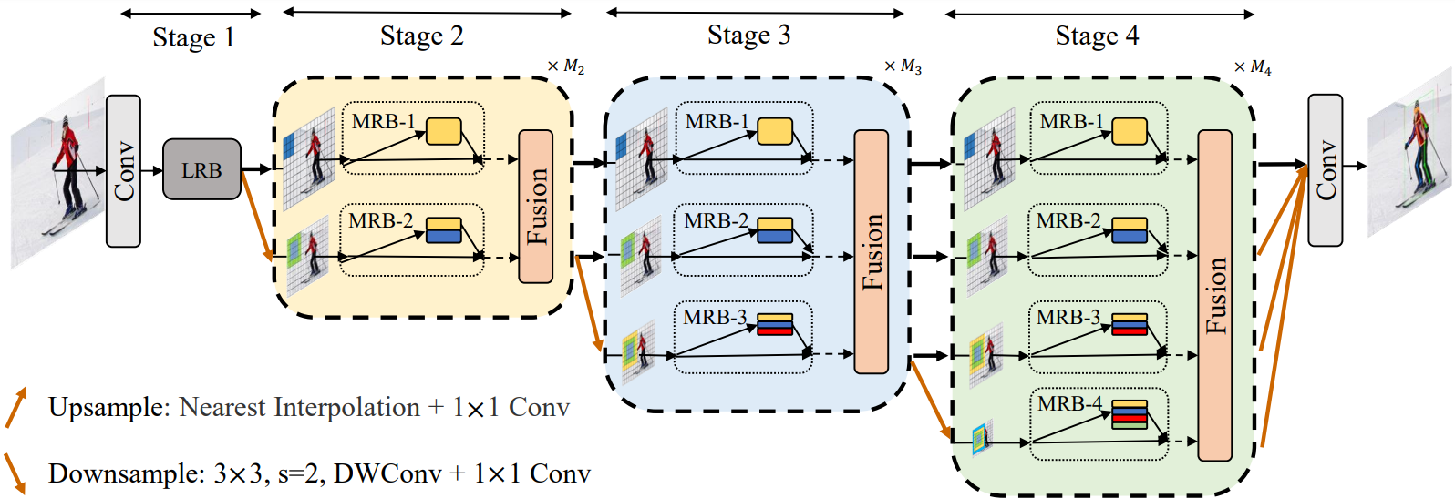
Framework
A Lightweight Pose Estimation Network with Multi-Scale Receptive Field – Shuo Li

Slide 9
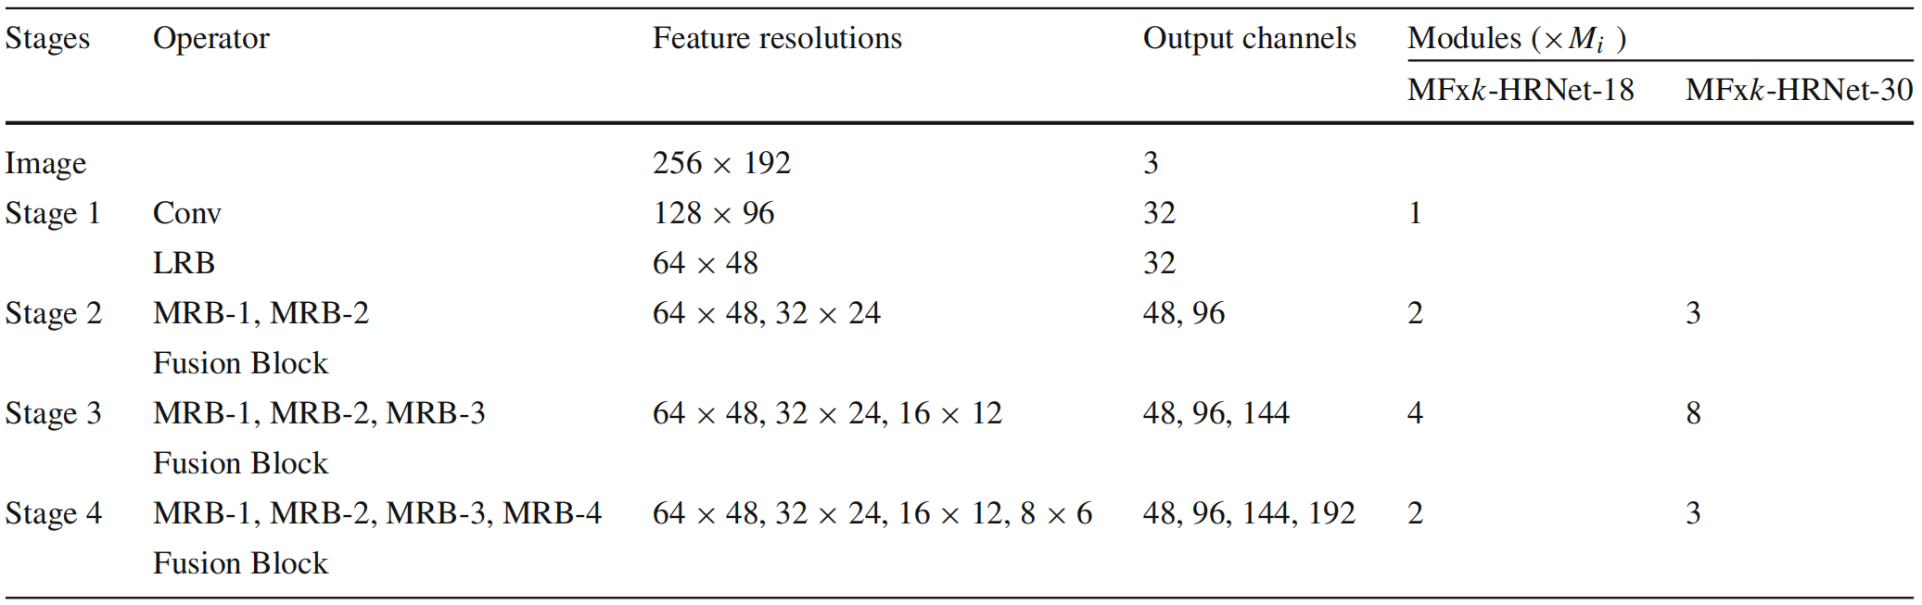
Framework
A Lightweight Pose Estimation Network with Multi-Scale Receptive Field – Shuo Li

Slide 10
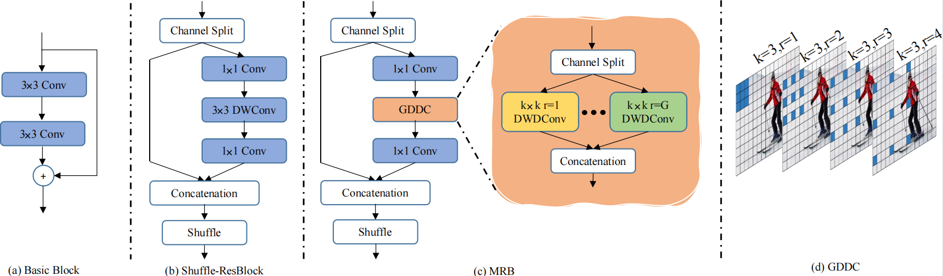
MRB Details
A Lightweight Pose Estimation Network with Multi-Scale Receptive Field – Shuo Li

Slide 11
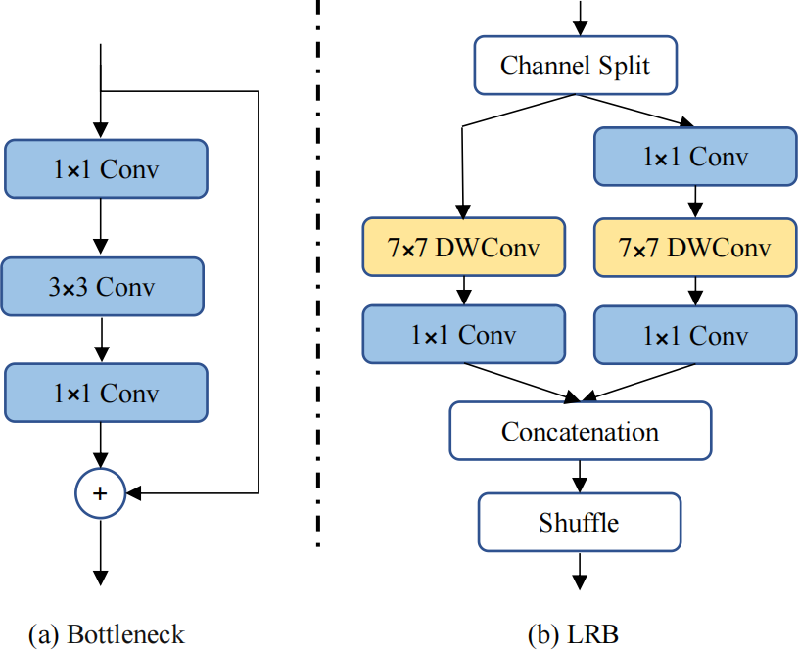
LRB Details
A Lightweight Pose Estimation Network with Multi-Scale Receptive Field – Shuo Li

Slide 12
Contents
Introduction
Method details
Experimental results
Limitations and conclusion
A Lightweight Pose Estimation Network with Multi-Scale Receptive Field – Shuo Li

Slide 13
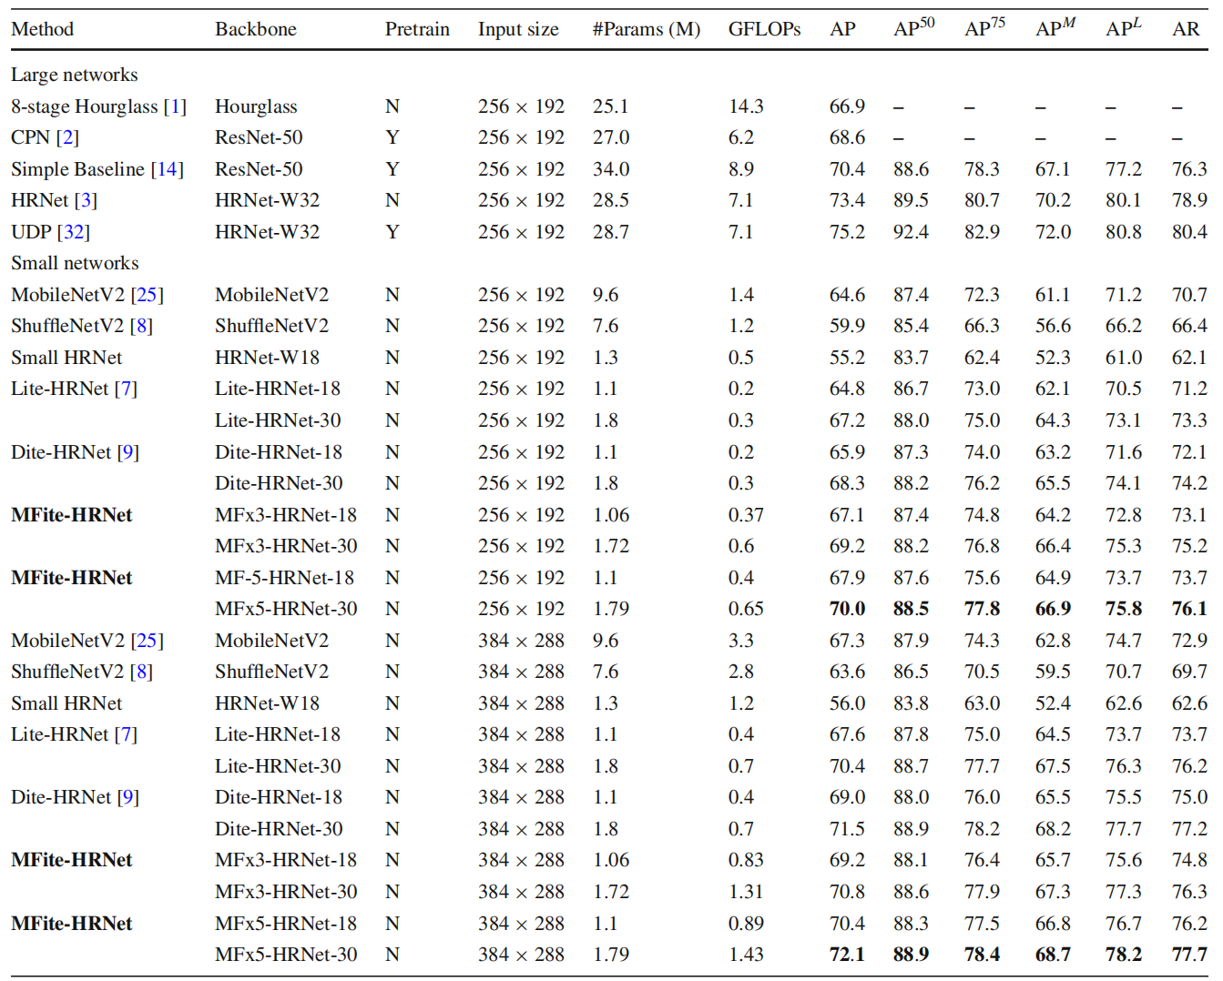
COCO val2017-Single person
A Lightweight Pose Estimation Network with Multi-Scale Receptive Field – Shuo Li

Slide 14
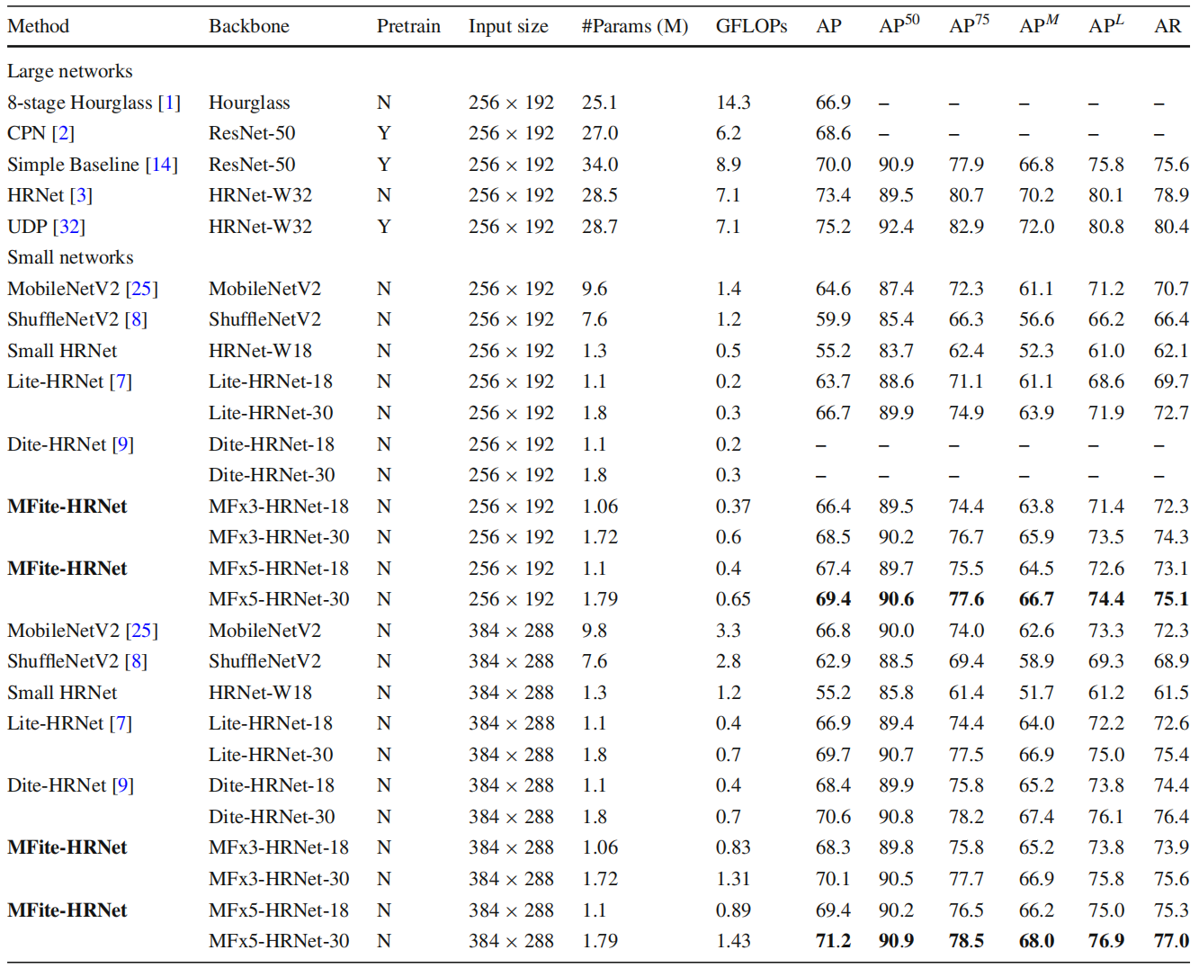
COCO test2017-Single person
A Lightweight Pose Estimation Network with Multi-Scale Receptive Field – Shuo Li

Slide 15
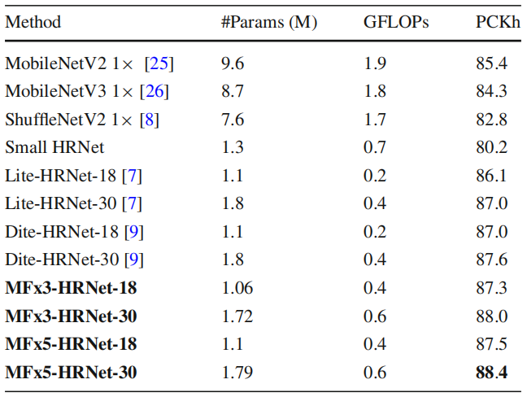
MPII val
A Lightweight Pose Estimation Network with Multi-Scale Receptive Field – Shuo Li

Slide 16
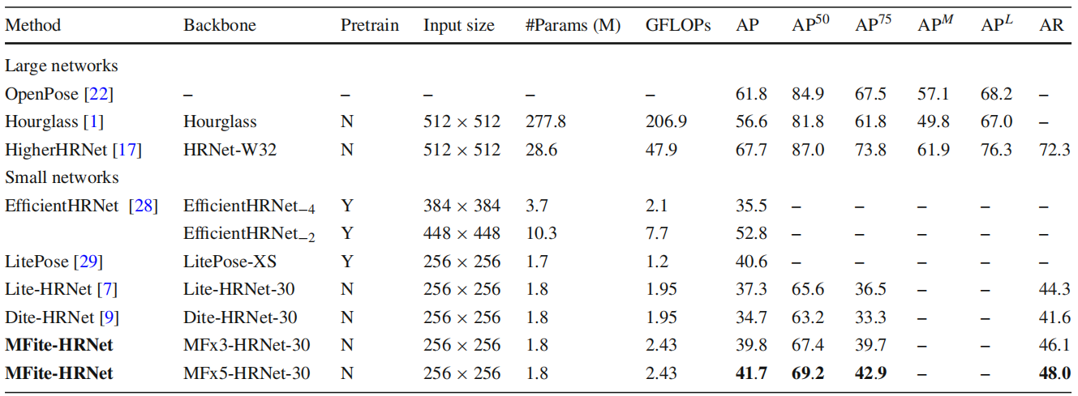
COCO val2017-Multi-person
A Lightweight Pose Estimation Network with Multi-Scale Receptive Field – Shuo Li

Slide 17
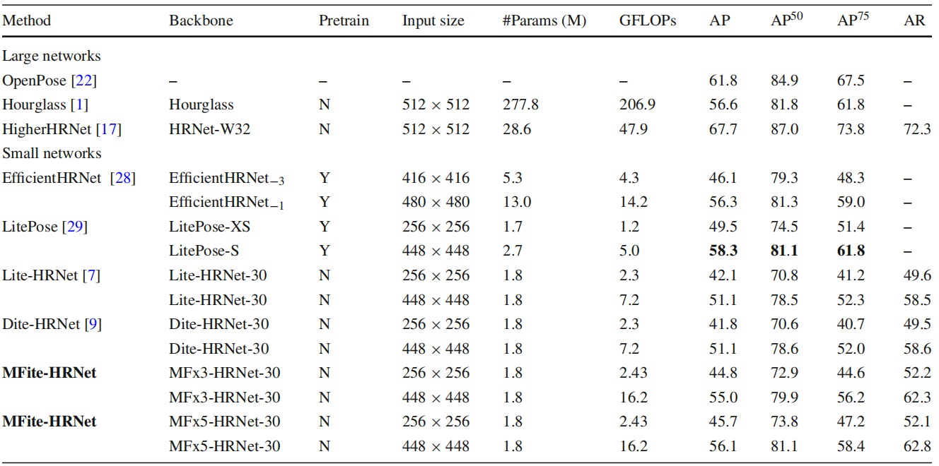
CrowdPose test-Multi-person
A Lightweight Pose Estimation Network with Multi-Scale Receptive Field – Shuo Li

Slide 18
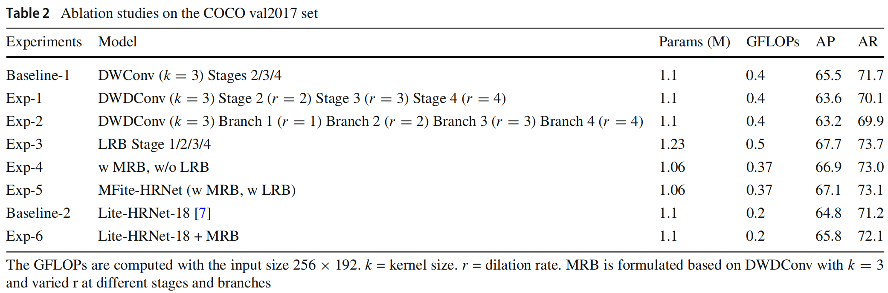
Ablation studies
A Lightweight Pose Estimation Network with Multi-Scale Receptive Field – Shuo Li

Slide 19
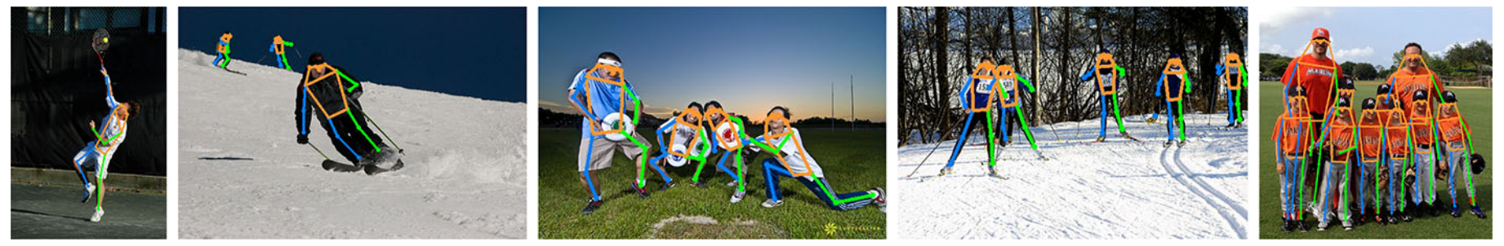
Visualization
Visualization of pose estimation results on COCO val2017 using MFx3-HRNet-18 model.
A Lightweight Pose Estimation Network with Multi-Scale Receptive Field – Shuo Li

Slide 20
Contents
Introduction
Method details
Experimental results
Limitations and conclusion
A Lightweight Pose Estimation Network with Multi-Scale Receptive Field – Shuo Li

Slide 21
Limitations
Selection of the dilation rate requires manual intervention.
The overall computational volume of the model is still large.
Multi Receptive Field Block may work better using dynamic null factor grouping.
A Lightweight Pose Estimation Network with Multi-Scale Receptive Field – Shuo Li

Slide 22
Conclusion
We propose the novel lightweight MFite-HRNet for human pose estimation tasks.
We create two new lightweight blocks: LRB for large-range spatial info at low-level maps and MRB for multi-scale context at different maps.
Using LRB and MRB blocks, our model outperforms lightweight pose models on COCO, MPII, and CrowdPose datasets.
A Lightweight Pose Estimation Network with Multi-Scale Receptive Field – Shuo Li

Slide 23
Source Code
https://github.com/lskdje/MFite-HRNet.git
A Lightweight Pose Estimation Network with Multi-Scale Receptive Field – Shuo Li

Slide 24
Thank You!
Q&A: Any question can be sent to the authors!
Email:
Ju Dai : daij@pcl.ac.cn
Junjun Pan : pan_junjun@buaa.edu.cn
A Lightweight Pose Estimation Network with Multi-Scale Receptive Field – Shuo Li

