Slide 1
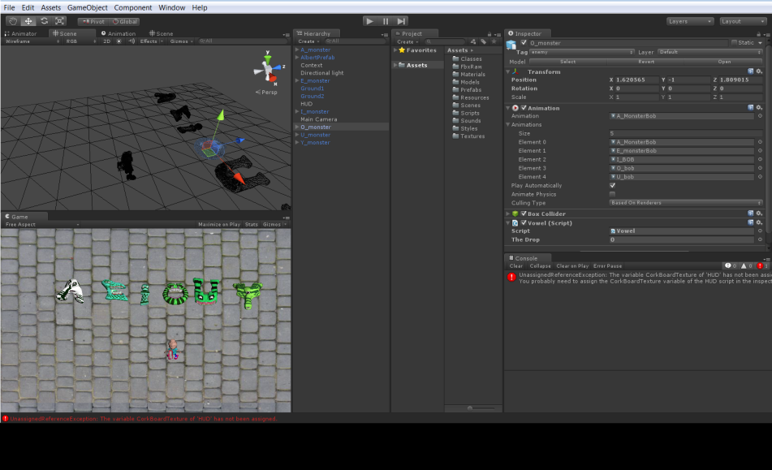
Unity IDE
Scene:
Contains all active objects
Inspector:
Details of an object’s composition
Camera view:
Shows what the player will see.
Assets:
Contains all of the project’s resources
Console:
For Debuging

Slide 2
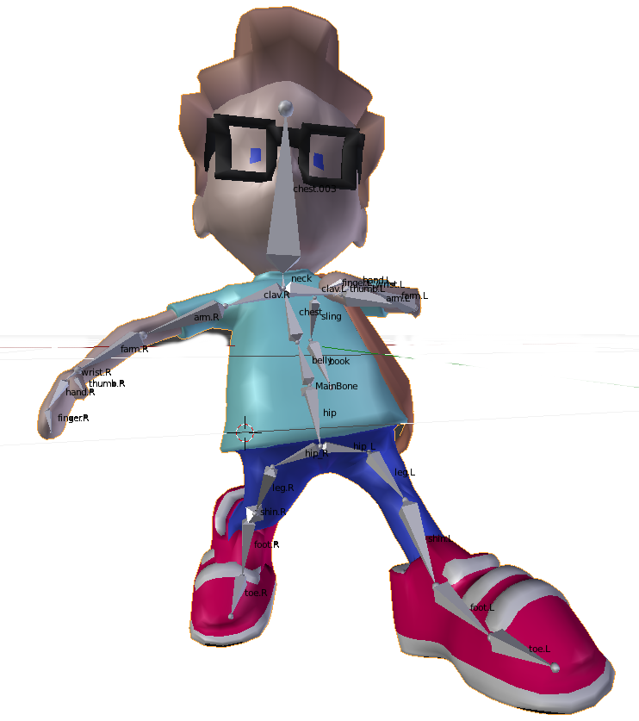
Transform:
position of the center point of an object in 3d space.
Mesh:
3D object defined by vertecies
Animations:
Armature’s recorded animations
Armature: collection of Mesh deforming entities called “bones”
Collider:
Unity Native object capable of detecting collisions with other colliders
Rigid Body:
Unity Native object capable of performing actions related to physics. Can have Gravity applied to it.
AlbertController.cs:
Albert’s script.
Albert Prefab

Slide 3
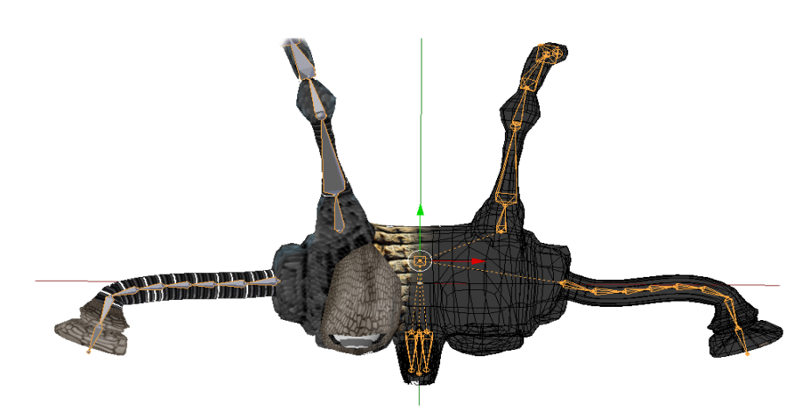
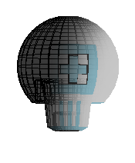
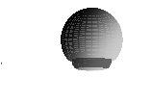
3D WORD
Boss_3d_wordGen.cs
AllertAlbert()
“gun has been destroyed”
Construct_3d_word()
HandleCollision()
BoldFont = name of Object
Empty GameObject
A B B is child of A
Armature Bone
C# script
Script attached
Boss_Motion_animation.cs
AnimationClip Action
AnimationClip Curlup
AnimationClip Uncurl
Boss_3d_wordgen.OnwrongLtr
-> do Attack()
Update(){ Move(){}; }
Attack(){ Coroutine(); }
Coroutine()
Boss_eye_and_gun.cs
Find_albert()
Follow _Albert()
OnCollision() hitcount++
3dWordGen.AllertAlbertOnce()
(note: collider is turned off)
BossShootInterval.cs
Gameobject bullet
Make bullet evry X second()
BossProjectile.cs
Move forward()
DestroyOutOfBound()
onCollision_Albert()
bullet

