Slide 1

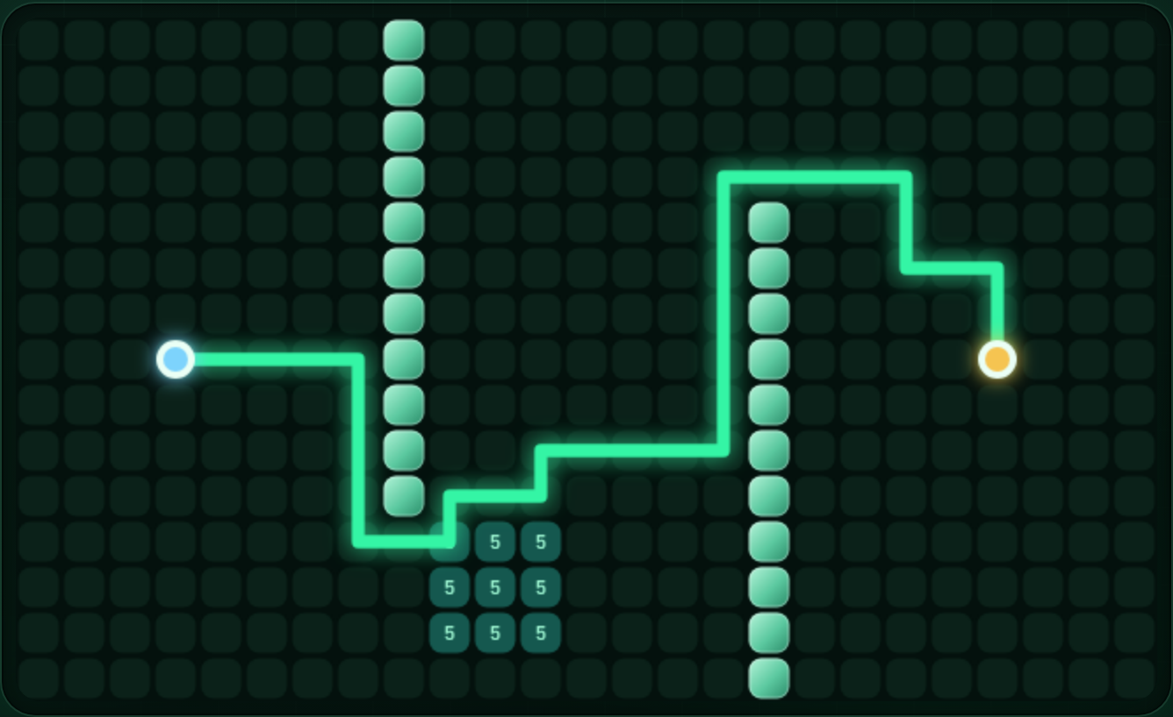
ThreeOhNine
AI Algorithm Visualizer
A* · Hill Climbing · Minimax — an interactive web app
Krasnobrizh Artyom · Orazgali Daulet
Live: threeohnine.vercel.app
QAIRU AI Application Development Challenge 2026 · AI Fundamentals
Notes:
Hello! We are presenting ThreeOhNine, an interactive web app that shows AI algorithms step by step. We implemented topics from three weeks with hand-written code: week 2 (search, A*), week 3 (Hill Climbing) and week 4 (Minimax).

Slide 2



Problem and goal
Problem
Goal
Result
You can see what an AI algorithm returns, but not how it gets there. Textbook figures are static: you cannot change a parameter and watch what happens.
Build an app where you can draw the input yourself, change parameters, watch each step and compare algorithms side by side.
3
7
11
weeks
algorithms
tests
Live demo online. No ready-made AI APIs — everything is written by hand.
Notes:
Problem: it is hard to understand an algorithm from a textbook alone. Our goal was an interactive tool. Result: topics from three weeks, 7 algorithms, 11 tests, and no ready-made APIs.

Slide 3



System architecture
src/search.js
UI
Deploy
BFS · DFS · UCS · A*
src/main.js
Canvas animation
Controls: sliders, segments
Explanation panel
GitHub
Vercel
Tests: node:test
src/localsearch.js
Hill Climbing, N-Queens
src/adversarial.js
Minimax · Alpha-Beta
The algorithms are pure functions, tested in Node.js without the UI. No backend: plain JavaScript (ES modules).
Notes:
The algorithms live in files separate from the UI, so they are tested without a browser. main.js is the interface. The site runs on Vercel, the code is on GitHub.

Slide 4
Week 2 · Search: A*
A*: 50% fewer nodes than UCS at the same cost (58). DFS expands fewer nodes, but its path costs 154 — 2.7× more.
Maze 15×25: green line — A* path; light blocks — walls; “5” — weighted cells
Notes:
A* uses f = g + h. You can draw on the grid and compare the algorithms. Measurement: on a 30×30 grid with 25% random walls UCS expanded 661 nodes and A* 331, both with cost 58. DFS expanded 231 nodes, but its path cost 154. On a weighted grid Manhattan is weak and A* was no better than UCS (400 nodes) — this is a limitation.

Slide 5
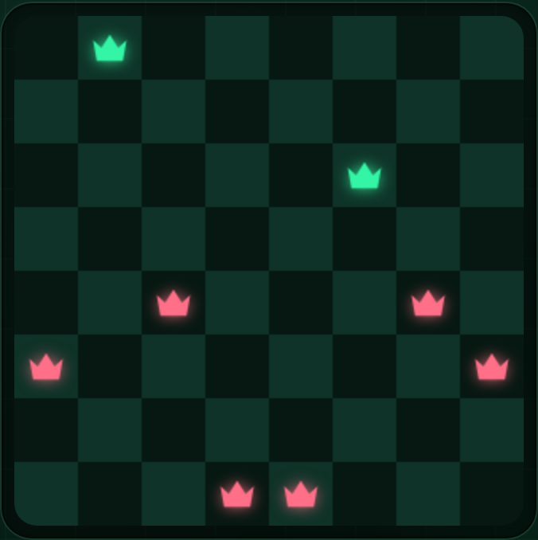
Week 3 · Hill Climbing
Hill Climbing gets stuck in local minima. Random restarts raised the success rate from 16.5% to 100% (N=8).
Initial state: h = 5. Red queens are attacked, green ones are safe
Notes:
At every step Hill Climbing moves the queen that reduces the number of conflicts the most, and stops at a local minimum. Measurement: 50 seeds, ≤100 restarts: N=8 — 50/50, N=12 — 49/50, N=20 — 45/50. Without restarts only 16.5% of 200 runs found a solution for N=8.

Slide 6
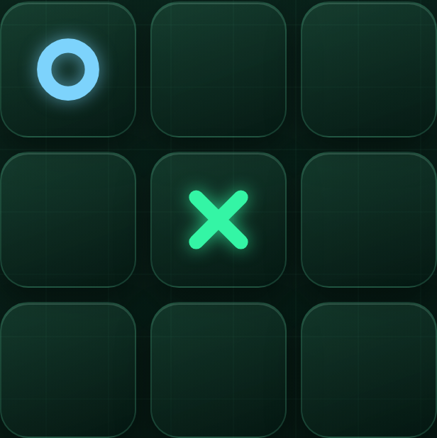
Week 4 · Minimax
96%
×22
nodes pruned (Alpha-Beta)
faster (empty board)
AI moving first on an empty board:
Minimax: 549,946 nodes, ~127 ms
Alpha-Beta: 20,866 nodes, ~6 ms
Same value for both; the AI never loses (tested)
The human played X in the center, the AI (O) answered in a corner
Notes:
Minimax searches the whole game tree: the AI maximizes, the human minimizes. Alpha-Beta prunes branches that cannot change the result: the same value with ~96% fewer nodes. Times vary slightly between runs; node counts do not.

Slide 7



Testing, limitations, demo
11/11
Demo and code
threeohnine.vercel.app
github.com/GGRANOX/ThreeOhNine
automated tests pass: optimality, invalid input, the AI never loses
Team
Limitations
Krasnobrizh Artyom
Orazgali Daulet
4-connected grid, no diagonals
Manhattan is weak on weighted grids
No guarantee for Hill Climbing at large N
Thank you! Questions?
Notes:
Everything is checked by 11 tests. Limitations: 4 directions, Manhattan is weak on weighted grids, Hill Climbing has no guarantee. Demo: threeohnine.vercel.app.

