Slide 1
Ames House Pricing Machine Learning Project
Gary Simmons 8 July 2022

Slide 2
Linear Model & Tree Model
Trained a linear regression model.
34 features
Focus on:
Top 4 Continuous variables:
Top 2 Categorical variables
All variables that correlated with top 10 feature importances of the random forest
Trained a random forest

Slide 3
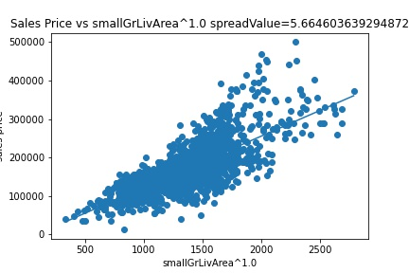
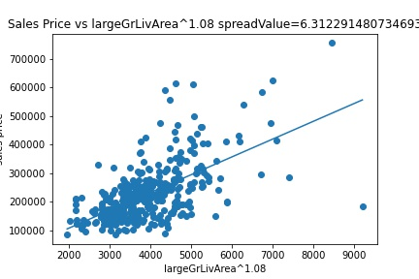


Gross Living Area
Project Proposal suggested we split top 80th quantile of each neighborhood and fit accordingly
$$price \sim smallGrLivArea x 70.17$$
$$price \sim {largeGrLivArea}^{1.08} x \text{39}\text{.}\text{55}$$

Slide 4
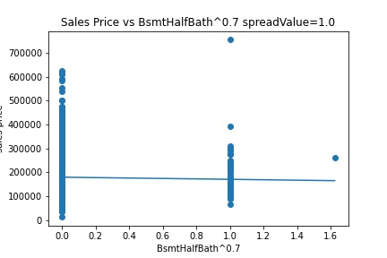
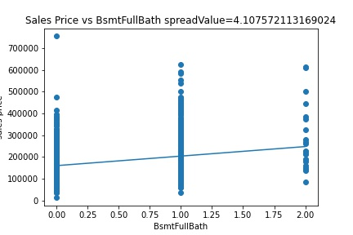


Basement full bathrooms & Basement Half Bathrooms
Small Features, but some how had some importance
$$price \sim {BsmtHalfBath}^{0.7}x 6136.45$$
$$price \sim BsmtFullBath x 15561.34$$

Slide 5
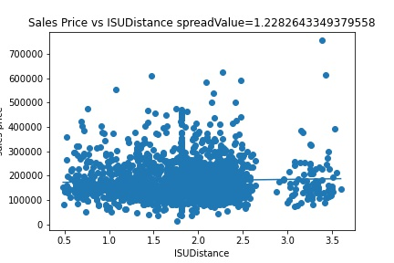

Distance from ISU
Surprisingly further distance increases price
$$price \sim ISUDistance(miles) x 800.13$$

Slide 6
Exterior Quality
Value | Coefficient
Excellent | 0
Average/Typical | -77548.30
Good | -63589.77
Fair | -69521.02
There was no poor quality

Slide 7
Home Functionality
Value | Coefficient
Major Deductions 1 | 0
Typical Functionality | +30540.98
Minor Deductions 2 | +13418.38
Minor Deductions 1 | +13696.73
Moderate Deductions | +14994.51
Major Deductions 2 | -19294.51
Salvage only | -39743.95
There was no severely damaged

Slide 8
Garage Type (Correlates with 1stFlrSF, YearBuilt)
Value | Coefficient
More than one type of garage | 0
Attached to home | +12115.56
Detached from home | +8766.90
No Garage | +14106.11
Basement Garage | -4296.42
Car Port | +2379.68
Built-In (Garage part of house - typically has room above garage) | -75.16

Slide 9
MSZoning (Correlates with LotArea)
Value | Coeffecient
Agriculture | 0
Residential Low Density | +30135.76
Residential Medium Density | +19187.83
Residential High Density | +29526.30
Commercial | +5694.83
Industrial | +9772.35
Floating Village Residential | +157.87
There was no Residential Low Density Park

Slide 10
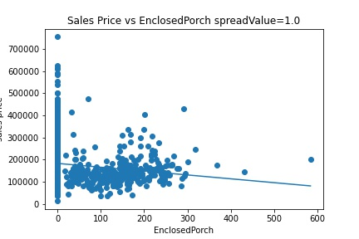

Enclosed Porch (Correlates with YearBuilt)
$$price \sim EnclosedPorch x \text{2.53}$$

Slide 11
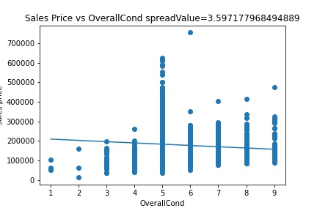

Overall Condition (Correlates with YearBuilt)
$$price \sim OverallCond x \text{4182}\text{.}\text{74}$$

Slide 12
Paved Drive (Correlates with Yearbuilt)
Value | Coefficient
Dirt/Gravel | 0
Paved | +5394.61
Partial Pavement | +1594.87

Slide 13
Garage Condition (Correlates with GarageCars)
Value | Coefficient
Excellent | 0
Typical/Average | -19754.59
No Garage | -31471.65
Fair | -23080.90
Poor | -23500.25
Good | -13646.57

Slide 14
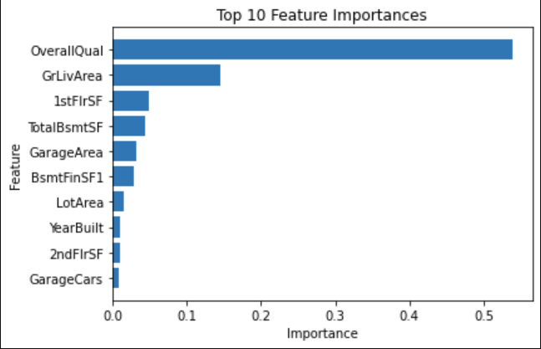
Random Forest Feature Importances

Slide 15
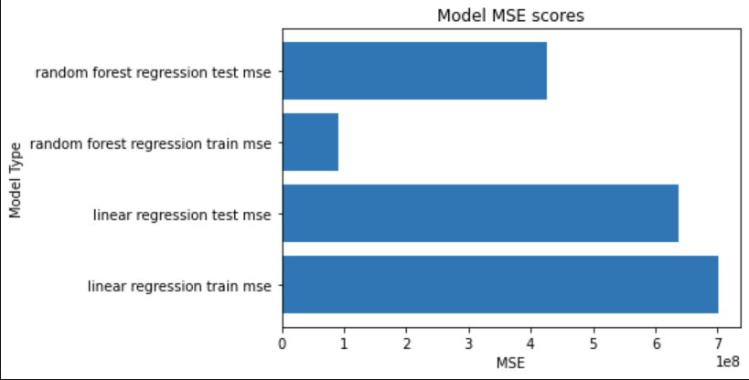
Model Comparison
Random Forest performed better than the Linear Regression
Random Forest was overfit to training data
Linear Regression was more balanced between training and testing

Slide 16
Lessons Learned / Future works
Start with Random Forest first and add features based off of Random Forest Feature importance
Any feature with a set less than 15 features should be categorical dummy variables
Don’t assume linearity scaling
All dummy/categorical variables should not be included in correlation analysis (determination of excluding collinearity)

Slide 17
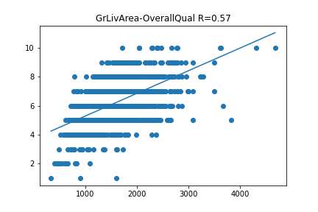
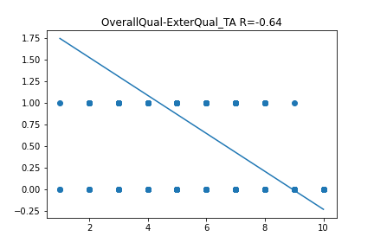
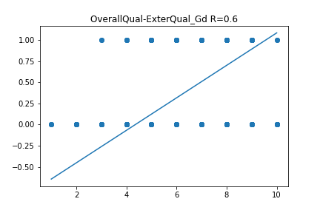
Overall Quality was not included in linear model due to Collinearity
"ExterQual_TA”, ”GrLivArea", "ExterQual_Gd"

Slide 18
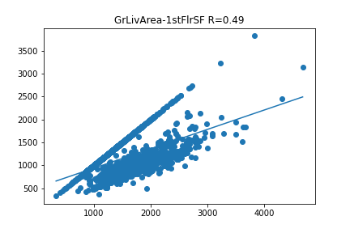
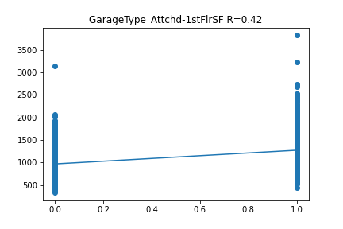
1stFlrSF was not included not included in linear model due to Collinearity
”GrLivArea", “GarageType_Attchd”

Slide 19
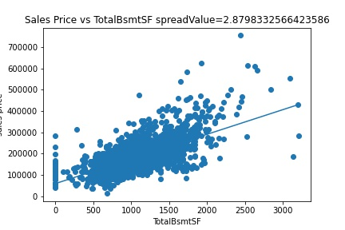
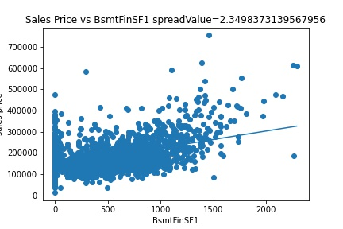
Totalbsmtsf and BSMTFINSF1 could not transform
Trying to apply power law or box cox worsened fit

Slide 20
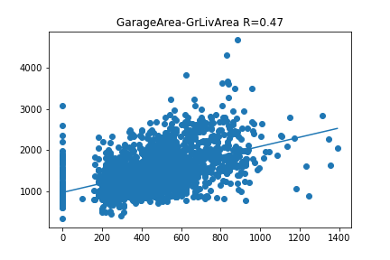
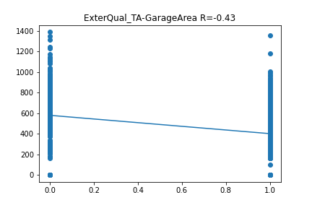
GarageArea was not included not included in linear model due to Collinearity
“GrLivArea”, “ExterQual_TA”

Slide 21
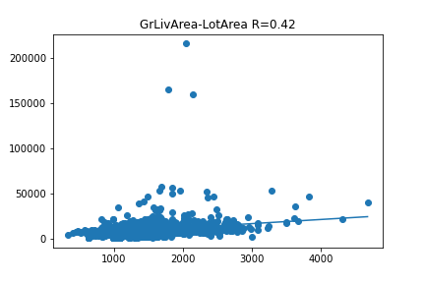
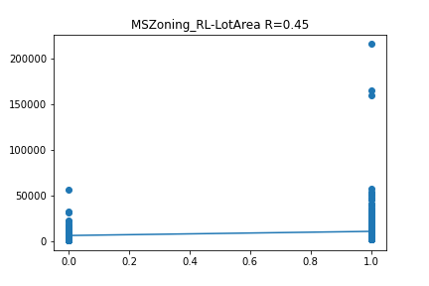
LotArea was not included not included in linear model due to Collinearity
“GrLivArea”, “MSZoning_RL”

Slide 22
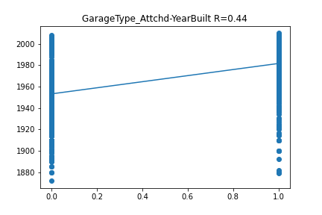
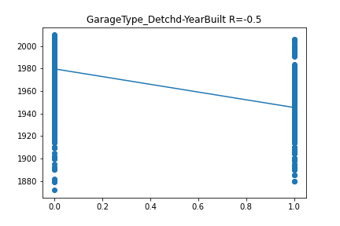
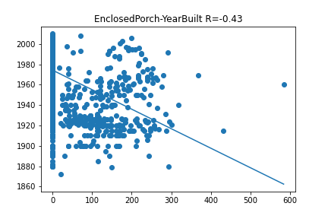
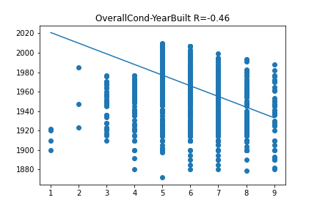
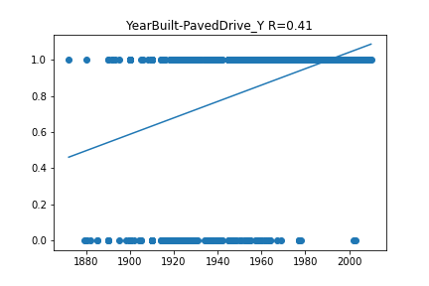
YEarBuilt was not included not included in linear model due to Collinearity

Slide 23
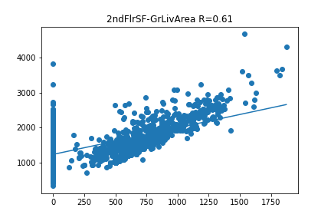
2ndFlrSF was not included not included in linear model due to Collinearity
“GrLivArea”

Slide 24
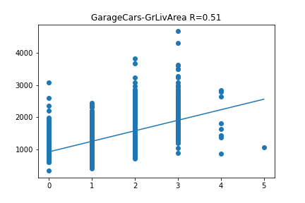
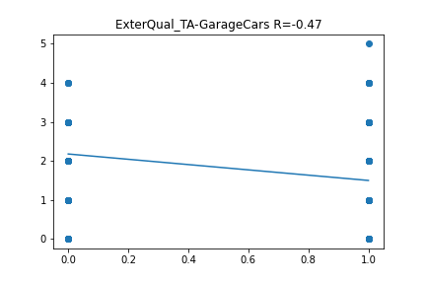
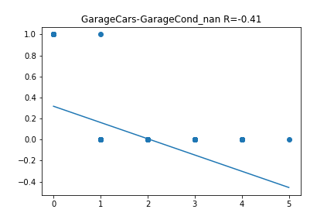
GarageCars was not included not included in linear model due to Collinearity
“GrLivArea”, ”ExterQual_Gd”, ”GarageCond_nan”

