Slide 1
Covid 19 Vaccine Tracker– Correlation Study
Gary Garth Simmons
15 October 2021

Slide 2
Vaccination rates are different amongst countries
Vaccines are ready and available here in the U.S.
However, when talking to colleagues in India and family in Trinidad, that’s not the case
My question: why is that so?

Slide 3
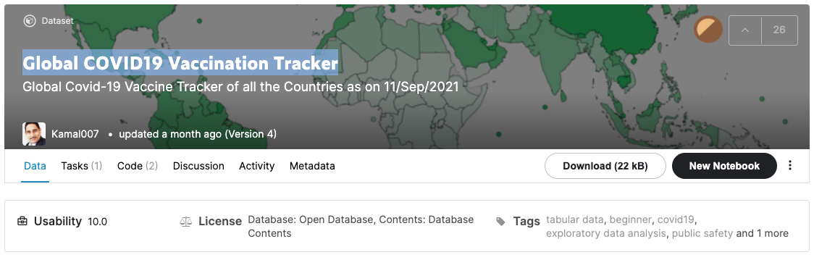
Kaggle dataset: Global COVID19 Vaccination Tracker
GDP_PerCapita.csv
Global_Covid_Vaccination_Tracker.csv

Slide 4
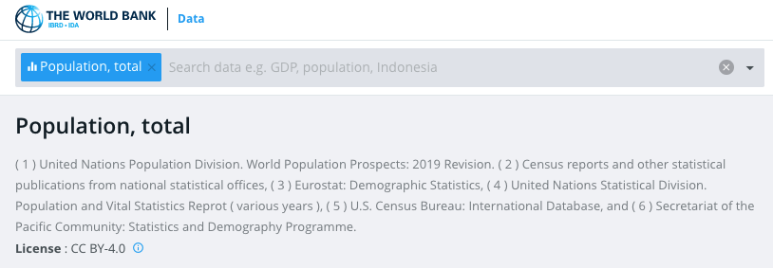
Population data from The World Bank
Chose 2020 for population data

Slide 5
Features/Targets of interest
Population
GDP
Enough vaccines for % of population
Daily dose rate
% of population fully vaccinated

Slide 6
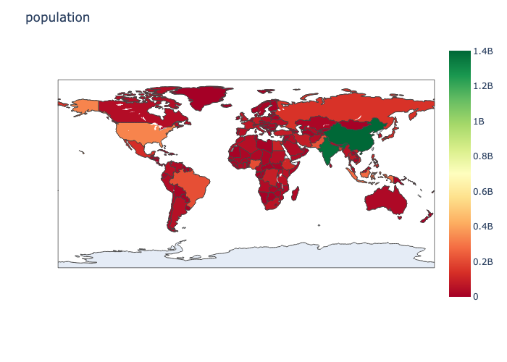
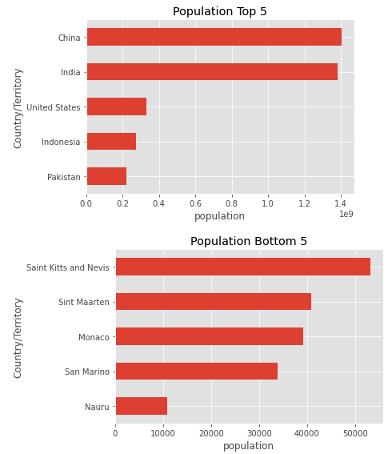
Population

Slide 7
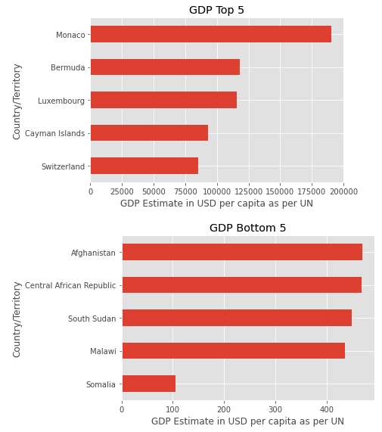
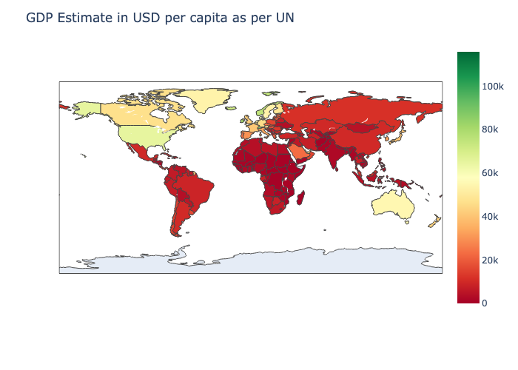
GDP

Slide 8
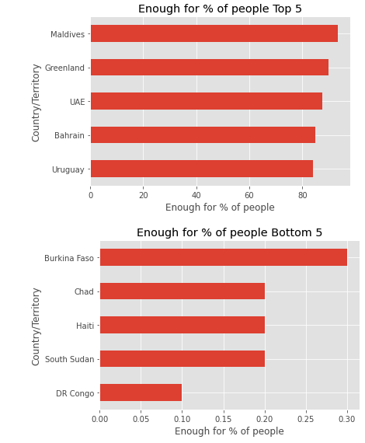
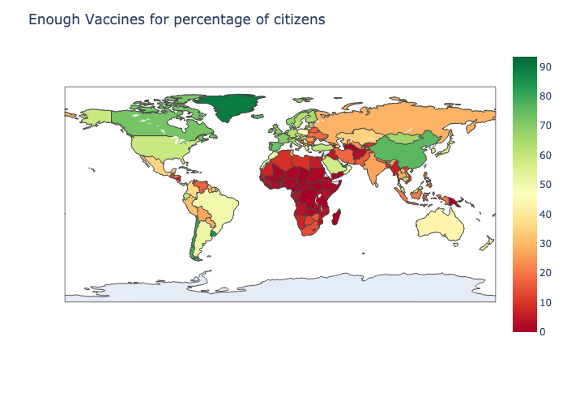
Enough vaccines for % of population

Slide 9
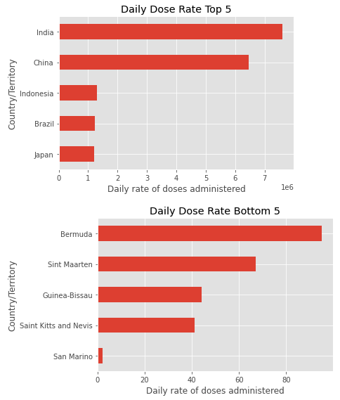
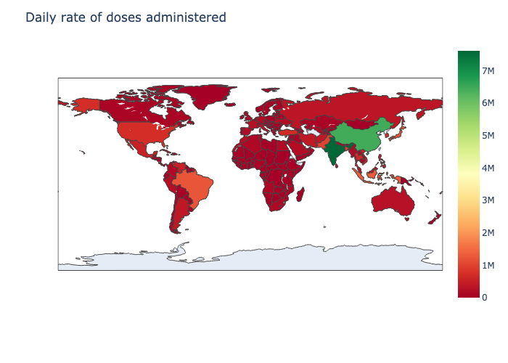
Daily dose rate

Slide 10
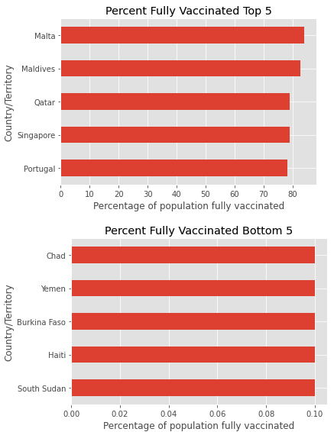
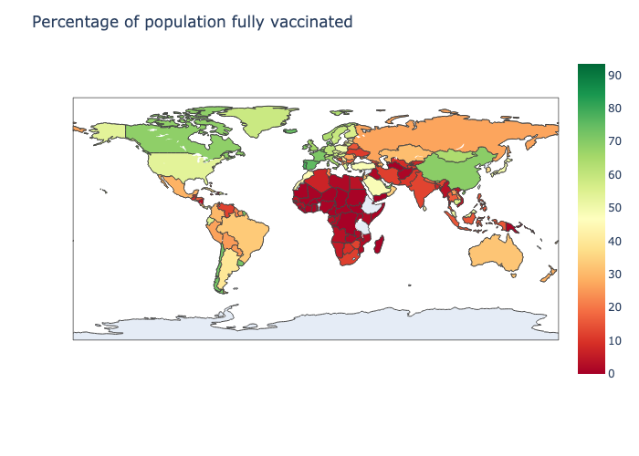
% Fully vaccinated

Slide 11

Correlations
None of the data is normally distributed
Spearman with Lowess Regression line
 | Population | GDP | Enough for % | Daily Dose | % fully vac.
Population |  | X
GDP
Enough for %
Daily Dose

Slide 12
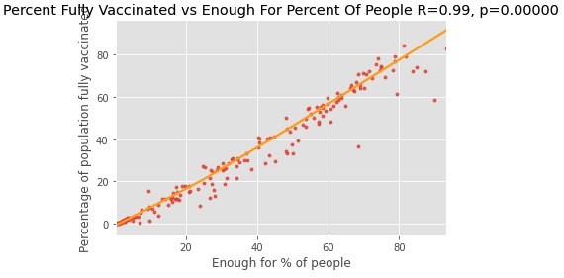
Significant correlation with Enough doses for % of population and % fully vaccinated
Dishing out vaccine at maximum capacity

Slide 13
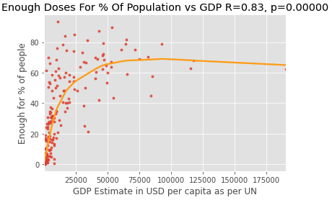
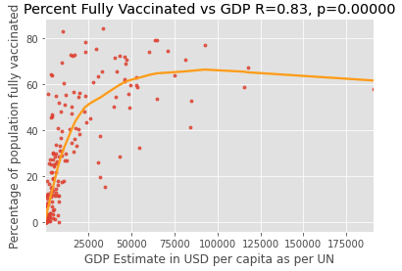
Significant correlation with GDP and the 2 highly correlated vaccine targets
GDP affects how many doses a population gets. In turn also affects how many can get fully vaccinated

Slide 14
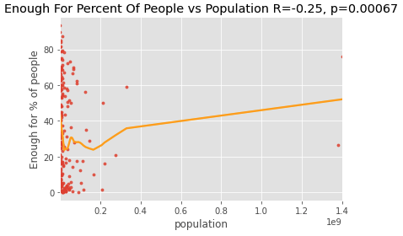
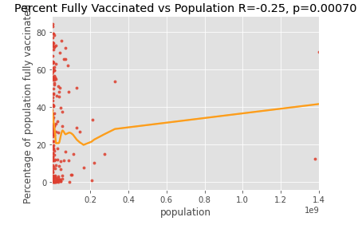
Significant anti-correlation with population and the 2 highly correlated targets
The more population a country has, the harder it will be to becoming fully vaccinated

Slide 15
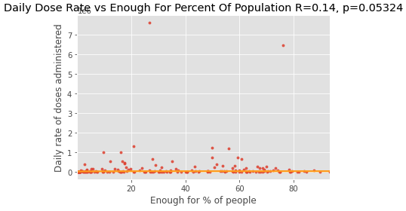
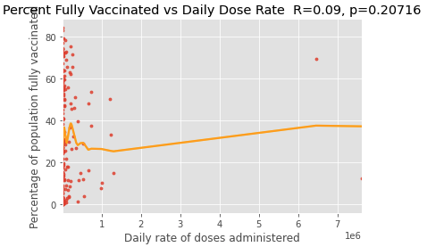
There is no significant correlation between daily doses and the 2 highly correlated targets
Enough vaccines for % of population does not affect the daily dose number.
Daily dose number does not affect % fully vaccinated

Slide 16
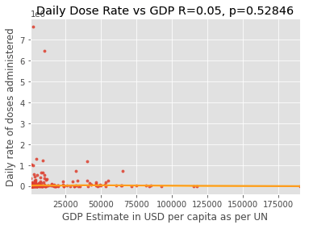
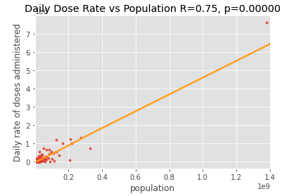
More daily dose correlations
No significant correlation between daily dose and GDP
There is a significant correlation between population and daily dose rate

Slide 17
Significant Correlations and reasonings
Enough vaccines for % of population significantly correlates with percent fully vaccinated, meaning we’re vaccinating at full capacity
GDP significantly correlates with Enough vaccines for % of population and percent fully vaccinated, meaning well off countries vaccinate faster
Population significantly anti-correlates with Enough vaccines for % of population and percent fully vaccinated, due to higher demand for the vaccine due to large populations
Daily dose numbers significantly correlates with population; large populations have a higher demand than small populations

Slide 18
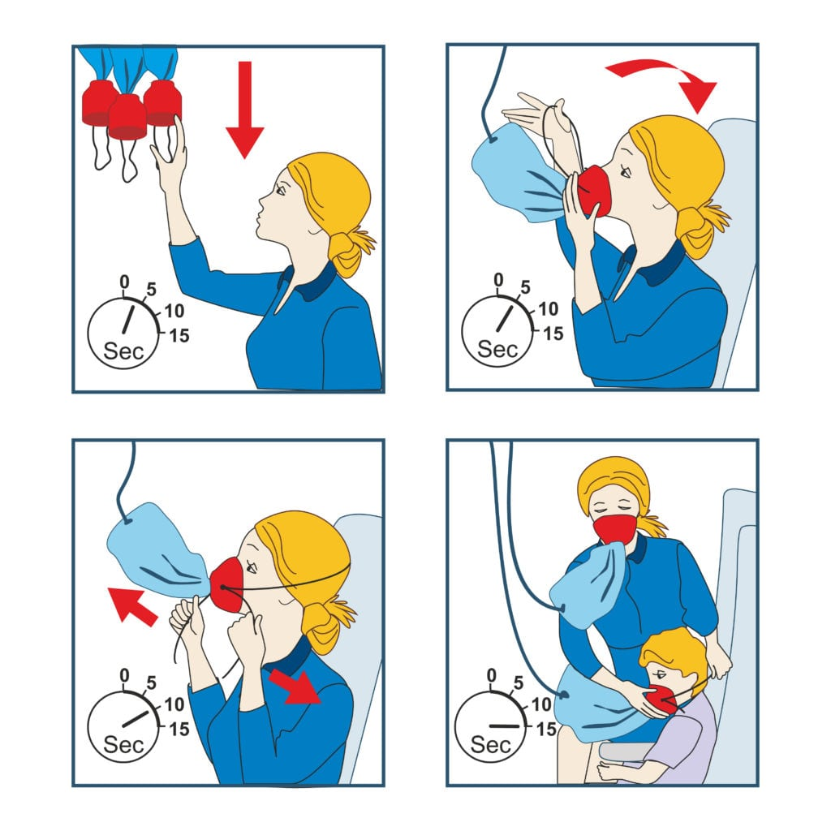
Large population and low GDP have low vaccination percentages.
To avoid suggesting a pure socialist or pure capitalist solution, lets suggest the oxygen mask approach.
Get well off countries vaccinated enough to herd immunity, then funnel vaccines to poorer countries.
The faster we do this, the faster we can stop variants
Image courtesy of campuspeak: https://campuspeak.com/wp-content/uploads/IMAGE4-1024x1024.jpg

Slide 19
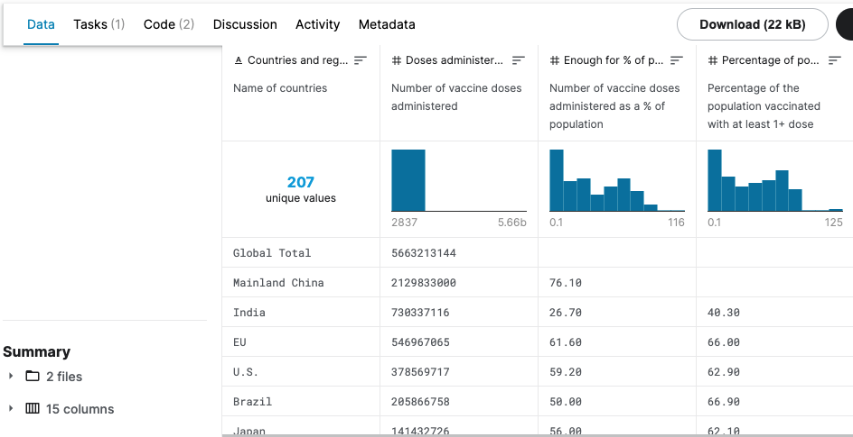
Future works
Looking into doses administered
Overlooked since larger number may not indicate that population is fully vaccinated. This should be tested, not assumed.

Slide 20
Thank you.
Data sources
Global COVID19 Vaccination Tracker:
https://www.kaggle.com/kamal007/global-covid19-vaccination-tracker?select=Global_COVID_Vaccination_Tracker.csv
World Bank Population, total:
https://data.worldbank.org/indicator/SP.POP.TOTL

