Slide 1
California Drought Analysis 2020
Gary Garth Simmons
24 July 2020

Slide 2
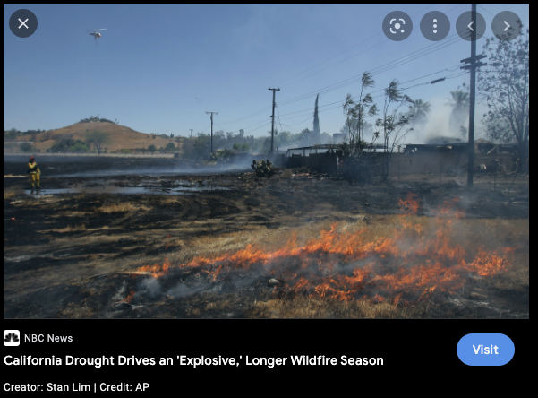
California weather
California is notorious for their wildfires
Due to climate change, wildfires worsen
Wildfires tend to form around dry areas
Lets look at the drought statuses of these areas

Slide 3
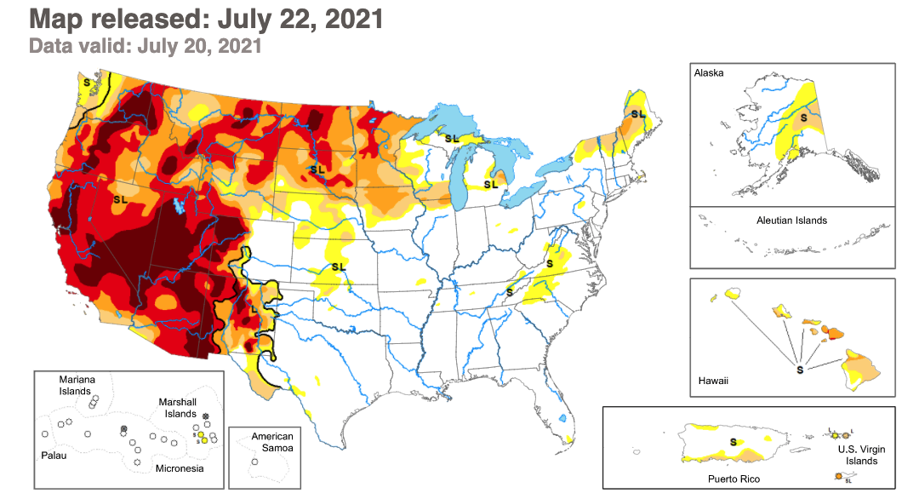
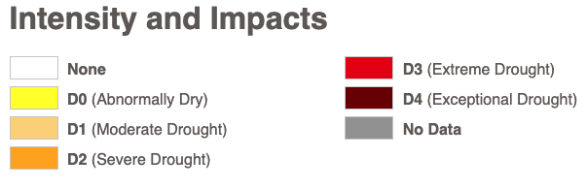
US Drought Monitor
Updates drought statuses of counties, states, and the nation weekly

Slide 4

What to do about the no drought weeks
When downloading the data, we download based on threshold (e.g. D0,D1,D2, etc…)
We’re missing no drought weeks
No drought = -1

Slide 5
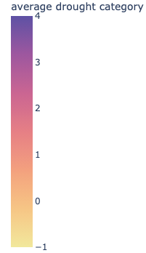
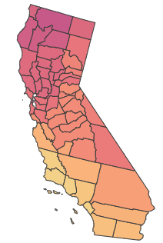
Choropleth of average drought category
Inyo and San Bernardino were the only ones with D4
What’s going on up north?
Choosing Trinity

Slide 6
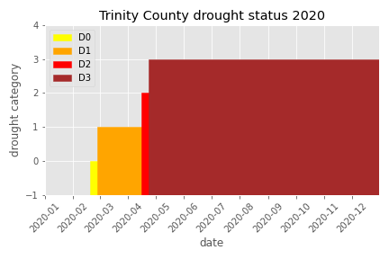
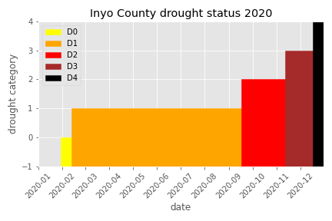
Time series using consecutive weeks

Slide 7
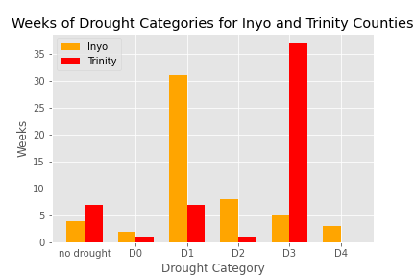
Bar chart of non-consecutive weeks

Slide 8
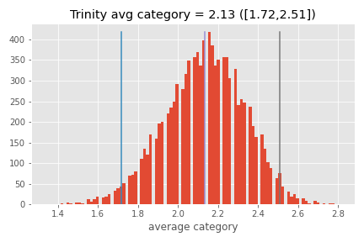
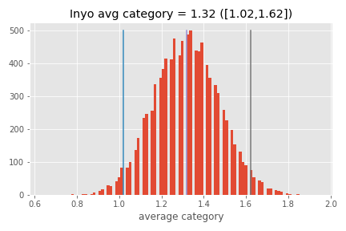
95% Confidence Interval from bootstrap

Slide 9
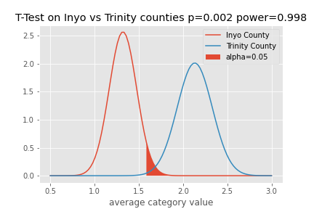
T-test

Slide 10
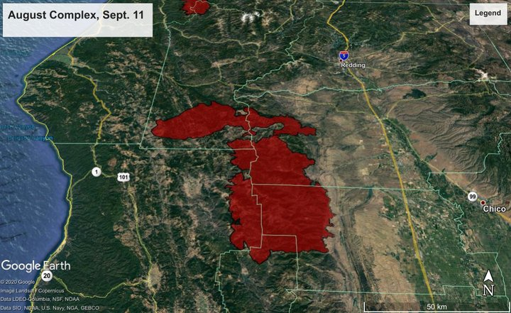
Conclusions
Rejecting the null hypothesis, Trinity has a larger average drought category than Inyo.
Based on choropleth, time series graph, non-consecutive weeks bar chart, and bootstrapped mean, Trinity has experienced longer and worse drought than Inyo.
August Complex Fire (11 Sept 2020)
Future works:
Correlate with a fire database

Slide 11
Sources
Lim, Stan. California Drought Drives an 'Explosive,' Longer Wildfire Season. NBC News, April 25, 2015. https://www.nbcnews.com/storyline/california-drought/california-drought-drives-stronger-longer-wildfire-season-n347671.
Sims, Hank. Overview of the 726,000-Acre August Complex Fire — the Largest Wildfire in California History — as of This Morning. FIRE ROUNDUP: The August Complex, Which Is Threatening the Southeast of the County, Is Now the Largest Wildfire in California History; Red-Salmon, Slater Fires Continue to Grow. Lost Coast Outpost, September 11, 2020. https://lostcoastoutpost.com/2020/sep/11/fire-roundup-sept-11/.
US Drought Monitor. Accessed July 1, 2021. https://droughtmonitor.unl.edu/.

