Slide 1
Global Powerplant Tracker Shiny App
Gary Garth Simmons

Slide 2
Outline
Introduction
Shiny App Questions

Slide 3
Sources of energy contested
Many liberal groups are interested in renewable energy
Conservative groups desire to stick with traditional sources of energy
However, it would be good to help future powerplant builders determine what is most effective and efficient

Slide 4
Questions
Country based questions
What powerplant type produced the most energy?
How does the energy production fluctuate over time?
How many plants of each type is built?
Type based question
What countries are building a specific type of plant?

Slide 5
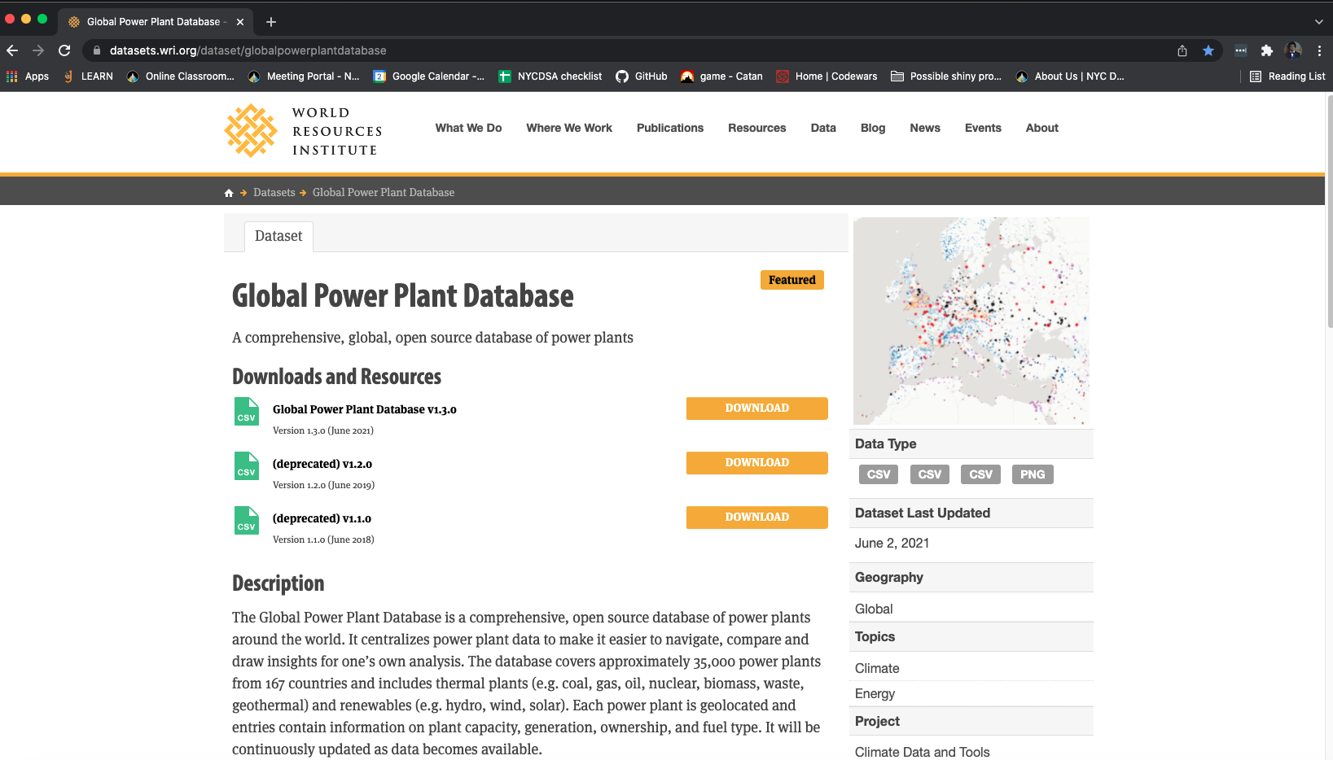
Global Power Plant Database
https://datasets.wri.org/dataset/globalpowerplantdatabase

Slide 6
Data clean up
Replaced nans with zeros
Narrow years of interest between 2013 & 2017
Removed powerplants with no energy outputs
Averaged estimated energy and actual energy outputs

Slide 7
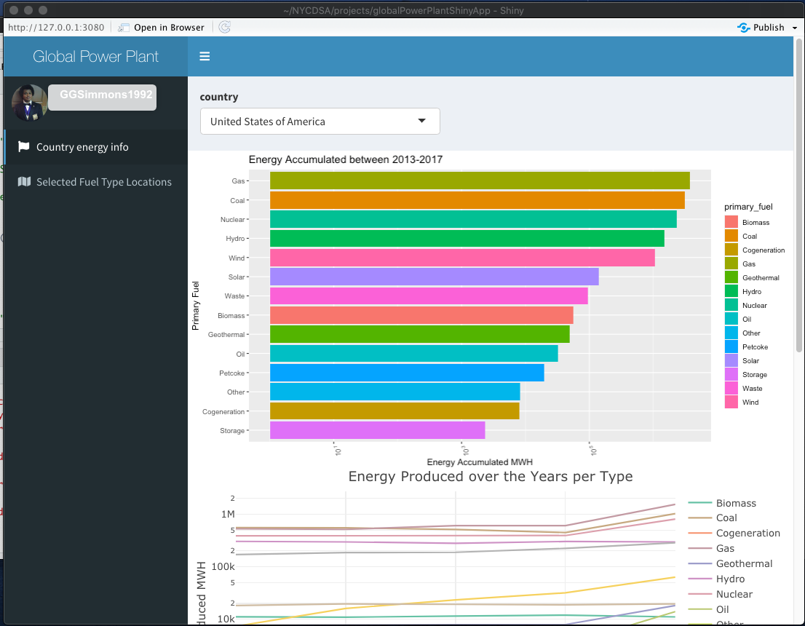
Shiny App

Slide 8
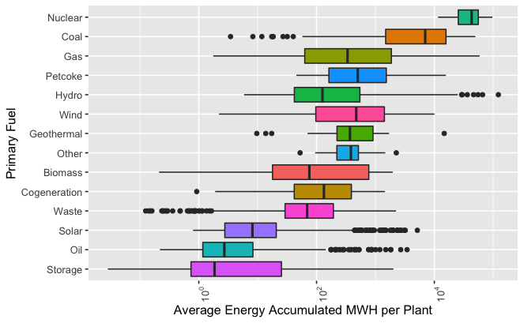
Future works for Shiny App
P=2.587867e-06

Slide 9
Oil Verses Wind Conclusions Based on USA Data & Fuel Type Map
Worldwide there is larger number of wind plants than oil plants
Due to party oscillation due to administrations we have similar number of wind based power plants to oil based power plants
When looking at both time based line plot and total accumulated energy bar chart, and the future works boxplot wind energy production out performs oil energy production

