Slide 1
PREDICTIVE MAINTENANCE ANALYTICS
Motivation: For most engineering industries (manufacturing, aviation, mining, oil & gas, etc.), downtime due to unanticipated equipment failures can be very costly.
On average, the True Downtime Cost (TDC) for automotive manufacturers is USD 22,000/min. (i.e. $1.3M per month!!) [Tran & Pham, 2016]
Acc. To MESA (2016), only 14% of member companies use manufacturing data in analytics.
How Can We Reduce Downtime Cost from Mission-Critical Equipment Failures?

Slide 2
PREDICTIVE MAINTENANCE ANALYTICS
The Data: Aircraft Engine Data from NASA Ames Prognostics Data Repository
Project Goals:
To build a ML model for predicting imminent machine failure
To build a regression model for predicting the remaining useful life (RUL)

Slide 3
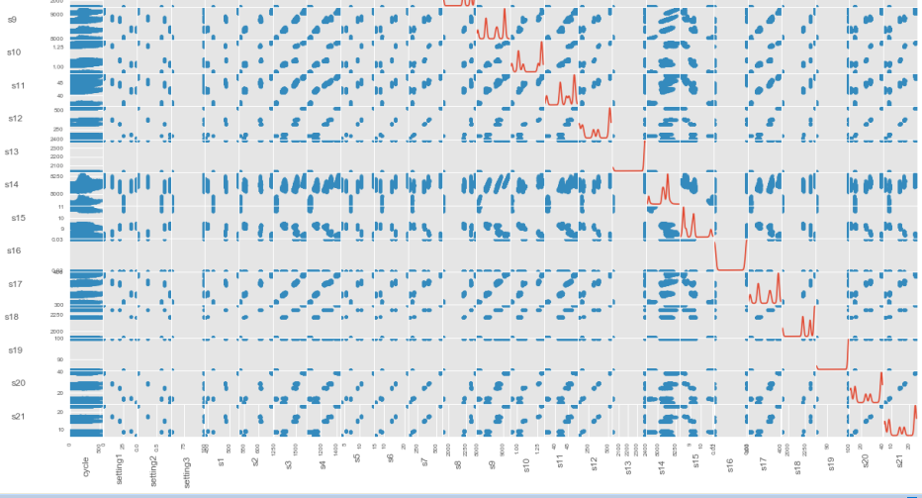
PREDICTIVE MAINTENANCE ANALYTICS
INITIAL EXPLORATORY ANALYSIS

Slide 4
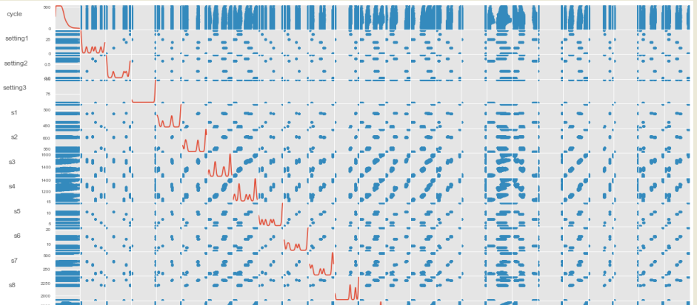
PREDICTIVE MAINTENANCE ANALYTICS
INITIAL EXPLORATORY ANALYSIS

Slide 5
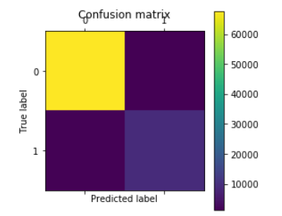
PRELIMINARY MODEL TRAINING & RESULTS
Performed binary classification
10-fold cross-validation
Models: k-NN, Logistic Regression
Logit Model Results:
Train Accuracy: 93.1%
Test Accuracy: 93.1%
ROC AUC: 0.984
K-NN Model Results:
Train Accuracy: 97.07%
Test Accuracy: 96.40%
ROC AUC: 0.987
 | Predicted Success | Predicted Fail
Actual Success | 67820 | 1042
Actual Fail | 1828 | 9028

Slide 6
PROPOSED FUTURE WORK AT DATA INCUBATOR
Further Exploratory Analysis
Feature Engineering / Feature Selection
Model Training Using Different Algorithms
Upsampling / Increasing penalty for False Negative predictions
Model Parameter Tuning
Model Performance Evaluation
Model Deployment

