Slide 1
Bidirectional Learning for Offline Infinite-width Model-based Optimization
Can (Sam) Chen, Yingxue Zhang, Jie Fu,
Xue (Steve) Liu, Mark Coates
Accepted by NeurIPS2022
Presenter: Can (Sam) Chen
2022.10.18

Slide 2
Contents
Problem
Related Work & Motivation
Method
Experiments
Discussion

Slide 3
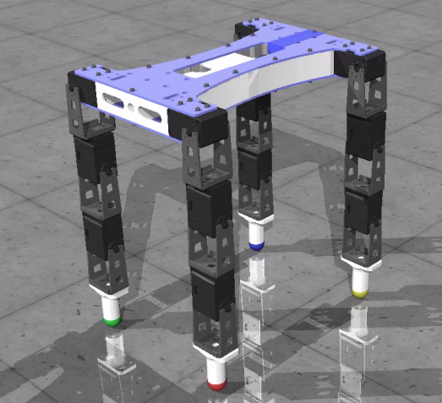

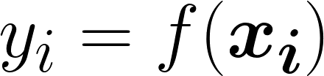
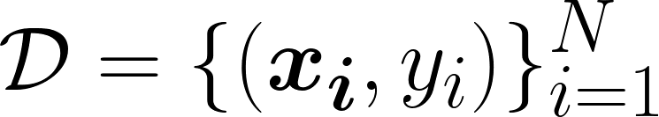


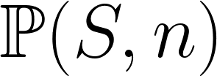
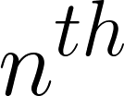

Problem
[1]
: some design (the structure of a robot);
: some property (the robot speed);
: a static dataset;
: some algorithm outputs candidates;
A 60-D continuous vector to parameterize the structure including size, orientation, etc; Robotic simulation to obtain speed.
: the percentile of .
[1] Trabucco B, Kumar A, Geng X, et al. Design-bench: benchmarks for data-driven offline model-based optimization[J]. 2020.

Slide 4
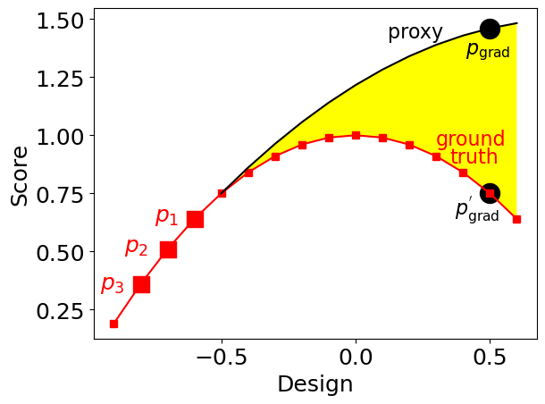
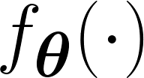
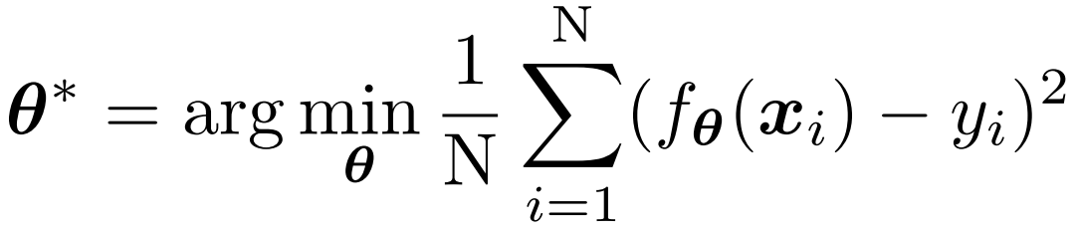
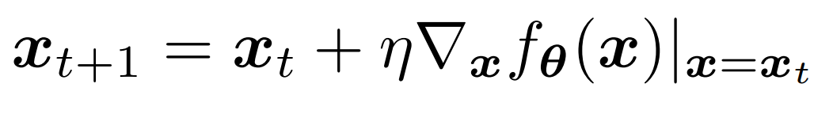

Related Work & Motivation
A common approach:
fit a DNN proxy :
2) perform gradient ascent:
The proxy overestimates the ground truth objective function, and the seemingly high-scoring design obtained by gradient ascent has a low ground truth score.

Slide 5
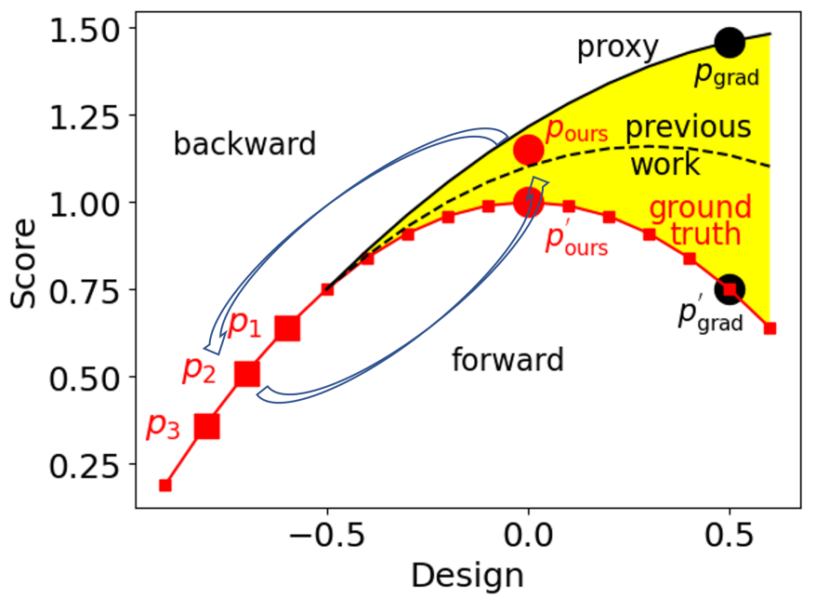


Related Work & Motivation
Previous works [2,3,4] try to:
better fit the proxy to the ground
truth from a model perspective;
2) obtain high-scoring designs by
gradient ascent regarding the proxy.
Our motivation:
Use the proposed design
to predict the static dataset .
This can distill more information
from to .

Slide 6
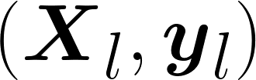
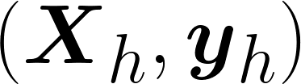
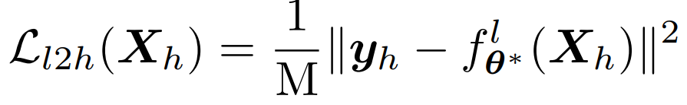
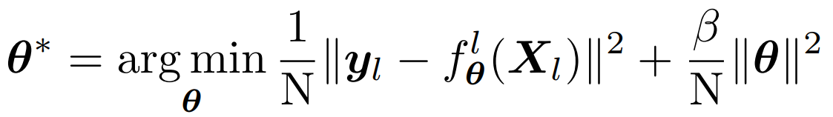


Method: Bidirectional Learning
We propose bidirectional learning: 1) forward mapping & 2) backward mapping.
Forward mapping leverages to predict ,
where is a predefined large score and is the regularization.
Forward mapping is similar to gradient ascent: both try to increase the score.
: size-N static dataset.
: size-M high-scoring designs.

Slide 7
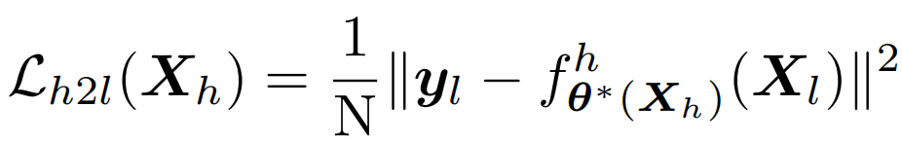
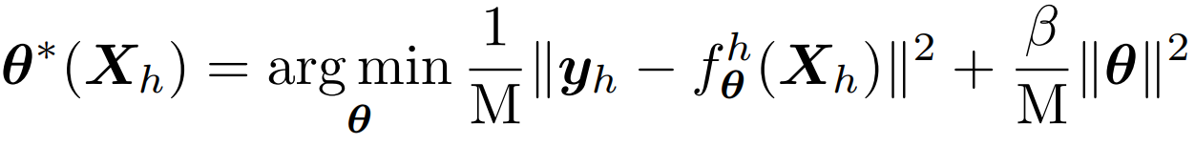
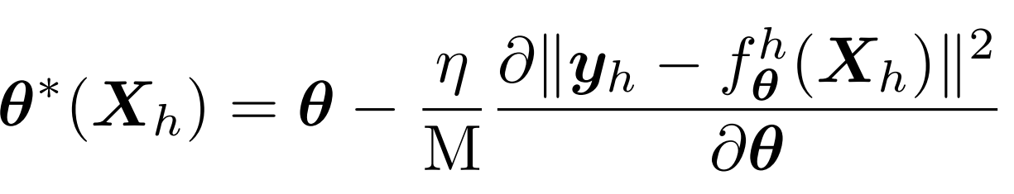

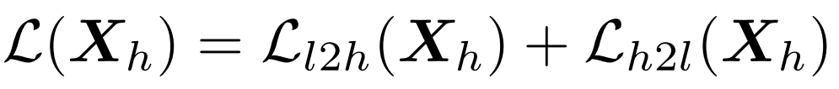

Method: Bidirectional Learning
backward mapping leverages to predict ,
The overall bidirectional learning can be written as,
where the only learnable parameters are the high-scoring designs .
No closed-form solution
for a finite-width NN:
where is learning rate.

Slide 8
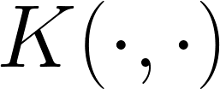
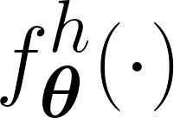
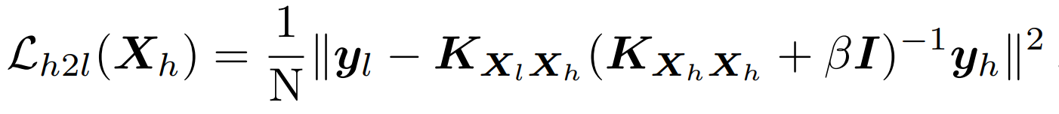
Method: Closed-form Solver
We thus adopt an infinite-width NN[5] and its neural tangent kernel .
can be computed via the neural-tangents library [6].
Infinite-width NN

Slide 9
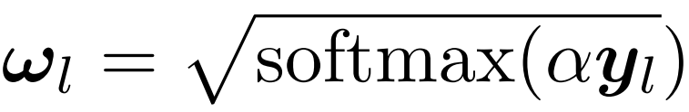

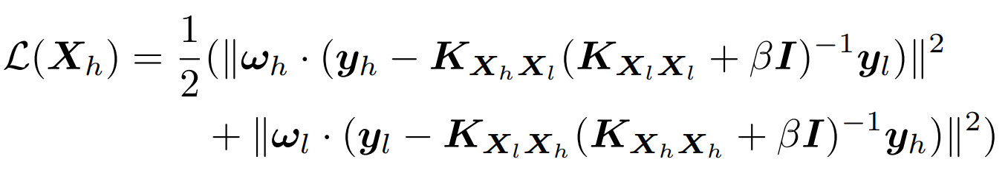
Method: BDI
To focus on higher-scoring designs in the static dataset, we introduce,
where the weight parameter is a constant.
We then recompute the backward mapping loss as,
The overall loss can be compactly written as,
To sum up, we propose BiDirectional learning for offline Infinite-width model-based optimization (BDI)

Slide 10
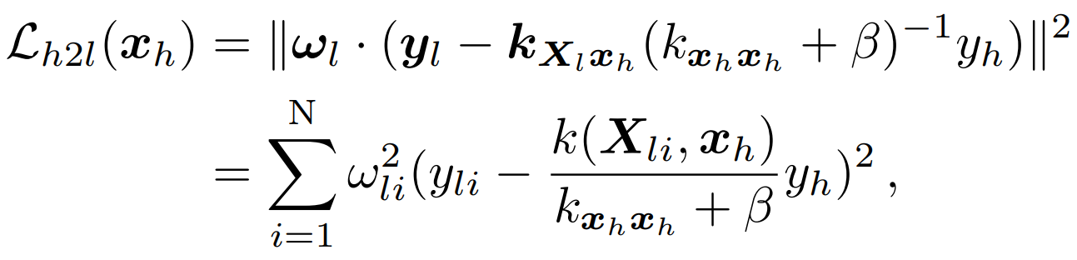
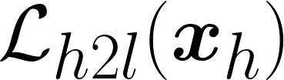
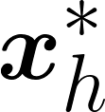
Method: Analysis of M=1
measure the similarity
a large predefined score
By minimizing , we aim to find a high-scoring such that:
any design similar to is encouraged to have a high score prediction.
In this way, tries to incorporate as many high-scoring features from the static dataset as possible.

Slide 11
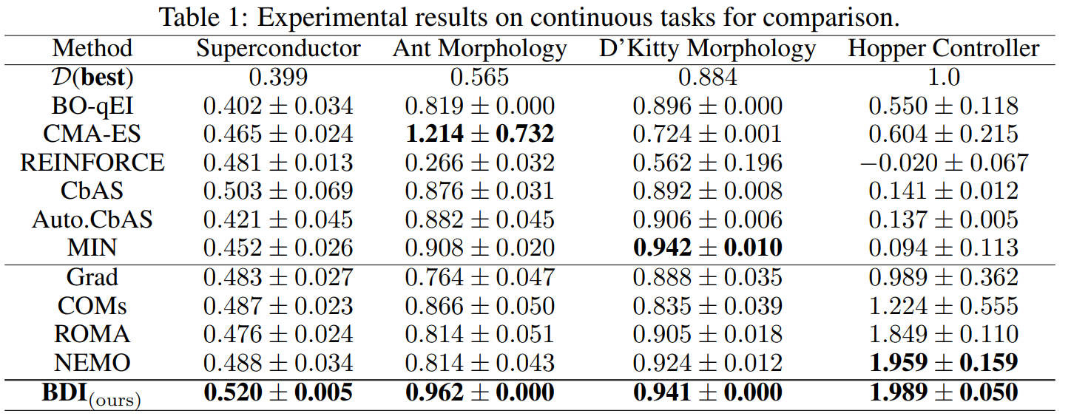
Experiments: Continuous Tasks
We conduct experiments on design-bench [1].

Slide 12
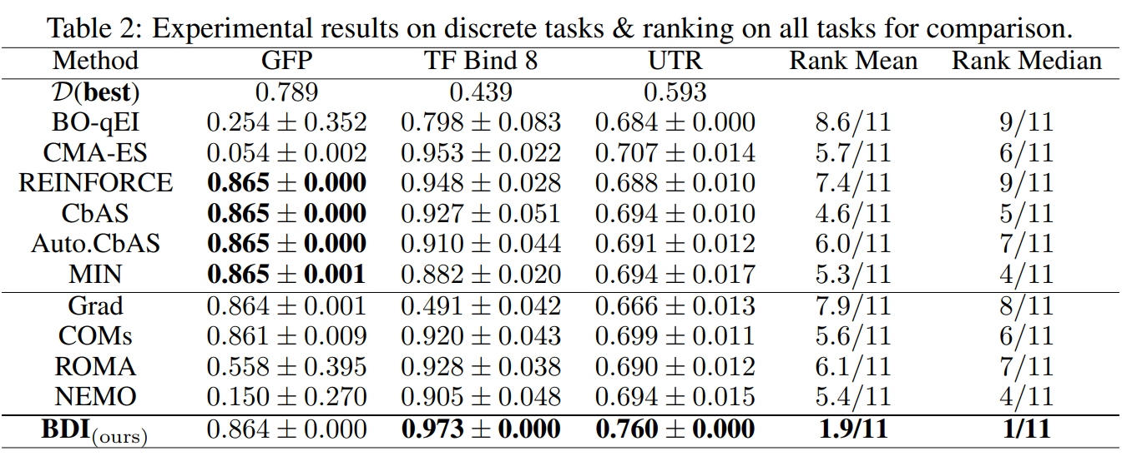
Experiments: Discrete Tasks

Slide 13
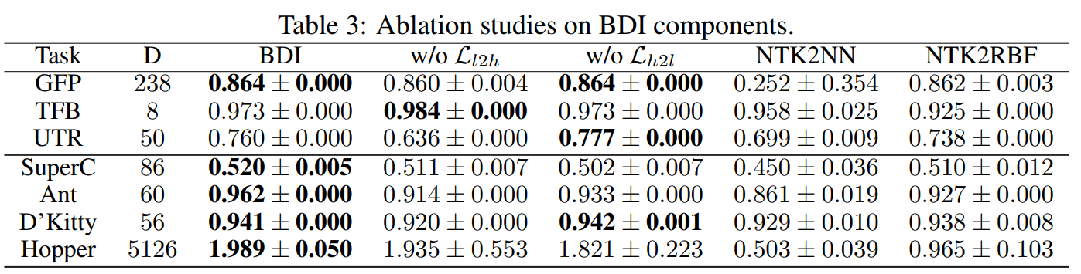
Experiments: Ablation Studies
Both forward mapping and backward mapping matter.
Replace NTK with its finite NN: NTK2NN is worse than BDI, especially for high-D tasks; high-D designs are more sensitive to the approximation.
Replace NTK with RBF: NTK2RBF is worse than BDI; the NTK enjoys the high expressiveness of a NN.

Slide 14
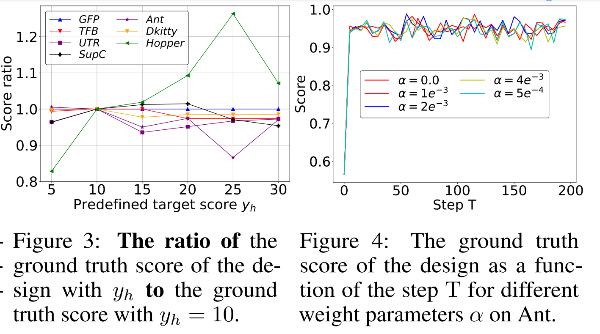
Experiments: Hyperparameter Sensitivity

Slide 15
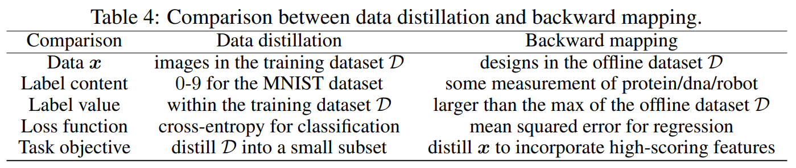
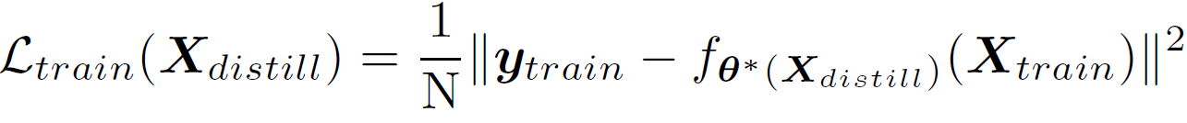
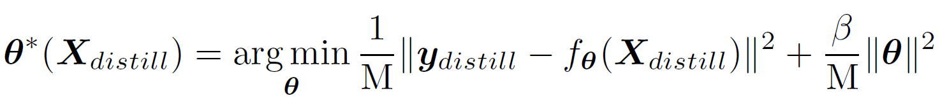
Discussion: Dataset Distillation

Slide 16
Discussion: Conclusion and Beyond
Conclusion: we address offline model-based optimization and propose bidirectional learning for offline infinite-width model-based optimization (BDI).
Drawback: BDI relies on the NTK of an infinitely wide NN, which cannot learn features because of its parametrization [1]. This prevents the incorporation of powerful pre-trained language models that can capture the rich biophysical information in millions of biological sequences.
Future: A promising future direction is to explore how to incorporate rich biophysical information into bidirectional learning.

Slide 17
Thanks for listening!

