Slide 2
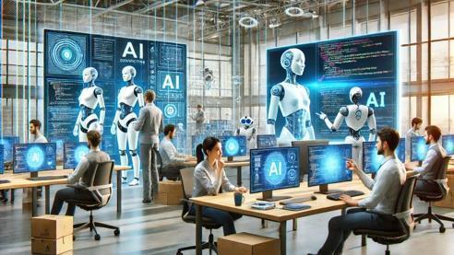
Software Engineers in the AI Era
The Future of Software Development
Svetlin Nakov, PhD
Co-Founder, Innovation and Inspiration Manager @ SoftUni

Slide 3
Table of Contents
AI Tools for Developers: Evolution
AI Chatbots for Coding (ChatGPT, Claude)
AI Coding Assistants (Cursor, GitHub Copilot, Tabnine)
AI Developer Agents (Devin, Code Droid, AutoCodeRover)
AI as a Tool for Developers, not a Replacement
Shifting Developer Skillsets to Adopt AI
Developer Job Market: Evolution

Slide 4

About Svetlin Nakov
Software engineer, educator, tech entrepreneur, author of 16 books, PhD
nakov.com
4 successful tech education initiatives
National Academy for Software Development (NASD) – 2004
Telerik Software Academy – 2009
SoftUni (Software University) – 2014
IT School "SoftUni BUDITEL" – 2018

Slide 5
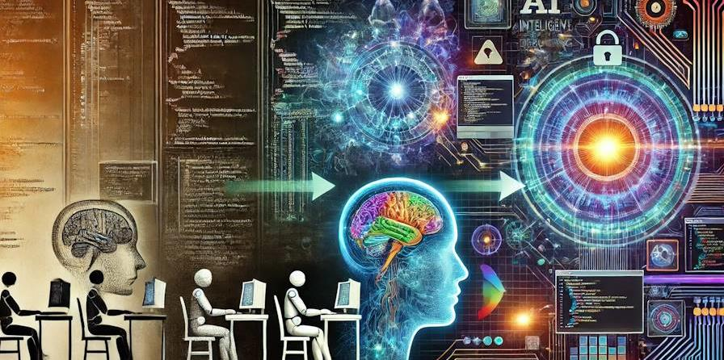
AI Tools for Developers
Evolution: AI Chatbots → AI Coding Assistants → AI Dev Agents

Slide 6
AI Tools for Developers are Improving!
AI-powered development tools are getting better and better over the time
How AI helps developers today?
AI-powered auto-complete: smart code completion
Automation of coding tasks: refactoring, bug fixing, code generation
Automated test writing and with auto code coverage
Explanation of code: on-demand AI-generated documentation
Auto code reviews and AI security checks

Slide 7
Evolution of AI-Powered Coding
Layers of AI-powered coding:
AI Chatbots (like ChatGPT)
AI Coding Assistants (like Cursor)
AI Developer Agents (like Devin)

Slide 8
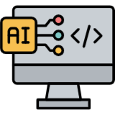
AI Chatbots for Coding
ChatGPT, Claude and Others

Slide 9
AI Chatbots for Coding Get Smarter
AI chatbots (like ChatGPT and Claude) can write code by text prompts
AI prompt → get the code → copy/paste it into your project
Leaders: Claude 3.5 Sonnet, ChatGPT 4o and ChatGPT o1
See https://livebench.ai
AI chatbots are the underlying building blocks of AI-powered code assistants

Slide 10
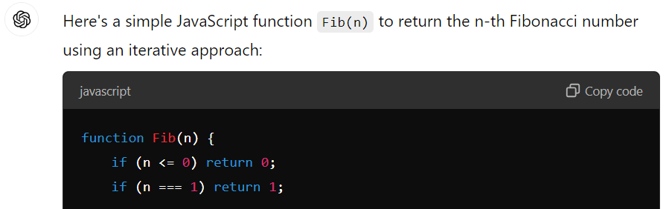
Sample AI Prompt for Coding
AI prompt for simple coding assistance:
Write a JavaScript function Fib(n) to return the n-th Fibonacci number.
Typically, ChatGPT generates a single file

Slide 11
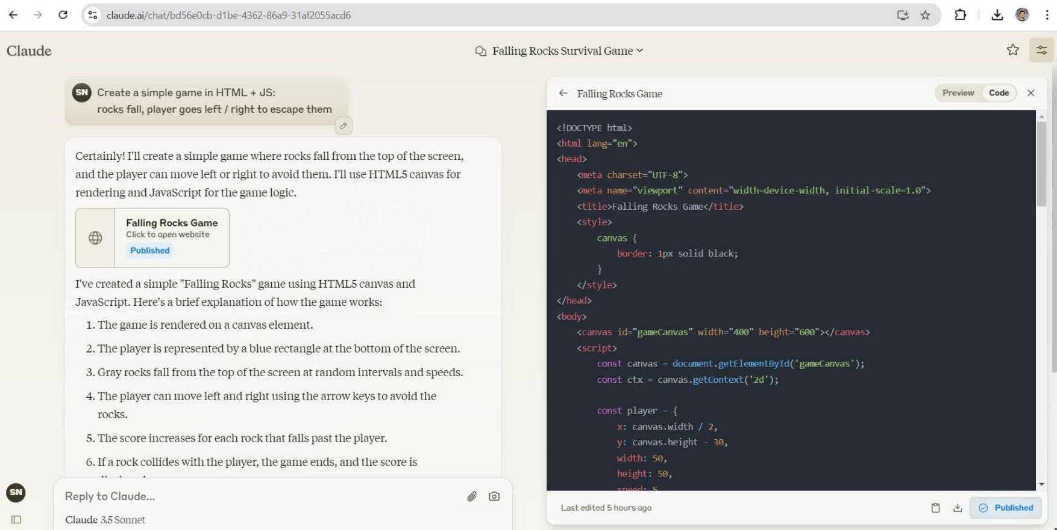
Claude 3.5 Sonnet – Example

Slide 12
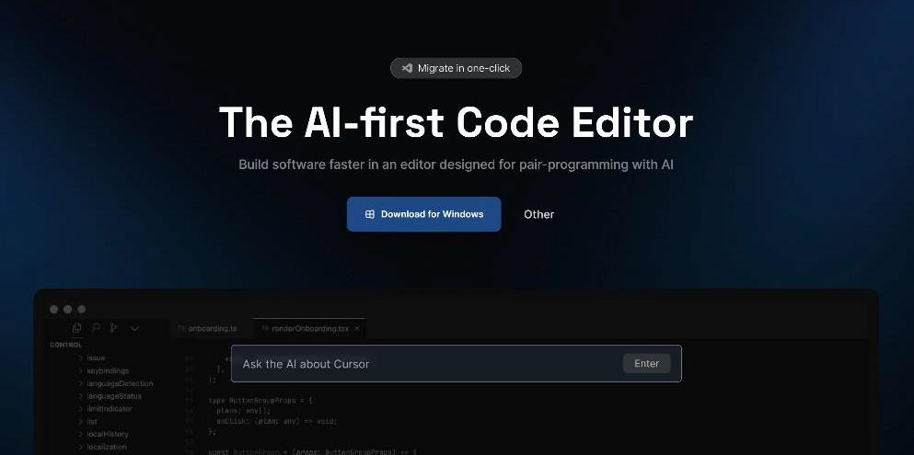
AI Coding Assistants
Cursor, GitHub Copilot, Aide, Tabnine

Slide 13
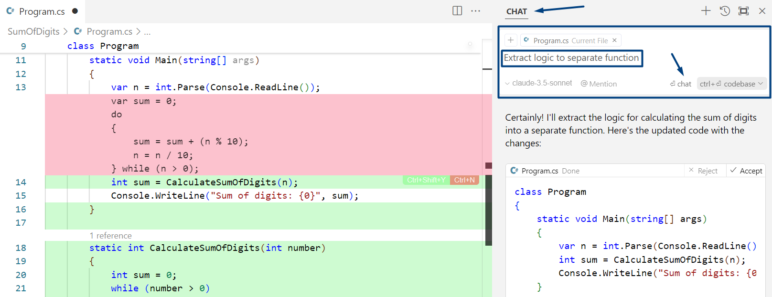
AI Coding Assistants (like Cursor AI)
AI-powered dev assistants integrate into your IDE and interact with your entire codebase through prompts

Slide 14
AI Coding Assistants in Action
Most-popular AI-powered assistants: Cursor AI, GitHub Copilot, Tabnine, Aide
Writing code through AI prompts, in any popular language:
AI prompt → create and implement a plan → review code changes → accept changes → test the code
Sample prompts:
create form: customers (name, phone, email)
add DB table customers
implement controller to save form data in DB

Slide 15
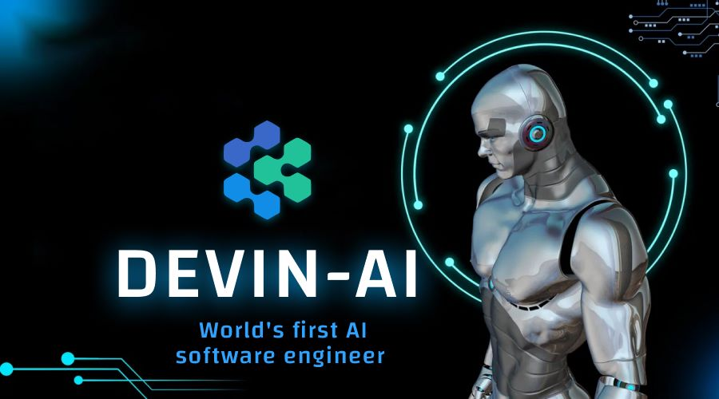
AI Developer Agents
Devin, Code Droid, Honeycomb, Genie, …

Slide 16
AI Developer Agents
AI developer agents (automated AI software engineers) go beyond coding assistance → fully autonomous development
Create end-to-end projects through AI prompts:
Describe the task / project / issue → create plan → auto execute the plan → generate the code and other assets → run and test the project → pull request
Examples: Devin, Code Droid, AutoCodeRover, Honeycomb, Genie, SWE-Agent, Devika, Gru, Aider
Benchmarking at SWE-Bench: https://swebench.com

Slide 17
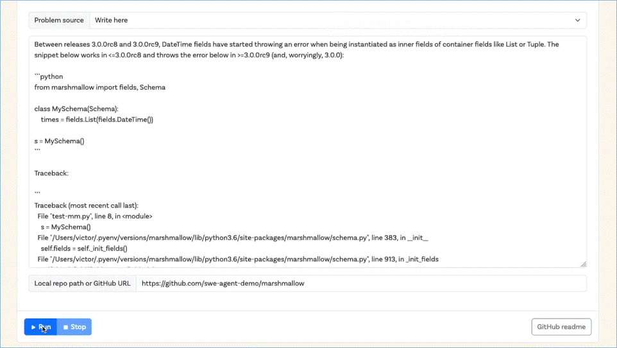
AI Developer Agent – Example

Slide 18
AI Developer Agents: When?
How far are we from AI agents handling large projects autonomously?
Depends on the project!
New or existing codebase
Well-described or briefly described
Small or large / simple or complex
Standard or not standard functionality
Programming languages, frameworks and platforms

Slide 19
Take a Break
Start the timer

Slide 20
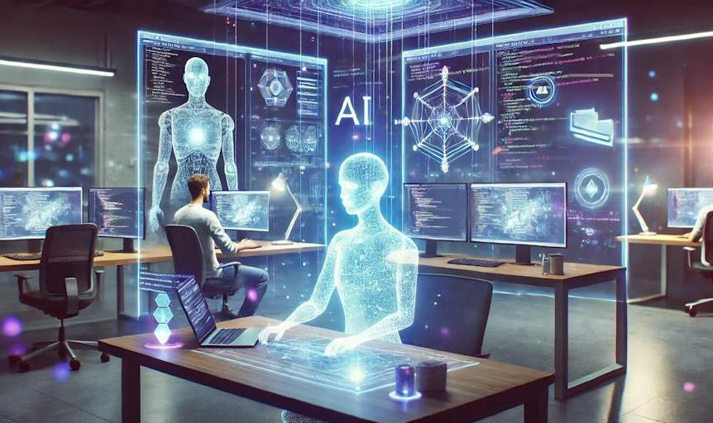
AI is a Tool for Developers
Not a Replacement!

Slide 21
AI Empowers, Don't Replace Devs!
AI tools (dev assistants and coding agents) empower developers, don’t replace them!
Developers are still needed to drive the dev process
Developers are essential for guiding the AI, setting objectives, checking results and solving complex task
Importance of human oversight: biases in code generation, conformance to requirements
Often requirements are not well defined → developers act as analysts, actively communicate with stakeholders

Slide 22
Humans in the AI-Development Era
Software development requires human skills like:
Communication and collaboration: need to collaborate effectively with stakeholders
Critical thinking and problem-solving: creative solutions, adapting to challenges, and understanding complex problems and environments
Domain expertise: a deep understanding of the specific problem domain

Slide 23

Shifting Developer Skillsets
From Writing Code to Writing Prompts

Slide 24
Shifting Developer Skillsets
Developers will work together with modern AI tools, integrating them into their workflows
AI takes over more routine tasks
Developers will need to focus on higher-level skills
Coding skills transforms from “writing code” to “writing AI prompts to generate code”
Statistics: 92% of US-based developers already using AI-powered coding tools at work

Slide 25
Traditional vs. Modern Developer Skillset
Aspect | Traditional Developer | Modern Developer (with AI)
Focus | Writing and debugging code manually | Guiding AI to generate and refine code
Core Skills | Programming languages, debugging | AI tool proficiency, prompt engineering
Task Automation | Manual refactoring and testing | AI-driven automation for routine tasks
Problem Solving | Hands-on problem solving and debugging | AI-assisted problem-solving
Code Reviews | Manual peer review | AI-powered code review and optimization
Documentation | Manually written | AI-generated and updated dynamically
Skill Development | Focus on coding mastery | Focus on integrating AI tools
Error Handling | Manual bug fixing | AI-aided error detection and resolution

Slide 26
New Roles in Software Development
AI-enhanced developer – collaborates with AI tools for code generation, testing, and debugging
AI tool integrator – ensures seamless integration of AI assistants into development workflows and IDEs
AI development manager – manages AI-driven dev projects, coordinating between human developers and AI agents
AI code auditor – reviews AI-generated code for quality, security, and compliance
AI integration specialist – integrate AI technologies into existing software systems

Slide 27

Developer Job Market
Evolution towards AI-assisted Development

Slide 28
Developer Job Market – Evolution
The demand for developers is unlikely to decrease
Developer performance will improve, but demand for software will also increase
The nature of the development work will evolve towards AI-assisted development
Developers who adopt AI-assisted development, will be the winners in the AI era
AI-powered low-code platforms will create basic apps through AI prompts, visual UI and pre-built components

Slide 29
More Examples
Just to Demonstrate Formatting

Slide 30
Code Example
This is a sample HTML code:
<!DOCTYPE html>
<html>
<head>
<title>Sample HTML Page</title>
</head>
<body>
<h1>Hello, HTML!</h1>
</body>
</html>

Slide 31
The "switch-case" Conditional Statement
switch-case works as a sequence of if-else-if-else-if…
switch (…)
{
case …:
// code
break;
case …:
// code
break;
default:
// code
break;
}
The switch starts by an input expression
Sequence of values for checking
Code to execute if no case is matched
Notes:
31

Slide 32

AI for Students
Ethical use of AI
AI as a helper, not a substitute
AI as a mentor and assistant
Help with the study material
Help in solving problems
Exam preparation
Systematization of study materials
The NotebookLM tool

Slide 33
Goods vs. Services
Goods
Objects or system made available for customers
Tangible
Manufactured, stored and transported
Ex: Food, furniture, electronic devices
It can be returned or replaced
Products sold can be identical
Service
Transactions where no physical goods are transferred
Intangible
Can’t be manufactured, stored and transported
Ex: cleaning, car repair, haircuts, medical checkups
Can’t be returned or replaced
Each delivery of service is never the same

Slide 34
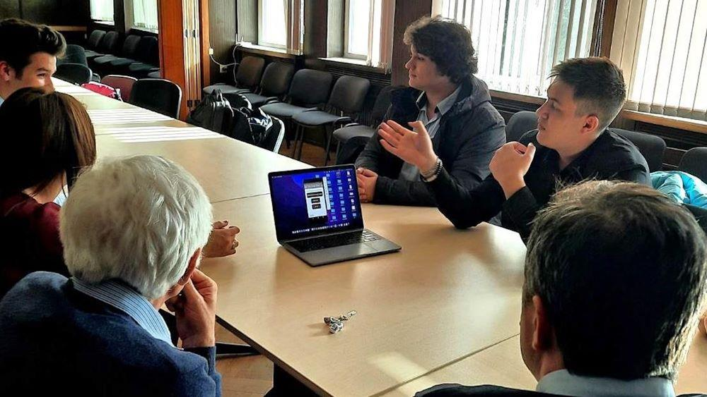
Pitching Your Product

Slide 35
Blank Slide

Slide 36
Homework
Install and run Cursor AI
Using Cursor AI, write a simple game in JavaScript, e.g.
Objects (of size 1 x 1) fall from the top of the screen to the bottom (objects are food, stones, knives)
The player (object 3 x 1) moves left and right and should collect food and avoid the other objects
Each collected object adds score, or causes "game over"
Using AI tool, rewrite the game in Python

Slide 37
Additional Resources
Cursor AI Tutorial
https://datacamp.com/tutorial/cursor-ai-code-editor
SWE-Bench
https://swebench.com
LLM Benchmark
https://livebench.ai
Replit Agent
https://replit.com

Slide 38
Summary
AI tools for developers are improving over the time
Soon or later AI will be used by all developers
Layers of AI-powered coding:
AI Chatbots (like ChatGPT)
AI Coding Assistants (like Cursor)
AI Developer Agents (like Devin)
AI tools empower developers, don't replace them!

Slide 39
Questions?

Slide 40

SoftUni AI
A comprehensive training program for applying AI in business and everyday life
Enroll for the free "AI Basics" course now:
https://ai.softuni.bg

Slide 41

License
This course (slides, examples, code, demos, exercises, tutorials, homework, projects, documents, videos and other assets) is copyrighted content, created by SoftUni
Unauthorized copy, reproduction or use is illegal
© SoftUni – https://softuni.bg
© SoftUni AI – https://ai.softuni.bg

Slide 42


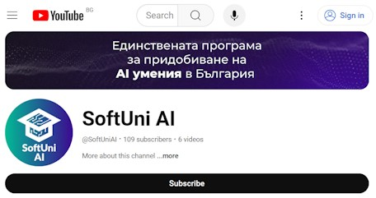
Trainings @ SoftUni AI
SoftUni AI: a comprehensive learning program for applying AI in business and everyday life
ai.softuni.bg
SoftUni AI @ Facebook
facebook.com/SoftUniAI
SoftUni AI @ YouTube
youtube.com/@SoftUniAI

