Slide 1

Super Market Navigation
Course: Multi Objective Optimization Student: Geryes Geryes
January 25

Slide 2
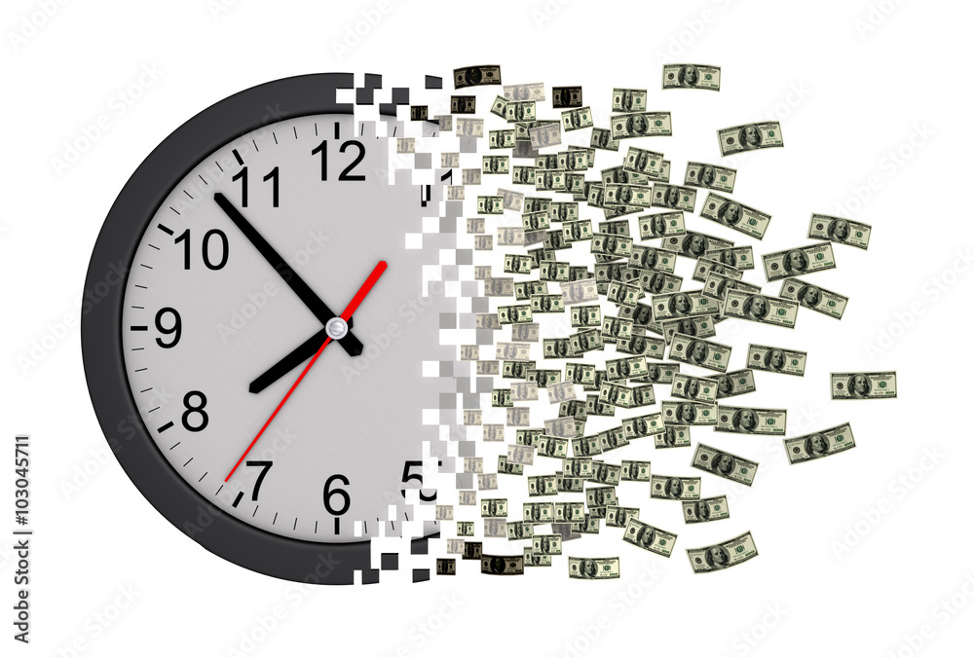

Problem statement
Going through a supermarket, if the path isn’t chosen wisely, the trip will take long time.
Heat sensitive items will spoil if held in cart for a long time.

Slide 3
Problem(s) statement
Going through a supermarket, if the path isn’t chosen wisely, the trip will take long time.
Heat sensitive items will spoil if held in cart for a long time.
Price of products – Leave to politicians !
Two objectives

Slide 4
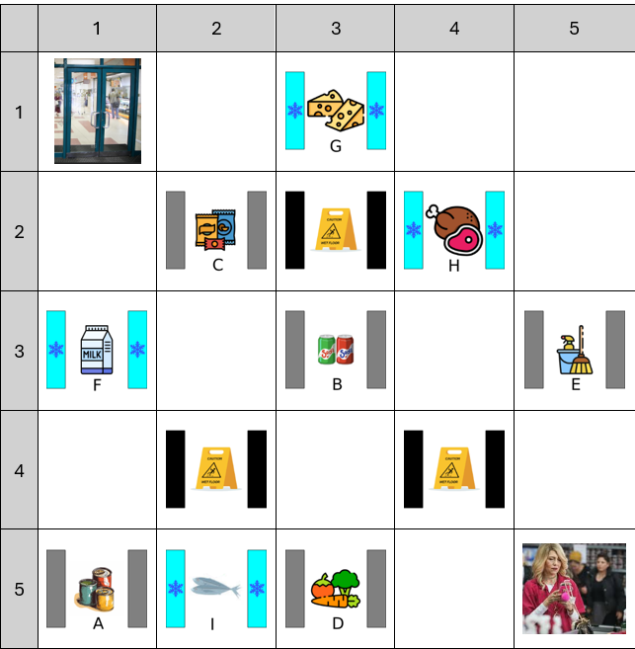
Supermarket layout:
Create a grid

Slide 5
Supermarket layout:
Create a grid
Define start and finish
חברים זה בא והולך, כסף זה לכל החיים!

Slide 6
Supermarket layout:
Create a grid
Define start and finish
Add regular isles

Slide 7
Supermarket layout:
Create a grid
Define start and finish
Add regular isles
Add cold isles

Slide 8
Supermarket layout:
Create a grid
Define start and finish
Add regular isles
Add cold isles
Add penalty isles

Slide 9
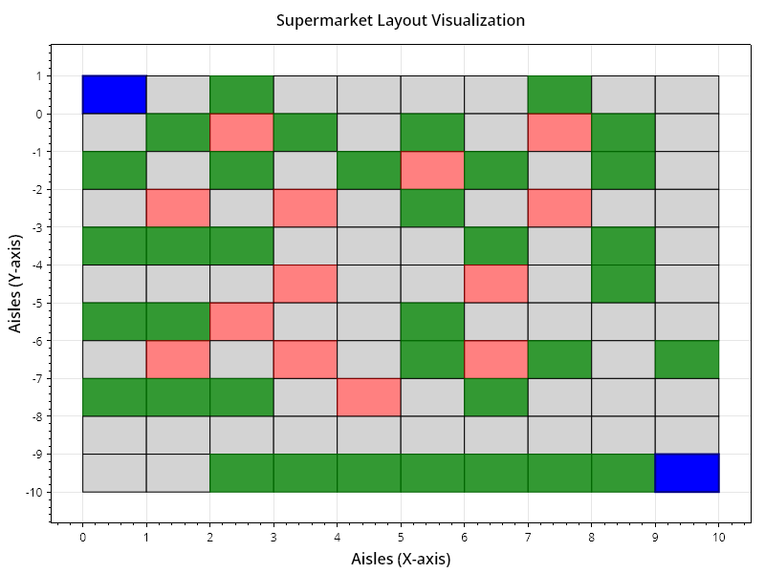
Actual Supermarket layout
Item Isle
Empty Isle
Maintenance (Hot) Isle
Entrance/Exit

Slide 10
Assumptions/Rules
Shoppers visit all isles before checkout.
Every heat sensitive item (from cold isle) decays at same rate.
Heat-sensitive items decay after being picked up.
Every shopper has a walking pattern.

Slide 11
Walking pattern
H2V: Horizontal To Vertical
V2H: Vertical then Horizontal
ZgZg: H,V,H,V,H…

Slide 12
Challenges
Crossover and mutations if done randomly (without rules) will almost always produce a faulty Individuals (like traveling salesperson problem).
The objectives are coupled, if an individual scores high in one he will also score high in the other (and the opposite also), this is because both penalties time in similar proportion. If we don’t solve this challenge our problem will become a boring single objective problem. (1 point Pareto)

Slide 13
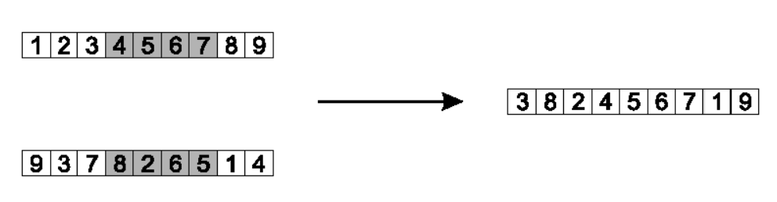
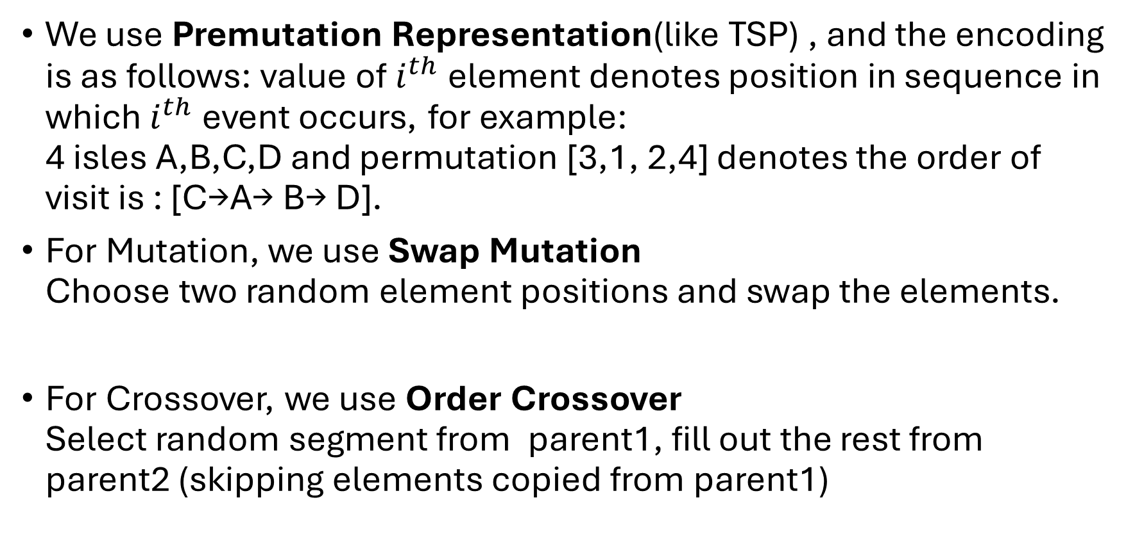
Solving Crossover and Mutation challenge
We use Premutation Representation(like TSP) , and the encoding is as follows: value of$i^{th}$element denotes position in sequence in which $i^{th}$event occurs, for example: 4 isles A,B,C,D and permutation [3,1, 2,4] denotes the order of visit is : [C→A→ B→ D].
For Mutation, we use Swap Mutation Choose two random element positions and swap the elements.
For Crossover, we use Order Crossover Select random segment from parent1, fill out the rest from parent2 (skipping elements copied from parent1)

Slide 14
Individual
Walking pattern | Isle visiting order
V2H | H | D | C | A | …
V2H or H2V or ZgZg
Needs to include all isles

Slide 15
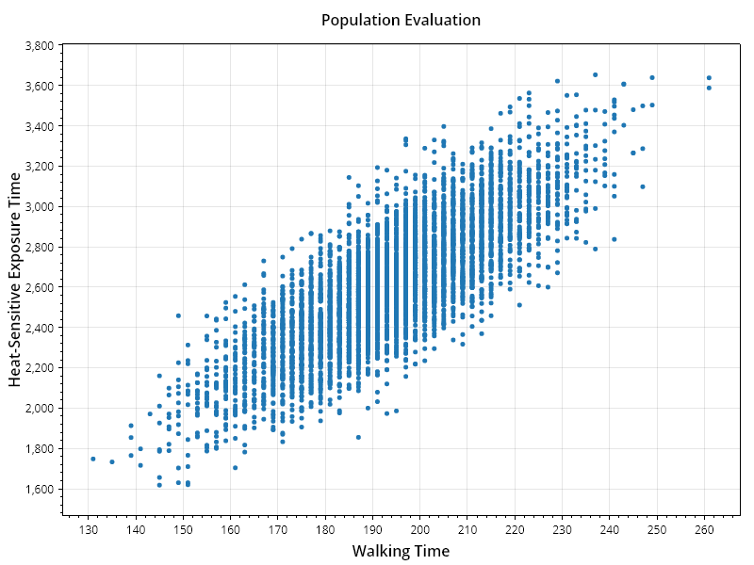
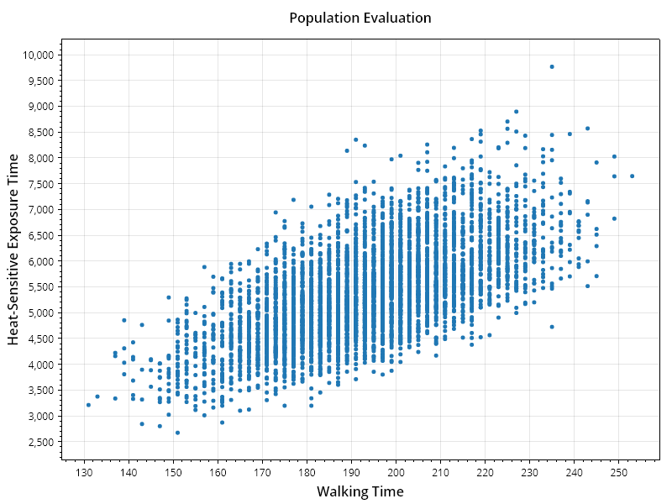
Solving Coupled Objective challenge
To uncouple the objectives, we need to penalize only one of the objectives.
I used the “maintenance isle” to act as an isle that when stepped on will penalize only the decay (heat sensitivity) score.
We can see the effect of the penalty on the coupling:
Foul = 1
Foul = 10

Slide 16
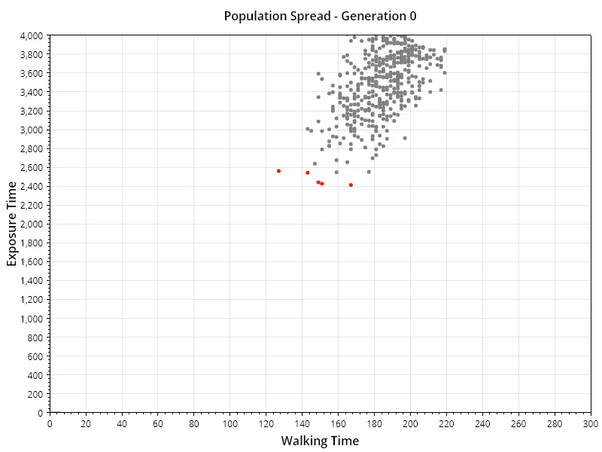
NSGA II
Population size = 500
Generations = 50
Elapsed time = 14322 [ms]

Slide 17
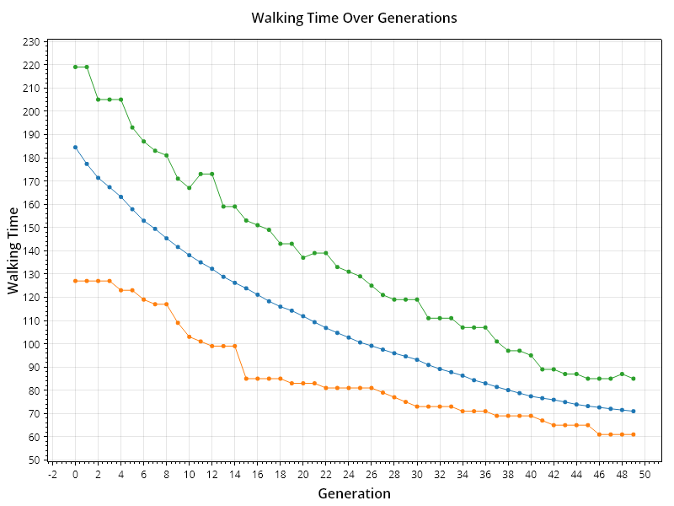
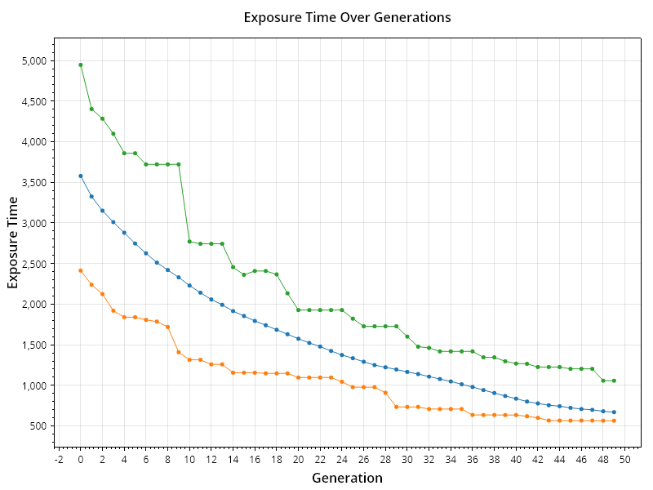
Performance Over Generations
Max
Avg
Min

Slide 18
Next steps
Running problem with NSGA III – for more diverse solutions
Randomizing the Supermarket layout and making it bigger
Comparing different population sizes affect on result

