Slide 2
Problem(s) statement
Going through a supermarket, if the path isn’t chosen wisely, the trip will take long time.
Heat sensitive items will spoil if held in cart for a long time.

Slide 3
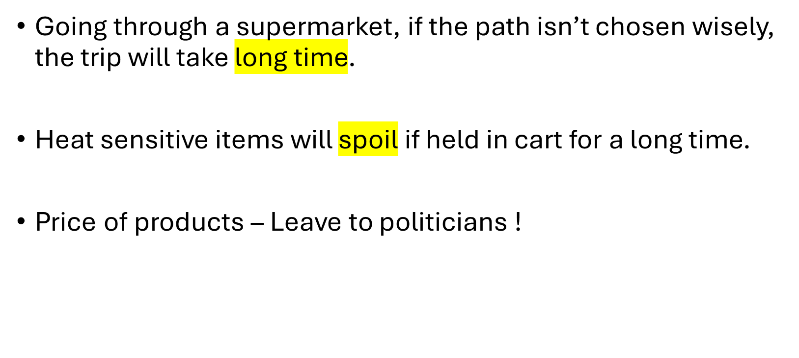
Problem(s) statement
Two
objectives

Slide 4
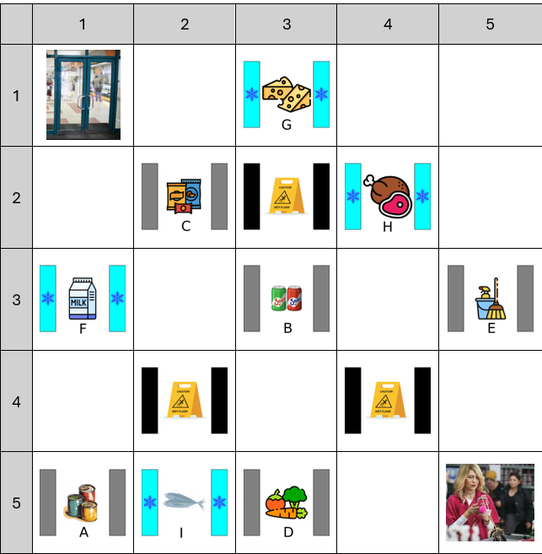
Supermarket layout:
Create a grid

Slide 5
Supermarket layout:
Create a grid
Define start and finish
חברים זה בא והולך,
כסף זה לכל החיים!

Slide 6
Supermarket layout:
Create a grid
Define start and finish
Add regular isles

Slide 7
Supermarket layout:
Create a grid
Define start and finish
Add regular isles
Add cold isles

Slide 8
Supermarket layout:
Create a grid
Define start and finish
Add regular isles
Add cold isles
Add penalty isles

Slide 9
Assumptions
Every shopper needs to visit all Isles before going to checkout.
Every heat sensitive item (from cold isle) decays at same rate.
Heat sensitive item starts decaying after getting picked up.
Every shopper has a walking pattern.

Slide 10
Walking pattern
H2V: Horizontal To Vertical
V2H: Vertical then Horizontal
ZgZg: H,V,H,V,H…

Slide 11
Challenges
Crossover and mutations if done randomly (without rules) will almost always produce a faulty Individuals (like traveling salesperson problem).
The objectives are coupled, if an individual scores high in one he will also score high in the other (and the opposite also), this is because both penalties time in similar proportion.
If we don’t solve this challenge our problem will become a boring single objective problem.

Slide 12
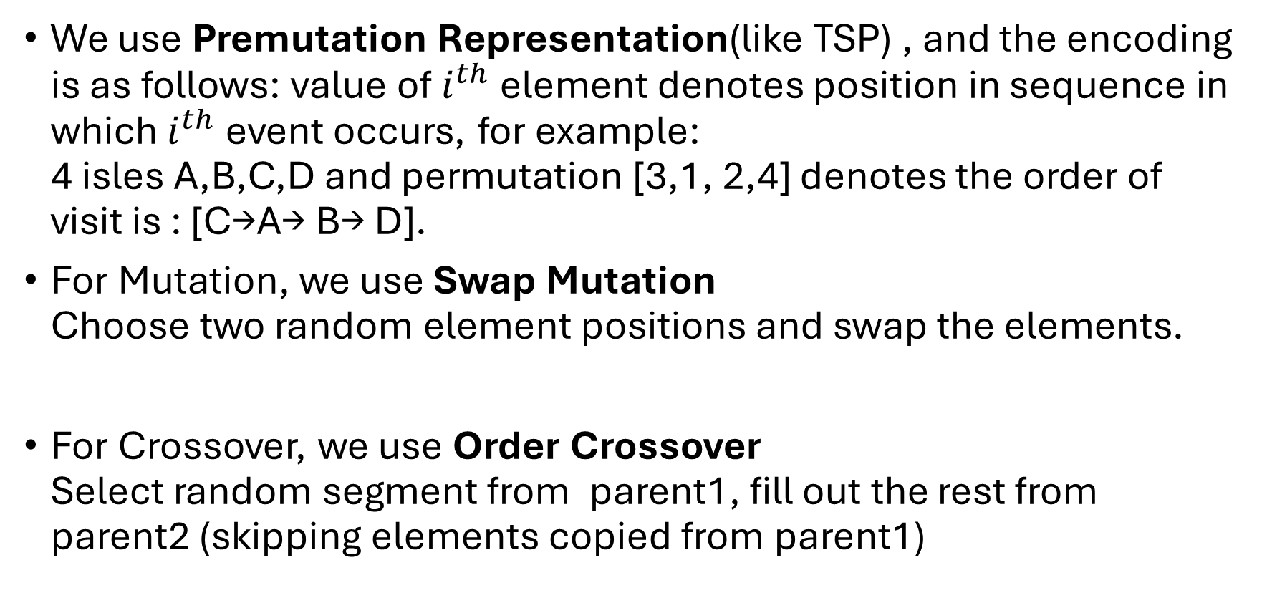
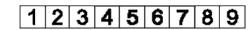
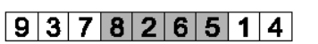
Solving Crossover and Mutation challenge

Slide 13
Individual
Walking pattern | Isle visiting order
V2H | H | D | C | A | …
V2H or H2V or ZgZg
Needs to include all isles

Slide 14
Solving Coupled Objective challenge
To uncouple the objectives, we need a way to either penalize or reward only one of the objectives score.
I used the “maintenance isle” to act as an isle that when stepped on will penalize only the decay (heat sensitivity) score, to act as a “Hot” isle.
We can see the effect of the penalty on the coupling, the higher the penalty the less connected the two objectives become.

