Slide 1


GnotesApp
Presentation for "Advanced Web Design"

Slide 2






Summary:
Note Table
About the app
4
1
Basic explanation regarding the creation of the functionalities in the app.
Design and functionality of the Notes Table section.
5
Sign Up/Sign In
Private/Public Notes
2
Design and functionality of the Sign up and Sign In process.
Design and functionality of the Private and Public section.
6
Create New Note
Other Functionalities
3
Design and functionality of the "Create New Note" button.
Other functionalities implemented in the app.

Slide 3
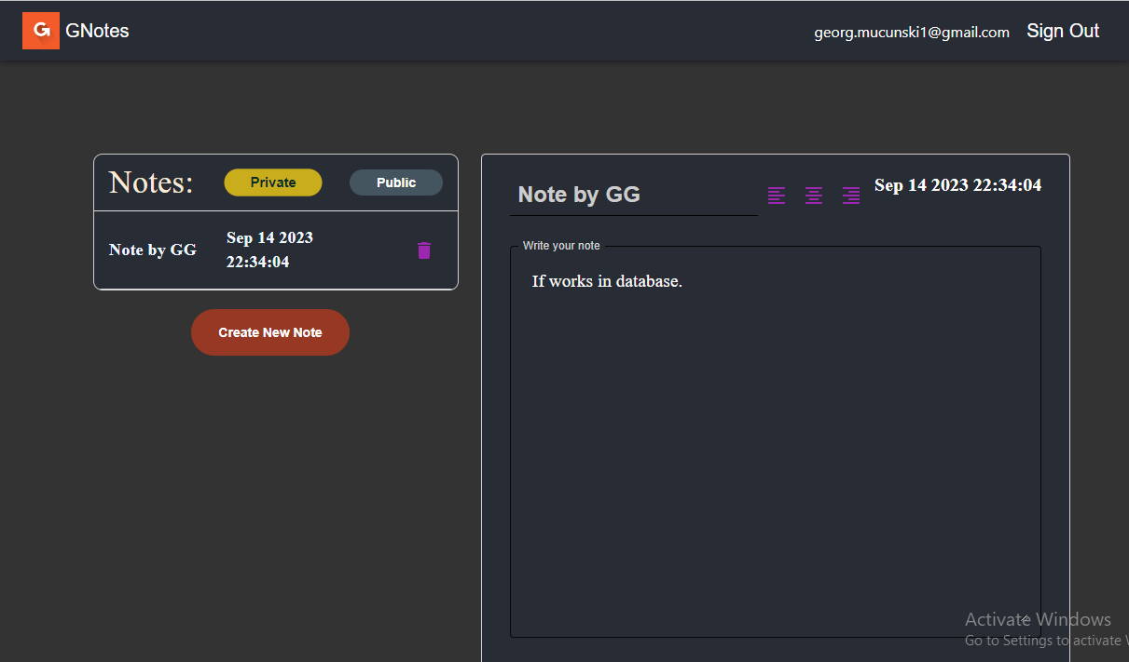
About the App
This project is built using Firebase which enables vital features in building the app.
Sign up/Sign in, note creation and public notes implementation.

Slide 4
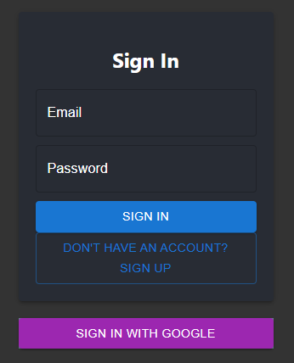
Sign up/Sign in
To begin using the app you need to sign up and sign in like most apps. Using firebase auth and firebase database, your Log in information is safely secured and stored enabling you the functionality of the app.

Slide 5
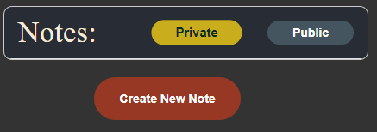

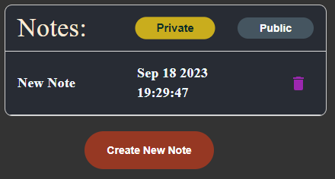
Create New Note
After the initial Sign In, you can start and create your first note by pressing the designated button.
The new note gets added in the table and it's saved in the database so the user can access it.

Slide 6
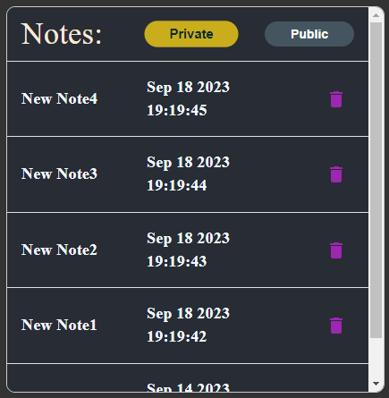
Notes Table
The note table includes all notes that the user has created.
The displayed notes consist of a title, date and delete icon.
At the top of the table there are 2 toggles where a user can select to view private or public notes.

Slide 7
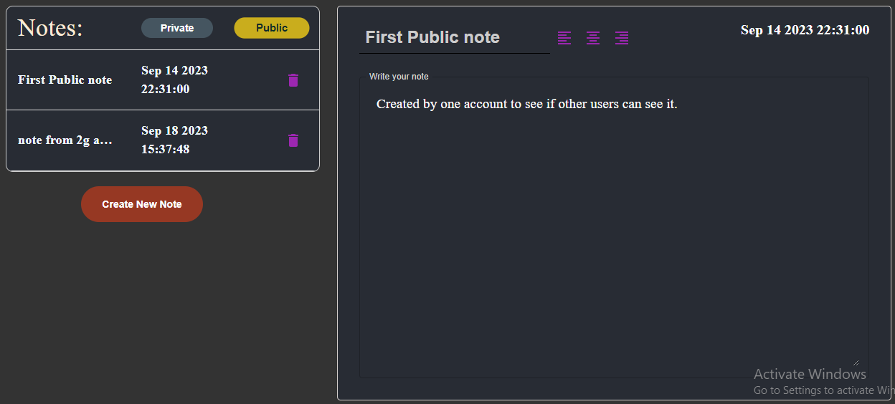
Private/Public Notes
The Note Table consists of "Private" and "Public" toggles that differentiate from personal notes(that only the user can see) and public notes(that all users see) respectfully.

Slide 8
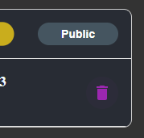
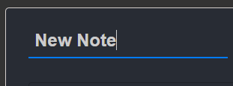
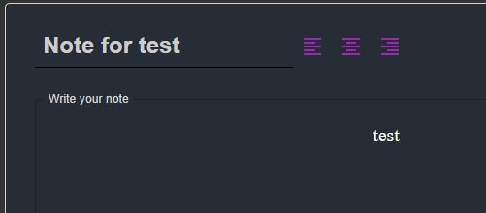
Other Functionalities
The title of the note is editable by clicking on it
Delete button that deletes the note from the table
Text alignment so the user can select how the note is being written.

Slide 9
Thank you for your attention!
Do you have any Questions?
201145 Georg Mucunski

