Slide 1


Rockbuster Stealth Film SALES STRATEGY 2020
By: Gonçalo Gomes
Tableau Link

Slide 2

Agenda
Introduction
Key considerations
Analysis
Key findings
Recommendations

Slide 3
Introduction
Rockbuster Stealth LLC, a global movie rental enterprise that formerly operated physical stores worldwide, is currently confronted with strong competition from streaming giants like Netflix and Amazon Prime. To maintain its competitiveness, the management team of Rockbuster Stealth aims to leverage their existing movie licenses by introducing an online video rental service.

Slide 4
Key considerations
Highly favored films
Top-rated genres
Genres with the longest rental periods
Top revenue-generating countries and their customer base

Slide 5

Analysis

Slide 6
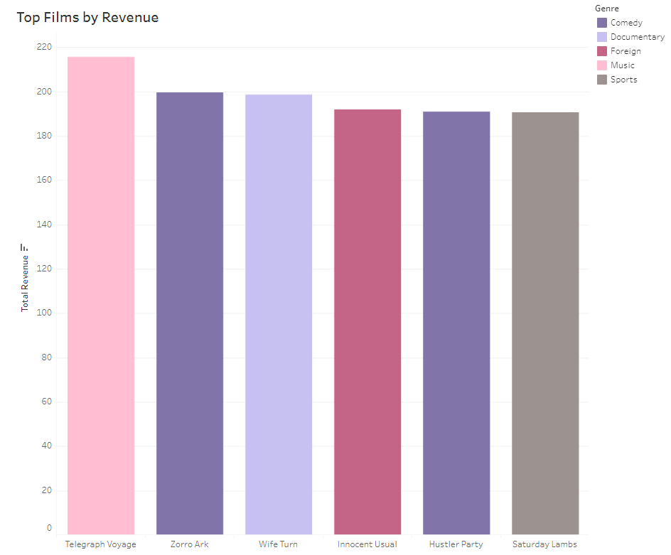
Highly favored films

Slide 7
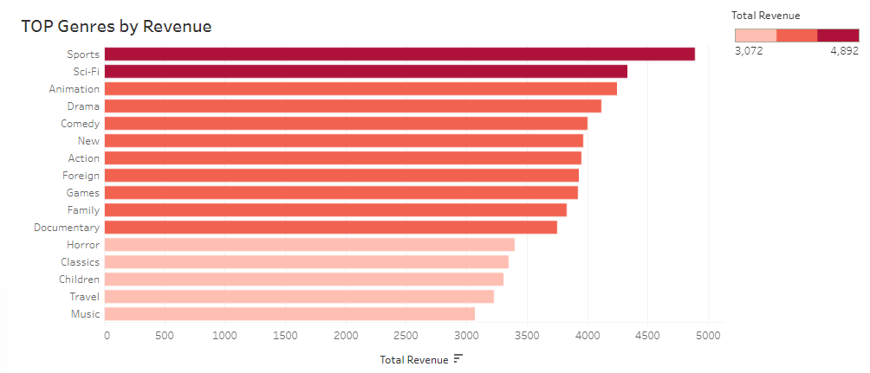
Top-rated genres

Slide 8
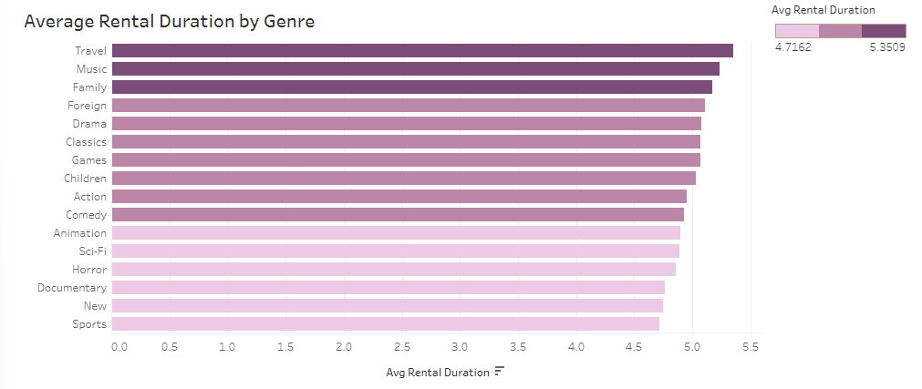
Genres with the longest rental periods

Slide 9
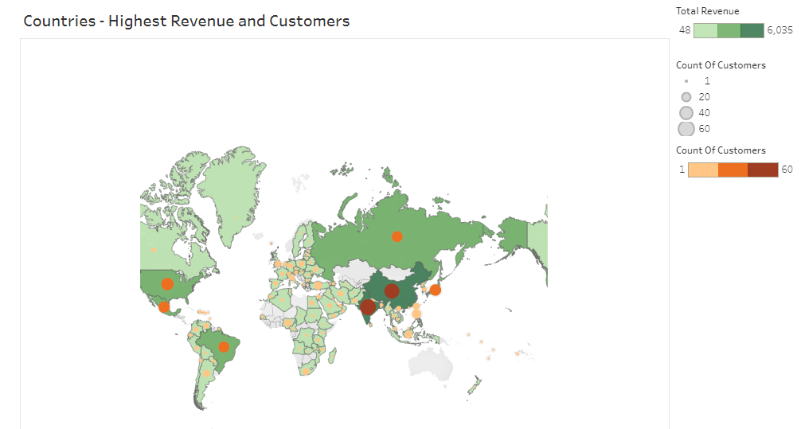
Top revenue-generating countries and their customer base

Slide 10
Key findings
- The genres that generate the most revenue include Sports, Sci-Fi, and Animation.
- Among the countries analyzed, India, China, and the United States stand out as having both the highest number of customers and the highest revenue.
- A total of 599 customers are distributed across 108 different countries.
- The countries with the customers displaying the highest lifetime value are Russia, the United States, Brazil, the Netherlands, and Belarus.

Slide 11
recommendations
- To optimize marketing efforts, prioritize the genres that yield the highest revenue, namely Sports, Sci-Fi, and Animation. - Direct marketing initiatives towards the countries and regions that demonstrate the greatest revenue potential, such as India, China, and the United States.

