Slide 1
US Migration Simulator
By: DJ W, Branavan N, Gahl G, Tarcisius H

Slide 2
Preview
Changes in population over time (year) in respect to migration
Calculate the changes using four factors: Jobs, Crime rate, Cost of living (rent), taxes
Simulates four cities: Seattle (focus), Chicago (focus), Los Angeles, and New York
We use a monte carlo simulation to calculate the four factors.
Notes:
Explain why we chose each factor, and why we chose each city
Monte Carlo simulation because we are looking a distribution of numbers.

Slide 3
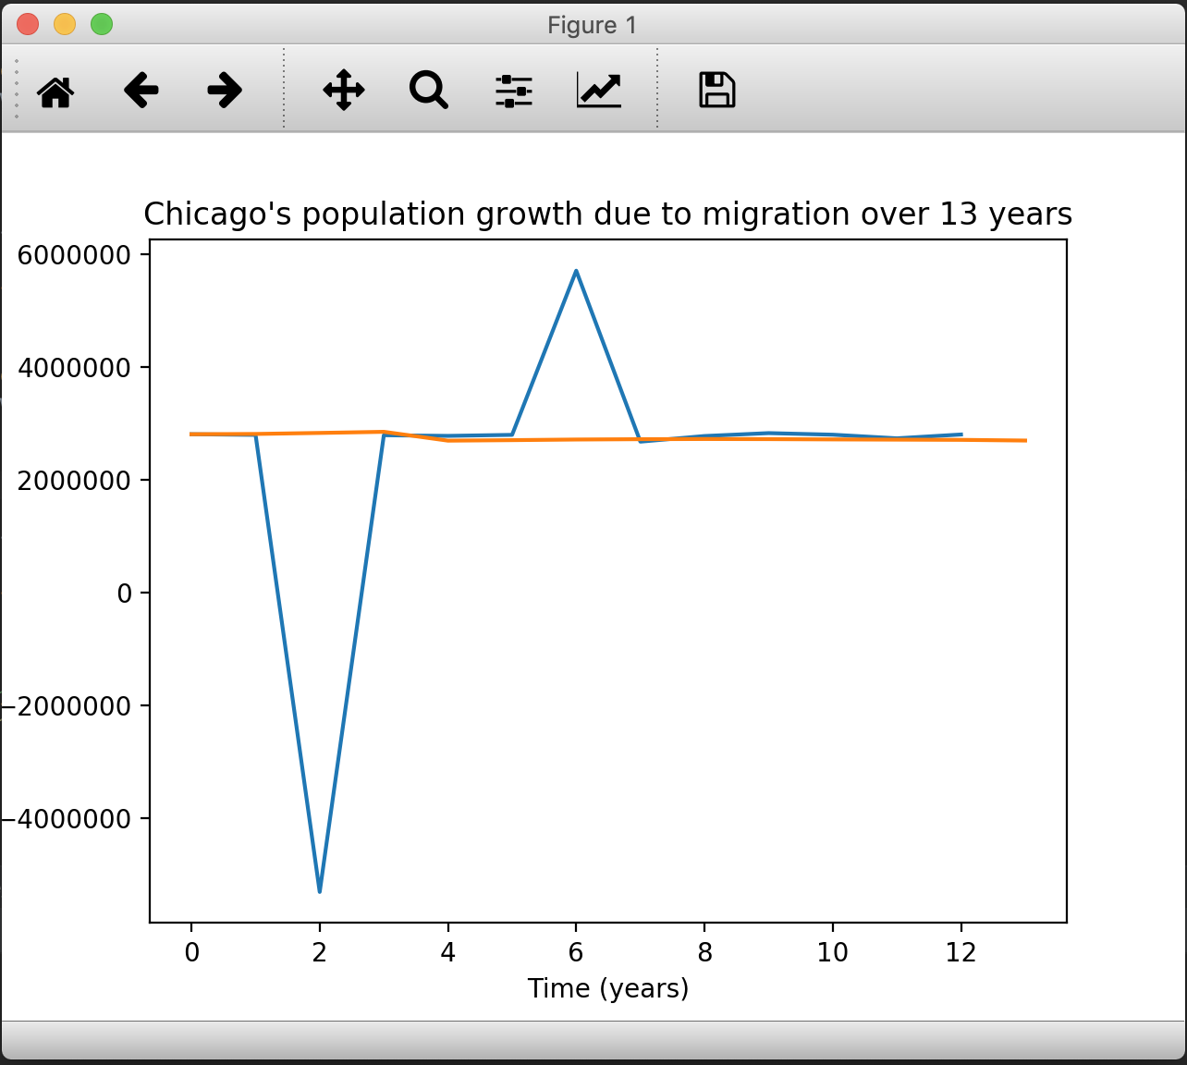
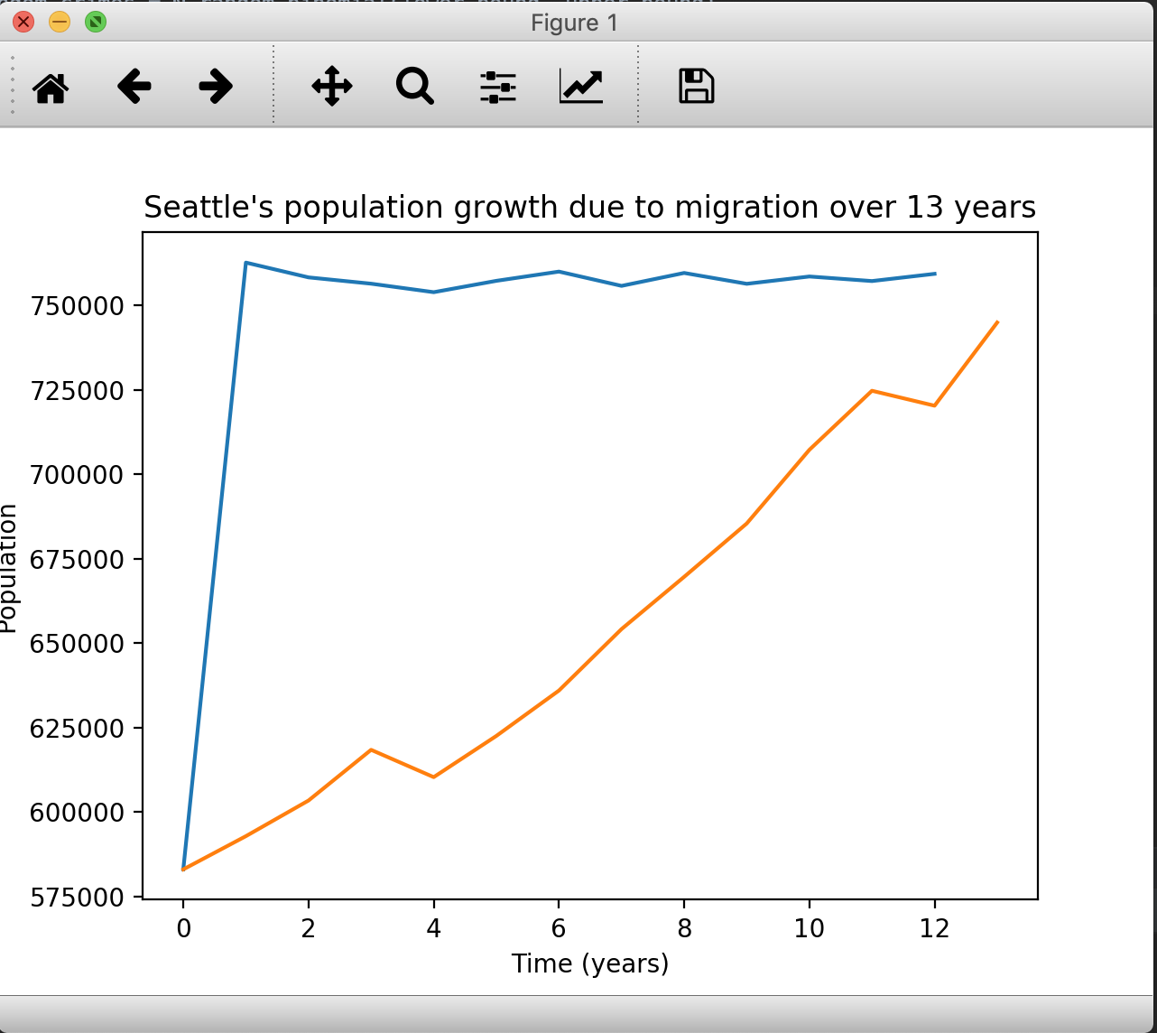
Our Model (before fix)
The problem was that we average the four factors individually in each timesteps across the trials.
This resulted in a model that was inconsistent and sometimes we had unrealistic values.

Slide 4
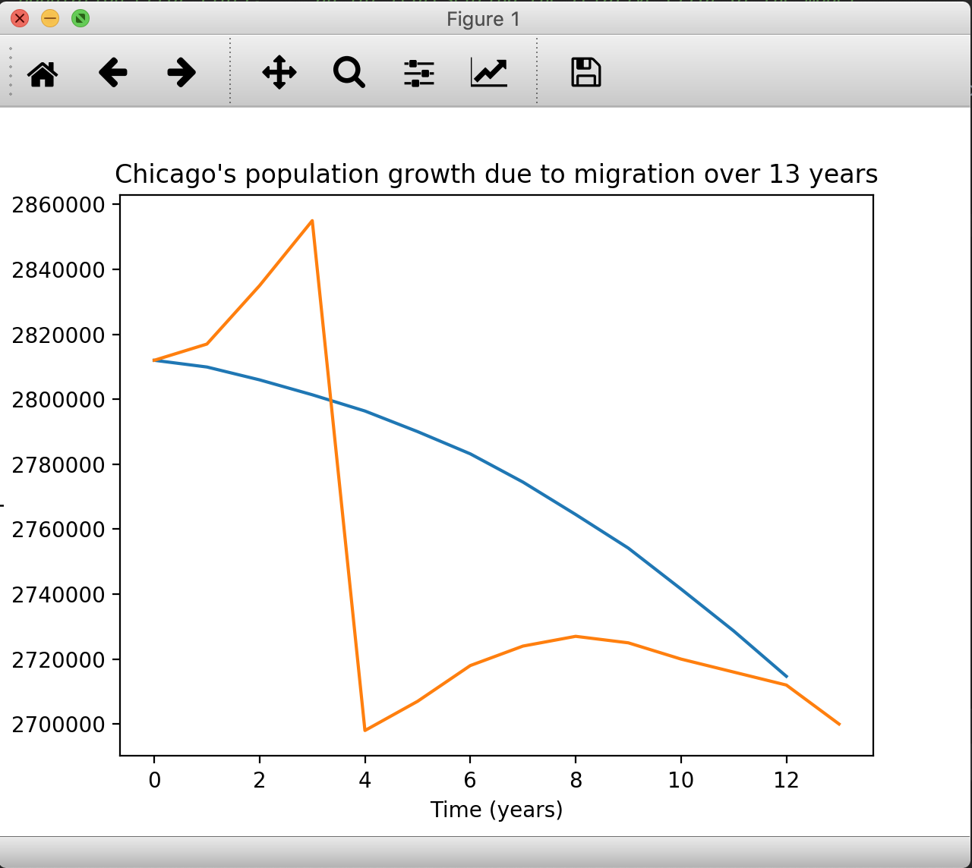
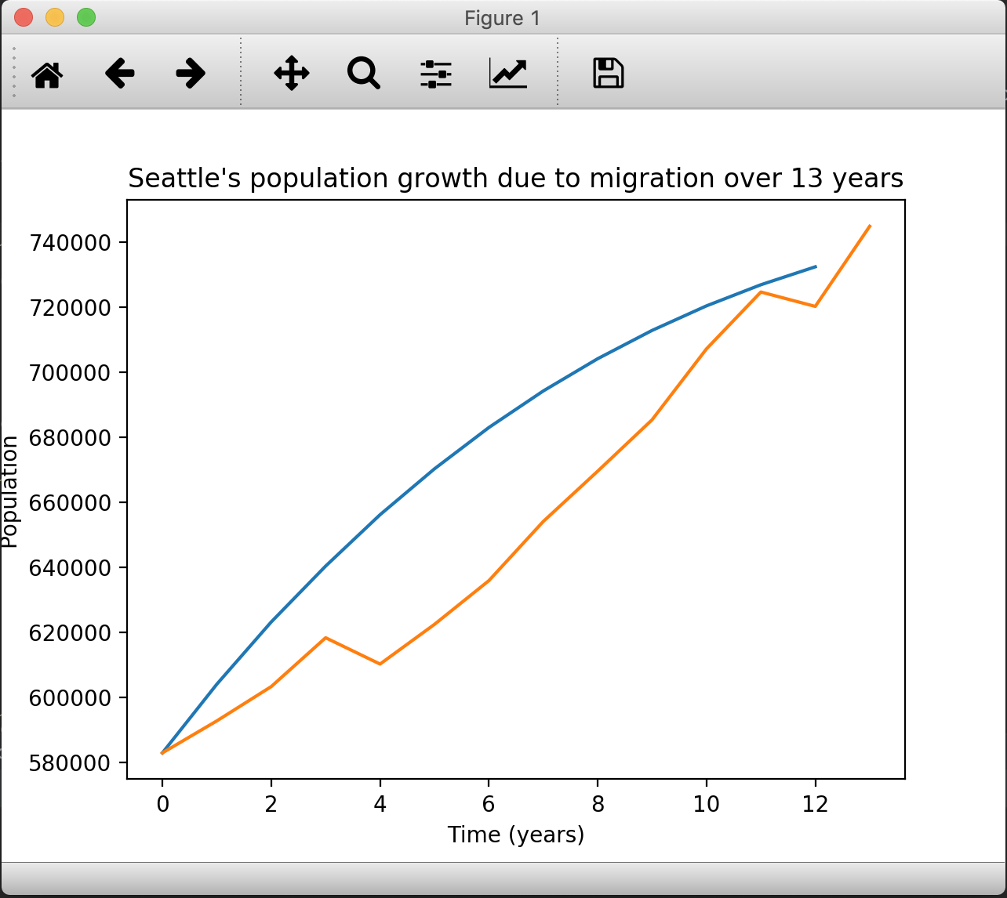
Our Model (fixed)
The fix was that we average the entire values of the four factors in each timestep across the trials
Much more accurate and consistent

Slide 5
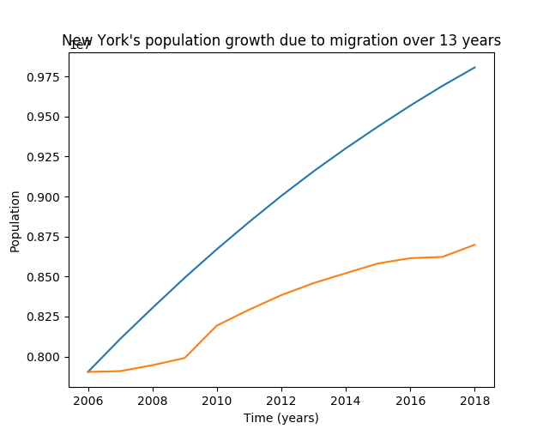
New York
New York doesn’t work well with our model
The population increases a lot quicker than it should.
Some potential reasons for this are:
There are additional factors that we didn’t account for like education.
These factors have high variance.

Slide 6
Analysis
In order to verify our model we:
Plotted the previous 13 years and compared our model with those values
We primarily discussed how our model changed with regards to changes in the distribution of random numbers in our monte carlo simulation
We also fixed a bug in our model to make our simulation output smoother

Slide 7
Conclusion
We faced many challenges when working on this model
Lack of experience in building heavy-data simulation
Miscalculations regarding the algorithm to calculate the population
Different random number distributions affect the simulation significantly
There are several factors that we did not account that affect the migration

Slide 8

https://github.com/djwadhwa/USMigrationSimulation

