Slide 1



A MURDER MYSTERY
inspired by Cluedo
Detective game
Charlotte Guedj, Rubén, Guilherme Granja, Oeendrila L.Gerold

Slide 2

PROJECT OVERVIEW
GAME STRUCTURE:
2. FUNCTIONS:
3. ADDED FEATURES:
The game consists of various rooms with clues and interactions.
Players start in a designated room and explore based on room connections.
Objective: Collect clues and solve the murder mystery.
move_to_room(): Manage movement between connected rooms.
make_accusation(): Process final accusation of the murderer.
Narrative_final(): Conclusion and resolution of the mystery with the correct accusation.
introduction(): Overview of the game setting and goals.
introduction2(): Introduction to suspects and their backgrounds.
review_files(): Review detailed information about each suspect.
explore_room(): Investigate clues in the current room.
Contextualized clues linking them to suspects and the story.
Room connections and navigation for structured exploration.
Enhanced narrative with detailed descriptions for immersion.
Notes:
note: project overview can be two slides
#2 will include functions and how they are imported
#3 How are they addeD?

Slide 3

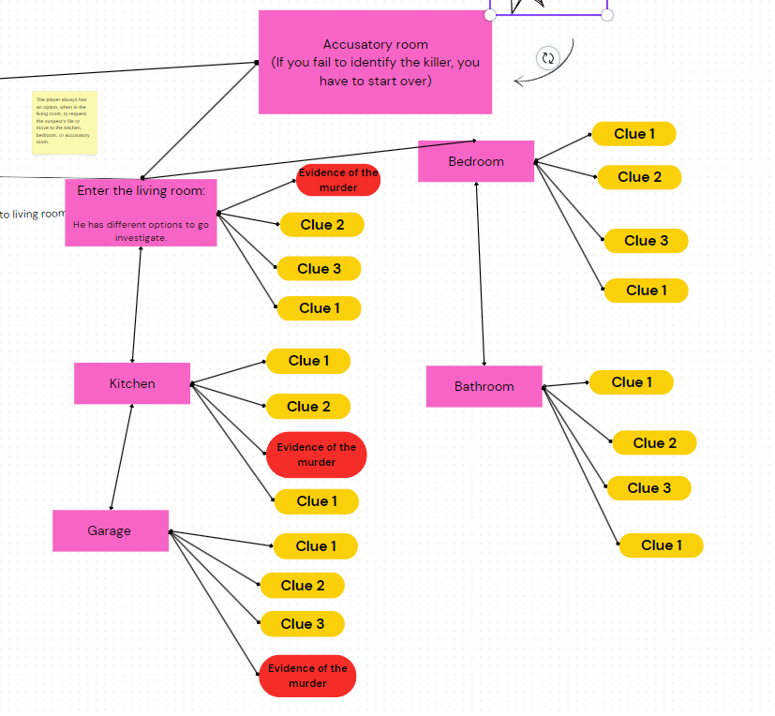
CLue#1 aka “we were lost" (technical challenges)
Most difficult hurdle:
Solution:
Create a system that allows moving between rooms in such a way that one can return to the previous room or continue to another room, considering that each room has its own connections.
First, we drew a map of each room and their connections. Then, we used room_connections to limit movement between rooms and move_to_room() to update the player's location with only valid options.
Notes:
this can be two slides:
here we are to describe the solution to our problem

Slide 4

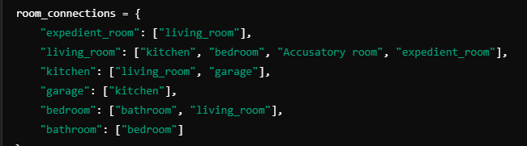

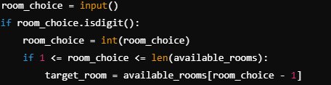
CLue#1 aka “we were lost" (technical challenges)
current_room
represents the player's current location and updates as the player moves through the game, starting in "living_room" and changing based on the chosen location.
Get Available Rooms
Show Options to User:
Process User Choice
Notes:
this can be two slides:
here we are to describe the solution to our problem

Slide 5


Clue #2 to become a programmer (big mistake)
Mistake description:
Lesson learnt:
The game's logic didn't always make sense, and the clues didn’t connect well, making it hard for players to progress.
We improved the context of the clues by adding details about who might have used each object or left each clue. This made the story clearer and helped players progress better.
Notes:
#this can also be 2 slides

Slide 6

Clue #3 Demo Slide
Let’s Play (Go to the code file)!!
Notes:
insert link to final project
p.s: not adding the last slide - project name etc is on the title page

Slide 7

lAST Clue
THANK YOU!!
Charlotte Guedj, Rubén, Guilherme Granja, Oeendrila L.Gerold
Notes:
insert link to final project
p.s: not adding the last slide - project name etc is on the title page

