Slide 1
Shift Registers Arduino & 7 Segment LED Displays
Presented by: Chris Chaney
christopher_chaney@homedepot.com

Slide 2
Who is this guy?
Chris Chaney
Software Engineer for 20 years
Lead Developer @ HomeDepot.com
Tinkerer with all things electronic and mechanical
Spends spare time with…
My aging motorcycle
My box of Arduinos and electric goodies
Any computer I can get my hands on

Slide 3
Who are you?
What experience do we have in the room?
Arduino?
Basic electric components? (LEDs, Resistors, capacitors)
C, C++, or Java?

Slide 4
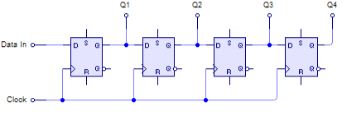
What is a Shift Register?
In digital circuits, a shift register is a cascade of flip flops, sharing the same clock, in which the output of each flip-flop is connected to the "data" input of the next flip-flop in the chain, resulting in a circuit that shifts by one position the "bit array" stored in it, shifting in the data present at its input ...

Slide 5



Slide 6
TL;DR
Shift registers are a set of storage compartments with the exit of compartment connected to the entrance of another. This set of connected compartments creates an array of data that can only be fed from one direction.
0
1
1
0
Step 1
1
1
0
1
1
Step 2
0
0
0
1
0
1
Step 3
0
1

Slide 7
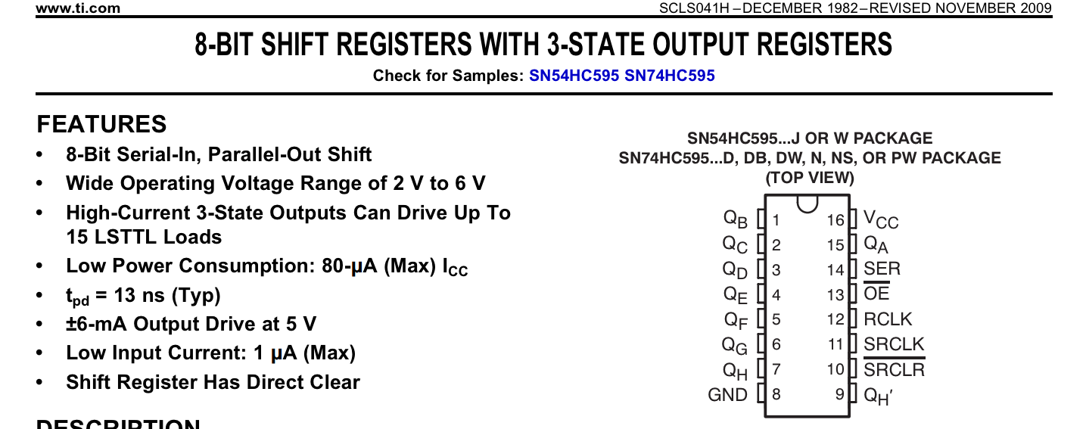
74HC595 : Much more than a pretty face

Slide 8
The 74HC595 “Schwifty” has…
An 8 bit shift register with a single overflow bit
An 8 bit storage register that can be activated in parallel
Cool functions like..
Master register clear
Output disable

Slide 9

Let’s get Schwifty!
The Players….
SER– Serial Input
OE – Output Enable
RCLK – Register Clock
SRCLK – Serial Clock
SRCLR – Serial Clear (or MR / Master Reset)

Slide 10
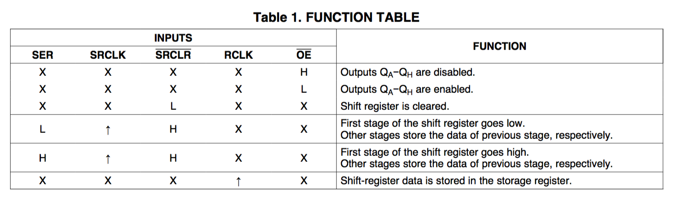
The Rules of “Schwifty”

Slide 11
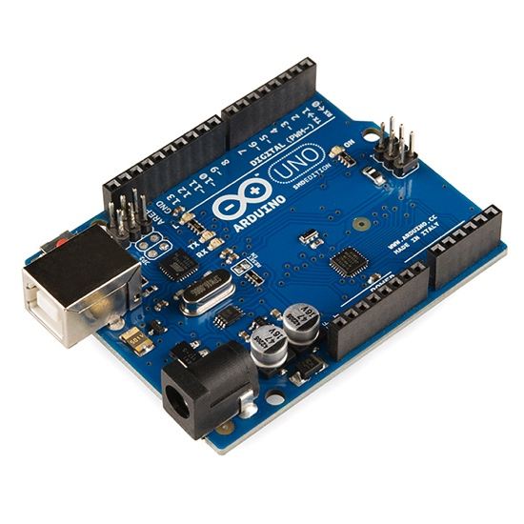
The Arduino
An open source microcontroller with amazing capabilities.
What we need to know for this talk….
Arduino runs code sent to it our computers via USB cables
We will use the official Arduino IDE to write our code
Arduino outputs 5 volts enough to power small projects

Slide 12
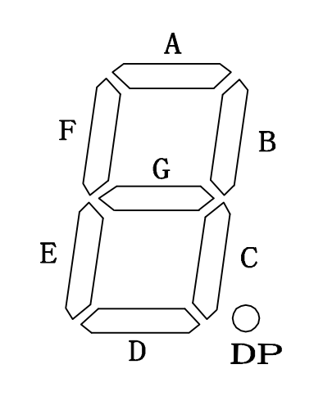
7 Segment displays
Made of LEDs (Light Emitting Diode)
ALWAYS use resistors (220ohm-330ohm)
Careful bringing them into Irving, TX
Notice the clockwise pattern of the segments (ignore the dot for now)

Slide 13
7 Segment display common anode wiring
g
f
+
a
b
+
e
d
+
c
o

Slide 14
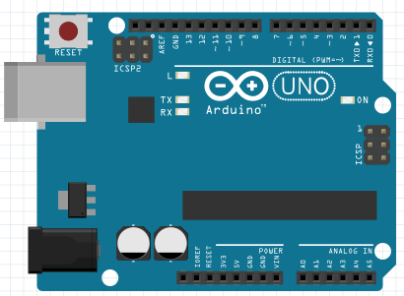
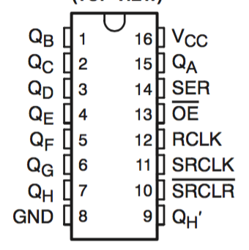
g
f
+
a
b
+
e
d
+
c
o

Slide 15
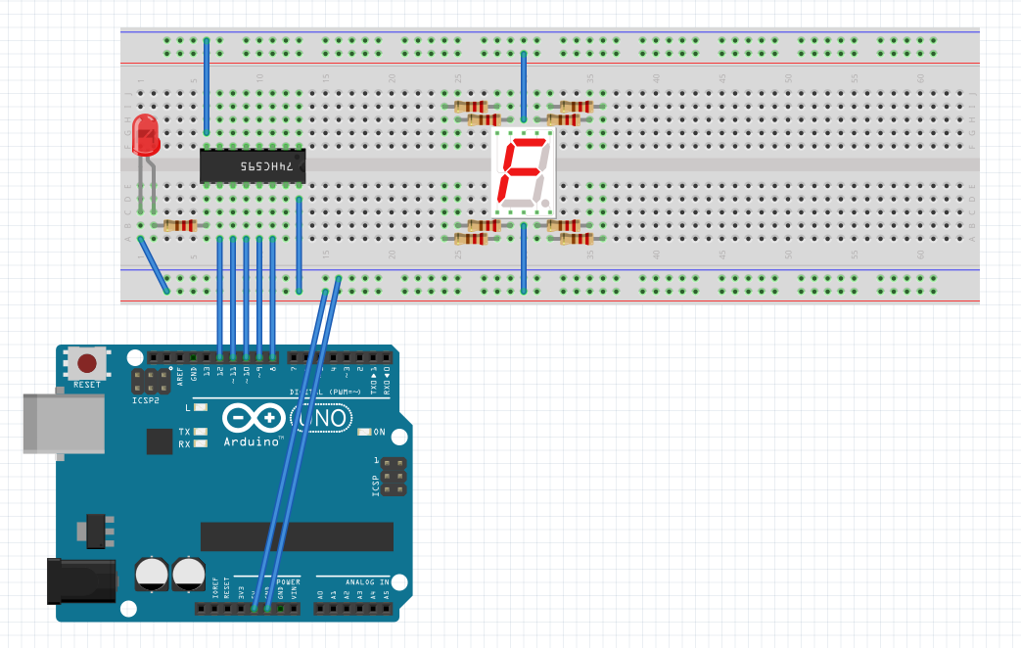
What we’re building!
Arduino driving a shift register to run a 7 segment LED display.
Why use the shift register? We could just connect the display to 7 Arduino leads.
Yes, but then you could only drive one display. This setup, and the use of the overflow register can drive 4 displays safely.

Slide 16
Get the tools and code
Fritzing (optional, but HIGHLY recommended)
http://fritzing.org/download/0.9.2b/
Arduino IDE
https://www.arduino.cc/en/Main/Software
The code and Fritznig file for the session
https://github.com/cechaney/Maker-Visit-Code.git

Slide 17
Fritzing follow-along for wiring

Slide 18
Arduino IDE follow along

Slide 19
Debugging and play

