Slide 1
CALCULOT
A fantasy-themed game to help students learn university-level mathematics
Developed by : Ryan Peterson, Kenneth Zheng, J.P. Acebedo, Levent Kylych

Slide 2
Overview
Introduction: Understanding the domain problem
Part 1: Games and applying concepts
Part II: the Learning System
Part III: Incentivizing “Calculot”
Conclusion: What does “Calculot” have to offer?

Slide 3
Introduction

Slide 4
Why are we making this application?
Jump from high school-level mathematics to post-secondary mathematics tend to be confusing to many students.
Studying these topics solely through a textbook tend to be drawn out and boring.
This can lead to a loss of interest and motivation to learn.
Approach this problem using application-based methods rather than concept-based ones.

Slide 5
games

Slide 6
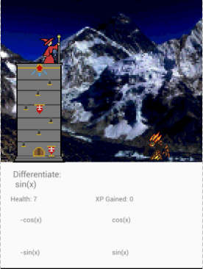
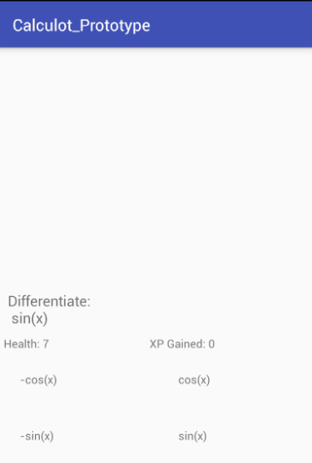
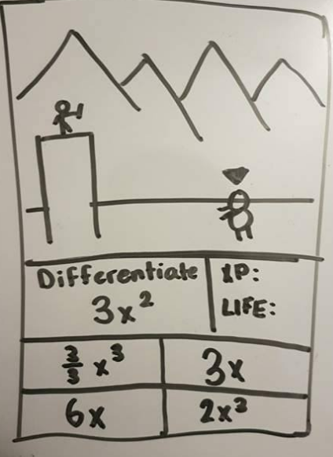
Game 1: the defense of calculot
features
screenshots
Trains the users ability to quickly derive and integrate simple mathematic functions.
These functions are generated at runtime, using randomly generated questions (constants, type, etc.)
This allows the user to be quick-thinking and help train unexpectedness, something that exams tend to display.
Iteration 1I: Multiple Choice Base
Iteration III: Full game CONCEPT
Iteration 1: Concept

Slide 7
Game ii: The wizard’s crystal ball
Features
screenshots
Trains the user on their understandability of concepts around linear algebra, complex numbers and trigonometry
Also features a randomly generated question set.
Tests the user on using concepts to solve answers, rather than reflexes.

