Slide 1
Project 3. Airbnb Pricing Strategy
Gaofeng Huang
Class: DATS6103 Data Mining (19Spring) of 15:30-18:00, Thursday.

Slide 2
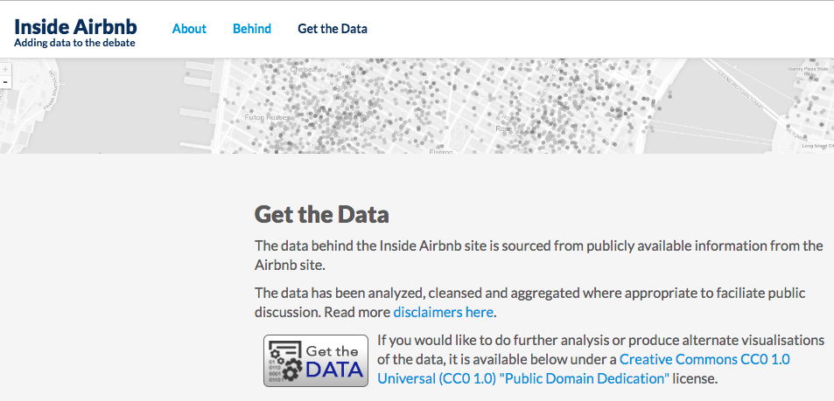
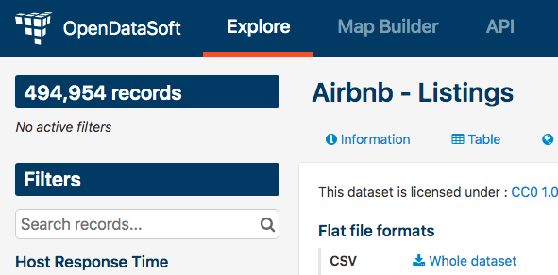
Data Source

Slide 3
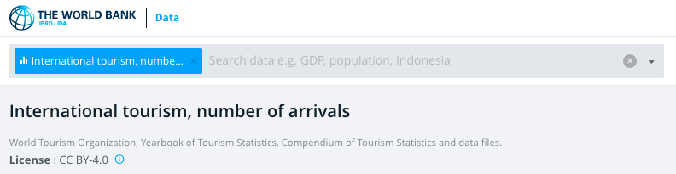
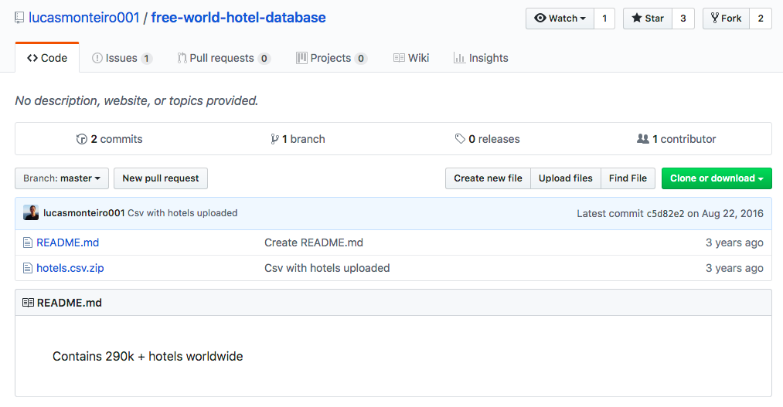
Data Source

Slide 4
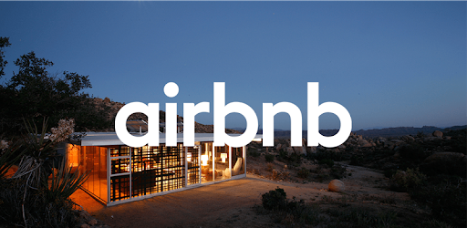

Something about the topic
What affects Airbnb pricing strategy?
Tourists
Hotels (short-term)
Property leasing (long term)

Slide 5
Data Overview
Multiply datasets
Tourists inflow
Airbnb listings
Hotels

Slide 6
Data Cleaning and Preprocessing
Some datasets are too large with useless information
Link these datasets together
Country Code (troublesome: 3-letter code? 2-letter code?)
Different datasets have different missing values
Select a particular group of countries
Each country has enough observations and the data is not weird
A particular year: 2015

Slide 7
What affects Airbnb (daily) price?
Tourists inflow NO
Hotel price YES

Slide 8
How to set Airbnb long-term price?
Weekly price: 5.7-6.5 times of Daily Price
Monthly price: 18.8-22.3 times of Daily Price

Slide 9
Conclusion
1. Airbnb is more popular in developed (high income) countries.
2. Tourists inflow does not have a significant effect on Airbnb price.
3. Hotels price is positively related to Airbnb price.
4. Daily Airbnb price < hotel price, Monthly Airbnb price > house leasing
→ Airbnb focuses on the market in short-to-mid term

