Slide 1

Eatmarna Tweets Analysis
T5 Bootcamp Data Science Project
Ghada Aljufair

Slide 2
What is Eatmarna
Eatmarna is a governmental application developed by Ministry of Hajj and Umrah used to enable those wishing to perform Umrah and visit to request the issuance of permits to enter the Two Holy Mosques to perform Umrah and visit.

Slide 3
Problem Definition and Goal
The goal is to figure out the customers registration problems, take their opinion about the
Eatmarna application performance and if the customer services team have high
responsiveness or not.
Objective of Analytical Solution
analyze number of tweets to achieve several objectives, such as:
• Describe the problems related to the registration process.
• Measure Customers’ satisfaction about the application performance.

Slide 4
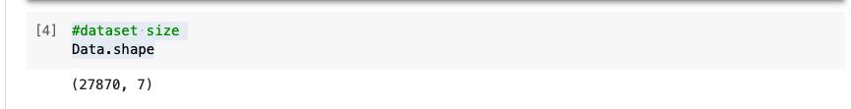
The dataset is provided in xlsx from twitter.

Slide 5
Clean The Data
Remove duplicate tweets
Remove mentions, hashtags, lines, taps, and links from tweet text
Remove punctuations
Remove Arabic stop-words
Tokenize the ‘text’ column

Slide 6
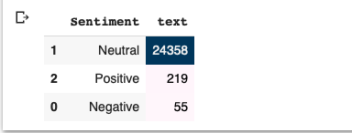
Model Planning and Building
Sentiment Analysis
Analysis on the "text" column to one of the classes (Positive, Negative, Neutral)

Slide 7
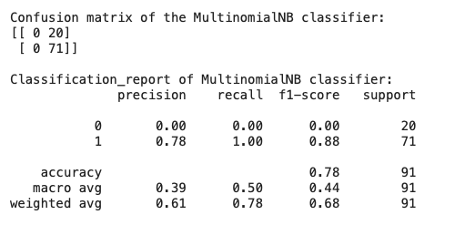
Predictive Analytics
1- Naive Bayesian Classifier model

Slide 8
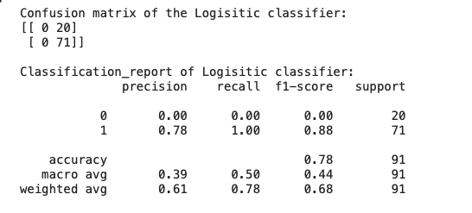
2- LOGISTIC REGRESSION model

Slide 9
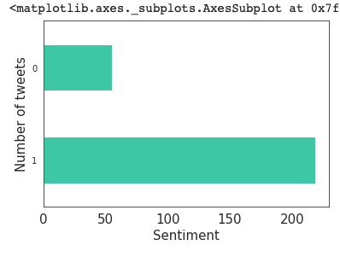
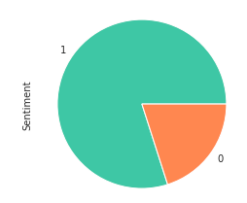
Communicate Results
How many positive, negative, and neutral tweets we have?

Slide 10
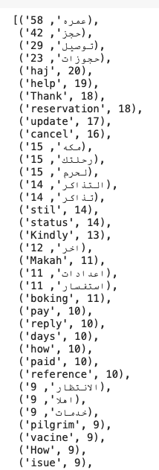
Most Common Words

Slide 11
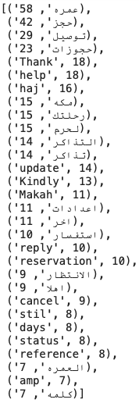
Most Common Positive Words

Slide 12
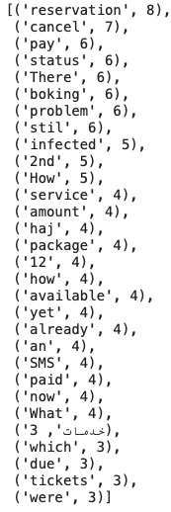
Most Common Negative Words

Slide 13
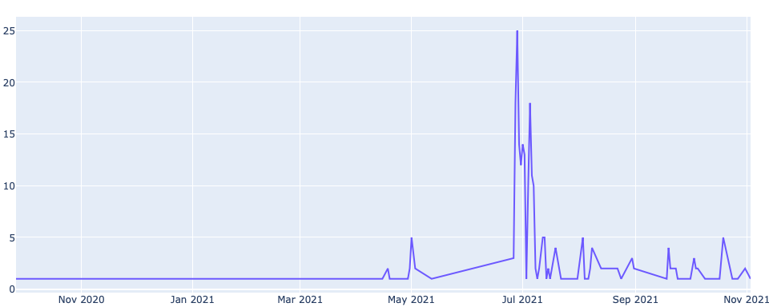
Findings
After visualizing the data that collected, findings the following:
Positive opinion tweets are more than negative opinion tweets.
The order of tweets number from bigger to smaller based on tweets semantic are neutral then positive followed by negative.
The tweets distribution per week starts increasing from june till jul then tweets start decreasing.

Slide 14
At the end of our analysis project and regarding the visualization phase proved the following:
• From the output of negative common words used in tweets proved the “there is a problem related to registration process”
by these words: (cancel، ، How، problem).
• From the output of positive common words used in tweets, proved the “the application’s customer services team high responsiveness”
by these words: ('Thank، اهلا، حجز )

