Slide 1
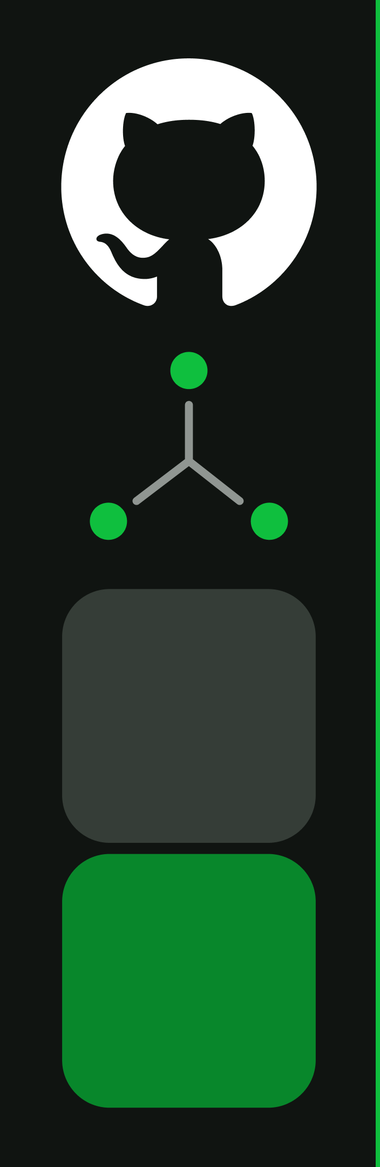
GitHub Advanced Security

Slide 2





Secure By Default
Code
Security
Secret
Protection
Dependabot
Code Quality
•
Code Scanning
•
Push Protection
•
Version Updates
•
Maintainability
•
Static Code
Analysis
•
Comprehensive
Coverage
•
Security Updates
•
Reliability
2
Notes:
At GitHub, we set out to do application security as follows:
Our mission is to empower developers to actually fix what they find and switch security testing from being reactive to proactivein every organization!
We start by natively embedding security findings inside the developer workflow they know and love to enable developers to takeaction on security alerts as they happen.
This allows teams to test proactively on every Git Push to see security issues across their supply chain, in the code their writing,and any potentially leaked secrets in every pull request as part of their code review process.
Teams can supplement any testing, for example, leverage an open-source or commercial container scanner with third-party plug-inswithout compromising on experience.
Once a finding is found, developers are empowered with jargon-free remediation info- and where possible the fix is automated for them.
And lastly, all of this is scaled through the power of the GitHub community!
GitHub Advanced Security helps you:
Create secure applications with a community-driven, developer-first approach.
Instead of multiple tools causing friction in the process, GitHub Advanced Security offers a unified, native and automated solutionwithin the developer workflow.
You can address security risks earlier, automate vulnerability fixes, and enforce policies as code to ship secure applications.

Slide 3
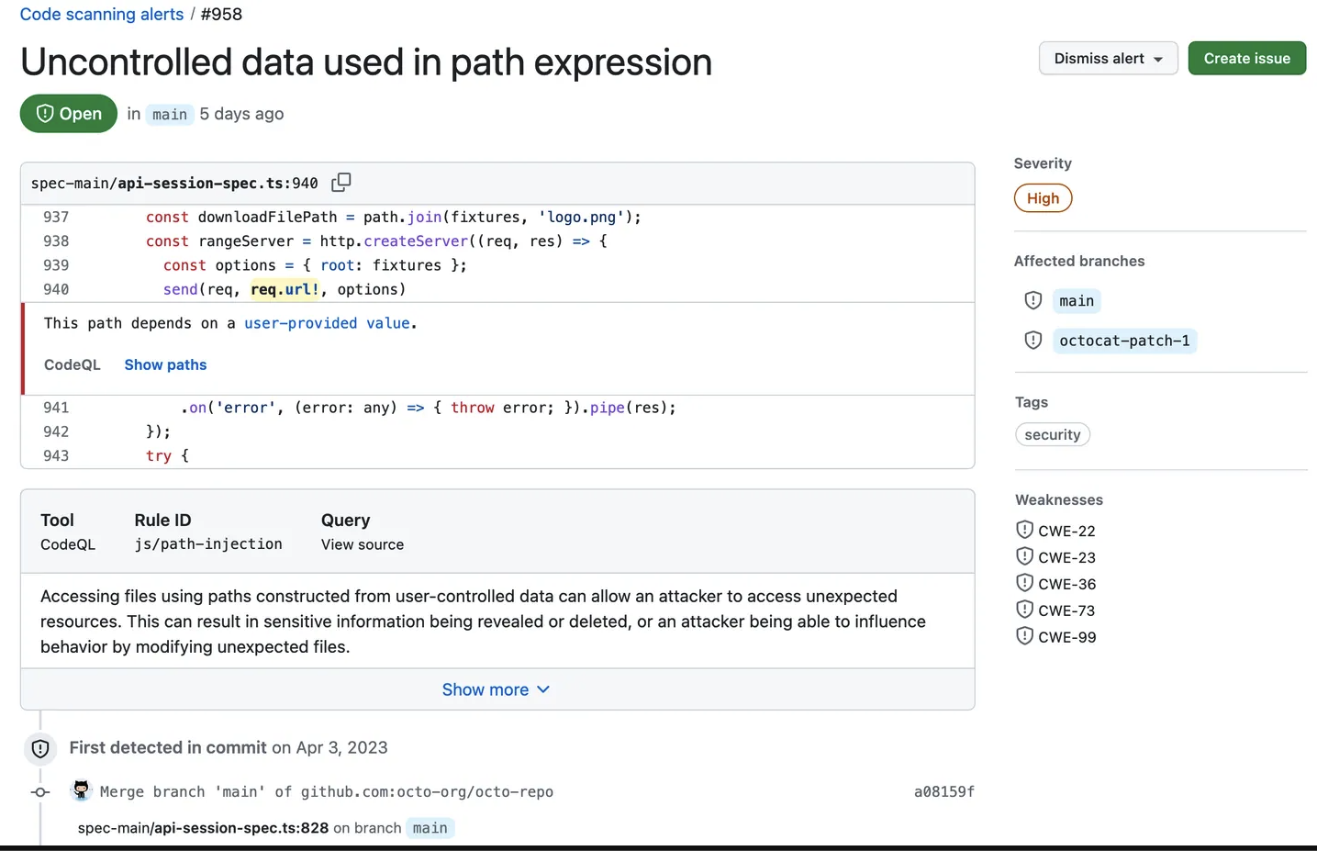
Introducing GitHub Code Security
Code scanning
A class leader in semantic code analysis with
CodeQL
Copilot Autofix
AI-powered remediation right in the developer
workflow
Security Campaigns
Remediate vulnerabilities at scale
Security overview
Enterprise-level insights to your software security
posture
3
Notes:
So how do we bring all of this together?
How do we enable security and development teams to move faster, work better together, and actually reduce risk at scale?
That’s where GitHub Code Security comes in.
GitHub Code Security brings a full suite of security capabilities built into the developer workflow, not bolted on after the fact. It’s designed to help teams find and fix vulnerabilities earlier, faster, and more collaboratively than ever before.

Slide 4
CodeQL — how it works
Query
Libraries
What to look for
Model key
concepts
Code base
Database scheme
QL compiler
Describes code as data
Build
system
Extractor
exprs
…
…
…
stmts
…
…
…
Compiled and
optimized query
Turns code
into data
Database
QL evaluator
Stores code as data
Build
artifacts
Query results
4

Slide 5
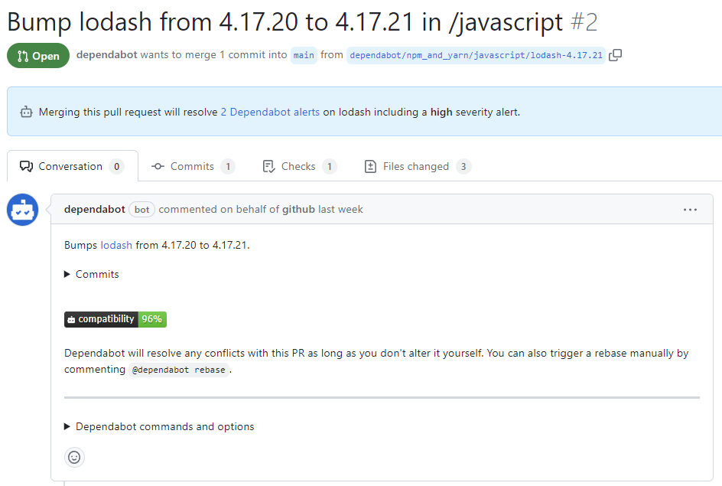
Dependabot
Find and fix vulnerable dependencies you rely on with Dependabot.
Dependency Alerts
Get notified of vulnerabilities, malware, and
license compliance issues in dependencies
Dependabot security updates
Review a PR to update to the minimum fixed
version
Dependabot version updates
Review a PR to update to the latest stable
dependency version
5
Notes:
Dependencies are pieces of code that your application relies on to function properly. These can include libraries, frameworks, and other third-party code. While dependencies can save you time and effort in development, they can also pose security risks if they are outdated or vulnerable to exploits.

Slide 6

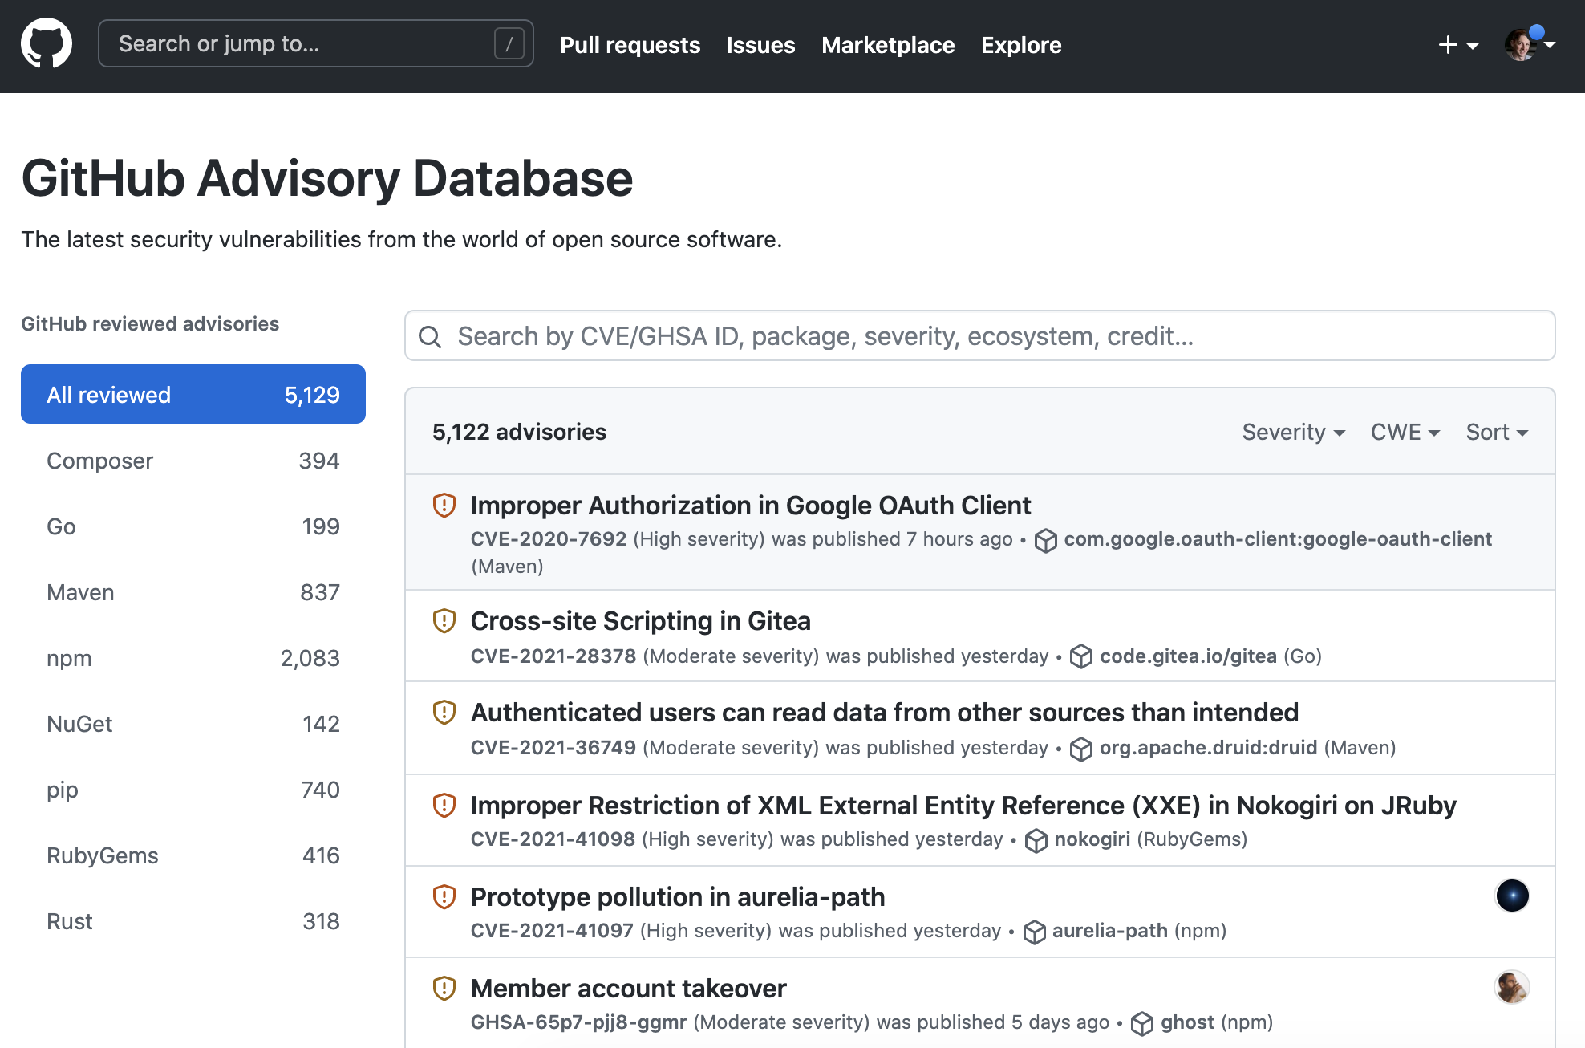
Advisory data direct from maintainers, curated by GitHub
Free, open source database of advisories
with a creative commons license
Maintained by GitHub with a full-time,
dedicated curation team (part of the
Security Lab)
Built into the disclosure workflow for
maintainers who can request CVEs from
GitHub
6

Slide 7
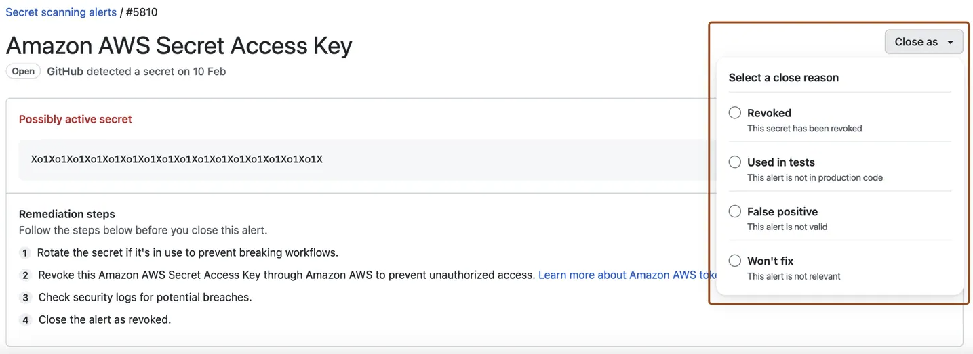
Secret Protection
Identifies secrets as
early as possible
Community of secret
protection partners
Define custom patterns
Supports both public
and private repos
Finds secrets as they are
pushed to GitHub.
For every commit & full git
history, secret formats from
secret protection partners
are searched.
For patterns that are internal
to your organization.
Watches public and private
repos for secret
vulnerabilities.
7
Notes:
Speaker Notes
Data points:
The other significant finding from the study was that 81% of the secrets discovered took two weeks or longer to be removed. This means that, the developers using these sensitive secrets probably weren’t aware that their secrets were exposed or drastically underestimate the risk this poses. Furthermore, even developers who were aware of the exposed keys and the need to keep them safe might delete the key, but fail to wipe the entire GitHub repository. In this case, the keys could still be found in the GitHub repository’s commit history, which holds changes made to the GitHub repository – including deleted keys. Source => https://www.cyberark.com/resources/blog/github-repositories-leak-thousands-of-secrets-study-shows
About secret scanning
If your project communicates with an external service, you might use a token or private key for authentication. Tokens and private keys are examples of secrets that a service provider can issue. If you check a secret into a repository, anyone who has read access to the repository can use the secret to access the external service with your privileges. We recommend that you store secrets in a dedicated, secure location outside of the repository for your project.
GitHub will also periodically run a full git history scan of existing content in your repositories where secret scanning is enabled, and send alert notifications following the secret scanning alert notification settings. Secret scanning will scan your entire Git history on all branches present in your GitHub repository for secrets, even if the repository is archived.
Secret scanning alerts for partners. Runs automatically on all public repositories and public npm packages. Service providers can partner with GitHub to provide their secret formats for scanning, hence the term "partners." Any strings that match patterns that were provided by secret scanning partners are reported directly to the relevant partner.Secret Secret scanning alerts for users. These alerts are reported on GitHub.com. The following users can enable and configure additional scanning:
Owners of repositories on GitHub.com, on any public repositories they own.
Organizations owning public repositories, on any of these repositories.
Organizations using GitHub Enterprise Cloud, on any public repositories (for free), and on any private and internal repositories, when you have a license for GitHub Advanced Security.
Additionally, secret scanning scans:
Descriptions and comments in issues
Titles, descriptions, and comments, in open and closed historical issues. A notification is sent to the relevant partner when a historical partner pattern is detected.
Titles, descriptions, and comments in pull requests
Titles, descriptions, and comments in GitHub Discussions
For Internal FYI.
Effective management of bypasses
This doesn’t mean that allowing bypasses is insecure! With some simple steps, organizations can implement effective controls for bypasses, allowing them to retain customer trust as well as prevent secrets from leaking.
There are two primary methods to track bypasses of push protections:
The secret_scanning_alert webhook which is fired every time a protection is bypassed (the push_protection_bypassed property is set to true)
The secret_scanning_push_protection category of audit logs
You can use either of these to send automated emails or notify admins when bypasses occur. This allows you to maintain visibility without losing developer trust, since the bypass can be inspected and, if valid for cases like false positives, ignored. For cases where the bypass was not valid, admins can have conversations with the developer who bypassed the protection.

Slide 8
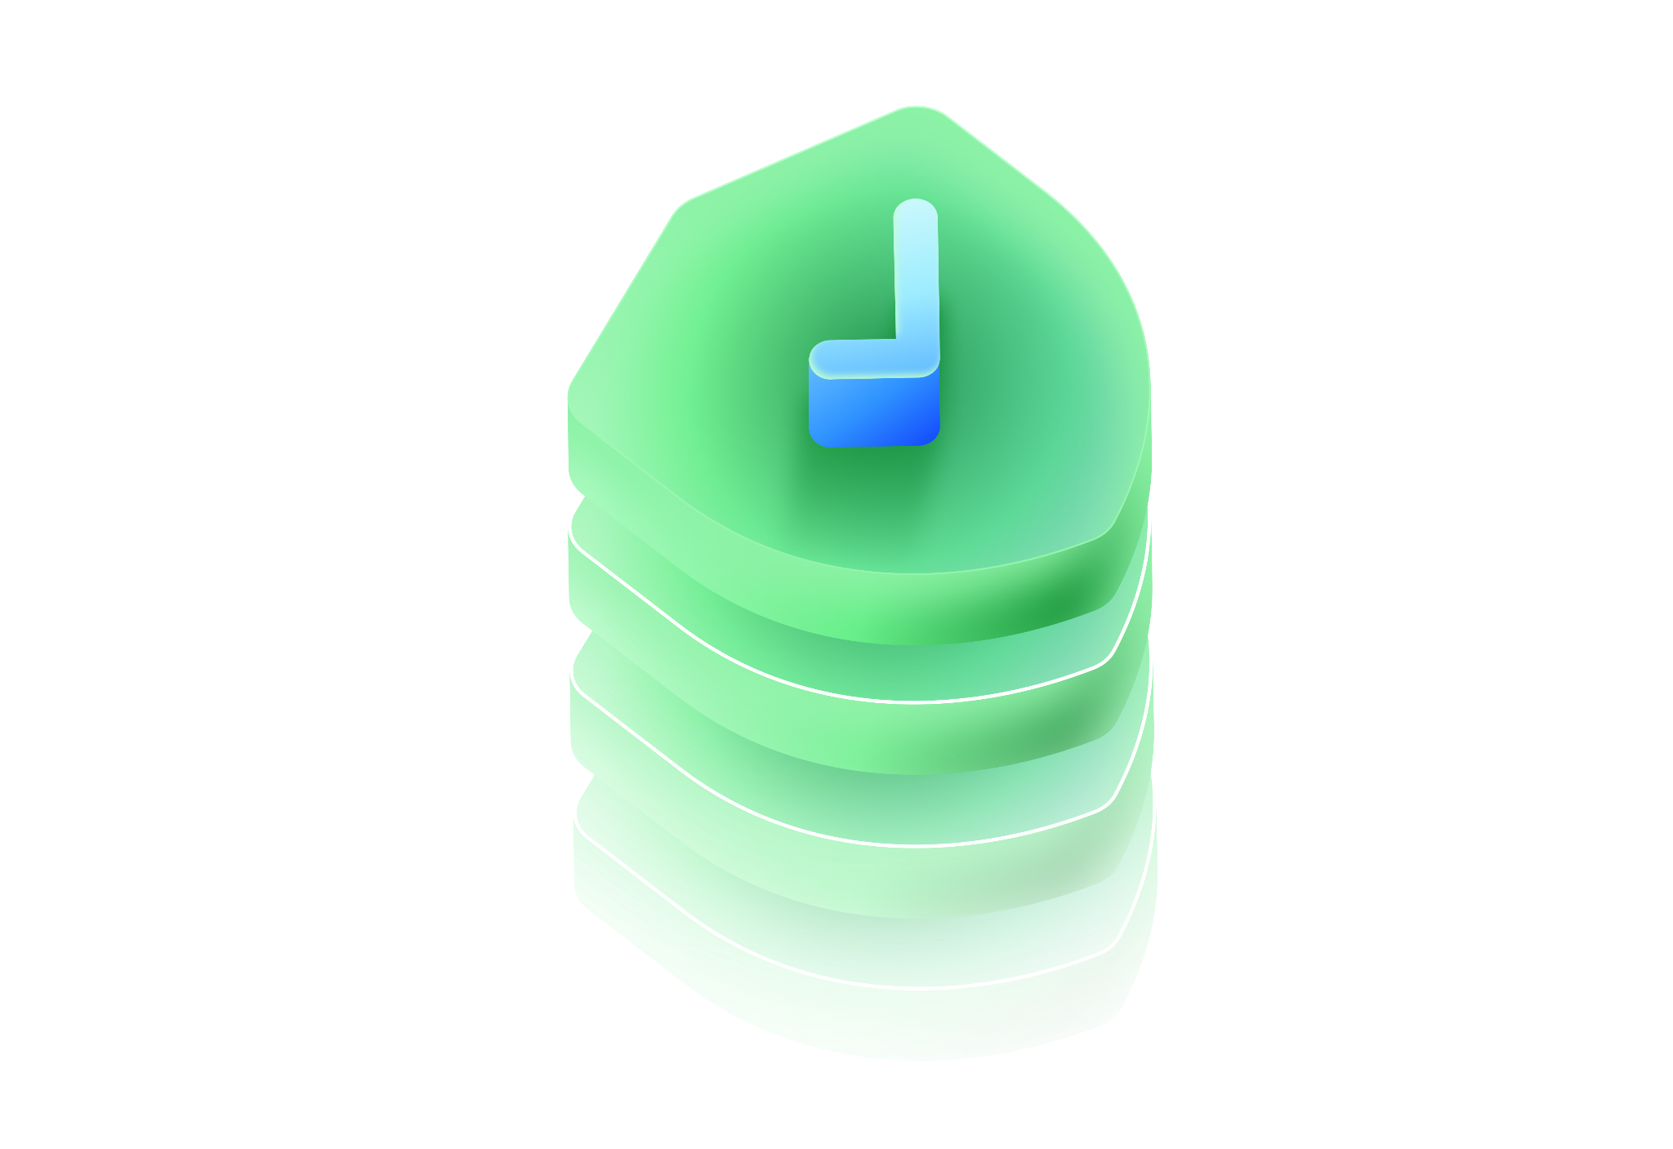


What is a secret?
Password
Access keys
API Key
Other Credentials
8
Notes:
But what exactly is a secret? It could be many things - it's anything that is used to secure your software or environment both whilst building software and running in production.
It could be a password and API key access keys such as ones for cloud providers or other credentials such as SSH keys or certificates.Secrets could be something you issue or issued by a provider.

Slide 9
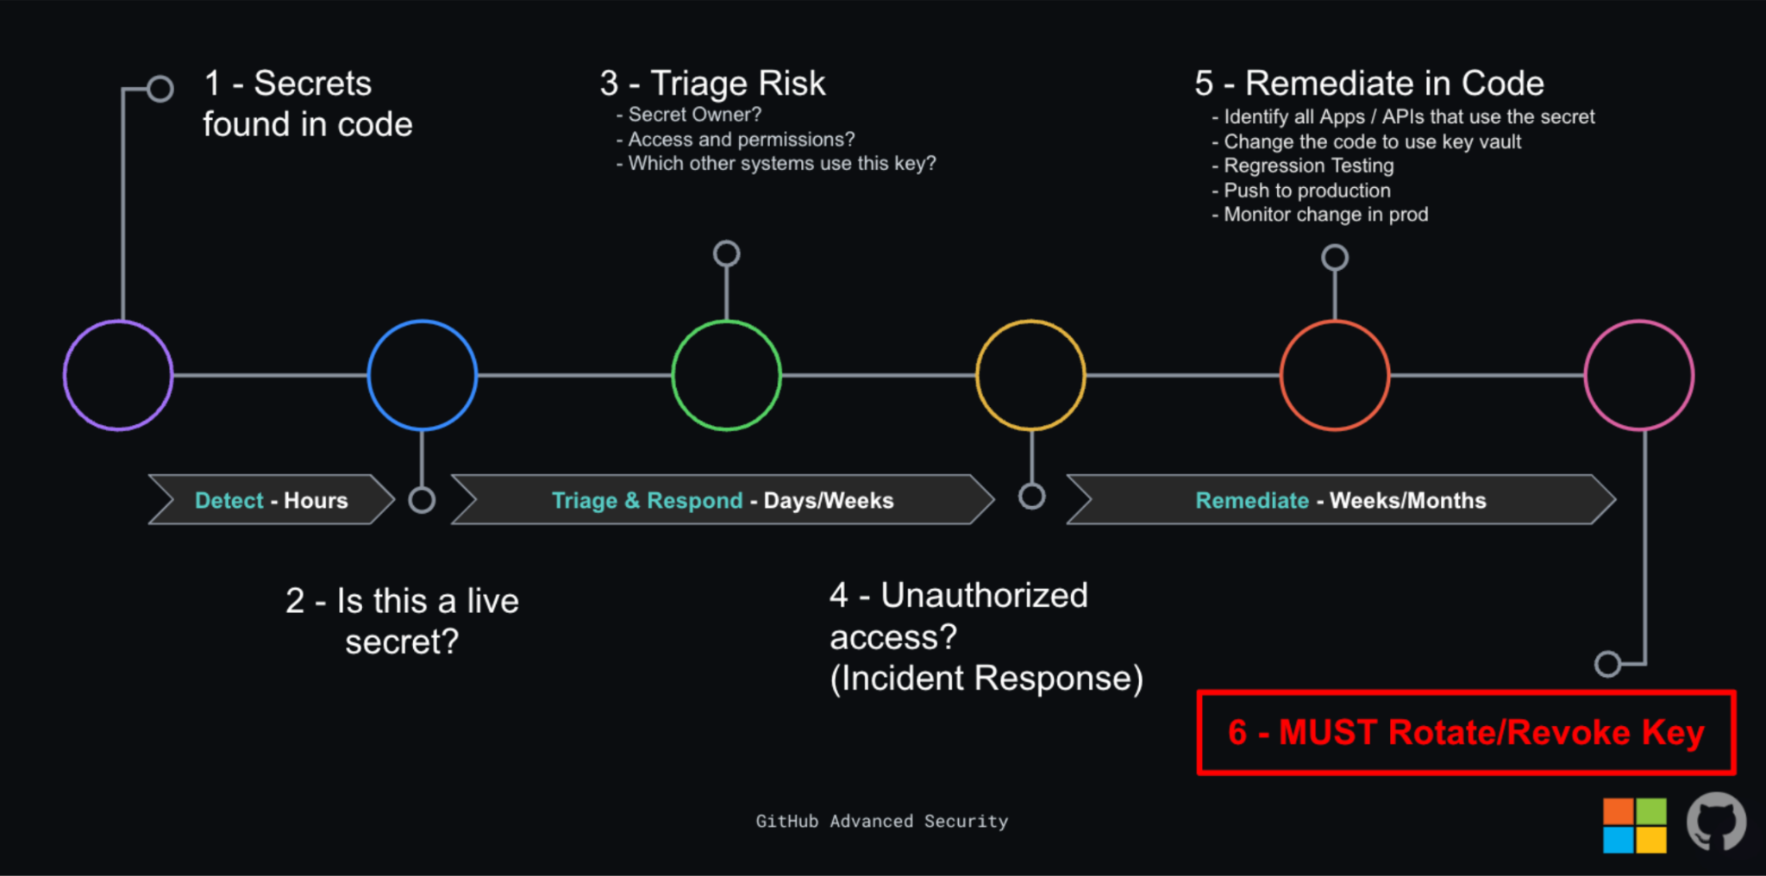
A typical remediation
9
Notes:
TODO: get better version of this diagram. Source was White Paper https://docs.google.com/document/d/18idAibU8hY3mfhaHDyTaCy1bE7KNvLzTQqJgOc29w4o/edit
This is a traditional remediation process for an organization.Your team this may be quicker or slower depending on your complexity.
Each step may involve one or more teams. Estimates range from 1000s of dollars to significantly more to fix just one exposed secret.

Slide 10
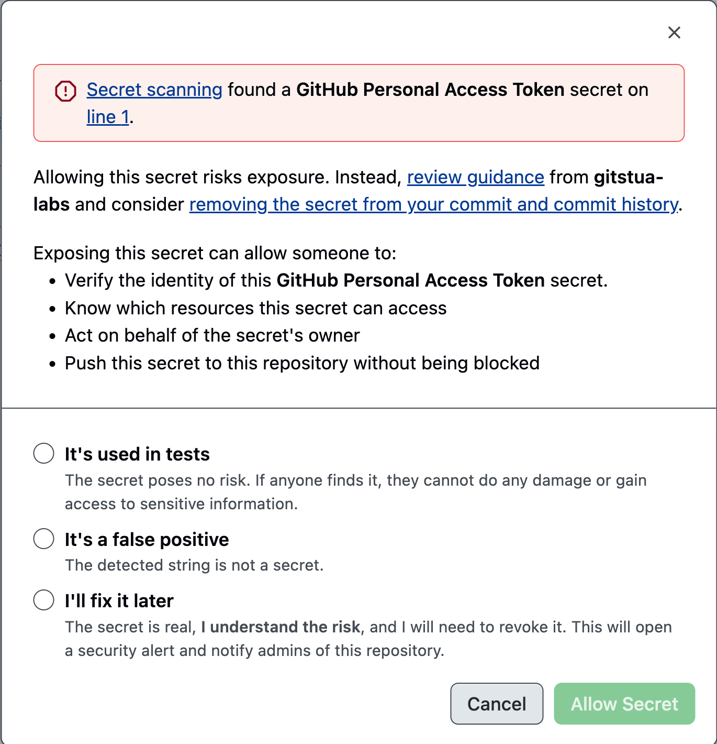
Push protection
Developer is prompted when they add a
secret
The secret has not yet been exposed
Where a secret is a test secret or a false
positive then the developer can choose to
bypass
Coach good practice and keep developers
in the flow
10
Notes:
Prevents push to GitHub of highest confidence secrets.
Works with code, issues etc, in Web UI, Git clients and IDEs,
Bypass controls are available (link)
CAVEATS
Designed to coach developers and keep them in their flow (you can have custom instructions)
Low confidence secrets will not be blocked as these have a lot of false positives
Very large repo pushes or pushes with lots of secrets may hit timeouts in which case these secrets will be shown as alerts

Slide 11
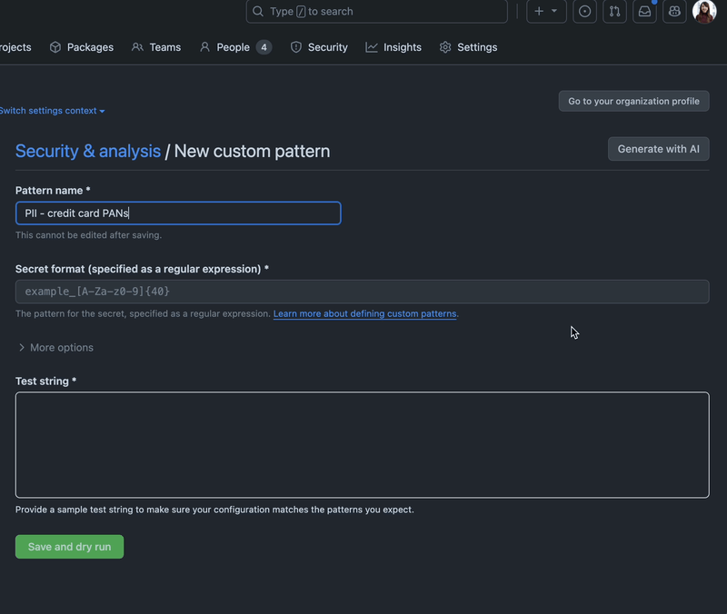
Custom patterns
Define your own patterns for your enterprise
secrets
Enable for push protection
We use AI to help generate the custom
pattern for you
Test with dry runs
11
Notes:
Define your own patterns for your enterprise secrets - you may issue tokens in a particular format
Enable for push protection (*) - be cautious about blocking developers if you have too many false positives
We use AI to help generate the custom pattern for you - as you can see from this example - you can give some samples and generate a pattern
Test with dry runs - to keep developers in the flow we allow you to complete dry runs to ensure your custom patterns are working as you want them to
You can define custom patterns for your enterprise, organization, or repository. Secret scanning supports up to 500 custom patterns for each organization or enterprise account, and up to 100 custom patterns per repository. docs

Slide 12

What’s new and what’s next
12

Slide 13
GITHUB ADVANCED SECURITY
What’s new and what’s next
SECRET PROTECTION
Public Monitoring
Next-gen AI Secret Detection
Find and stop
leaked
credentials
GA · UNIVERSE
PUBLIC PREVIEW
Detects your secrets leaked anywhere on public GitHub (e.g.
personal repos) and attributes them back to your enterprise.
Significantly more accurate AI detection of passwords and
generic secrets, now blockable with push protection.
CODE SECURITY
Agentic Autofix
AI Detections
Find and fix
code
vulnerabilities
GA · UNIVERSE
PRIVATE PREVIEW
Iterates until its fix is validated and flags false positives,
clearing backlog from CodeQL and third-party tools
ingested via SARIF.
One-click, full-repo AI scanning for every language, with two
levels of depth: GitHub AI Scan and Deep Scan via MDASH.
SUPPLY CHAIN (SCA)
Reachability
Package Firewall
License Compliance
Secure your
open source
dependencies
PUBLIC PREVIEW
PUBLIC PREVIEW
GA · UNIVERSE
Flags vulnerable dependencies your
code calls to prioritize by exploitability.
Blocks malicious or vulnerable
packages at install, before they reach
your code.
Blocks non-compliant licenses at the
pull request with one enterprise-wide
policy.
Preview capabilities are subject to change before general availability.
13

Slide 14
GITHUB ADVANCED SECURITY · AI DETECTIONS
Two AI scans. One click. Pick your depth.
BROAD AND FAST
DEEP AND THOROUGH
 | GitHub AI Scan | Deep AI Scan (MDASH)
BEST FOR | Every repo, every language | Crown-jewel repos and critical code
HOW IT RUNS | One click single model AI scan for vulns in GitHub | Multiple models cross-checking each other
SPEED AND COST | Fast and low cost — run it on demand | Slower and costlier — run it deliberately
WHAT IT CATCHES | Vulnerabilities and flaws out of scope for SAST | Subtle, multi-step issues one pass misses
THINK OF IT AS | GitHub native Claude and OpenAI Security compete | The deep inspection, on demand
FLEXIBILITY AND CHOICE
Choose the scope and depth. Results surfaced alongside other GHAS code security findings and are assignable to Agentic Autofix.
Consistent, scalable AI scanning.
14

Slide 15
GITHUB ADVANCED SECURITY · THE BIG PICTURE
Native AppSec for the Agentic Era
01
02
03
Comprehensive Detection
Agentic Remediation
Proactive Prevention
Deterministic Code Scanning
Validated fixes
Push protection
Static analysis for security and quality,
PR and full repo
Pre-triaged for false positives
Secrets blocked before they ever land
AI Scanning
Support for every finding
Configurable blocking at the PR
LLM detection, PR and full repo
GitHub’s own plus third-party via SARIF
Proactively prevent risk via customizable
repo rulesets
Supply Chain Security
Developer-native
Package firewall
Dependency risk, ranked by reachability
Fixes arrive as PRs, reviewed like any
change
Malicious packages blocked at install
Secret Scanning
Backlog burndown
Enforced and managed at scale
Partner patterns + next-gen AI
detections
Years of security debt, cleared at scale
Centrally implemented via enterprise
level security config
ALL NATIVE IN GITHUB
One developer experience, one policy model, one set of results — in the workflow developers already use.
15

