Slide 1



Feature Selection Techniques

Slide 2

UNIVERSITY INSTITUTE OF TECHNOLOGY, BURDWAN
SEMINAR - II
IT – 892(OLD)
Academic Year : 2016-20
Feature Selection Techniques
Submitted by : PRAKASH ANAND (2016-3016)

Slide 3
Feature Selection
Feature selection is primarily focused on removing non-informative or redundant predictors from the model.
Feature selection methods are intended to reduce the number of input variables to those that are believed to be most useful to a model in order to predict the target variable. It is one of the core concepts in machine learning which hugely impacts the performance of any model.

Slide 4
Why Feature Selection?
Benefits of performing feature selection before modeling your data
Reduces Over-fitting: Less redundant data means less opportunity to make decisions based on noise.
Improves Accuracy: Less misleading data means modeling accuracy improves.
· Reduces Training Time: fewer data points reduce algorithm complexity and algorithms train faster.

Slide 5
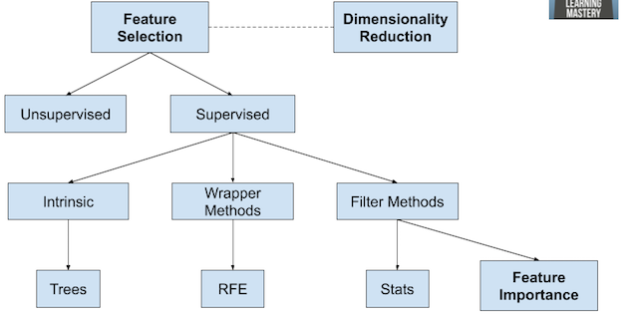
Overview of Feature Selection Techniques

Slide 6
Feature Selection Methods
Granger Causality Hypothesis Test: The Granger causality test is a statistical hypothesis test for determining whether one time series is useful in forecasting another.
ANOVA F-Test: Analysis of variance (ANOVA) is a collection of statistical models and their associated estimation procedures used to analyze the differences among group means in a sample.

Slide 7
Granger Causality Hypothesis Test
A time series X is said to Granger-cause Y if it can be shown, usually through a series of t-tests and F-tests on lagged values of X (and with lagged values of Y also included), that those X values provide statistically significant information about future values of Y.
Granger causality Tests the null hypothesis that the coefficients of past values in the regression equation is zero. In simpler terms, the past values of time series (x) do not cause the other series (y). So, if the p-value obtained from the test is lesser than the significance level of 0.05, then, you can safely reject the null hypothesis.

Slide 8
ANOVA F-Test
Steps to perform ANOVA F-Test:
Define Hypothesis.
Calculate the Sum of Squares.
Determine degrees of freedom.
F-value.
Accept or Reject the Null Hypothesis.

Slide 9
Feature Selection Methods
Filter Method: filtering our datasets and taking only a subset of it containing all the relevant features (correlation matrix using Pearson Correlation).
Wrapper Method: follows the same objective of the Filter Method but uses a Machine Learning model as it’s evaluation criteria (Forward/Backward/Bidirectional/Recursive Feature Elimination).
Embedded Method: like the Filter Method also the Embedded Method makes use of a Machine Learning model.

Slide 10
Filter Methods
Filter methods are generally used as a preprocessing step. The selection of features is independent of any machine learning algorithms. Instead, features are selected on the basis of their scores in various statistical tests for their correlation with the outcome variable.
Feature/Response | Continuous Data | Categorical Data
Continuous Data | Pearson’s Correlation | Linear discriminant analysis
Categorical Data | ANOVA | Chi-Square

Slide 11
Univariate Selection
Univariate Feature Selection is a statistical method used to select the features which have the strongest relationship with our correspondent labels. Using the SelectKBest method we can decide which metrics to use to evaluate our features and the number of K best features we want to keep.
Different types of scoring functions are available depending on our needs:
Classification = chi2, f_classif, mutual_info_classif
Regression = f_regression, mutual_info_regression

Slide 12
Wrapper Methods
In wrapper methods, we try to use a subset of features and train a model using them. Based on the inferences that we draw from the previous model, we decide to add or remove features from your subset. The problem is essentially reduced to a search problem. These methods are usually computationally very expensive.
Some common examples of wrapper methods:
Forward Selection
Backward Elimination
Recursive Feature elimination

Slide 13
Embedded Methods
Embedded methods combine the qualities’ of filter and wrapper methods. It’s implemented by algorithms that have their own built-in feature selection methods. Some of the most popular examples of these methods are LASSO and RIDGE regression which have inbuilt penalization functions to reduce over-fitting.
Lasso regression performs L1 regularization which adds penalty equivalent to absolute value of the magnitude of coefficients.
Lasso regression performs L1 regularization which adds penalty equivalent to absolute value of the magnitude of coefficients.

Slide 14
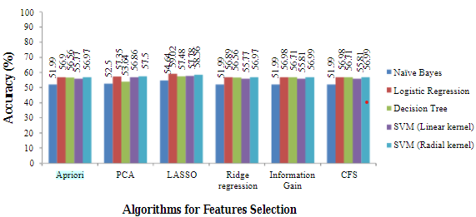
Feature Selection for Classification

Slide 15
Conclusion
Our approach for feature selection is using fully data-driven techniques
such as ANOVA Testing and Granger Causality Hypothesis test
becomes effective. Using these techniques we enhance the accuracy of
the model by eliminating trivial attributes present in the dataset. We
have also applied these techniques in other datasets(pima diabetes, lung
cancer, heart disease, breast cancer, abalone) to improve the accuracy.

Slide 16
References
Feature selection techniques for classification and Python tips for their application: https://towardsdatascience.com/
Machine Learning Mastery!: https://machinelearningmastery.com/
Feature Selection Methods: https://analyticsindiamag.com/
Best feature Selection Techniques: https://www.researchgate.net/

Slide 17
Thanks

