Slide 1

UNIVERSITY INSTITUTE OF TECHNOLOGY, BURDWAN Project- II IT-891 Project Name : Feature Selection using Statistical hypothesis test Granger Causality and Analysis Of Variance(ANOVA) Under the Supervision of Submitted by : Mrs. Kasturi Ghosh Dipesh Kumar(2016-3015, Regn. A4515 of 2016-17) In - Charge Prakash Anand(2016-3016, Regn. A4516 of 2016-17) Dept. of Information Technology Arjun Kumar(2016-3042 , Regn. A5072 of 2016-17) University Institute Of Technology, BU Devendra Kumar(2016-3064, Regn. A4533 of 2016-17)

Slide 2
AIM
The main aim of our project is to select the feature in multivariate time series datasets using Granger Causality and Analysis of Variance(ANOVA) for improving the accuracy of Machine Learning(ML) model. We have to reduce the complexity of a model and makes it easier to interpret.

Slide 3
ALGORITHM
Data Pre-processing
Computing Accuracy of the given datasets
Feature Selection Using Analysis of Variance(ANOVA)
Computing Accuracy of reduced dataset
Feature Selection using Granger Causality Hypothesis Test
Computing Accuracy of reduced dataset
Accuracy Comparison between original and reduced dataset

Slide 4
Feature Selection Feature Selection is one of the core concepts in machine learning which hugely impacts the performance of your model. Some Benefits of performing Feature Selection are Reduces Overfitting, Improves Accuracy, Reduces Training Time. Here is some feature selection technique we use :
Granger Causality Hypothesis Test
Analysis Of Variance(ANOVA) F-Test

Slide 5
Classification Model Classification is a supervised learning approach in which the computer program learns from the data input given to it and then uses this learning to classify new observation. The goal of classification is to accurately predict the target class for each case in the data. Here are some classification algorithm in Machine Learning.
K-Nearest Neighbours(KNN)
Logistic Regression
Support Vector Machines(SVM)
Decision Trees

Slide 6
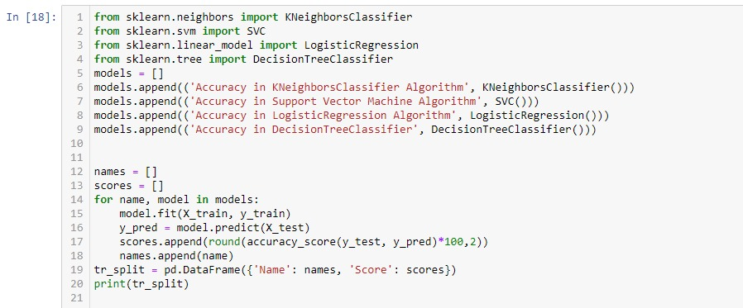
Implementation of different classifier to find accuracy of the dataset

Slide 7
Implementation of Analysis of Variance(ANOVA) F-Test A one way ANOVA is used to compare two means from two independent (unrelated) groups using the F-distribution.
We decide the result on the basis of P-Values. If the P-value is less than significance value(0.05), then null hypothesis (H₀) will be rejected and alternate hypothesis(H₁) will be selected which represent the given variable cause the required variable.
Code Snippet :
one.way <- aov(target variable~ independent variable, dataset)
summary(one.way)

Slide 8
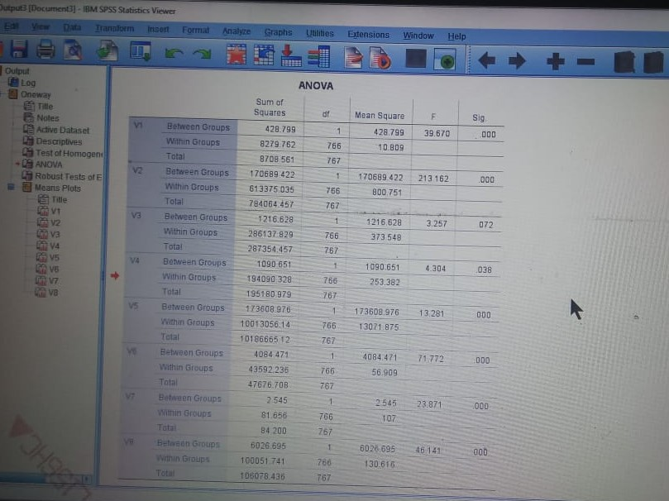
IBM – SPSS Result of ANOVA
Here, V3 attribute has p- value .072 which is more than the significance value, then we are going to remove to this attribute.

Slide 9
Implementation of Granger Causality Test The Granger causality test is a statistical hypothesis test for determining whether one time series is useful in forecasting another, first proposed in 1969.
def grangers_causation_matrix(data, variables, test='ssr_chi2test', verbose=False):
X_train = pd.DataFrame(np.zeros((len(variables), len(variables))), columns=variables, index=variables)
for c in X_train.columns:
for r in X_train.index:
test_result = grangercausalitytests(data[[r, c]], maxlag=maxlag, verbose=False)
p_values = [round(test_result[i+1][0][test][1],4) for i in range(maxlag)]
if verbose: print(f'Y={r}, X={c}, P Values = {p_values}')
min_p_value=np.min(p_values)
X_train.loc[r, c] = min_p_value
X_train.columns =[var + '_x' for var in variables]
X_train.index = [var + '_y' for var in variables]
return X_train

Slide 10
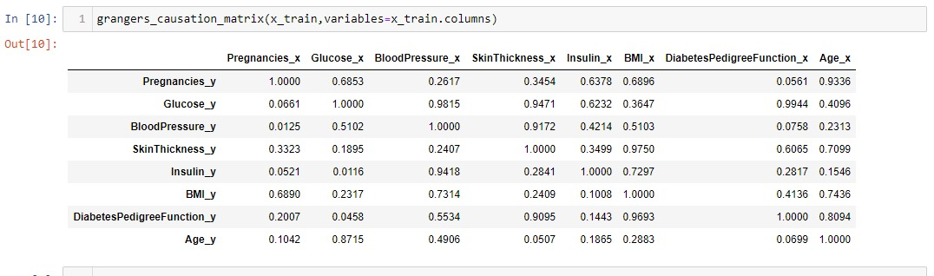
Result of Granger Causality test
If the value is less than 0.05, it means that attribute is affected by some attribute(x2) and also it is affecting other attributes(x1) of the dataset.
And, if x1-x2 is negative or zero, then we are going to discard this attribute.

Slide 11
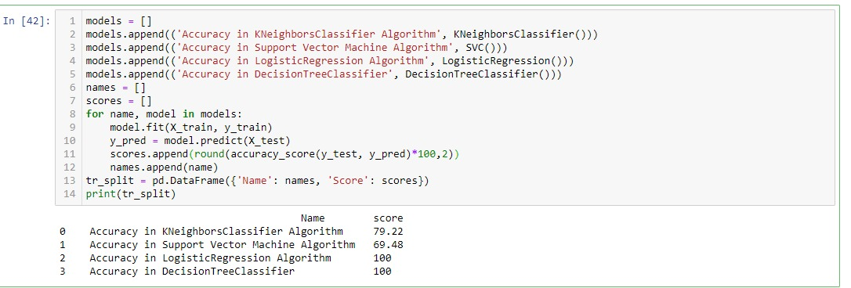
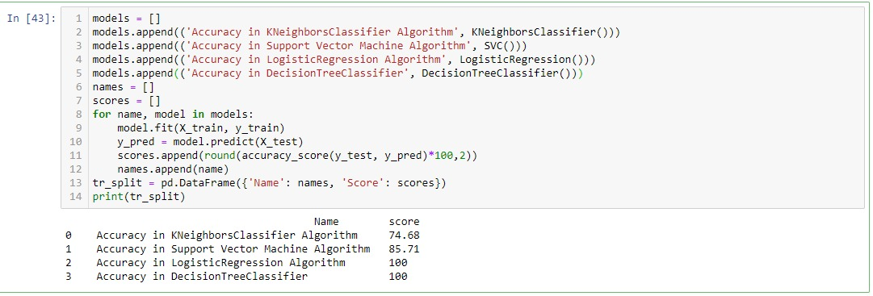
Final result of ANOVA
Final result of Granger causality test

Slide 12
Accuracy Comparison between original and reduced Pima dataset
Classifier | On Original Dataset | After Applying ANOVA F-test | After Applying Granger Causality
K-Nearest Neighbour | 66.20 % | 79.22 % | 74.68 %
Support Vector Machine | 64.2 % | 69.48 % | 85.71 %
Logistic Regression | 100 % | 100 % | 100 %
Decision Tree | 100 % | 100 % | 100 %

Slide 13
Accuracy comparison using Bar Graph

Slide 14
CONCLUSION
Our approach for feature selection is using fully data-driven techniques such as ANOVA Testing and Granger Causality Hypothesis test becomes effective. Using these techniques we enhance the accuracy of the model by eliminating trivial attributes present in the dataset.

Slide 15
FUTURE SCOPE
We will going to use factor analysis technique to reduce a large number of variables into fewer number of factors. By using this technique we extracts maximum common variance from all variables and put them into a common score. As an index of all variables, we will use this score for further analysis.
And also we will apply Reducts and core to increase the efficiency or accuracy of the dataset.

Slide 16
REFERENCES
Sankar Narayan Patra, Amrita Prasad, Soumya Roy, Gautam Bhattacharya, Subhash Chandra Panja, Koushik Ghosh : Causality Analysis between Solar Irradiance and Forbush Decrease Indices
Granger Causality : http://www.scholarpedia.org/article/Granger_causality
Andreas Lindholm, Niklas Wahlström,Fredrik Lindsten, Thomas B. Schön : “ Supervised Machine Learning “, http://www.it.uu.se/edu/course/homepage/sml/literature/lecture_notes.pdf
Breast Cancer Dataset : https://www.kaggle.com/uciml/breast-cancer-wisconsin-data
Tingquan Deng and Jinhong Yang :- An Improved Semisupervised Outlier Detection Algorithm Based on Adaptive Feature Weighted Clustering

Slide 17


