Slide 1
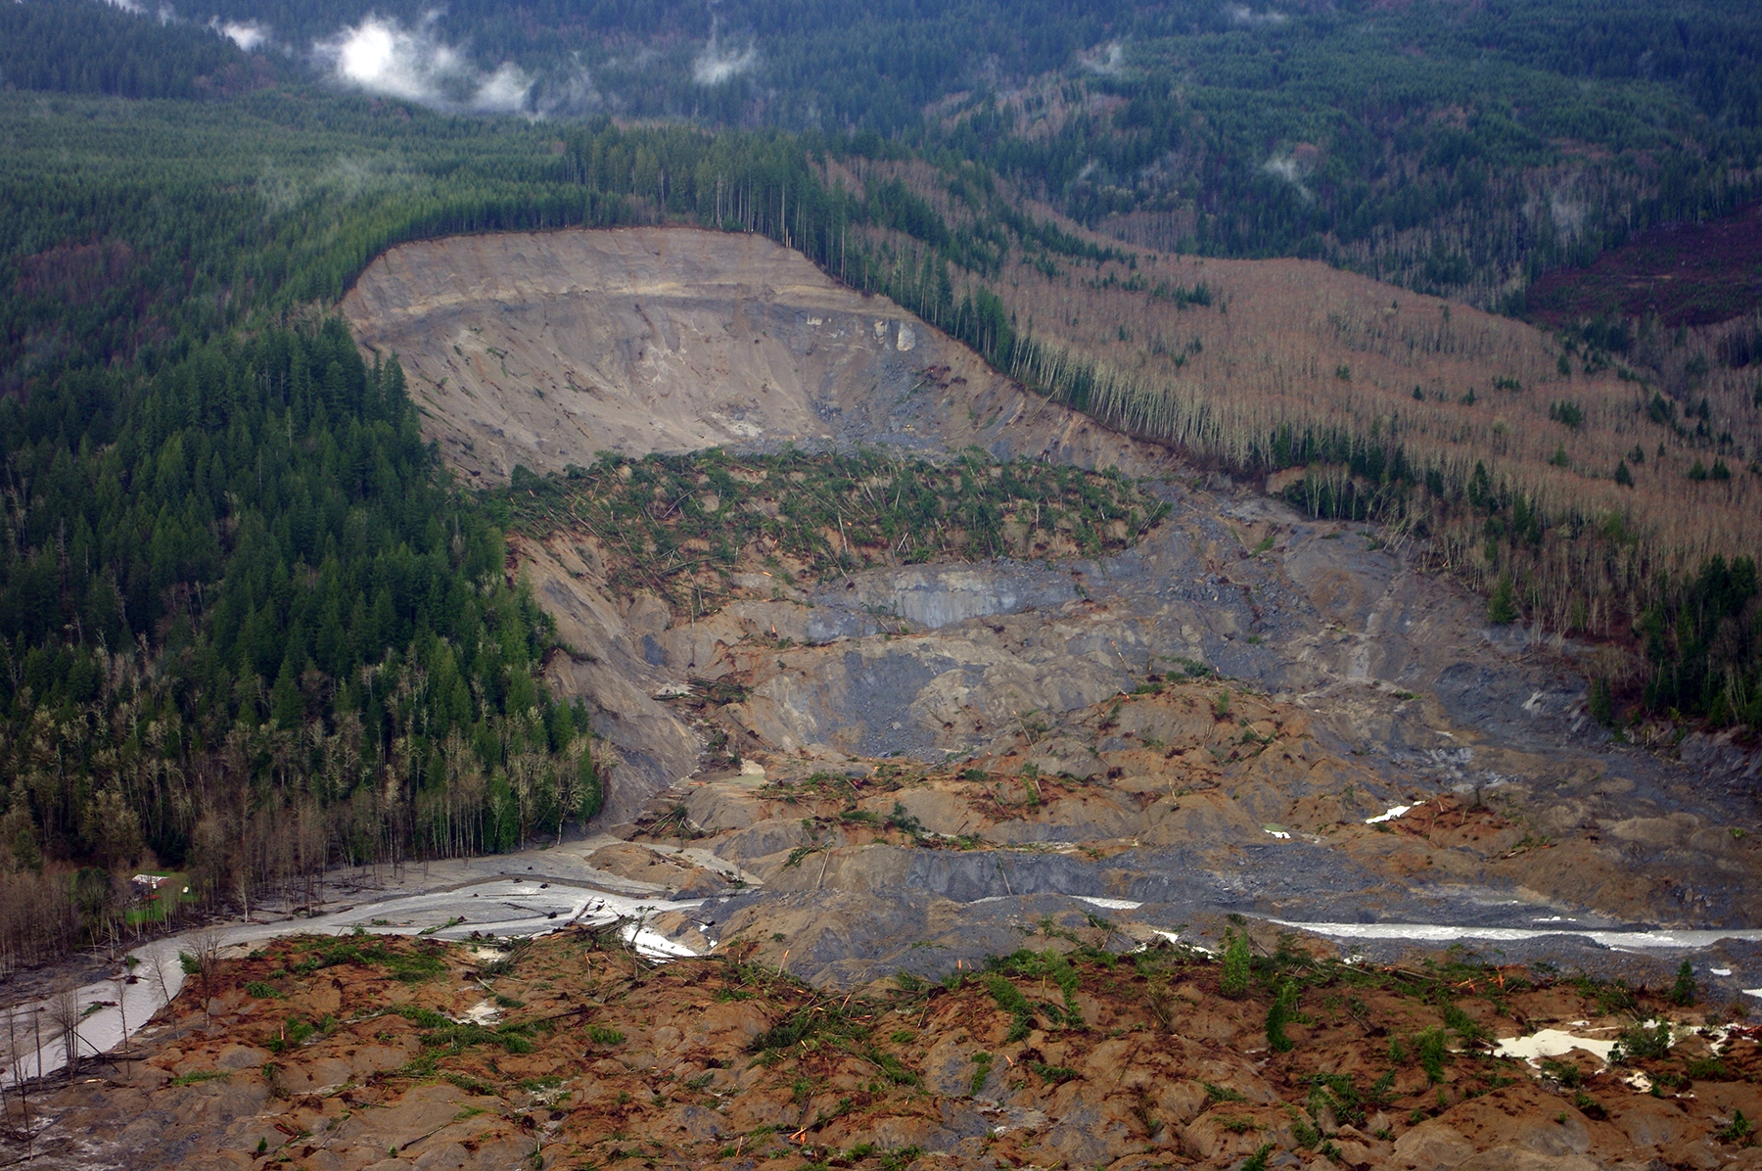



Introduction to GPU programming for computational models: Debugging, profiling and optimizing.
Workshop 2 – RESCUER MSCA Doctoral Network
Sergio Martínez-Aranda
Fluid Dynamics Tecnologies - I3A, University of Zaragoza
sermar@unizar.es

Slide 2
Debugging, profiling and optimizing
Workshop 2 – RESCUER MSCA-DN
Module content
Optimizing tools
Debugging code with Compute Sanitizer
Profiling code with Nsight System

Slide 3
Optimizing tools
Workshop 2 – RESCUER MSCA-DN
CUDA Toolkit optimization
Profiling tools
1. Nsight Systems
A system-wide performance analysis tool for CUDA applications.
Timeline view of CPU, GPU, and memory activities.
Profiling of CUDA kernels, memory transfers, and API calls.
Identify performance bottlenecks.
2. Nsight Compute
An interactive kernel profiler for CUDA applications.
More detailed metrics for CUDA kernels (e.g., warp execution efficiency, memory bandwidth).
Source-level analysis and optimization suggestions.
Customizable profiling sessions.

Slide 4
Optimizing tools
Workshop 2 – RESCUER MSCA-DN
CUDA Toolkit optimization
Debugging tools
1. Compute Sanitizer
A suite of tools for detecting and diagnosing issues in CUDA applications.
Memory allocation checking: out-of-bounds access, memory leaks, etc
Memory initialization checking
Race condition and synchronization problems detection.
2. CUDA-GDB
A GPU-aware debugger based on GDB for debugging CUDA applications.
Debug both host (CPU) and device (GPU) code.
Set breakpoints, inspect variables, and step through CUDA kernels.
Examine CUDA threads, blocks, and grids.

Slide 5
Debugging, profiling and optimizing
Workshop 2 – RESCUER MSCA-DN
Module content
Optimizing tools
Debugging code with Compute Sanitizer
Profiling code with Nsight System

Slide 6
Debugging cuda applications
Workshop 2 – RESCUER MSCA-DN
Debugging with Compute Sanitizer
Compilation flags
Include –g: Add information for the host code.
Include –G: Add information for the device code.
Do not include compiler optimization flags (e.g., -03).
Check for memory errors: memcheck
Memory errors include out-of-bounds accesses, memory leaks, and illegal memory operations.
Check for memory initialization: initcheck
Detection of uninitialized memory accesses.
Check for race conditions: racecheck
Multiple threads access shared data concurrently without a proper synchronization.
Check for synchronization conditions: synccheck
Detection of synchronization errors, such as incorrect use of barriers or warps divergence.

Slide 7
Debugging cuda applications
Workshop 2 – RESCUER MSCA-DN
Check for memory errors
Memory-related issues during execution of the CUDA kernels can range from out-of-bounds memory access, memory leaks and other illegal memory operations.
Execution
>> compute-sanitizer --tool memcheck ./my_cuda_app app_command_line_options
Optional flags
--leak-check full Perform a detailed memory leak check
--track-unused-memory yes Track memory that is allocated but never used.
--log-file <file> Save the output to a file.
--verbose Enable verbose output for more detailed information.

Slide 8
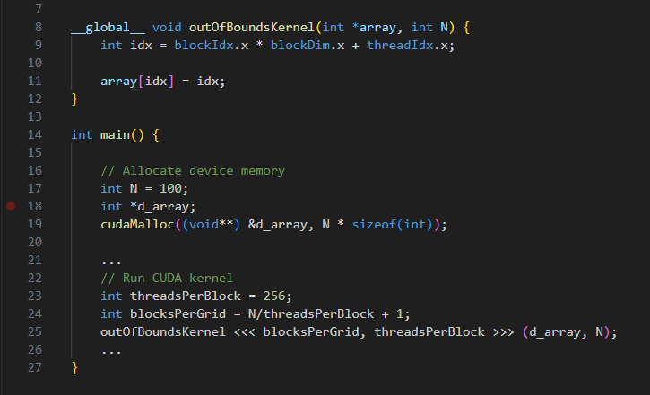
Debugging cuda applications
Workshop 2 – RESCUER MSCA-DN
Check for memory errors
Error example: out-of-bound access
Threads with idx>=N will access to an out-of-bound memory position
d_array allocates 100 integer elements in the global memory
The grid for the kernel has
1 block * 256 threads/block = 256 threads

Slide 9
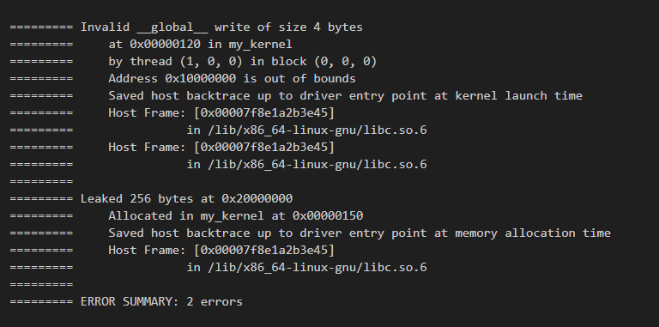
Debugging cuda applications
Workshop 2 – RESCUER MSCA-DN
Check for memory errors
Memcheck output message
Error type & mem. size
Invalid __global__ write
Invalid __global__ read
Leak
Misaligned address
Illegal memory operation

Slide 10
Debugging cuda applications
Workshop 2 – RESCUER MSCA-DN
Check for memory errors
Memcheck output message
Location:
CUDA kernel name
Thread Idx (x,y,z)
Block Idx (x,y,z)

Slide 11
Debugging cuda applications
Workshop 2 – RESCUER MSCA-DN
Check for memory errors
Memcheck output message
Address

Slide 12
Debugging cuda applications
Workshop 2 – RESCUER MSCA-DN
Check for memory errors
Memcheck output message
Call stack
Sequence of function calls leading to the error origin.

Slide 13
Debugging cuda applications
Workshop 2 – RESCUER MSCA-DN
Check for memory errors: Solutions
Invalid __global__ write Writing to an invalid memory location, such as out-of-bounds or freed memory.
Invalid __global__ read Reading from an invalid memory location.
Ensure all memory accesses are within the allocated bounds.
Check array indices and pointer arithmetic.
Leak Memory was allocated but not freed.
Free all allocated memory using cudaFree or cudaFreeHost.
Misaligned address Accessing memory with improper alignment, such as accessing a float2 at an char address.
Ensure memory is properly aligned for the data type being accessed
Illegal memory operation Performing an illegal operation, such as accessing freed memory.
Avoid accessing memory after it has been freed.
Use proper synchronization to prevent race conditions.

Slide 14
Debugging cuda applications
Workshop 2 – RESCUER MSCA-DN
Check for memory initialization
Memory allocated on the device (GPU) or host (CPU) is not properly initialized before being used by API functions or in CUDA kernels.
Execution
>> compute-sanitizer --tool initcheck ./my_cuda_app app_command_line_options
Optional flags
--track-unused-memory yes Track memory that is allocated but never used.
--log-file <file> Save the output to a file.
--verbose Enable verbose output for more detailed information.

Slide 15
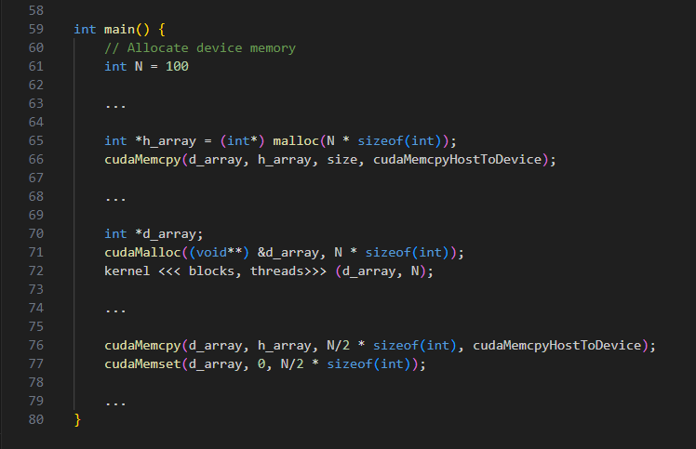
Debugging cuda applications
Workshop 2 – RESCUER MSCA-DN
Check for memory initialization
Error example: access to uninitialized memory
Host memory is not initialized before cudaMemcpy
Device global memory is not initialized before launch kernel
Partial initialization with cudaMemcpy or cudaMemset

Slide 16
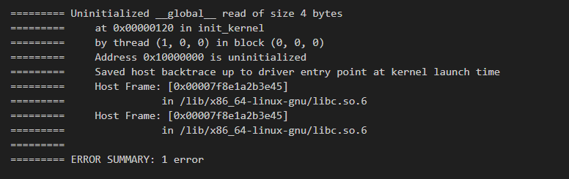
Debugging cuda applications
Workshop 2 – RESCUER MSCA-DN
Check for memory initialization
Initcheck output message
Error type & mem. size
Location
Kernel
Thread and block
Address
Memory address being accessed.
Call stack
Initializing the memory
API functions: cudaMemcpy, cudaMemset, etc.
Use initialization kernels.

Slide 17
Debugging cuda applications
Workshop 2 – RESCUER MSCA-DN
Check for race conditions
A race condition in CUDA occurs when multiple threads access and modify shared memory or global memory concurrently without proper synchronization.
Execution
>> compute-sanitizer --tool racecheck ./my_cuda_app app_command_line_options
Optional flags
--track-unused-memory yes Track memory that is allocated but never used.
--log-file <file> Save the output to a file.
--verbose Enable verbose output for more detailed information.

Slide 18
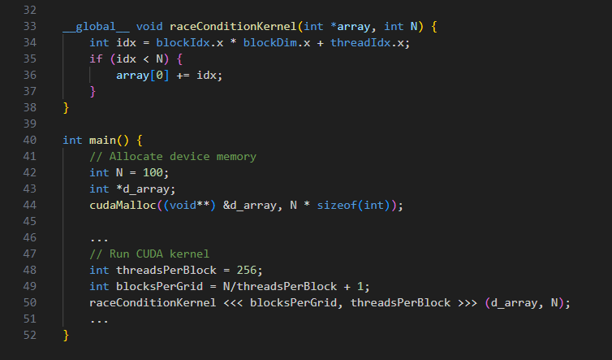
Debugging cuda applications
Workshop 2 – RESCUER MSCA-DN
Check for race conditions
Error example: race condition during reduction
Multiple threads access simultaneously to the memory position array[0]
d_array allocates 100 integer elements in the global memory
kernel with a grid of 256 threads in 1 block

Slide 19
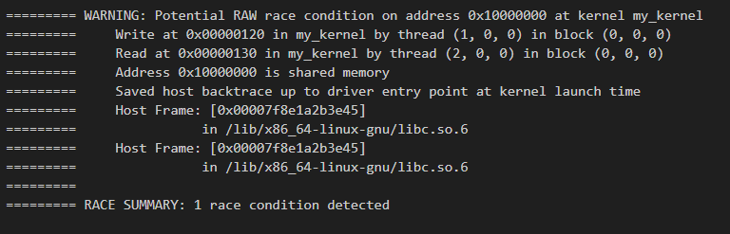
Debugging cuda applications
Workshop 2 – RESCUER MSCA-DN
Check for race conditions
Racecheck output message
Error type
& mem. address
& kernel
Location
Thread that wrote to the shared memory.
Thread that reads from the share memory.
Address
The shared memory address involved.
Call stack

Slide 20
Debugging cuda applications
Workshop 2 – RESCUER MSCA-DN
Check for race conditions
Synchronization primitives
Add synchronization barriers: __syncthreads()
Use atomic operations for fine synchronization: atomicAdd, atomicExch, …
Re-designing the kernel
Avoid algorithms where multiple threads write to the same memory location.
Modify the memory allocation to avoid shared memory use.

Slide 21
Debugging cuda applications
Workshop 2 – RESCUER MSCA-DN
Check for synchronization conditions
Synchronization errors occur when threads in a CUDA kernel do not properly synchronize their access to shared or global memory, leading to race conditions and deadlocks.
Execution
>> compute-sanitizer --tool synccheck ./my_cuda_app app_command_line_options
Optional flags
--track-unused-memory yes Track memory that is allocated but never used.
--log-file <file> Save the output to a file.
--verbose Enable verbose output for more detailed information.

Slide 22
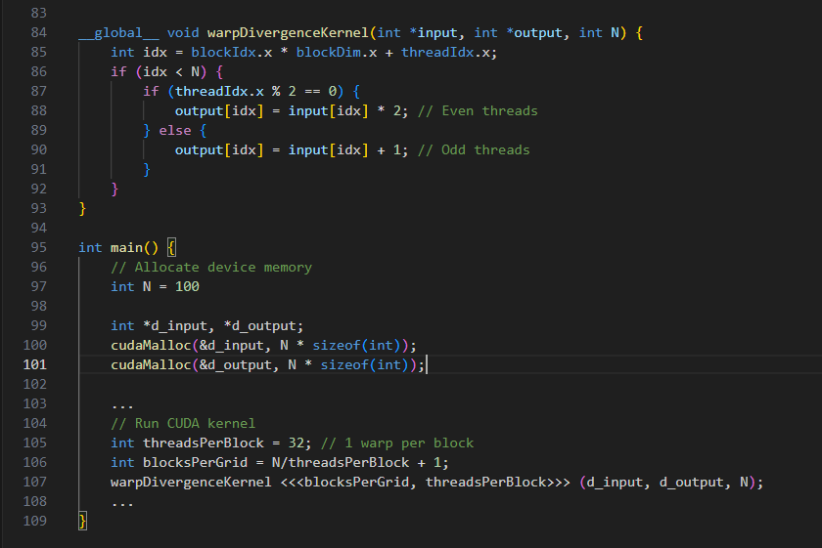
Debugging cuda applications
Workshop 2 – RESCUER MSCA-DN
Check for synchronization conditions
Error example: warp divergence
Warp divergence: threads in the same warp take different paths.
kernel with a grid of 32 threads (1 warp) blocks

Slide 23
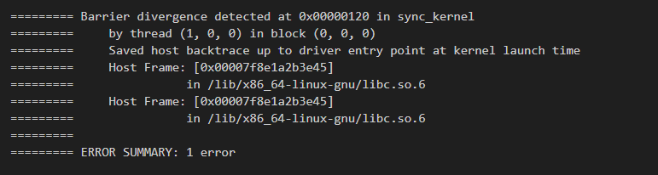
Debugging cuda applications
Workshop 2 – RESCUER MSCA-DN
Check for synchronization conditions
Synccheck output message
Error type
Barrier divergence
Warp divergence
Adress
Kernel
Location
Thread and block leading to the problem.
Call stack

Slide 24
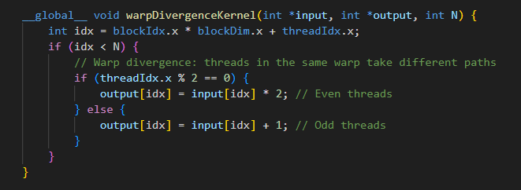
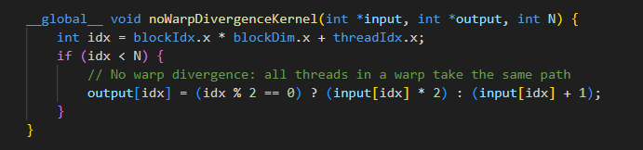
Debugging cuda applications
Workshop 2 – RESCUER MSCA-DN
Check for synchronization conditions
Using synchronization barriers properly
Use __syncthreads() to synchronize all threads in a block
Use atomic operations for fine synchronization: atomicAdd, atomicExch, …
Avoiding warp divergence
Minimize conditional statements that cause threads in a warp to follow different execution paths.
Avoid situations where threads need to synchronize in complex ways.

Slide 25
Debugging, profiling and optimizing
Workshop 2 – RESCUER MSCA-DN
Module content
Optimizing tools
Debugging code with Compute Sanitizer
Profiling code with Nsight System

Slide 26
profiling cuda applications
Workshop 2 – RESCUER MSCA-DN
Profiling with Nsight System
Compilation flags
Include –g: Add information for the host code.
Include –G: Add information for the device code.
Include -03: High-level compiler optimizations
Running Nsight System
>> nsys profile -o report_file ./my_cuda_app app_command_line_options
>> nsys-ui
Timeline View
Execution of the CPU and GPU activities over time.
Sequential calls to CUDA kernels, memory transfers and CUDA API calls.
GPU activity statistics
Detailed metrics of the kernel execution time, the block/grid dimensions, and memory usage.
Time spent on data transfers between the host and device.

Slide 27
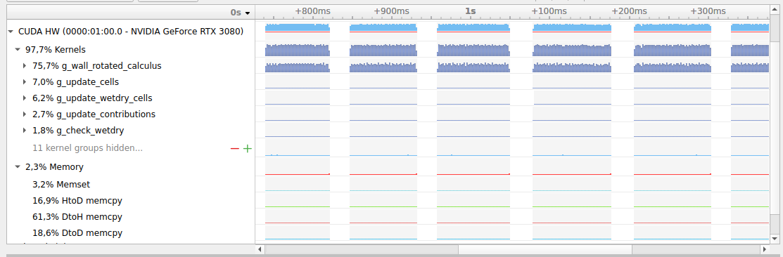
profiling cuda applications
Workshop 2 – RESCUER MSCA-DN
Timeline view
Running CUDA kernels (GPU)
Writing output files
(CPU)
Kernel execution sequence
Memory transfer sequence

Slide 28
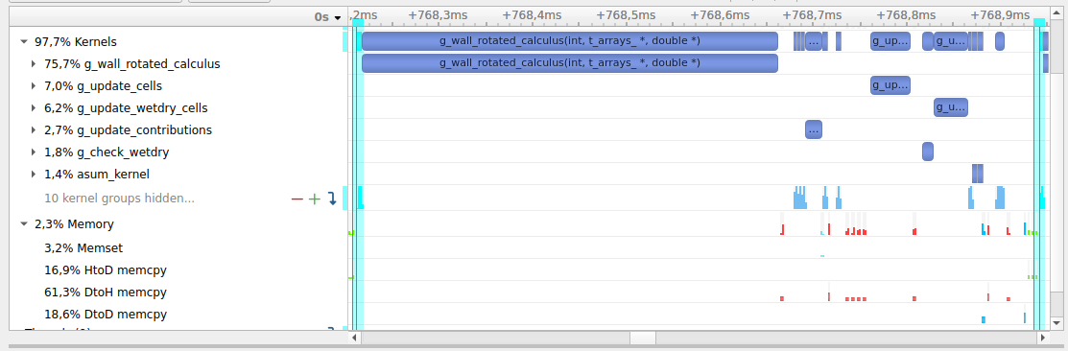
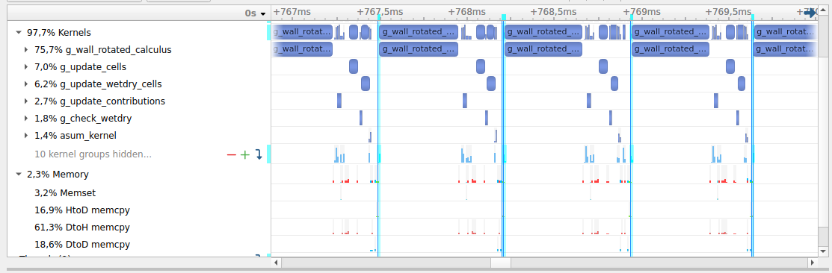
profiling cuda applications
Workshop 2 – RESCUER MSCA-DN
Timeline view
Time step analysis
Fine-grained analysis of the kernel launches and the memory transfer during each time step.
Wall calculus kernel elapsed time
Memory copy from device to host

Slide 29
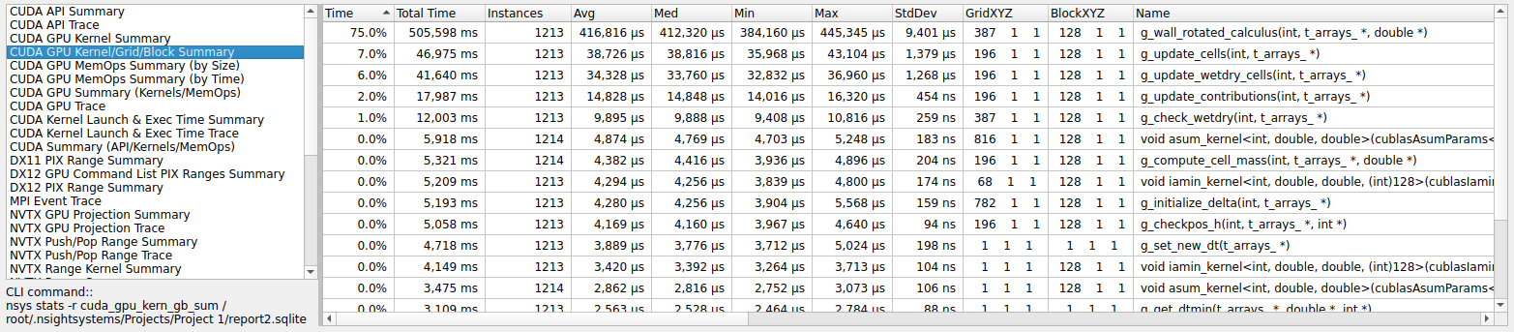
profiling cuda applications
Workshop 2 – RESCUER MSCA-DN
Statistics and summary
Kernel execution
Relative/Total execution time
Number of calls
Execution statistics
Grid and block size
CUDA kernel

Slide 30
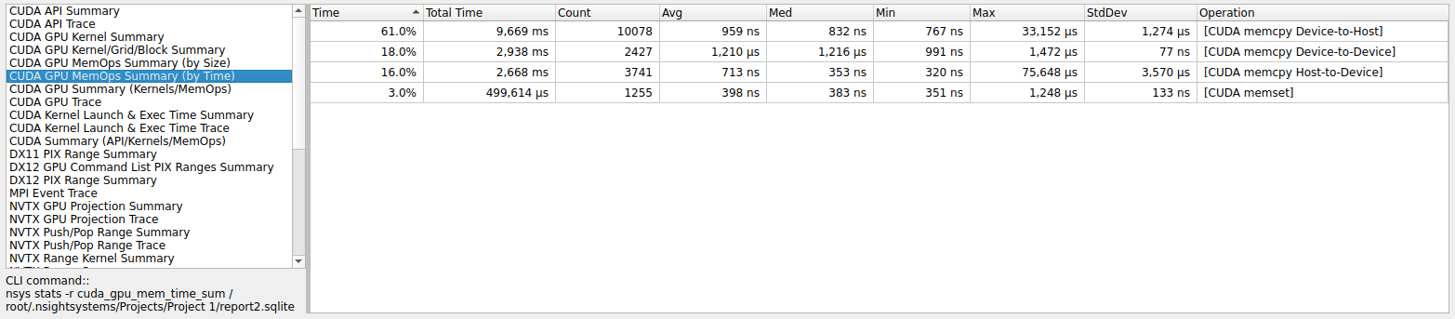
profiling cuda applications
Workshop 2 – RESCUER MSCA-DN
Statistics and summary
Memory operations
Relative/Total execution time
Number of calls
Execution statistics
Memory operation type

Slide 31
profiling cuda applications
Workshop 2 – RESCUER MSCA-DN
Custom profiling of hybrid GPU/CPU workflow
Hybrid workflow
Sequence of CUDA kernels, API calls and CPU functions that execute an unique complex task within a code.
Common hybrid workflow:
Allocate host memory
+ allocate CUDA memory + transfer CPU to GPU
+ launch kernel
+ perform reductions + transfer GPU to CPU
To calculate the total computational time required by hybrid workflows is not straight forward by common profilers.

Slide 32
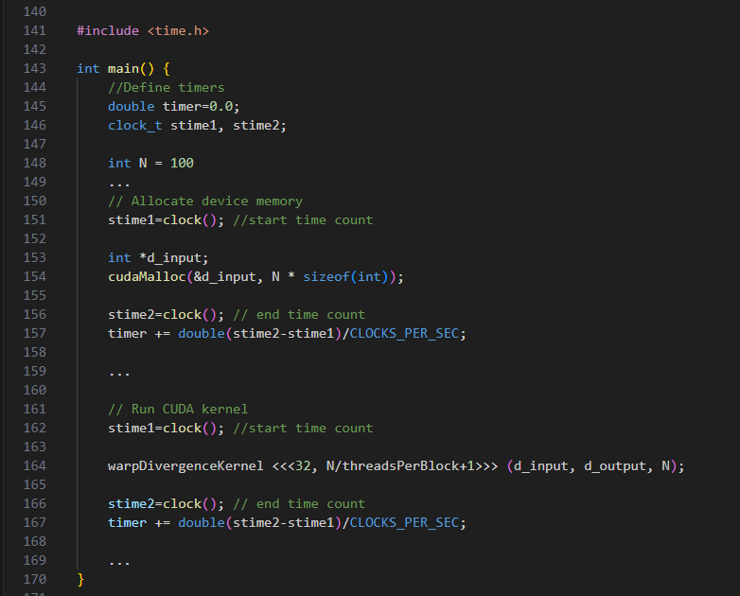
profiling cuda applications
Workshop 2 – RESCUER MSCA-DN
Custom profiling of hybrid GPU/CPU workflow
Include the standard C++ time.h library
Container to accumulate total elapsed time for the hybrid workflow
Start time accounting
End time accounting
Add elapsed time in seconds

Slide 33
profiling cuda applications
Workshop 2 – RESCUER MSCA-DN
Custom profiling of hybrid GPU/CPU workflow
Include the standard C++ time.h library
Container to accumulate total elapsed time for the hybrid workflow
Start time accounting
End time accounting
Add elapsed time in seconds

Slide 34
Introduction to GPU programming for computational models
Workshop 2 – RESCUER MSCA-DN
References
Wu, W. (2007). Computational River Dynamics. NetLibrary, Inc, CRC Press .
Fernández-Pato J., et al., 2025. Acceleration of pipeline analysis for irrigation networks through parallelisation in Graphic Processing Units. Biosystems Engineering 252, pp. 1-14.
An, S., and Seo, SC., 2020. Efficient Parallel Implementations of LWE-Based Post-Quantum Cryptosystems on Graphics Processing Units. Mathematics 8(10) pp. 1781.
NVIDIA developers, 2025. https://developer.nvidia.com/
CUDA Toolkit Documentation v12.8 Update 1, 2025. https://docs.nvidia.com/cuda/
Aragón Institute of Engineering Research I3A, 2025. https://i3a.unizar.es/es

Slide 35
Introduction to GPU programming for computational models: Debugging, profiling and optimizing.
Workshop 2 – RESCUER MSCA Doctoral Network
Sergio Martínez-Aranda
Fluid Dynamics Tecnologies - I3A, University of Zaragoza
sermar@unizar.es

