Slide 1
What do you call data that describes data?
Metadata
Open https://pad.carpentries.org/2021-10-19_ed-dash_fair-bio-practice

Slide 2
Metadata is data about the data!
Metadata is the description of data
permits understanding and interpretation of data
as important as your data
It should be continuously added to your research data
Metadata can be produced in an automated way or manually
Notes:
Metadata are data about data. They play an important role in making your data FAIR. Metadata have to be added continuously to your research data, not just at the beginning or at the end of a project. Metadata can be added manually or automatically, and preferably according to a disciplinary standard. From a FAIR perspective, metadata are more important than your data, because metadata would always be openly available and they link research data and publications in the Internet of FAIR Data and Services.
While data documentation is meant to be read and understood by humans, metadata (which are sometimes a part of the documentation) are primarily meant to be processed by machines.

Slide 3
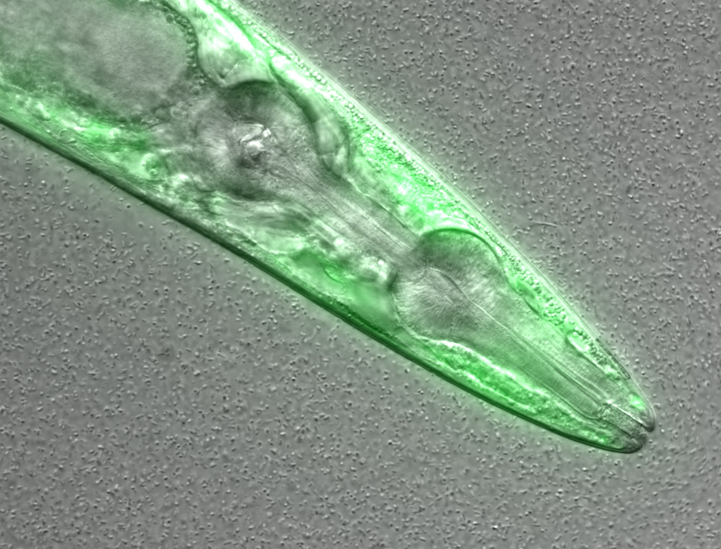
This is a confocal microscopy image of a C. elegans nematode strain used as a proteostasis model, which was deposited in a Public Omero Server.
What information can you guess without the associated description (metadata)?
Figure credits: María Eugenia Goya
Notes:
Image metadata
Name: OP50 D10Ad_06.czi Image ID: 3485 Owner: Maria Eugenia Goya ORCID: 0000-0002-5031-2470
Acquisition Date: 2018-12-12 17:53:55 Import Date: 2020-04-30 22:38:59 Dimensions (XY): 1344 x 1024 Pixels Type: uint16 Pixels Size (XYZ) (µm): 0.16 x 0.16 x 1.00 Z-sections/Timepoints: 56 x 1 Channels: TL DIC, TagYFP ROI Count: 0
Tags: time course; day 10; adults; food switching; E. coli OP50; NL5901; C. elegans
Dataset metadata
Name: Figure2_Figure2B Dataset ID: 263 Owner: Maria Eugenia Goya ORCID: 0000-0002-5031-2470
Description: The datasets contains a time course of α-syn aggregation in NL5901 C. elegans worms after a food switch at the L4 stage:
E. coli OP50 to OP50 Day 01 adults Day 03 adults Day 05 adults Day 07 adults Day 10 adults Day 13 adults
E. coli OP50 to B. subtilis PXN21 Day 01 adults Day 03 adults Day 05 adults Day 07 adults Day 10 adults Day 13 adults
Images were taken at 6 developmental timepoints (D1Ad, D3Ad, D5Ad, D7Ad, D10Ad, D13Ad)
* Some images contain more than one nematode.
Each image contains ~30 (or more) Z-sections, 1 µmeters apart. The TagYFP channel is used to follow the alpha-synuclein particles. The TL DIC channel is used to image the whole nematode head.
These images were used to construct Figure 2B of the Cell Reports paper (https://doi.org/10.1016/j.celrep.2019.12.078).
Creation date: 2020-04-30 22:16:39
Tags: protein aggregation; time course; E. coli OP50 to B. subtilis PXN21; food switching; E. coli OP50; 10.1016/j.celrep.2019.12.078; NL5901; C. elegans

Slide 4
Real life example of metadata
Figure credits: María Eugenia Goya
https://publicomero.bio.ed.ac.uk/webclient/?show=project-58
https://publicomero.bio.ed.ac.uk/webclient/?show=dataset-231
Notes:
Image metadata
Name: OP50 D10Ad_06.czi Image ID: 3485 Owner: Maria Eugenia Goya ORCID: 0000-0002-5031-2470
Acquisition Date: 2018-12-12 17:53:55 Import Date: 2020-04-30 22:38:59 Dimensions (XY): 1344 x 1024 Pixels Type: uint16 Pixels Size (XYZ) (µm): 0.16 x 0.16 x 1.00 Z-sections/Timepoints: 56 x 1 Channels: TL DIC, TagYFP ROI Count: 0
Tags: time course; day 10; adults; food switching; E. coli OP50; NL5901; C. elegans
Dataset metadata
Name: Figure2_Figure2B Dataset ID: 263 Owner: Maria Eugenia Goya ORCID: 0000-0002-5031-2470
Description: The datasets contains a time course of α-syn aggregation in NL5901 C. elegans worms after a food switch at the L4 stage:
E. coli OP50 to OP50 Day 01 adults Day 03 adults Day 05 adults Day 07 adults Day 10 adults Day 13 adults
E. coli OP50 to B. subtilis PXN21 Day 01 adults Day 03 adults Day 05 adults Day 07 adults Day 10 adults Day 13 adults
Images were taken at 6 developmental timepoints (D1Ad, D3Ad, D5Ad, D7Ad, D10Ad, D13Ad)
* Some images contain more than one nematode.
Each image contains ~30 (or more) Z-sections, 1 µmeters apart. The TagYFP channel is used to follow the alpha-synuclein particles. The TL DIC channel is used to image the whole nematode head.
These images were used to construct Figure 2B of the Cell Reports paper (https://doi.org/10.1016/j.celrep.2019.12.078).
Creation date: 2020-04-30 22:16:39
Tags: protein aggregation; time course; E. coli OP50 to B. subtilis PXN21; food switching; E. coli OP50; 10.1016/j.celrep.2019.12.078; NL5901; C. elegans

Slide 5
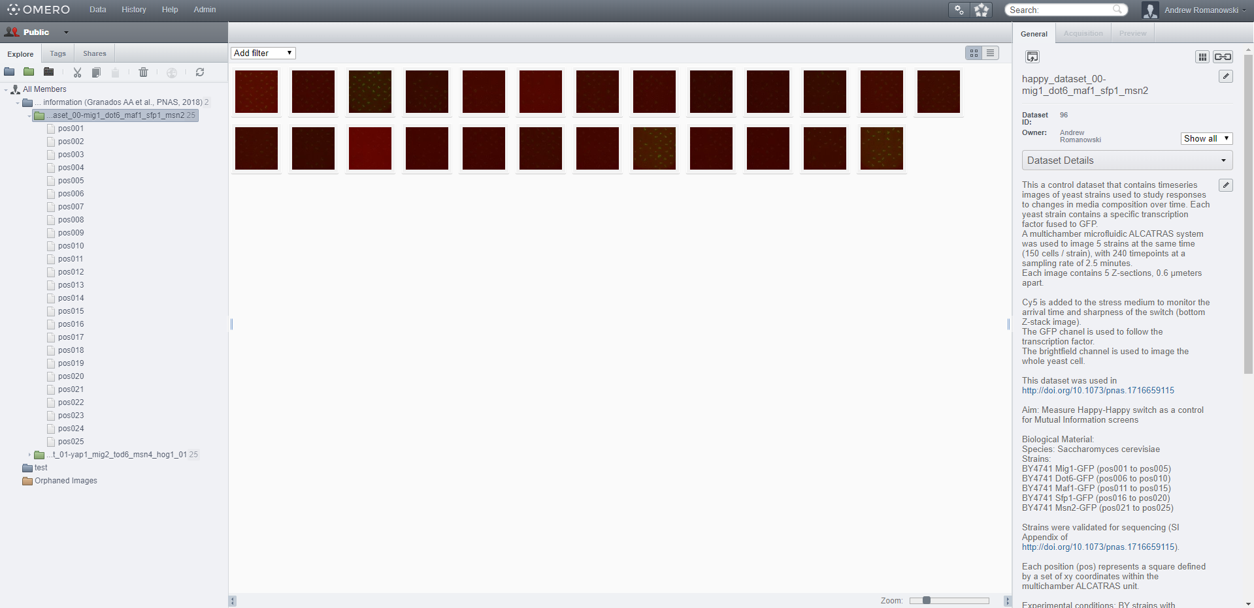
Public Omero
Notes:
Within each project, the data is organised in datasets

Slide 6
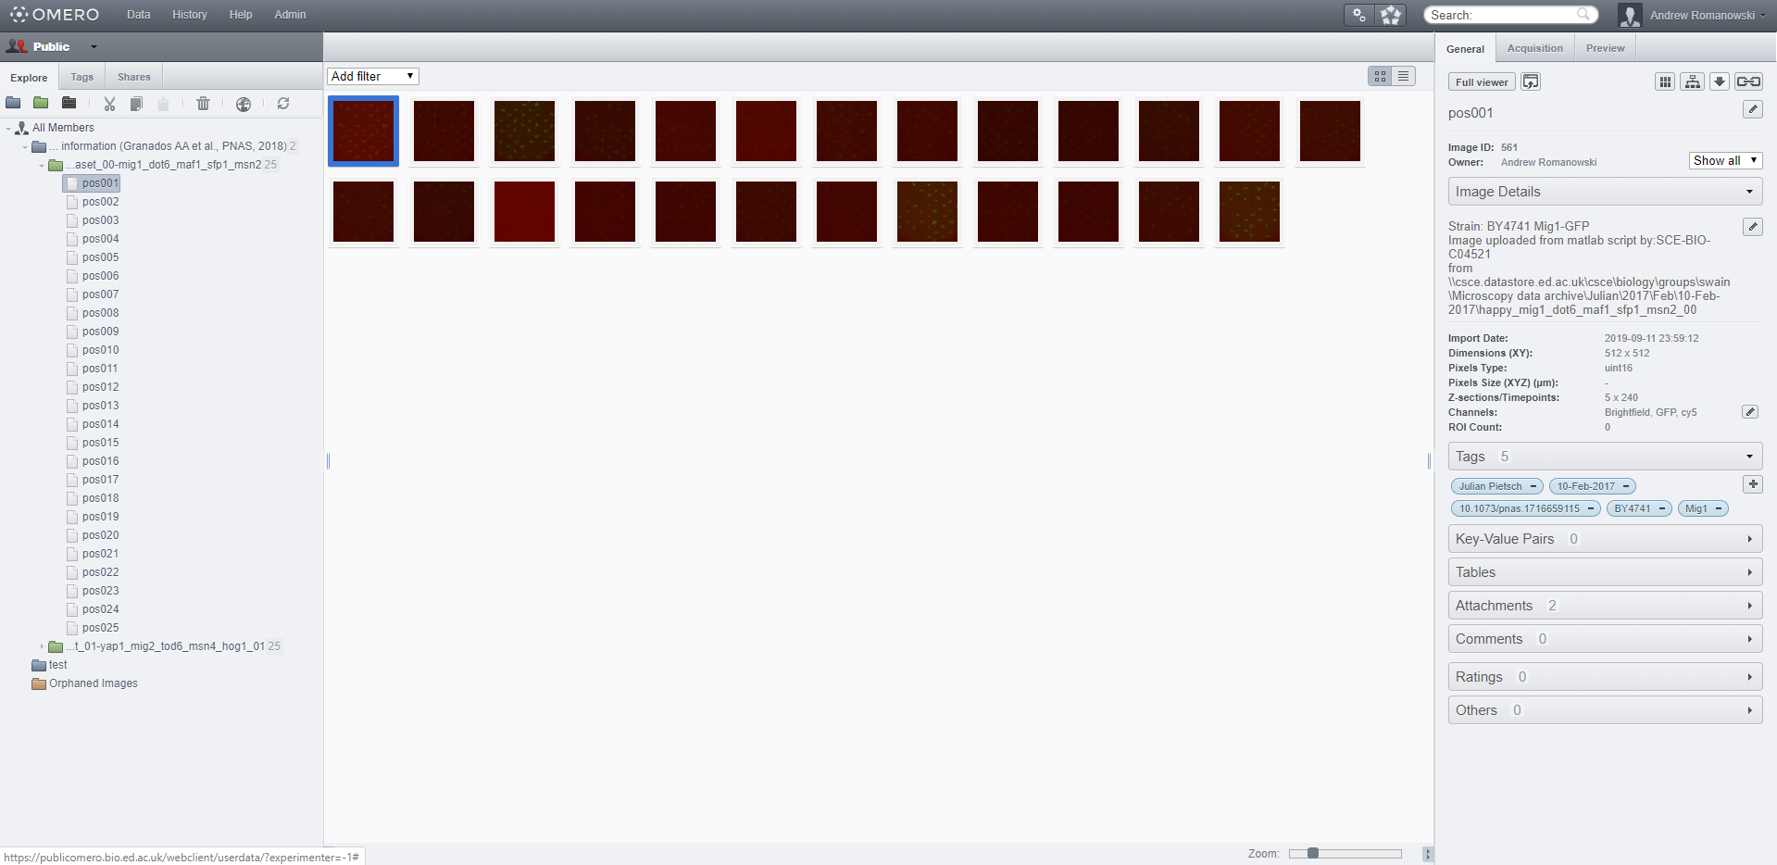
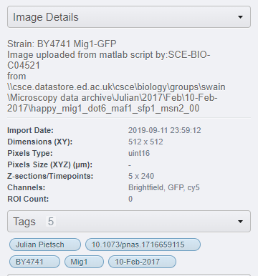
Image associated metadata
Notes:
DETAILS:
When describing the image:
Information that should be added to help make sense of the pixel information but are NOT usually saved in the files:
Type of sample (e.g.: cell line, organism, etc)
If this is different from what was explained for the entire dataset, then also include:
Element used to hold the sample (e.g.: slide / dish, glass vs. plastic, coating, etc)
Sample preparation (e.g.: live, fixation method, etc)
Type of labeling (e.g.: fluorescent protein, dyes, antibodies, etc)
Describe labeling protocols (e.g.: blocking, incubation times, concentrations, transfections, etc)
Otherwise, you could also point the reader to the section of the manuscript were this is described.
Include any additional information you believe is important regarding the experimental conditions used to generate the image.
TAGS:
When deciding which tags to include:
You can include all the proper tags that were already used when describing the dataset
Include the experimenters that acquired the image
Include the date the image was taken
Include the organisms and strains (if applicable)
Include the DOI of the publication (if it is the same as in the dataset description, this becomes optional)
Consider including information on which figures / tables were generated using this image

Slide 7
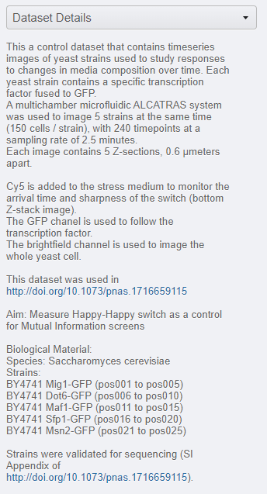
Dataset structure and associated metadata
Notes:
The details section of the dataset should contain multiple sections:
Dataset content: Describe what the dataset contains
Aim Briefly explain the aim of the dataset
Biological material List which species and strains were used in the dataset (if applicable)
Experimental conditions List the experimental protocols used to generate the dataset.
Additional Comments Include any comments you believe are important regarding the experimental conditions used to generate the dataset (if applicable)

Slide 8
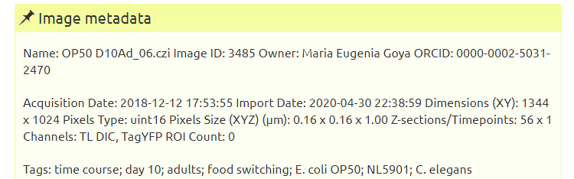
Real life example of metadata
Figure credits: María Eugenia Goya

Slide 9
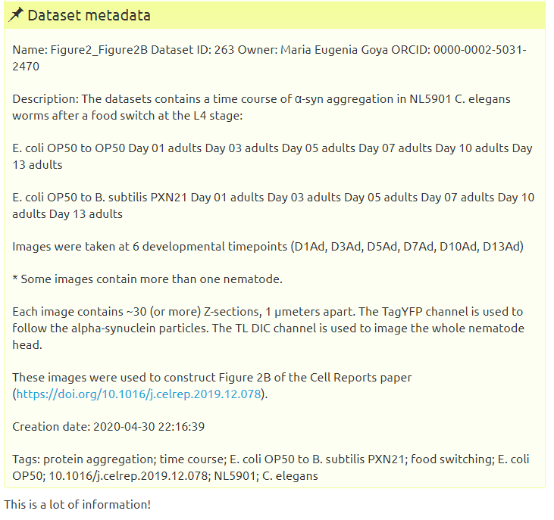
Figure credits: María Eugenia Goya

Slide 10

Types of metadata
Administrative: relevant to managing it
e.g. Experimental code, PI
Descriptive/citation: assists with discovery/identity
e.g. Authors, persistent identifier
Structural: how the data came about & is structured
e.g. Collection method, folder structures
Notes:
Administrative metadata are data about a project or resource that are relevant for managing it; for example, project/ resource owner, principal investigator, project collaborators, funder, project period, etc. They are usually assigned to the data, before you collect or create them.
Descriptive or citation metadata are data about a dataset or resource that allow people to discover and identify it; for example, authors, title, abstract, keywords, persistent identifier, related publications, etc.
Structural metadata are data about how a dataset or resource came about, but also how it is internally structured. Structural metadata describe, for example, the unit of analysis, collection method, sampling procedure, sample size, categories, variables, etc. Structural metadata have to be gathered by the researchers according to best practice in their research community and will be published together with the data. Descriptive and structural metadata should be added continuously throughout the project.

Slide 11
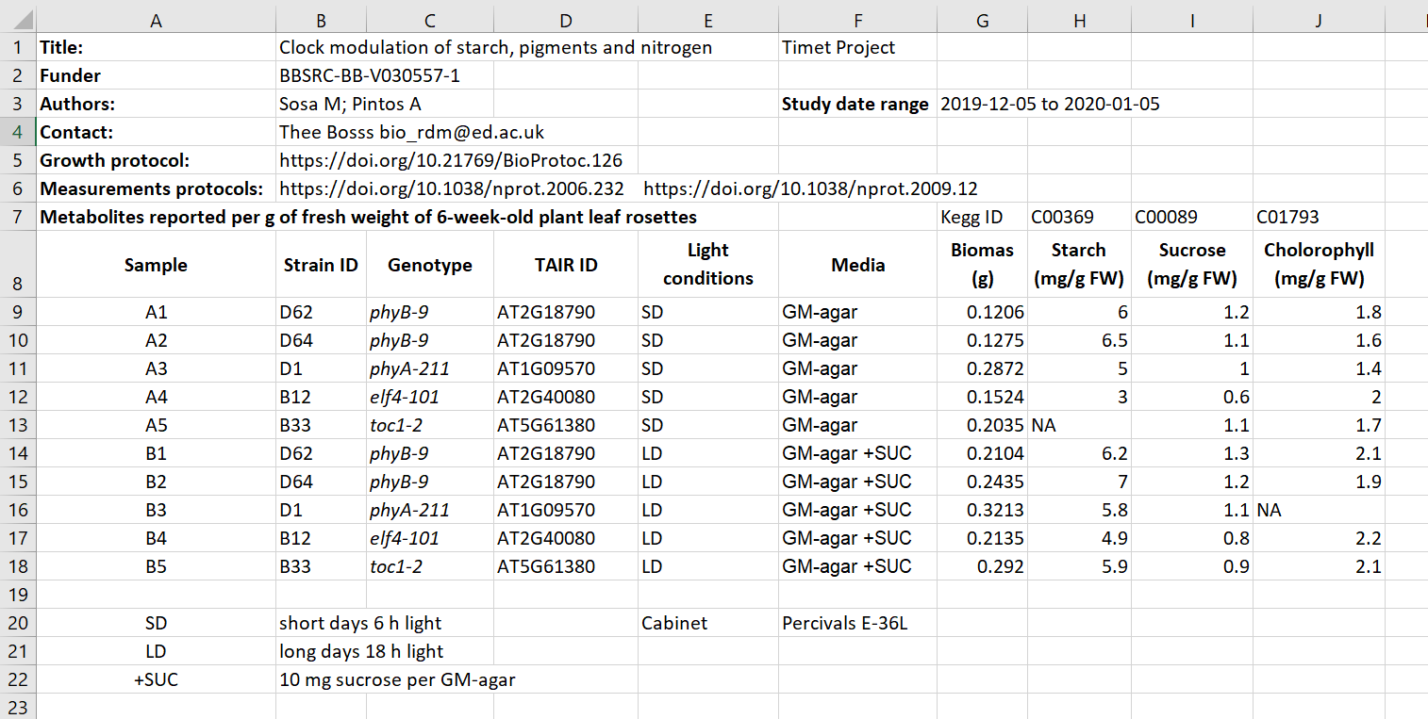
Exercise 1:
Identifying metadata types
Figure credits: Tomasz Zielinski and Andrés Romanowski
Notes:
In groups, identify different types of metadata (administrative, descriptive, structural) present in this example.

Slide 12
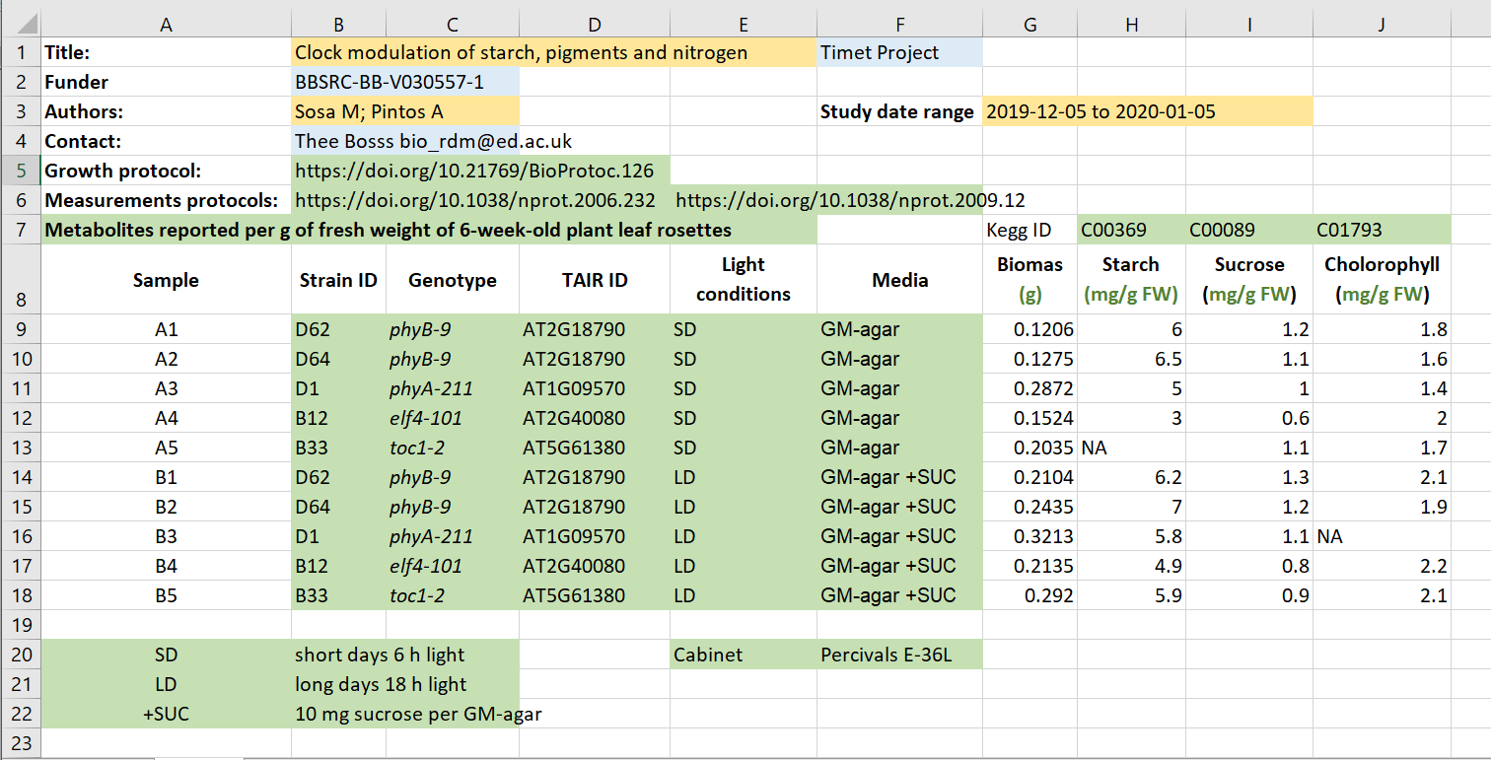
Exercise/challenge 1:
Identifying metadata types
Administrative
Descriptive
Structural
Figure credits: Tomasz Zielinski and Andrés Romanowski

Slide 13
Where does data end and metadata start?
What is "data" and what is "metadata" can be a matter of perspective:
Some researchers' metadata can be other researchers' data.
Think of an example from our „excel” table
Notes:
The distinction between data and metadata is not ontological, but it is grounded in use. What is “data” and what is “metadata” is thereby a matter of perspective: Some researchers’ metadata can be other researchers’ data.

Slide 14
Figure credits: Tomasz Zielinski and Andrés Romanowski
Notes:
In groups, identify different types of metadata (administrative, descriptive, structural) present in this example.

Slide 15

What to include in metadata
The minimum information standard
set of guidelines for reporting data derived by relevant methods in biosciences
ensures that the data can be easily verified, analysed and clearly interpreted by the community.
Minimum Information for Biological and Biomedical Investigations (MIBBI)
is the collection of the most known standards:
https://fairsharing.org/collection/MIBBI
Notes:
As we saw metadata can take many forms from as simple as including a ReadMe.txt file, by embedding them inside the Excel files, to using domain specific metadata standards and formats.
But,
What should be included in metadata?
What terms should be used in descriptions?
For many assay methods and experiment types, there are defined recommendations and guidelines called Minimal Information Standards.

Slide 16
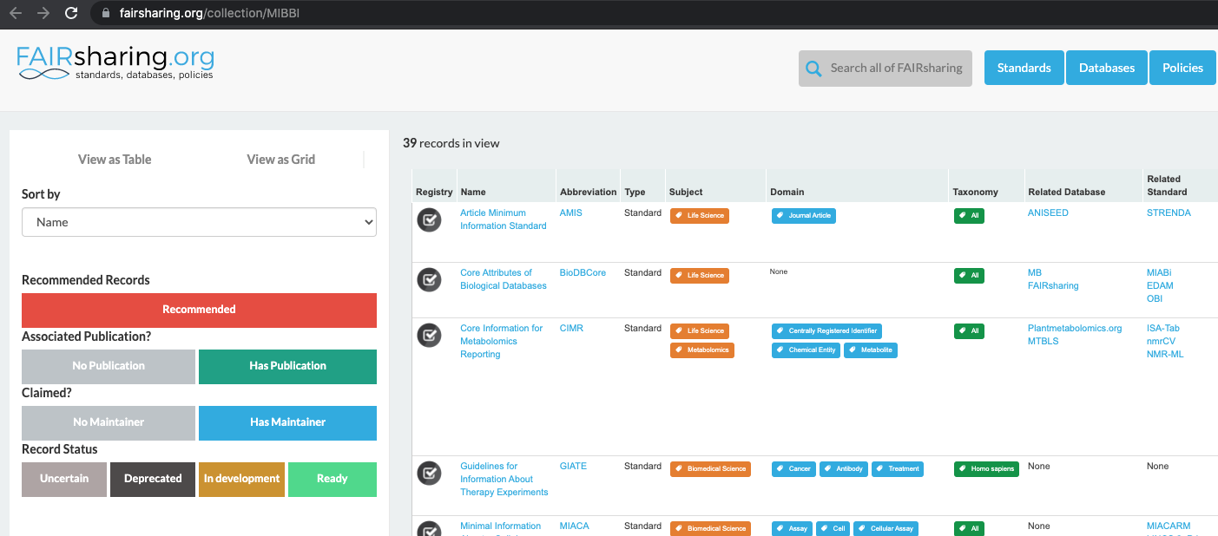
Minimum information standards
Notes:
The minimum information standard is a set of guidelines for reporting data derived by relevant methods in biosciences. If followed, it ensures that the data can be easily verified, analysed and clearly interpreted by the wider scientific community. Keeping with these recommendations also facilitates the foundation of structuralized databases, public repositories and development of data analysis tools. Individual minimum information standards are brought by the communities of cross-disciplinary specialists focused on issues of the specific method used in experimental biology.
Minimum Information for Biological and Biomedical Investigations (MIBBI) is the collection of the most known standards.
FAIRSharing offers excellent search service for finding standards

Slide 17

Exercise 2: Minimal information example
Minimum Information about a Neuroscience Investigation (MINI) Electrophysiology
https://www.nature.com/articles/npre.2008.1720.1.pdf
Notes:
Scroll to Reporting requirement and decide which of the points 1-8 are:
a) important for understanding and reuse of data
2, 3, 4, 5, 6, 8
b) important for technical replication
2, 3, 7
c) could be applied to other experiments in neuroscience
1, 2, 3, 4, 5, 6, 8
Structural metadata!!!

Slide 18


What can you do if there are no metadata standards defined for your data/field of research?
Think about the minimum information that someone else (from your lab or from any other lab in the world) would need to know about your dataset to be able to work with it without any further inputs from you.
Think as a consumer about your data not the producer!
Notes:
What can you do if there are no metadata standards defined for your data / field of research?
Think about the minimum information that someone else (from your lab or from any other lab in the world) would need to know about your dataset to be able to work with it without any further inputs from you.
Think as a consumer of your data not the producer!

Slide 19
Exercise 3
What to include - discussion
Notes:
Some typical elements are:
biological material, e.g. Species, Genotypes, Tissue type, Age, Health conditions
biological context, e.g. speciment growth, entrainment, samples preparation
experimental factors and conditions, e.g. drug treatments, stress factors
specifics of data acquisition
specifics of data processing and analysis

Slide 20
Metadata and FAIR guidelines
Metadata provides extreme valuable information for us and others to be able to interpret, process, reuse and reproduce the research data it accompanies.
Because metadata are data about data, all of the FAIR principles i.e. Findable, Accessible, Interoperable and Reusable apply to metadata.
Ideally, metadata should not only be machine-readable, but also interoperable so that they can interlink or be reasoned about by computer systems.

Slide 21

Quiz

