Slide 1

Reusable analysis
Open https://link

Slide 2
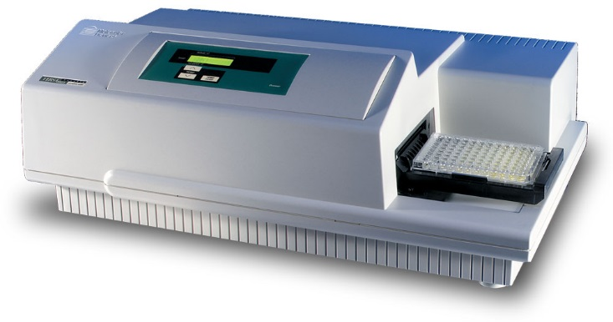

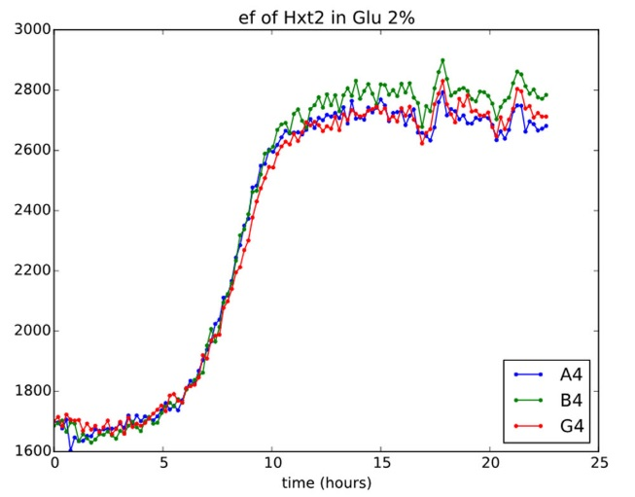

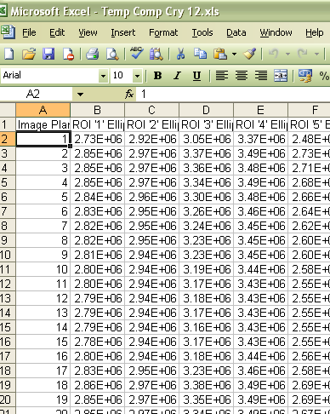
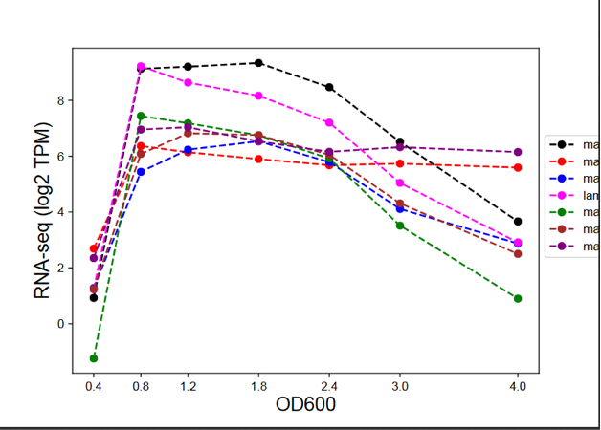
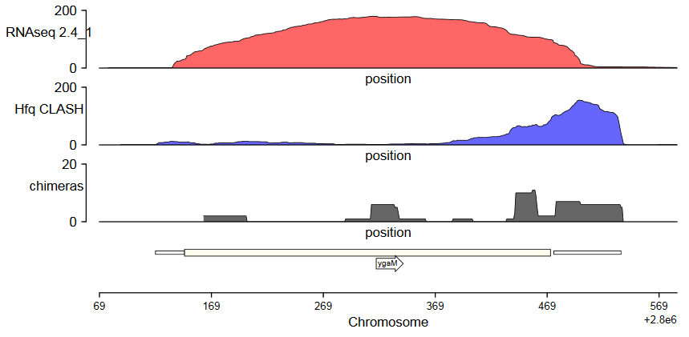
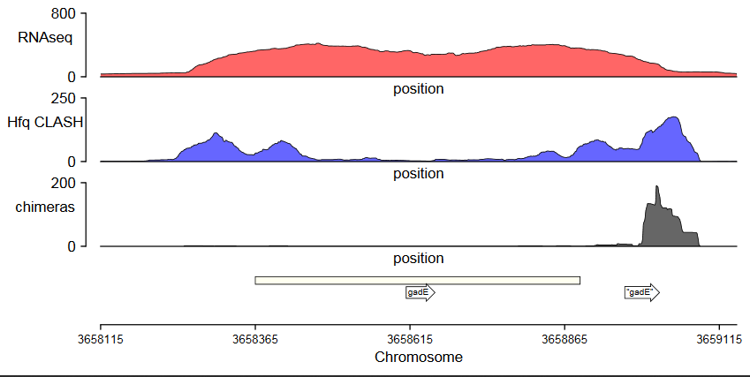
Analysis

Slide 3
Ad-hoc Analysis
Some biological context and inputs
data (initial results) exploration
(retries, adjustments, modifications to exp procedures)
data exploration
selection of analysis methods and parameters
(statistical) validation of results
final version of results and graphical rendering

Slide 4
Ad-hoc Analysis
Jupyter notebook example - Exercise 1

Slide 5
Plotting in R (Python)
Natural starting point for learning programming
More „powerful” / „professional” scientific plots than ones available in Excel
Easier to recreate
Easier to adjust for specific dimensions/formats/styles

Slide 6
Reusable ad-hoc analysis with jupyter
Motivation, how we got into the final results
Input data
Parameters
Methods (functions)
Interminent reusults, adjustments, steps….
Outputs
Conclussions

Slide 7
Reusable ad-hoc analysis with jupyter
… only as good as your self discipline
Document the decission process
Document parameters and their significance
Decide what to retain/clean
Comment code where necessary
Follow good practices: - in naming variables, functions - in formating: intentations, line length, line breaks
- modularization

Slide 8
Reusable ad-hoc analysis with jupyter
… only as good as your self discipline
Notebook has to be shipped with all file inputs and description of runtime environment

Slide 9
Reusable ad-hoc analysis with jupyter
Notebooks shine
in orchestrating „short”, step by step operations in R, python, shell (notebooks can use all 3 at the same time)
capturing parameters
adding interpretations
acting as a „flexible” user interface

Slide 10
Jupyter notebook is not IDE
do not write long programs in notebook
use the adequate tools
learn and adhere to software engineering practise (language specific)

Slide 11

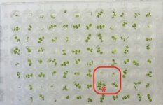
Pipeline

Slide 12
Reusable pipeline
Robust (re-starting job)
Efficient (paralel computing)
Methodological sound
Easy to maintain
Well specified dependencies

Slide 13
Reusable pipeline
Build it with workflows:
Nextflow
Snakemake
Galaxy
Well defined:
inputs and their formats,
behaviour
software and system dependencies

Slide 14
Computing in R and Python
Easy to start
Flexibile
Easy to pick up bad habbits
Easy to introduce ugly hacks
Beware spaghetti code

Slide 15
Computing in R and Python
We recommend:
Firstly, learn how to make simple plots, clean/reorganize files and data tables
Secondly, learn basics of software engineering and good programming practices
Then start coding advanced analysis, processing, pipelines…

Slide 16
Computing in R and Python
R and Python behaviour depends on what is installed in your system
„… but it works (only) on my machine”

Slide 17
Computing in R and Python
R and Python behaviour depends on what is installed in your system
Conda is a package management system for Win, Mac OS, Linux.
Conda install, run, and update packages and their dependencies.
Conda can switch between project environments.
Conda suport many language: R, Ruby, Lua, Scala, Java, JavaScript, C, C++, FORTRAN.

Slide 18
Computing in R and Python
R and Python behaviour depends on what is installed in your system
always use Conda environments to manage what is installed in your system
create new Conda environment for any new project
keep a list of what you installed (and in which order)

Slide 19
Computing in R and Python
Ed-DASH courses:
https://edcarp.github.io/Ed-DaSH/workshops.html
Shell, Conda, Workflows

