Slide 1
Public repositories
Open https://pad.carpentries.org/2022-02-18-ed-dash-fair

Slide 2
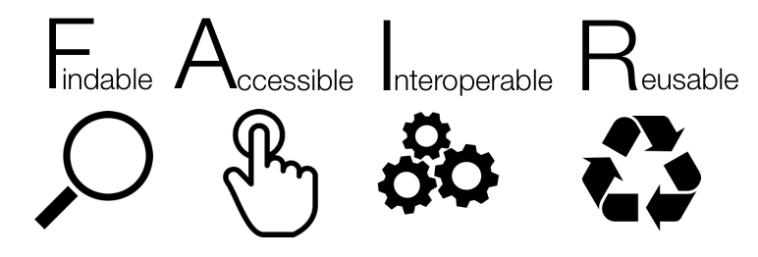
Notes:
Findable -> means that the data can be discovered by both humans and machines
Accessible -> means that the data are archived in long-term storage and can be made available using standard technical procedures
Interoperable -> data can be exchanged and used across different applications and systems
Reusable -> means that the data are well documented and curated and provide rich information about the context of data creation

Slide 3



Research data repositories are online repositories that enable the preservation, curation and publication of research ‘products’:
data
code
protocols

Slide 4
Repositories are crucial for
FINDABLE and ACCESSIBLE

Slide 5



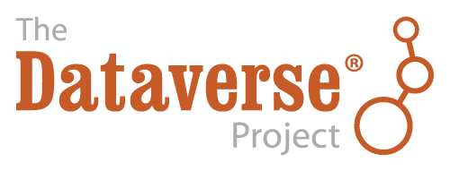

There are general “data agnostic” repositories
[Dryad](http://datadryad.org)
[Zenodo](http://zenodo.org)
[FigShare](http://figshare.com)
[Dataverse](http://dataverse.org)
Notes:
Dryad is an international open-access repository of research data. It is a nonprofit organization that provides long-term access to its contents at no cost to users. The base DPC per data submission is $120 USD. Access is free.
Zenodo built and operated by CERN and OpenAIRE to ensure that everyone can join in Open Science.
Figshare is an online open access repository where researchers can preserve and share their research outputs, including figures, datasets, images, and videos. It is free to upload content and free to access, in adherence to the principle of open data. Figshare is one of a number of portfolio businesses supported by Digital Science, a subsidiary of Springer Nature.
Dataverse is funded by Harvard with additional support from the Alfred P. Sloan Foundation, National Science Foundation, National Institutes of Health, Helmsley Charitable Trust, IQSS's Henry A. Murray Research Archive, and many others.

Slide 6




Or “domain” (type) specific repositories
[UniProt](https://www.uniprot.org/) – protein data
[GenBank](https://www.ncbi.nlm.nih.gov/genbank/) – sequence data
[MetaboLights](https://www.ebi.ac.uk/metabolights/) – metabolomics data
[GitHub](https://github.com/) – for code

Slide 7
Public record
Exercise 1
https://doi.org/10.5281/zenodo.5045374

Slide 8
Public record - Solutions
Findable:
F1. (Meta)data are assigned a globally unique and persistent identifier - YES
F2. Data are described with rich metadata (defined by R1 below)- YES
F3. Metadata clearly and explicitly include the identifier of the data they describe - YES
F4. (Meta)data are registered or indexed in a searchable resource - YES

Slide 9
Public record - Solutions
Accessible:
A1. (Meta)data are retrievable by their identifier using a standardised communications protocol - YES
A2. Metadata are accessible, even when the data are no longer available - YES

Slide 10
Public record - Solutions
Interoperable:
I1. (Meta)data use a formal, accessible, shared, and broadly applicable language for knowledge representation. - YES
I2. (Meta)data use vocabularies that follow FAIR principles - PARTIALLY
I3. (Meta)data include qualified references to other (meta)data - YES

Slide 11
Public record - Solutions
Reusable:
R1. (Meta)data are richly described with a plurality of accurate and relevant attributes - YES
R1.1. (Meta)data are released with a clear and accessible data usage license - YES
R1.2. (Meta)data are associated with detailed provenance - YES
R1.3. (Meta)data meet domain-relevant community standards - YES/PARTIALLY

Slide 12
Dataset discovery
Exercise 2
https://doi.org/10.5281/zenodo.5045374

Slide 13
Dataset discovery - Solution
Zenodo is a good place to keep your data separate from paper. It gives access to all files, allowing you to cite the data as well (or instead of) the paper. However, it is not (always) good for discovery, and does not enforce most metadata!

Slide 14
Minimal data set (after PLOS)
Minimal data set to consist of the data required to replicate all study findings reported in the article, as well as related metadata and methods.
The values behind the means, standard deviations and other measures reported
The values used to build graphs
The points extracted from images for analysis.
(no need for raw data if the standard in the field is to share data that have been processed)
https://journals.plos.org/plosbiology/s/data-availability

Slide 15
Domain specific repositories
Higher exposure
Data specific features (e.g. Visulization)
Enforced minimal metadata
API for data retrival / agregation /searching
Curated data
Better searching
Interlinking between data types

Slide 16
Domain specific repositories
Exercise 3

Slide 17
Dataset discovery - Solution
Some advantages are:
The repository is more relevant to your discipline than a generalist one.
Higher exposure (people looking for those specific types of data will usually first look at the specific repository).
Higher number of citations (see above).

Slide 18
Finding repositories – use recommendations
[BioMed Central / Springer Nature] - (https://www.springernature.com/gp/authors/research-data-policy/recommended-repositories)
[eLife] - (https://submit.elifesciences.org/html/elife_author_instructions.html#policies)
[Elsevier] - (https://www.elsevier.com/about/policies/research-data)
[EMBO Press] - (https://www.embopress.org/page/journal/14602075/authorguide#datadeposition)
[F1000 Research] - (https://f1000research.com/for-authors/data-guidelines)
[GIGAscience - OUP] - (https://academic.oup.com/gigascience/pages/instructions_to_authors)
[PLoS] - (https://journals.plos.org/plosbiology/s/recommended-repositories)
[Scientific Data - Nature] - (https://www.nature.com/sdata/policies/repositories)
[Taylor and Francis] - (https://authorservices.taylorandfrancis.com/data-sharing-policies/repositories/)
[BBSRC] - (https://bbsrc.ukri.org/research/resources/)
[NERC] - (https://nerc.ukri.org/research/sites/environmental-data-service-eds/policy/)
[Royal Society] - (https://royalsociety.org/journals/ethics-policies/data-sharing-mining/)
[Wellcome Open Research] - (https://wellcomeopenresearch.org/for-authors/data-guidelines)

Slide 19
Finding repositories
FAIRSharing.org – search engine
Repositories
Data standards
Policies
(too) many options for each type

Slide 20
Finding repository
Exercise 4

Slide 21
Finding repository - Solution
Find a repo for genomics data:
GEO/SRA and ENA/ArrayExpress are good examples. Interestingly these repositories do not issue a DOI.

Slide 22
Evaluating a data repository
1. Who is behind it? What is its funding?
2. Quality of interaction/interface: is the interaction for purposes of data deposit or reuse efficient,
effective and satisfactory for you?
3. Take-up and impact:
what can I put in it? is anyone else using it? will others be able to find stuff deposited in it? is the repository linked to other data repositories? can others cite the data?
4. Policy and process: does it help meeting community standards, good practices and policies? is it curated?

Slide 23
Repositories Summary
Find suitable repository(ies) as soon as you get your data
If repository permits embargo deposit data as soon as you get it (especially if analysed externally)
Deposit simultaneously to a very specialized repo and a „main stream” one (better discovery)
Cross link your repositories’ records
Add data availability section to your papers and list all the public records
List your data sets in ORCID

Slide 24

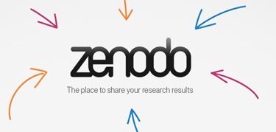
What about Github? Can it be cited?
To make your code repositories easier to reference in academic literature, you can create persistent identifiers for them. Particularly, you can use the data archiving tool in Zenodo to archive a GitHub repository and issue a DOI for it.
YES!
Image credits:
Zenodo logo: Openaire.eu
Github logo: Klint Finley (TechCrunch+)
Notes:
https://docs.github.com/en/repositories/archiving-a-github-repository/referencing-and-citing-content

Slide 25
What about the ReadMe file?
Always include a ReadMe file when you deposit in “General” research data public repositories, such as DataShare or Zenodo.
An example readme file can be found at
BioRDM’s Wiki Page for DataShare
https://www.wiki.ed.ac.uk/x/XbRVHQ

Slide 26
Repositories and FAIR – Discussion
Why is choosing a domain specific repository over Zenodo more FAIR?
How can selecting a repository for your data as soon as you do an experiment (or even before!) benefit you research and help your data become FAIR?
What’s your favourite research data repository? Why?

