Slide 1
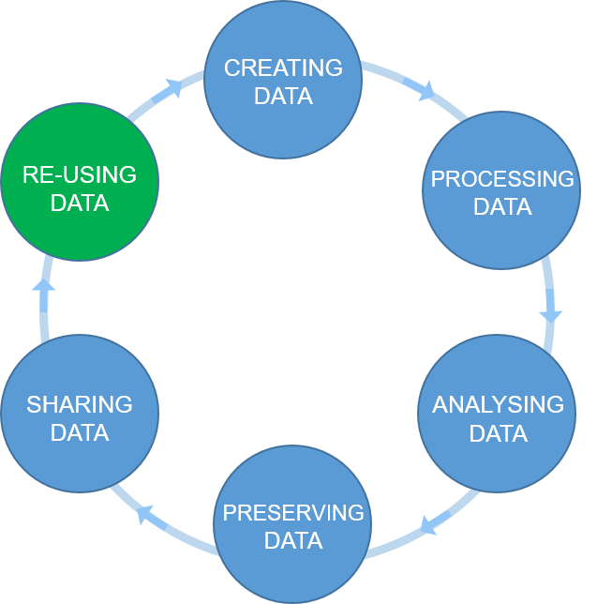

The research data life cycle
1
6
2
5
3
Open https://pad.carpentries.org/2022-02-18-ed-dash-fair
4
Figure credits: Tomasz Zielinski

Slide 2
Exercise/challenge 1:
Action plan challenge
Open https://pad.carpentries.org/2022-02-18-ed-dash-fair

Slide 3
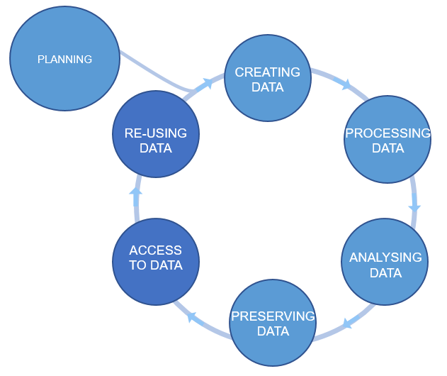
Plan ahead
data management plans
(DMPs)
Figure credits: Tomasz Zieliński and Andrés Romanowski

Slide 4
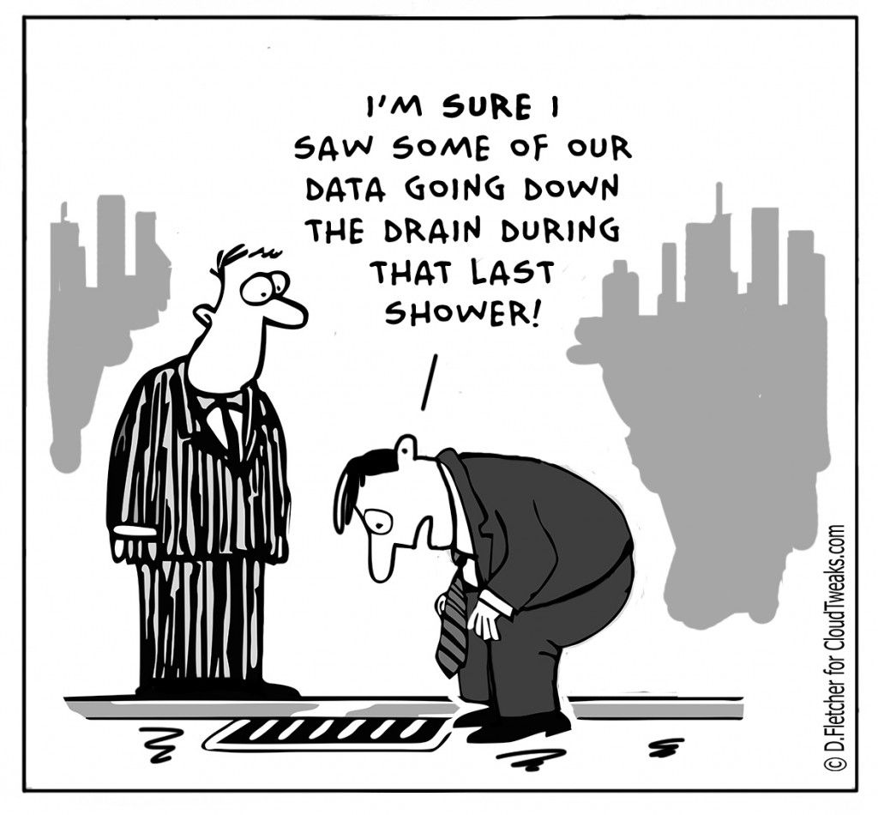
Why do we need Data Management Plans?
Your data is the basis for research papers and your PhD theses.
Data is fragile and easily lost. You need to backup your data!
Growing data management demands by funders.
It saves time and resources in the long run.
It enables reproducibility and troubleshooting and helps prevent future mistakes.
It is a protection measure against scientific fraud.
Facilitates data sharing.
A scientific paper is often written more than 1 year after the experiments were performed. What about your thesis? Will you remember everything you did? It is impossible to remember all the details! (unless you have some sort of special memory abilities)

Slide 5
What should we consider in a good DMP?
Good DMPs
Think about:
how you will store the data
how you will organize and describe your data
how you will grant access to your data
how you will share your data
how you will preserve your data
how others can use your data
how much it will all cost
Notes:
Most of the funders require that you present a DMP together with your grant applications. Some institutions ask eve their PhD students to prepare a DMP for their PhD project.
You should think how you are going to manage your data (our outputs, in general) for each of your projects (or even individual assay types). For individual project the main focus should be on: what data will be produced, how they will be stored and organized, how you are going to describe them and track them. For example what file formats will be generated, how you are going to name your files, and how you will link it to your laboratory notes.
For grant applications, DMP tend to be less technical, for example no need to discuss folder structures, but, they should emphasize the data safety (as preservation and access), data longevity, sharing, discovery and re-use.

Slide 6

Useful resource
https://dmponline.dcc.ac.uk/
Contains DMP templates for the different funders requirements and information on how to fill each section.

Slide 7
DMP example
https://www.wiki.ed.ac.uk/x/yesNGQ

Slide 8
Exercise 2:
Working in pairs, think of your last paper (or project). Write a short DMP for this joined project.
Starts in this session & continues as homework.
Open https://pad.carpentries.org/2021-10-22_ed-dash_fair-bio-practice

Slide 9
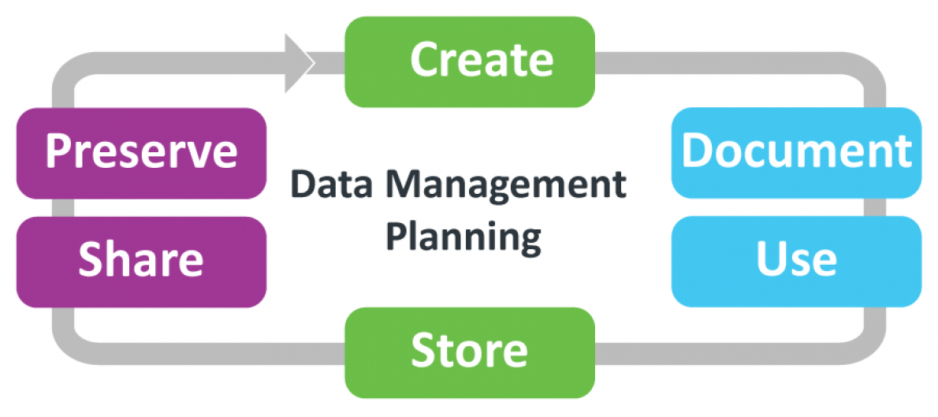
How do we manage our data at Edinburgh?
UoE DataShare
Public Repositories
Lab Notebooks
UoE DataVault (long term storage)
UoE DataStore (active storage)
UoE Data SafeHaven
UoE DataSync
UoE Wiki
UoE SharePoint
UoE ECDF
UoE GitLab
UoE Subversion
UoE PURE records
https://www.wiki.ed.ac.uk/x/2MmBGQ
https://www.ed.ac.uk/information-services/research-support/research-data-service
Image credit: RDS (UoE)

Slide 10
During: UoE DataStore
It is an active storage solution, which is backed up off site (3 secure locations).
500 Gb per PhD student of free storage (there is a fee for more space).
Data can be shared with all lab members or with someone specific within the UoE community.
Closed when you leave University (there is a small grace period before deletion).
For more information, visit the links below.
https://www.ed.ac.uk/information-services/research-support/research-data-service/during/data-storage
https://www.wiki.ed.ac.uk/x/tet_H
Other tools:
UoE Data SafeHaven
UoE DataSync
UoE Wiki
UoE SharePoint
UoE ECDF
UoE GitLab
UoE Subversion

Slide 11
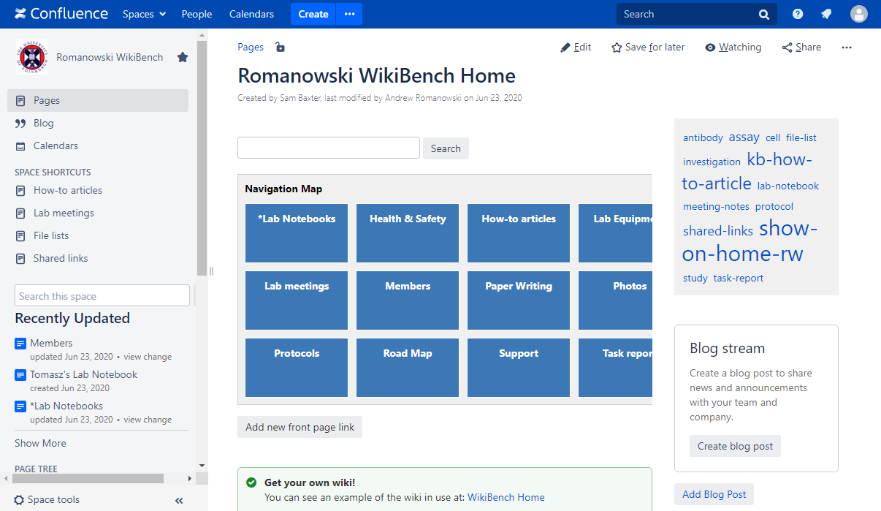
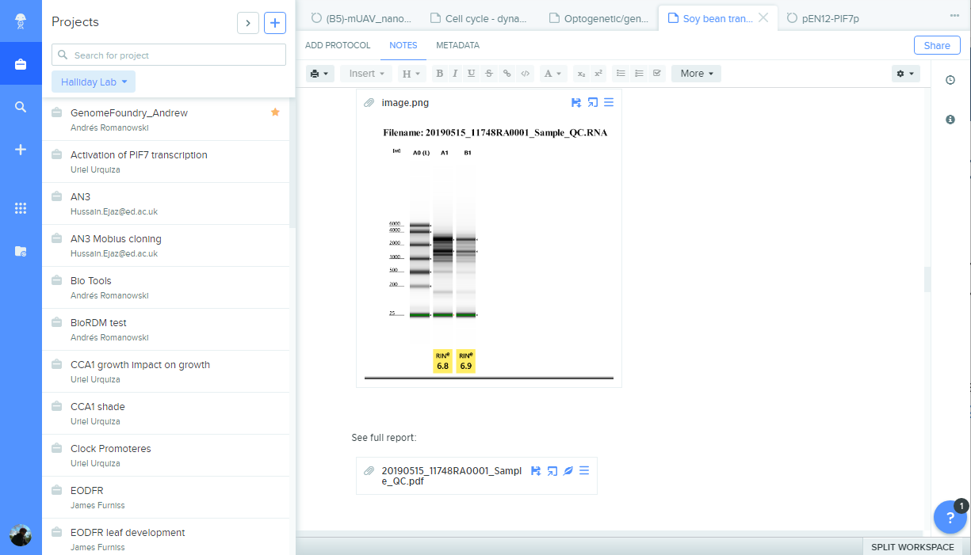
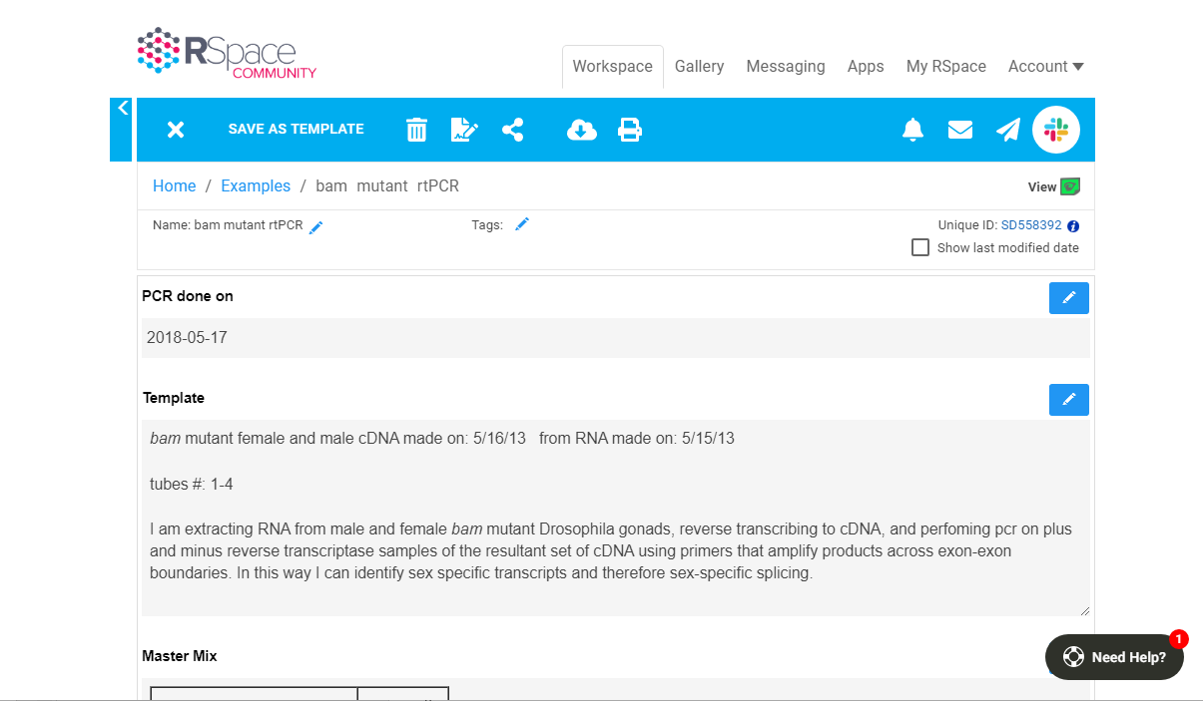
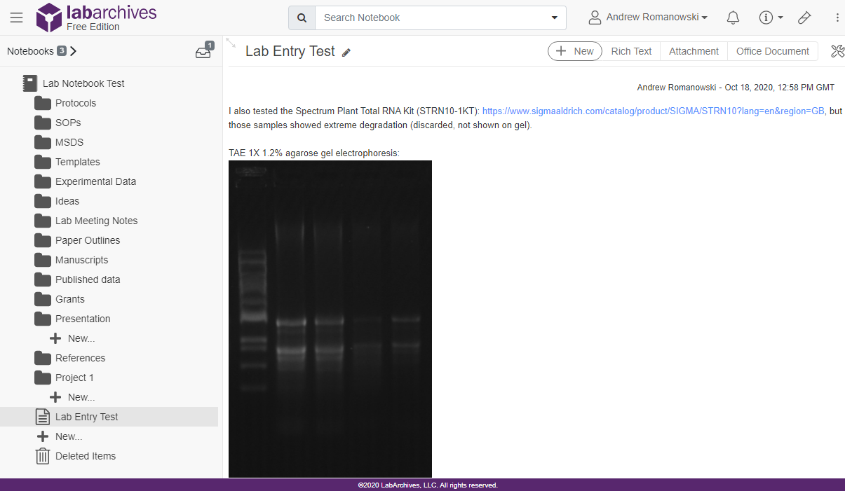
During: ELNs
WikiBench (UoE Wiki)
Benchling (UoE Wiki)
RSpace
LabArchives
Image credit: Dr Andrés Romanowski

Slide 12
Choosing an ELN
Does my group already use one?
Yes
No
Use that one!
Things to take into account:
Cost
Traceable? (data cannot be deleted and are time stamped)
Where are the servers located?
Can the data be downloaded?
What happens to the data when someone leaves the group?

Slide 13


ELNs Resources
During: ELNs
https://www.wiki.ed.ac.uk/x/f0SkGw
Hands-on tutorial on Benchling:
https://www.wiki.ed.ac.uk/display/RDMS/Benchling+tutorial+and+resources

Slide 14
RDM as part of the workflow
After: UoE DataVault
‘Golden’ copy of data.
Full encryption for sensitive data.
Long term storage of research data.
Permanent dataset identifier DOI.
Required by funders (e.g.: BBSRC requires 10 years of long term data storage after a research project has finished).
For more information, visit the links below.
https://www.wiki.ed.ac.uk/x/3smBGQ
https://www.ed.ac.uk/information-services/research-support/research-data-service/after/datavault

Slide 15
RDM as part of the workflow
After: UoE DataShare
A big advantage of depositing your data is that they will be preserved - even for your own future use.
The data submission process creates a permanent record, a persistent identifier (DOI), and a suggested citation, so that your work can be formally attributed when re-analysed by others.
Your data will be discoverable through search engines to maximise visibility and impact. The service can provide you with usage statistics so you know when your data has been downloaded.
You do not need to maintain your own website to deliver your data; once deposited, management of your data is assured by Research Data Service staff.
For more information, visit the links below.
https://www.wiki.ed.ac.uk/x/XbRVHQ
https://www.ed.ac.uk/information-services/research-support/research-data-service/after/data-repository

Slide 16
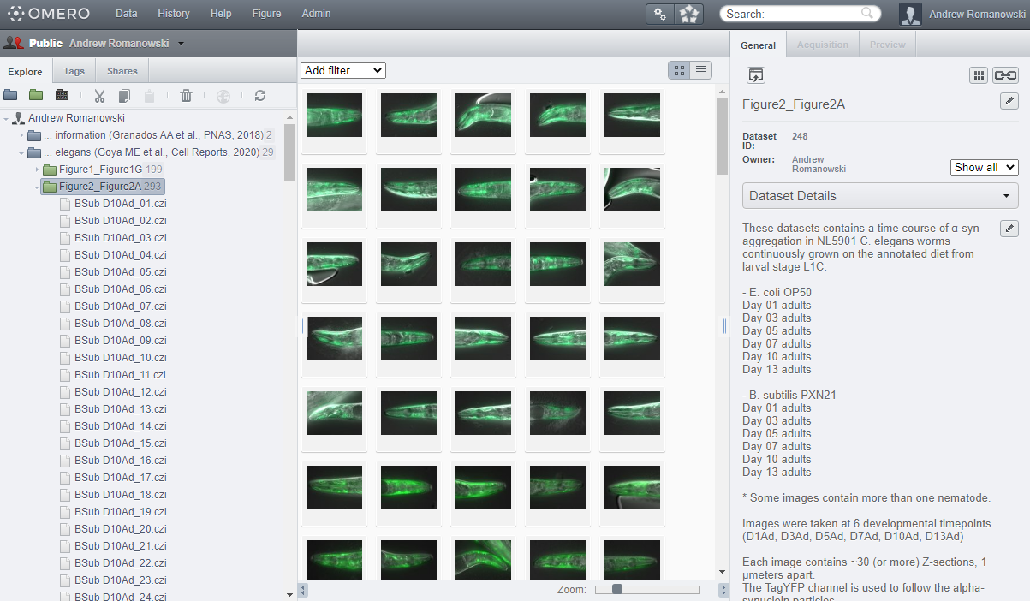
RDM as part of the workflow
After: SBS Public Omero
https://publicomero.bio.ed.ac.uk/
BioRDM’s list of suggested data repositories:
https://www.wiki.ed.ac.uk/display/RDMS/Suggested+data+repositories
Image credit: Dr Andrés Romanowski

Slide 17
RDM as part of the workflow
Is this all for free?
Some RDS costs
DataStore 500Gb default free storage space, then storage per TB/year - £175
DataVault storage per TB for 10 years - £500
Eddie storage per TB/year - £400 (free if below 200Gb)
DataShare – free
DataSync – free (20Gb default quota + DataStore space)
GitLab - free
Subversion - No charge up to 10GB >10 GB by arrangement (50Mb default quota)
Note/disclaimer: These prices might not reflect current pricing and are present here to give you a ballpark estimate (last checked: Feb 2022). Check current values through this link or contact RDS: more information on these charges
Version control services description and cost: Version Control Services.
DataSync info: https://www.wiki.ed.ac.uk/display/ResearchServices/DataSync
More info on DataVault: https://www.ed.ac.uk/information-services/research-support/research-data-service/after/datavault/cost.
BioRDM costs
Professional Data Curation Services: for more information and an up to date quote e-mail the BioRDM team.
SBS Public Omero: Free for SBS researchers.
More info and other costs
Web Hosting: https://www.ed.ac.uk/information-services/computing/audio-visual-multi-media/web-hosting/hosting-service-options.
VM: https://www.ed.ac.uk/information-services/computing/computing-infrastructure/virtual-hosting/availability.
Notes:
Web-Hosting -> free up to 5Gb of webspace
VM -> 512MB memory size/1 vCPU £33/month £182/year £827/5 years

Slide 18
Data Management Plans
Show that you are thinking about what will happen with your data during and after the project.
How your data is going to be FAIR.
Data management & admin should be done throughout the project, not at the end!

Slide 19

Data Management Plan Quiz
Open https://pad.carpentries.org/2021-10-22_ed-dash_fair-bio-practice
Notes:
1. F
2. T
3. F
4. F
5. T
6. T
7. T
8. F
9. F
10. T

Slide 20
Data Management Plan Quiz - Solutions
1. The best time to do data management is at the end of a project, when you've collected all the data you're managing. FALSE
2. Data management plans (DMPs) detail what will happen to data before collection begins. TRUE
3. The best storage method for data is multiple backups to USBs. FALSE
4. There is a single best way to manage, organise, and share data. FALSE
5. For grant applications, DMPs should mention data preservation, longevity, sharing, discover, and reuse. TRUE
6. Your metadata should be standardised and descriptive. TRUE
7. Taking the time to plan out what's needed in metadata and your DMP will save you time in the long run and make your data more FAIR. TRUE
8. DMP online is a tool which constructs DMPs for researchers. FALSE
9. Data addressed in a DMP can be freely shared regardless of confidentiality. FALSE
10. Data can be given creative commons licenses to dictate how others can and cannot use it. TRUE
Notes:
1. F
2. T
3. F
4. F
5. T
6. T
7. T
8. F
9. F
10. T

