Slide 1
Figure 1: Conceptual figure of the merger of DAMM (blue and orange boxes) and MCNiP (box and arrow diagram). SOM depolymerization occurs using Arrhenius and Michaelis-Menten kinetics, substrate diffusion, and a temperature-dependent Vmax (blue box). We held Km constant for the model runs in this study, but a linear temperature-sensitivity relationship can be applied to it if desired. DOC uptake is controlled by DAMM kinetics as well as O₂ concentration at the reaction site (orange box; see Table 1 for DAMM equation parameter definitions). MCNiP has four pools: SOM, DOM, Microbial biomass, and Enzymes. Litter and root inputs enter the SOM and DOM pools, respectively, and outputs are CO₂ as a product of respiration and inorganic N as a product of N mineralization.

Slide 2
Figure 2: Model inter-comparison of a) DAMM (pink), b) MCNiP (blue), c) DAMM-MCNiP (red), and d) DAMM-MCP (green) overlayed on soil C efflux measurements from trenched plots in Harvard Forest, MA.

Slide 3
Figure 3: Relationship between predicted and measured C efflux for a) DAMM alone, b) MCNiP alone, c) DAMM-MCNiP, and d) DAMM-MCP. The solid line is the regression fit, and the dotted line is the 1:1 line.

Slide 4
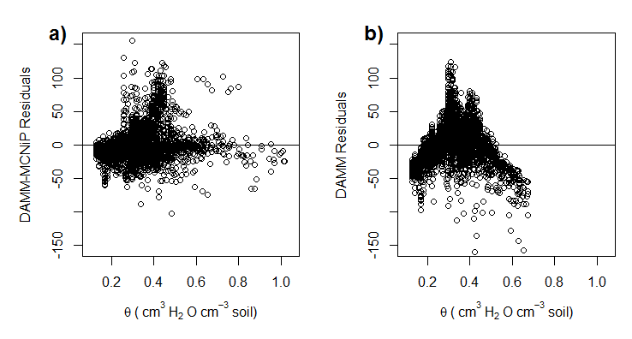
Figure 4: a) DAMM-MCNiP and b) DAMM model residuals plotted as a function of soil moisture (θ).

Slide 5
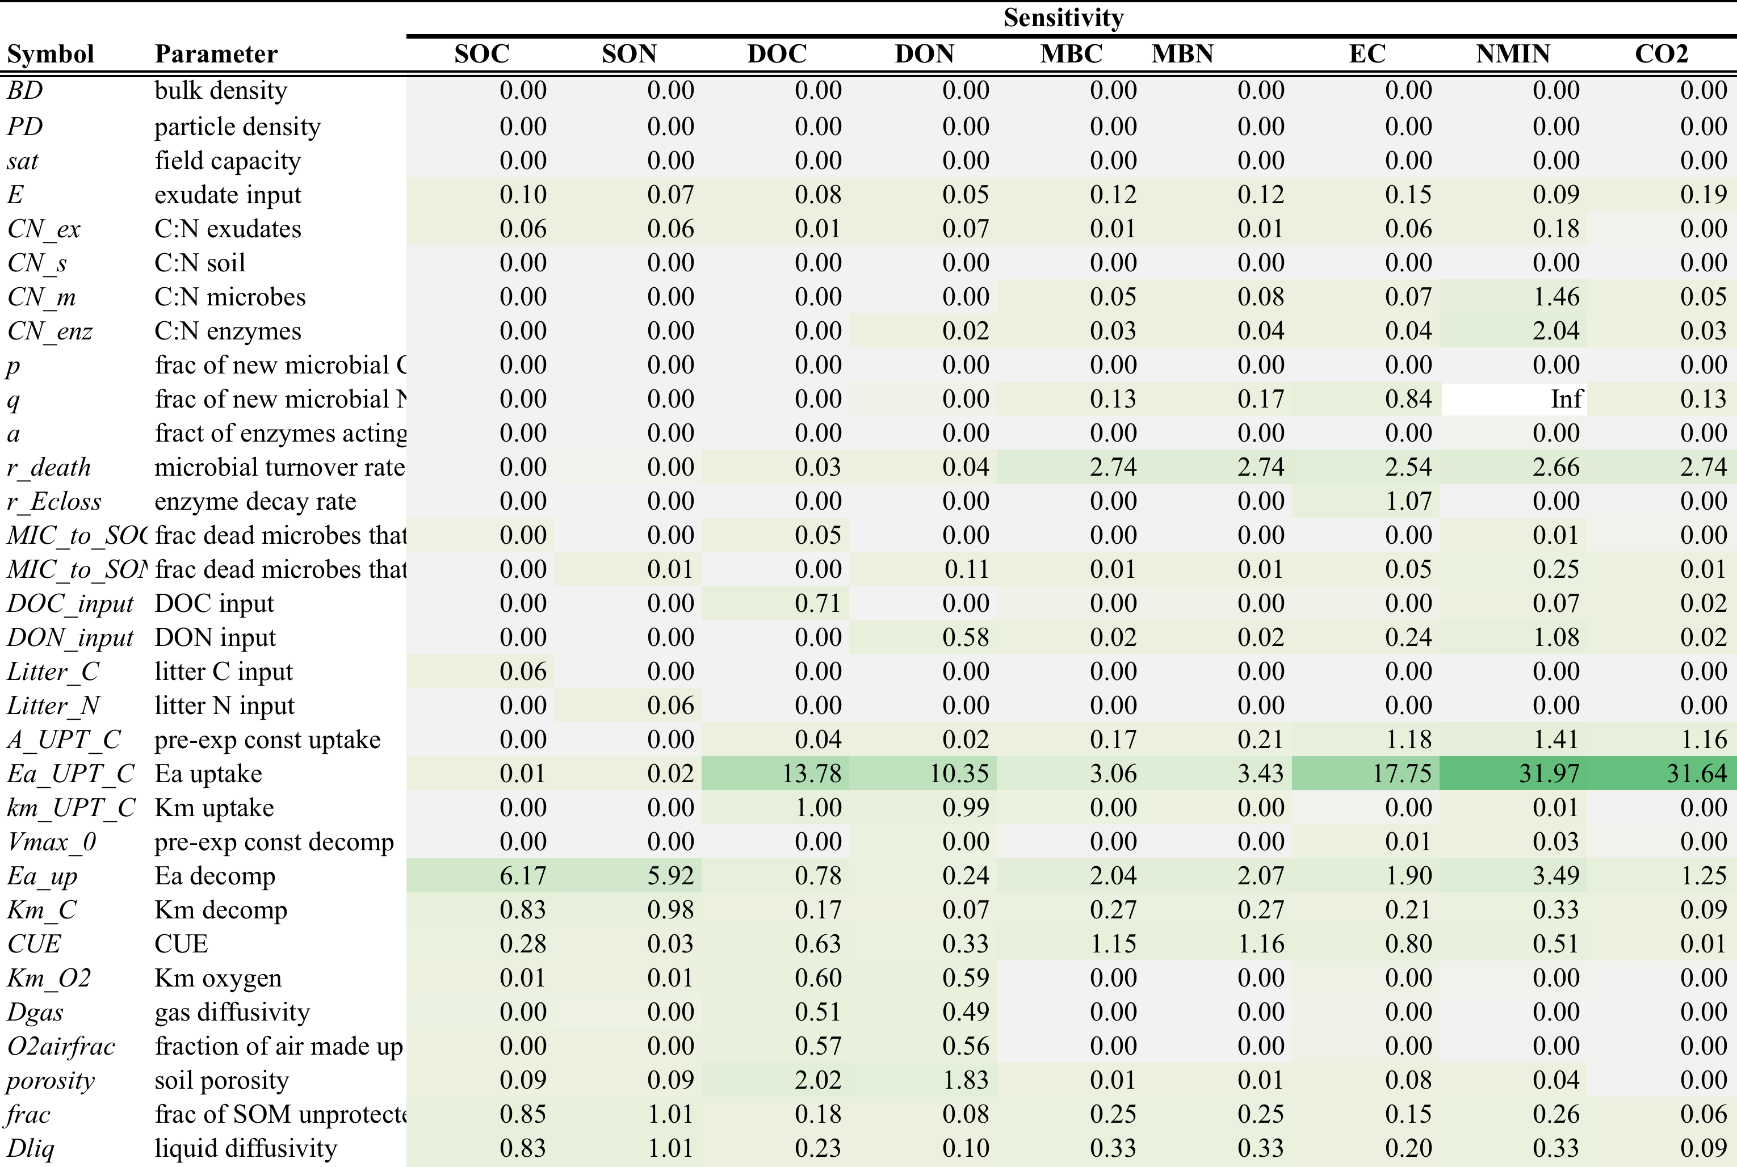

Slide 6
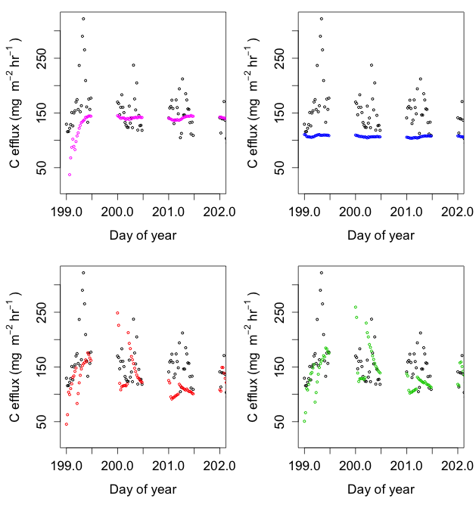
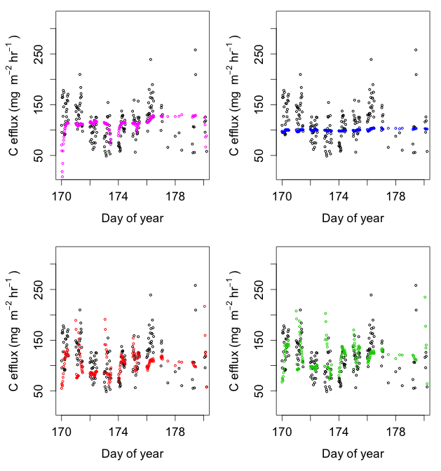
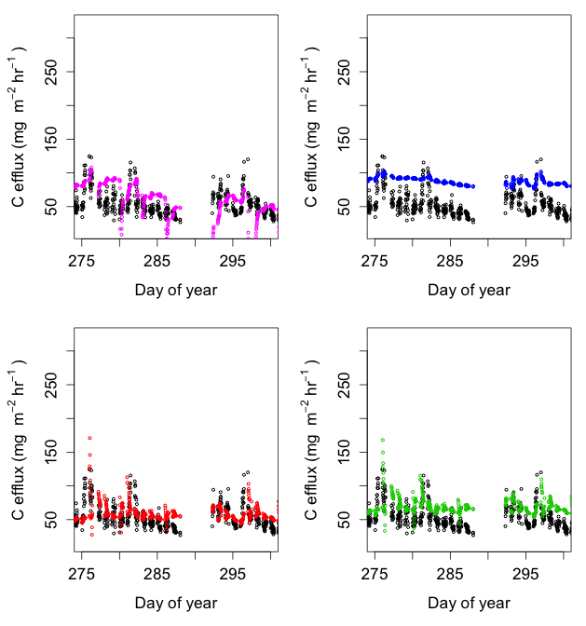

Slide 7
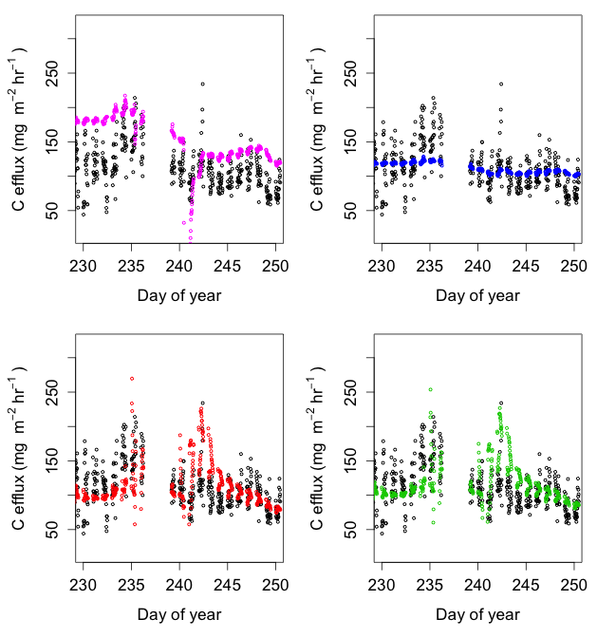
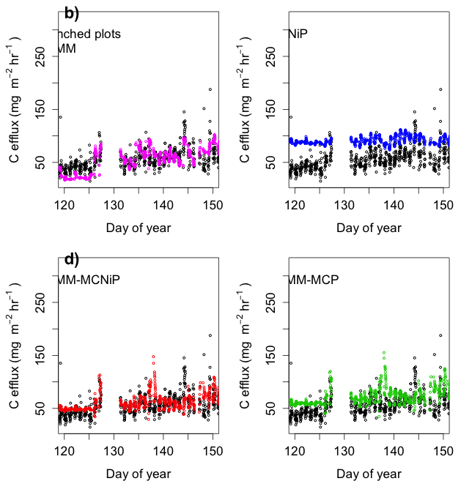

Slide 8
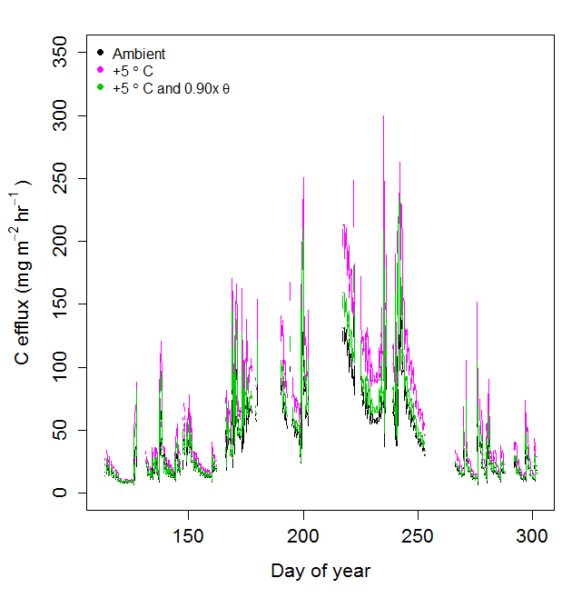
Figure 12: C mineralization under ambient temperature and soil moisture (θ; black line), 5ºC warming with no change in soil moisture (pink line), and 5ºC warming with a 10% decrease in soil moisture (0.90x; green line).

Slide 9
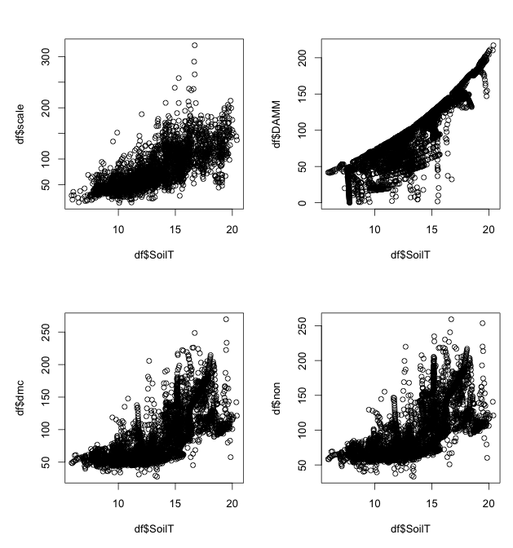
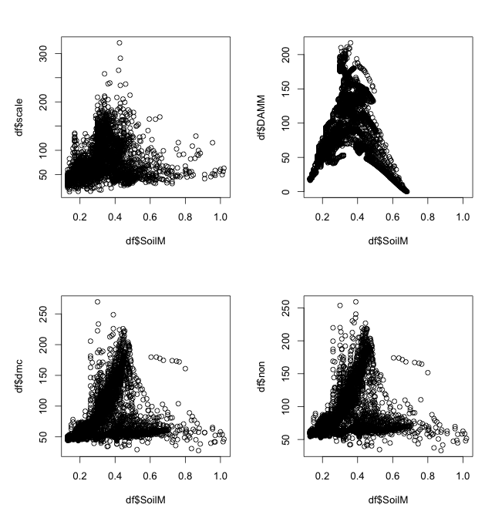
Data
DAMM
Data
DAMM
DAMM-MCNiP
DAMM-MCP
DAMM-MCNiP
DAMM-MCP

