Slide 1
CostGuard
Cost-regression testing for AI agents
UiPath AgentHack. Build the AI agents of tomorrow.

Slide 2
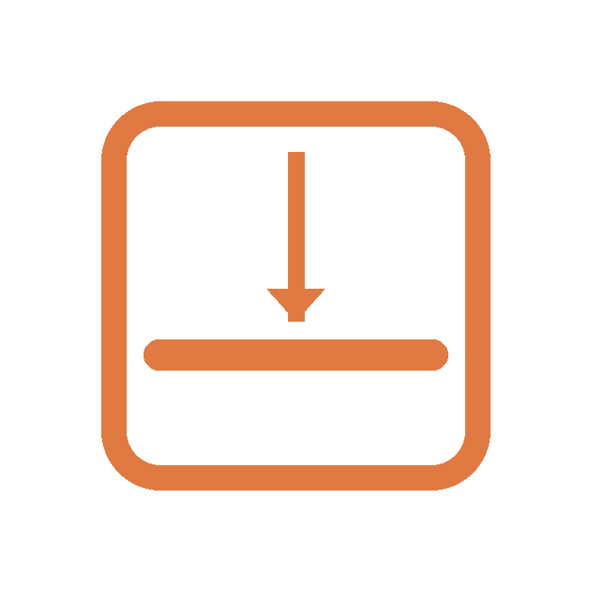
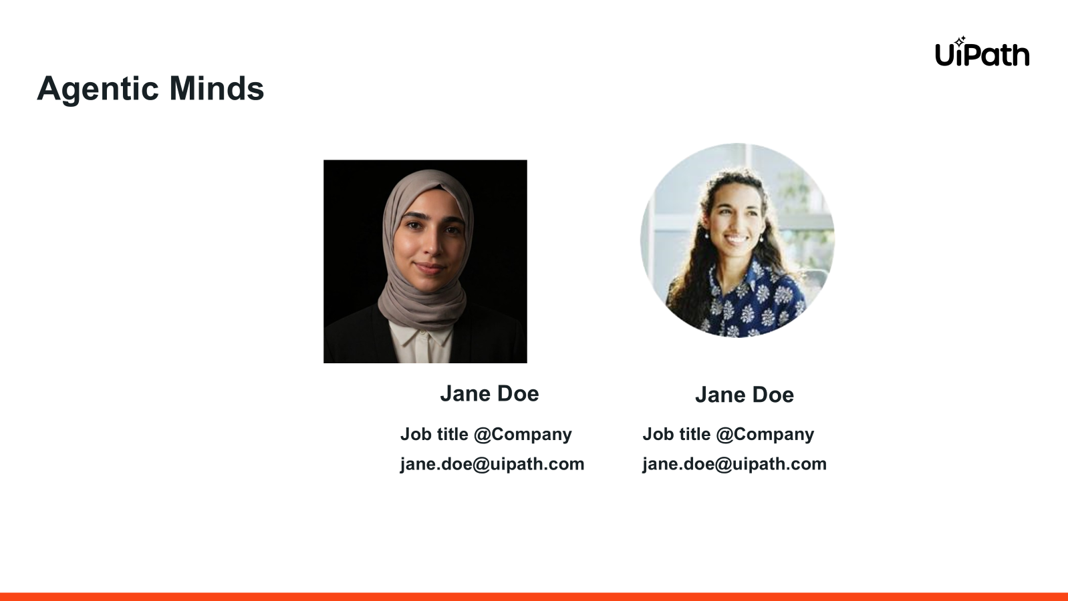
CostGuard
Built solo by Leonardo Calancea · Track 3 (Test Cloud)

Slide 3
Problem statement and proposed solution
Problem
Solution
Teams ship AI agents fast. A small prompt or model change can quietly triple token spend while still passing every correctness test.
QA checks whether the agent is right, never what it costs to be right. The bills are board-level: FinOps X 2026 called it the Great Token Panic, and one 4-agent loop burned about $47K in 11 days.
There is a correctness gate before production. There is no cost gate.
Scores: Business Impact
CostGuard adds a first-class test type: cost-regression testing, run and governed on UiPath.
Before a change ships, it runs the agent many times on a Test Cloud scenario set, measures cost per correctly-processed invoice (not per token), compares to the last approved baseline, and blocks a regression. The call goes to a human in Action Center.
Cost is paired with a quality score, so a cheaper-but-worse agent cannot slip through. The line nobody else can draw: cost per business outcome.
Scores: Creativity · Platform Usage

Slide 4
Benefits and technologies used
Details
Benefits, impact and outcomes
End-user​ | Platform, QA and FinOps engineers shipping AI agents
User department​ | Engineering, QA, Platform Ops, FinOps
Industries​ | Enterprises running production AI agents (finance, insurance, BPO)
UiPath products used​ | Test Cloud, Coded Agents (Python SDK), Orchestrator, Action Center, Document Understanding, AI Trust Layer Gateway
Other - integrations / APIs / technologies used​ | LangChain / CrewAI agent-under-test, OpenTelemetry, Claude Code via uip skills
Blocks silent cost regressions before production. In the demo a “smarter” candidate scored +4.5% accuracy but cost 7× more per processed invoice, and CostGuard blocked it. On real UiPath-gateway models the same trap cost 13× for no accuracy gain.
It prices agents in dollars per business outcome, works on any agent or framework, and a human always owns the final call.
Scores: Business Impact · Technical Execution

Slide 5
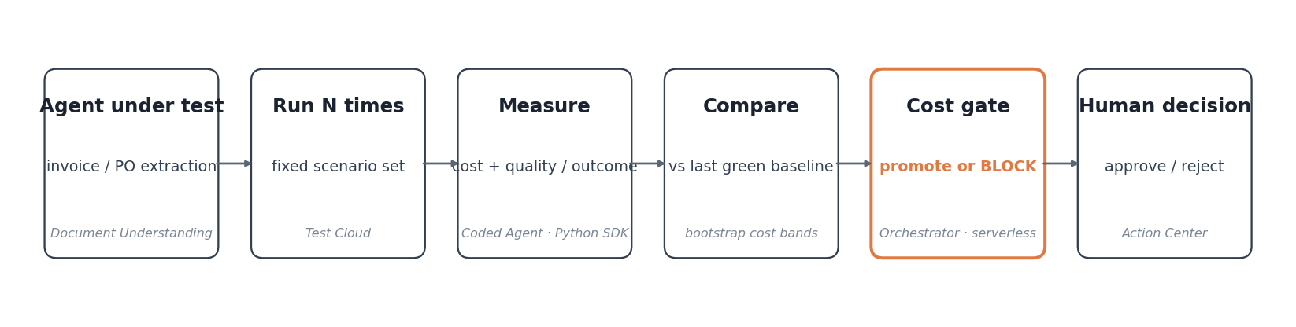
Solution architecture
A change goes in. CostGuard runs the agent many times on UiPath, prices each correct outcome, compares to the baseline, and blocks a regression. A human owns any block.
Scores: Platform Usage · Technical Execution

Slide 6
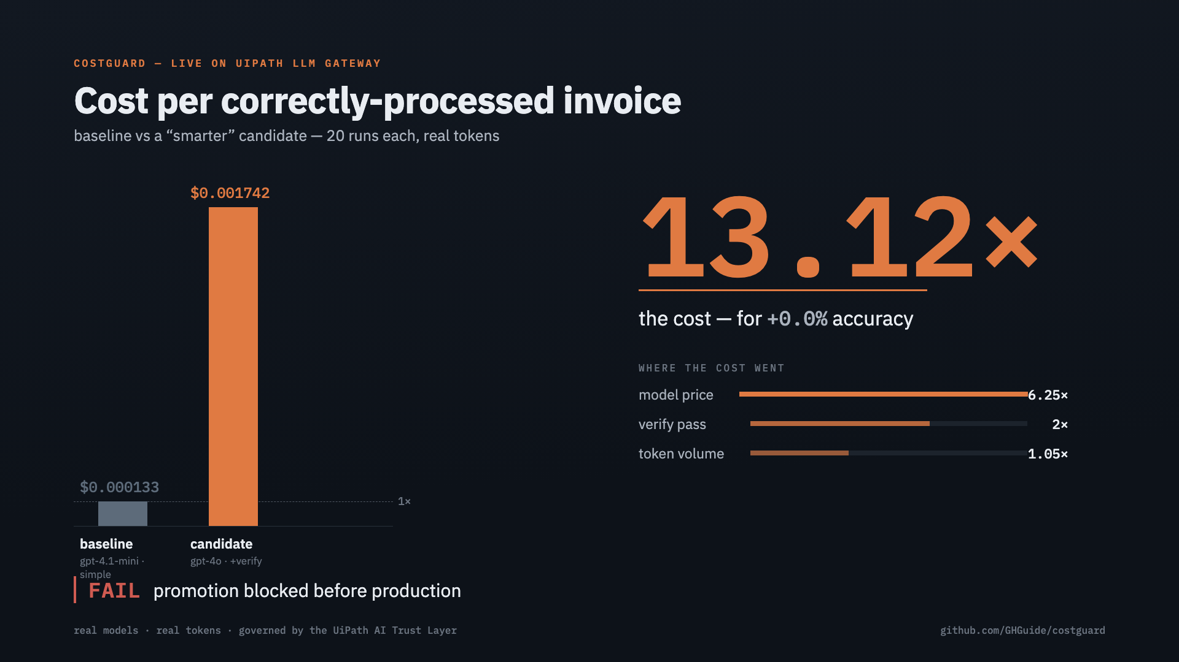
Live proof: real, not a slide
A live serverless job on UiPath Automation Cloud returned verdict FAIL: cost 7.26× for +4.5% accuracy. On the AI Trust Layer gateway the same upgrade cost 13.12× for zero gain.
The verdict is registered as a first-class Test Cloud result, and a 30-scenario regression suite keeps the gate's own verdicts pinned in CI.
Scores: Completeness · Technical Execution

Slide 7
Looked fine. Cost 7× more. Blocked before it shipped.
CostGuard · github.com/GHGuide/costguard

