Slide 1
PROJECT
Project Title : Mutual Fund Data Scraper & Basic
Forecasting System
Name : Akshya Jangir (EC)
Institute Name : B.K. Birla Institute Of Engineering &
Technology, Pilani

Slide 2
Problems :
Mutual fund data is scattered across different websites.
Manual analysis is time-consuming.
Estimating future trends is difficult.
Lack of Quick Analysis
Lack of forecasting tools
Difficult fund comparison
Solution:
Automated scraping from real financial websites
Data analysis
Forecasting
Dashboard visualization

Slide 3
Objectives :
Collect mutual fund data automatically through scraping
Store data in CSV format
Analyze performance
Forecast future trends
Visualize trends
Predict future NAV (Net Asset Value)
Create interactive dashboard

Slide 4
Technologies & Purpose :
Technology | Purpose
Python | Programming
Requests | Data Collection
BeautifulSoup | Web Scraping
Pandas | Data Analysis
Matplotlib | Visualization
Scikit-Learn | Forecasting
Streamlit | Dashboard

Slide 5
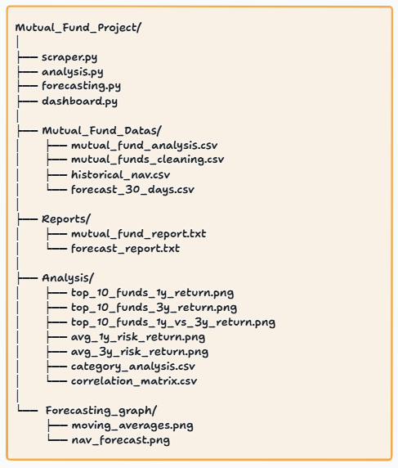
Project Workflow :
Website (Groww and ET Money)
Scraper.py
CSV Storage
Analysis.py
Forecasting.py
Dashboard.py
Browser

Slide 6
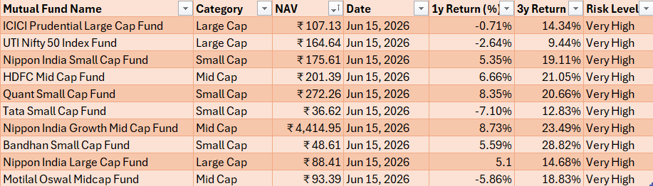
Data Collection :
Mutual Funds Data :

Slide 7
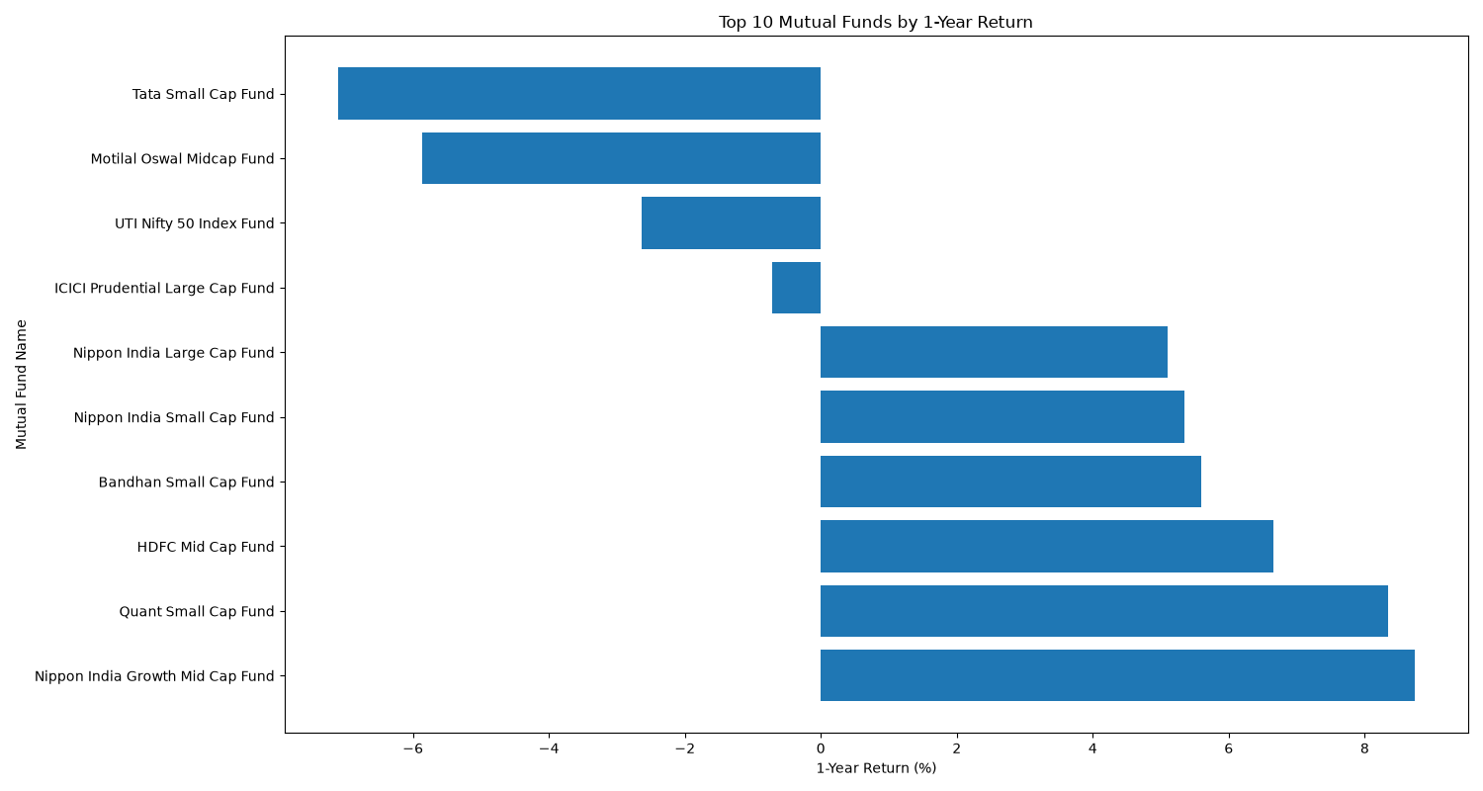
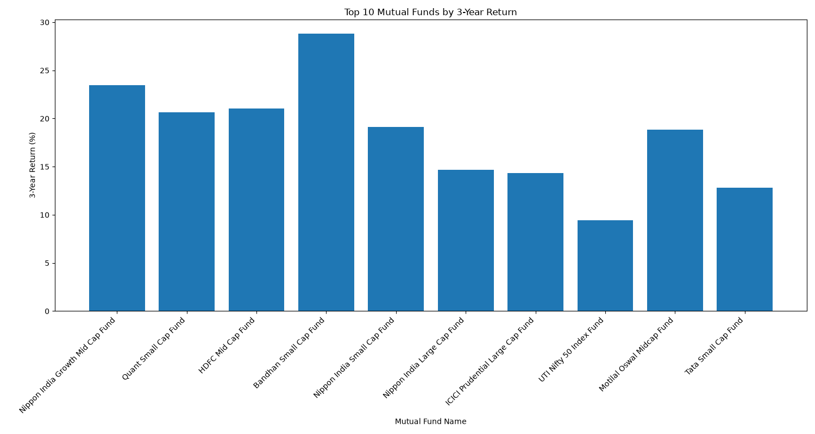
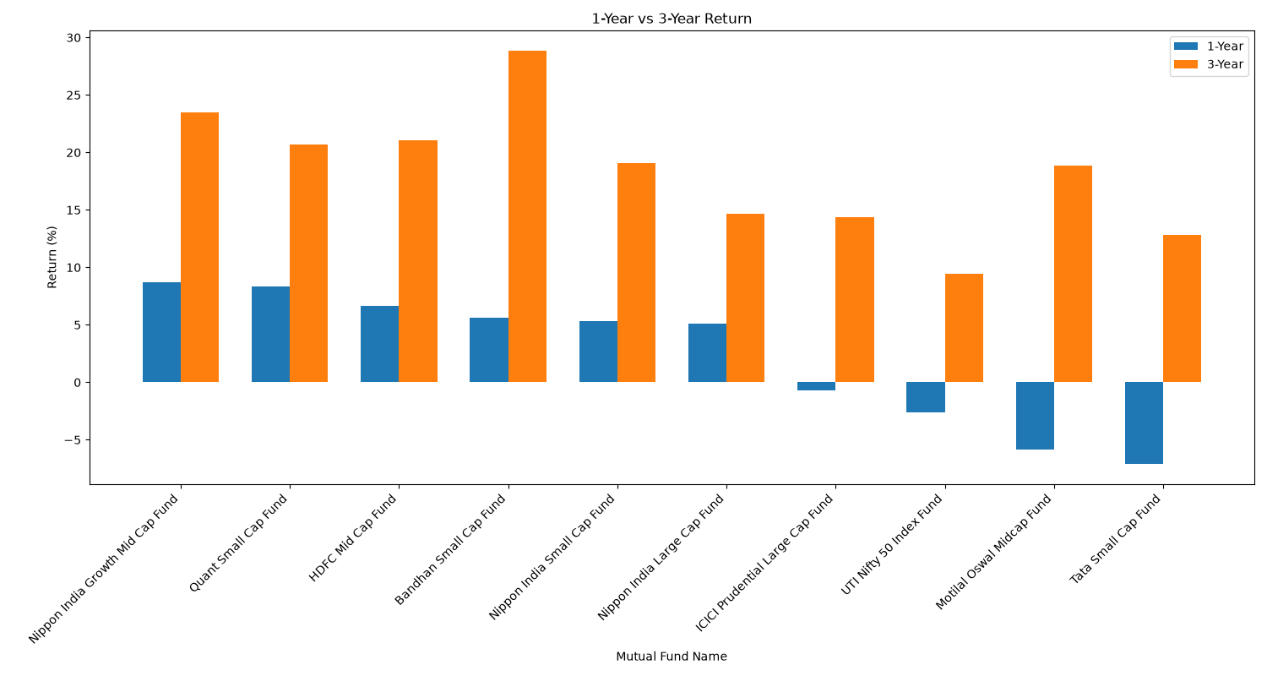
Analysis Results :

Slide 8
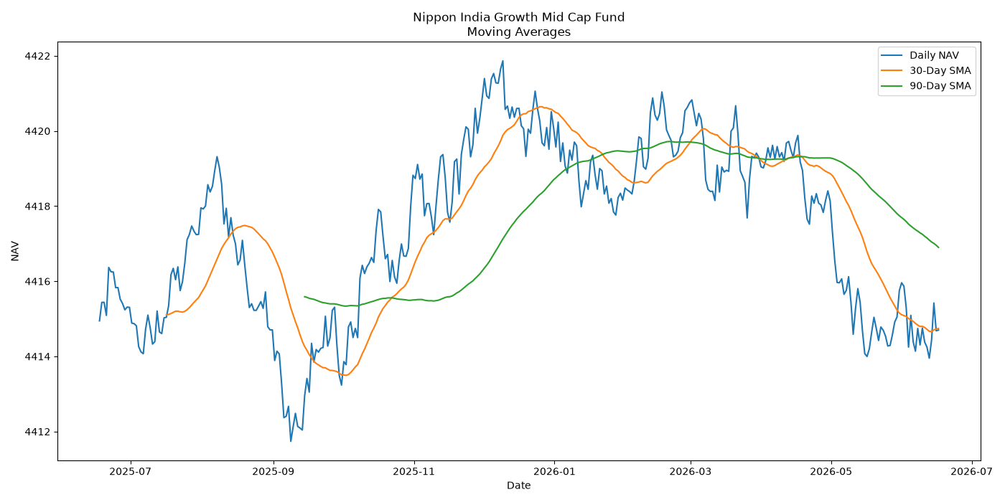
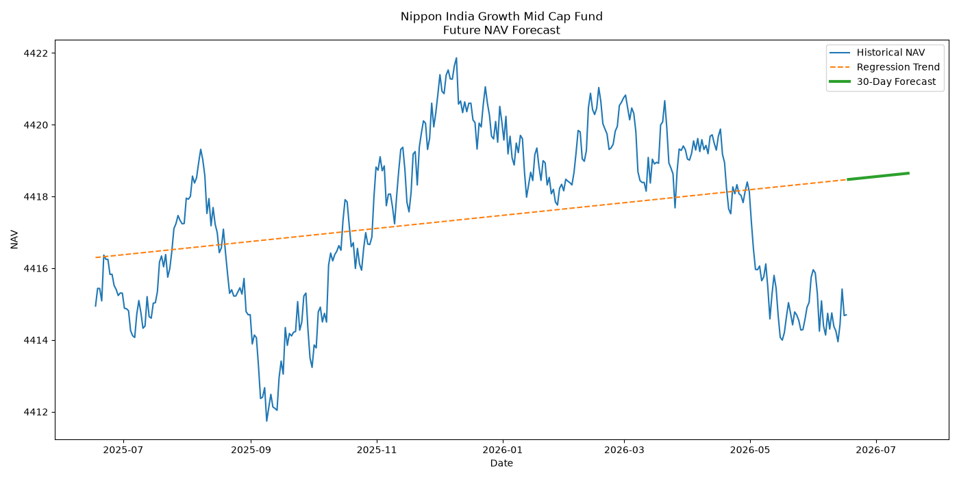
Forecasting Results :
Moving Average Graph
Forecast Graph

Slide 9
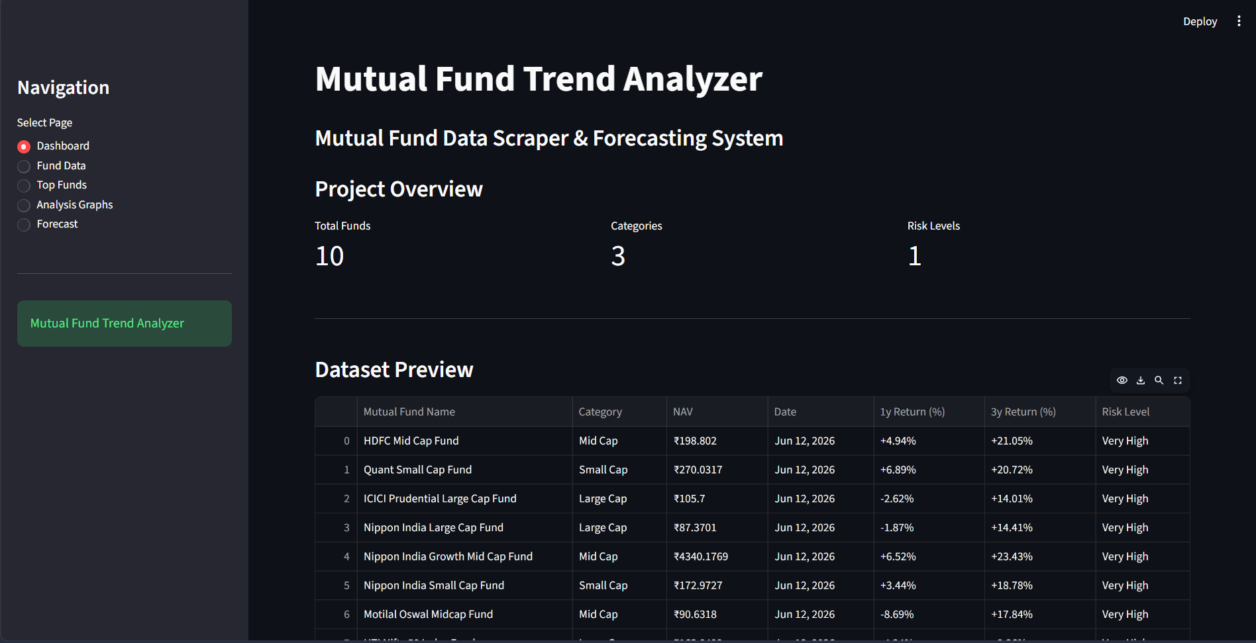
Dashboard :
Dashboard
Features:
Dataset View
Search Fund
Analysis Graphs
Forecast Results

Slide 10
Conclusion & Future Scope :
Conclusion :
Successfully scraped mutual fund data
Performed analysis
Generated forecasts
Built dashboard
Future Scope :
Real-time APIs
ARIMA/LSTM models
Fund recommendation system
Portfolio analysis

Slide 11
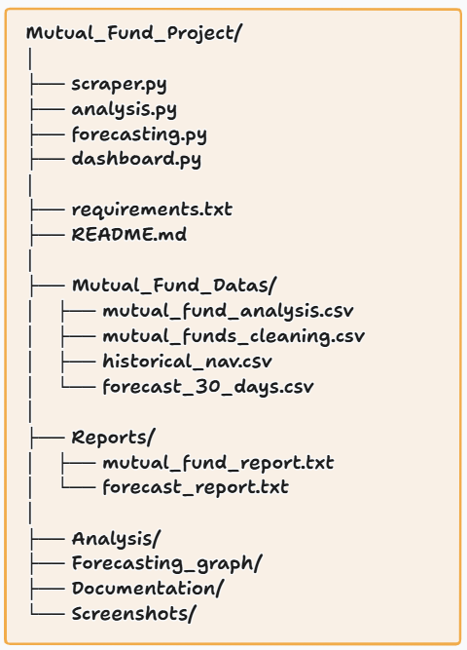
Repository Structure
GitHub Repository :
Repository Contains:
Source Code
Dataset
Analysis Results
Forecasting Result
Dashboard
Documentation
Project Presentation

Slide 12
Thank You

